Slide 1
Software designer
Hao Zhong
Shanghai Jiao Tong University

Slide 2
Last class
Software architect
Definition
Typical architect styles
Modularity
Design decisions
Tool support
Software market model
License

Slide 3
What is software architecture
Software architecture is the structure of a software system – like the blue prints in building architecture
Software components
Details (data structure and algorithms) hidden
Relationships among the components
Relations can be vague
Data flows
Control flows
Dependencies

Slide 4
Popular architecture styles
Pipe and Filter
Layered
Repository
MVC

Slide 5
Why licenses?
The specialty of software, compared to other publications
You often have to copy the software to use it, consider a multiple-CD/floppy disk game, hardware disposal, …
Section 117 of copyright Act: the owner of a software copy have the rights to copy the software to a computer for using purpose
General principle of copyrights: the owner of a copy can resell the copy without the agreement of the copyright owner: resell a book
So, basically, you can copy the software from the CD to your computer, and resell the CD…

Slide 6
GPL (General Public License)
Most widely used license
About 45% all open source projects according to Black Duck
GNU software
gcc, glibc, emacs, …
Linux kernel
MySQL
Responsibilities
Providing source code when re-distribute
Re-distribute (any code including or revised from GPL licensed code) under GPL license
Ignore patents and regional rules (liberty or death)
So what will happen if I want to revise a GPL-licensed software, and then sell the revised software?

Slide 7
Software process models
Requirements
engineering
Design
Implementation
Integration
The waterfall model

Slide 8
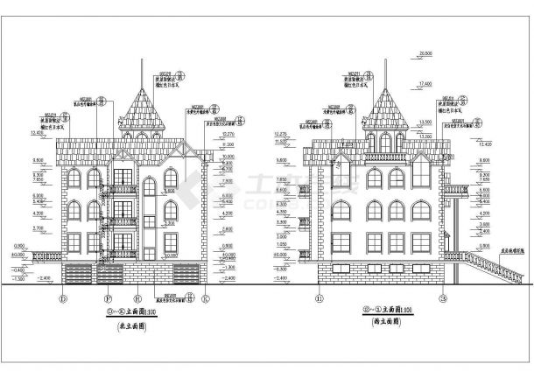

Role
Software design is the process by which a designer creates a specification of a software artifact, intended to accomplish goals, using a set of primitive components and subject to constraints.

Slide 9
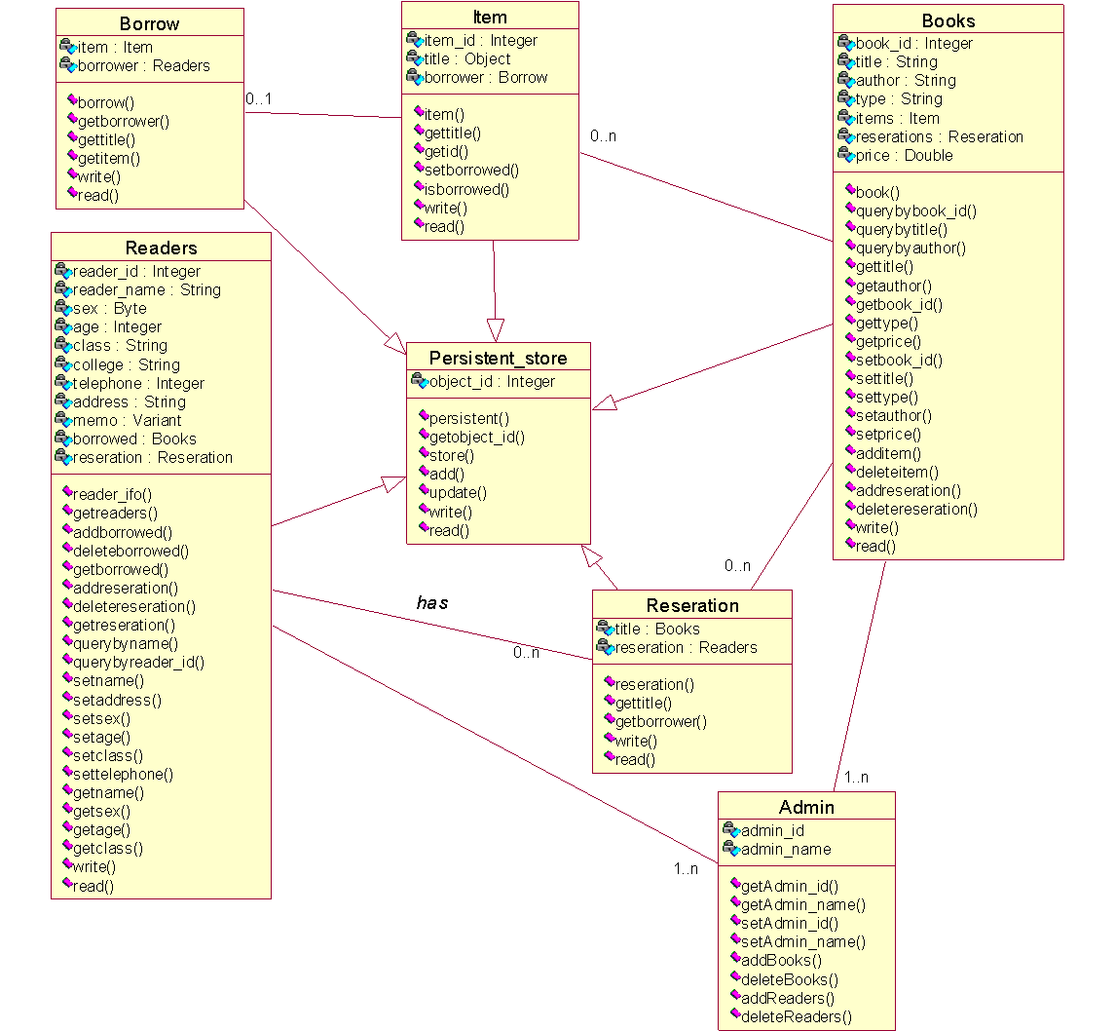
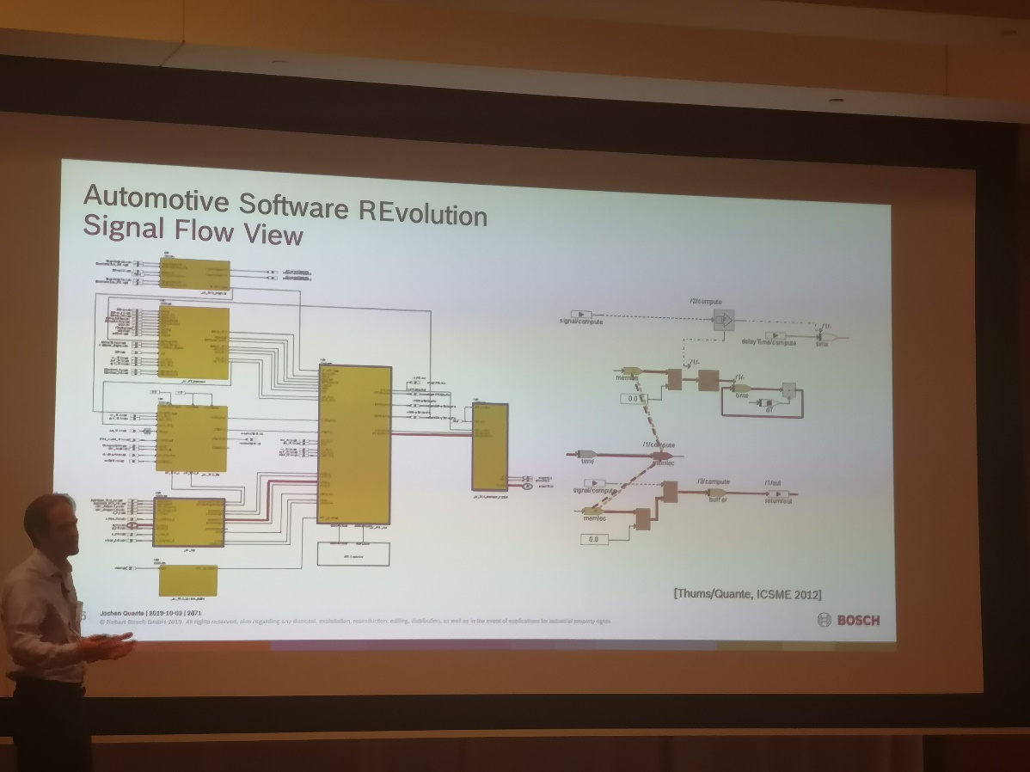
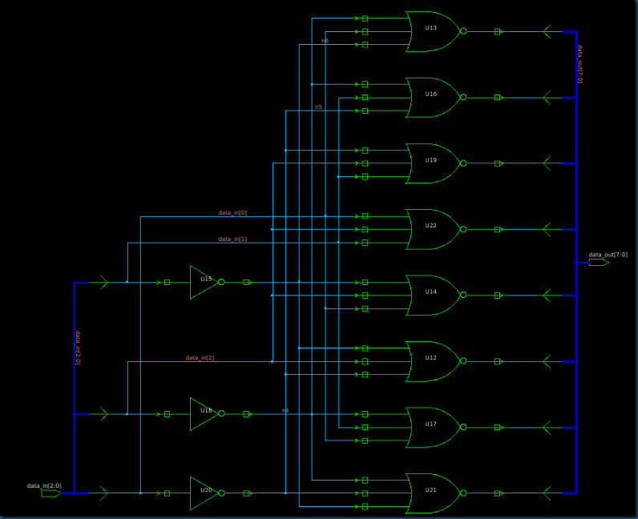
Role
Software design is the process by which a designer creates a specification of a software artifact, intended to accomplish goals, using a set of primitive components and subject to constraints.

Slide 10
Use case diagram for ATM
Domain experts may not draw use case diagrams in their requirements.
Software designers have to redraw use case diagrams, if software architects have changed.

Slide 11
Process for identifying use cases
Choose your system boundary
Identify primary actors
For each actor, find their goals
Define a use case for each goal
Decompose complex use cases into sub-use cases
Define the relations among use cases

Slide 12
Object-oriented approach
The runtime of software is viewed as an set of objects interacting with each other
Bookstore system: books, shelves, sales clerk, client, …
Objects have data and operations
Shelves: id, size, load books; clerk: name, field, sell books
A user ask an object (providing inputs) to get the information he/she wants (getting output)
Ask shelves: how many books on shelves
No pre-assumed steps or sequences of execution (compared to procedure-oriented approach)

Slide 13
Key steps in OOA
Define the domain model
Find the objects, classes
Define design class diagram
Find relationships between classes
Define the interaction diagrams
Describe the interaction between the objects

Slide 14
Objects
Definition
Discrete entities with well-defined boundaries
Data
Operations
Life Cycle
Construction (new shelf bought)
Running (loading books, removing books, move)
Runtime state: value of mutable data in the object
Destruction (shelf broken or removed)

Slide 15


Classes
Too many objects
Cannot define one by one in the system
Not general enough
Consider three clerks in the bookstore (John, Mike, Nancy)
Objects share similar features can be grouped as a Class
John, Mike, Nancy - > Sales Clerk
Thousands of different books - > Book

Slide 16
UML class diagram
A diagram to describe classes and relations
Core part in UML and OO approach
Used as a general design document
Maps to code directly in OO programming languages
Modeling the system in a static way

Slide 17
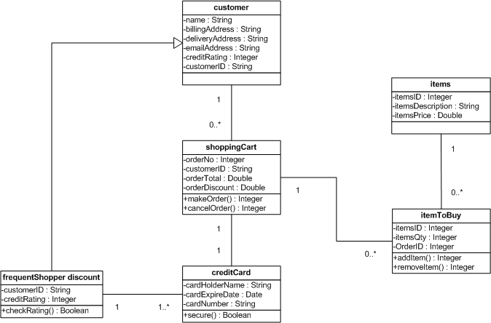
UML class diagram
Elements of class diagram:
Class represented as a box containing three compartments
Relation represented as a line between two classes

Slide 18
Class
Class represented as a box containing three compartments
Name
Attributes
Operations
Attributes
Visibility (+: public, -: private)
Name (lowercase start)
Type
Operations
Visibility (+: public, -: private)
Name (lowercase start)
Parameters (name, type)
Return Type

Slide 19
Class
Classes are named, usually, by short singular nouns
Name convention
Class names start with capitalized letters
Field names and method names start with lower case letters

Slide 20
Identifying Class
Classes are usually derived from the use cases for the scenarios currently under development
Brainstorm about all the entities that are relevant to the system

Slide 21
Identifying Class
Classes are entities from the problem domain
Actors that interact with system.
Concrete objects with some information. e.g., Books, shelves
Abstract objects. e.g., transactions, etc.
Structured Outputs. e.g., forms, reports
Helper Classes. e.g., utility, logger, order manager, etc.
Noun Phrases
Go through the use cases and find all the noun phrases
Watch out for ambiguities and redundant concepts
Subtypes of a class may also be a class. e.g., customer->member

Slide 22
Identifying Class
Not too many
Poor performance
Complexity
Maintenance efforts
Not too few
Class too large
Have a class BookStoreManager and do everything
Uneasy to reuse
Class Publisher : may be used in both book information, and order, if no such class, may have to implement twice

Slide 23
Class Relationships
Generalization 泛化
Aggregation 聚合
Composition 组合
Dependency 依赖
Association 关联

Slide 24
Generalization
Indicates an “is-a” relationship
All instances of the subclass are instances of the super class
A subclass inherits all attributes, operations and associations of the parent : enabling reuse
Example:
Member is a customer
Fruit is a Food

Slide 25
Generalization
Open triangle at the super class end of the association
The common attributes and operations are placed in the super class;
Subclasses extend the attributes, operations, and relations as they need them

Slide 26
Generalization
public class Person{
String id;
String name;
int age;
String phoneNumber;
String address
public updateInfo (String phoneNumber, String adress){
…
}
}
public class SalesClerk extends Person{
String field;
public sell(Book book){
…
}
}

Slide 27
Aggregation
Indicates a loose “has-a” relationship
The compound class is made up of its component classes
Whole can exist independently of the parts
Part can exist independently of the whole
It is possible to have shared ownership of the parts by several wholes
Example:
Committee : Person

Slide 28
Aggregation
Syntax: hollow diamond at the compound class end of the association
public class Committee{
ArrayList<Person> list = new ArrayList<Person>();
int size;
…
public accpet(Person p){
if(list.size()<size)
list.add(p);
}
}

Slide 29
Composition
Composition also describe “has a” relationship
Component classes are physically part of the compound class
The component class dies if the compound class dies
Example:
Car : Engine

Slide 30
Composition
Syntax: filled diamond at the compound class end of the association
public class Car{
Engine engine;
…
public Car(){
engine = new Engine();
}
}

Slide 31
Composition vs. aggregation
The main difference is that: in composition, the lifecycle of components is controlled by the compounds
public class Compound{
Component c;
public Compound (){
this.c = new Component();
}
}
public class Aggregation{
Component c;
public Aggregation(Component comp){
this.c = comp;
}
}

Slide 32
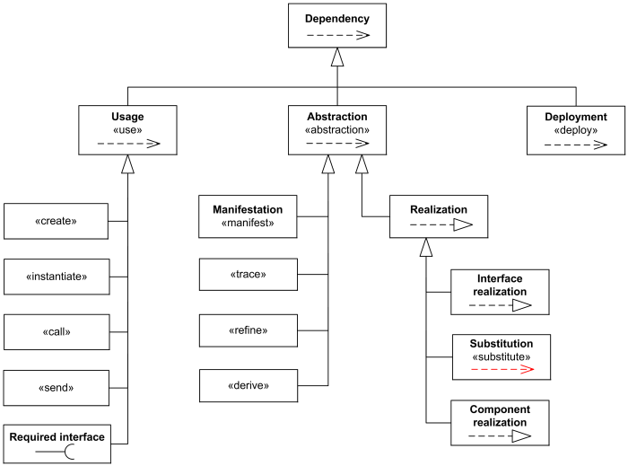
Dependency
A dependency is a directed relationship which is used to show that some UML element or a set of elements requires, needs or depends on other model elements for specification or implementation.

Slide 33

Dependency
public interface Car {
void run();
}
public class Audi implements Car {
public void run() {…}
}
public class Byd implements Car {
public void run() {…}
}
public class CarFactory {
public static Car createCar(String type){
if("奥迪".equals(type)){
return new Audi();
}else if("比亚迪".equals(type)){
return new Byd();
}else{
return null;
}
}
}

Slide 34
Association
An association is a relationship between classes
An association is a name, usually short verb
Some people name every association
Others name associations only when such names will improve understanding
e.g., avoid names like “is related to”, and “has”
An association represents different types of relationships
e.g., student take course, book on the shelf, etc.

Slide 35
Association
An association may have
An association name
Multiplicity,
Role names

Slide 36
Multiplicity
Multiplicities on classes indicate how many instances of the class can be associated at run time
Syntax: 1, *, etc. at the association end. Examples:
* (zero or more)
Person : car
1 .. * (one or more)
Person : address
5 .. 40 (5 to 40)
Students : course
5 (exactly 5)
Athlete : basketball team
If no multiplicity is specified, the default is 1

Slide 37
Role Name
Is a part of association
Describes how the object at the association end is viewed by the associated object
Is useful for specifying the context of the class
Syntax: name at the association end

Slide 38
Review of Class Diagram
A class defines a group of objects with same features within the context of the system
A class diagram describes classes and their relations
Identify classes
Actors
Concrete / Abstract objects
Structured Inputs/ Outputs

Slide 39
Review of class diagram
Class
Name, Attributes, Operators
Relations
Generalization
Aggregation
Composition
Aggregation vs. Composition
Dependency
Association
Name, multiplicity, role name
Dependency vs association

Slide 40
Sequence diagram
Class Diagram describes the static structure of a software
Need to know how objects will interact with each other
Sequence Diagram describes how objects talk with each other
Sequence diagram emphasizes the time-ordered sequence of messages sent and received

Slide 41
Sequence diagram
Column is an instance of the class
Name of the instance
Name of the class that the instance belongs to
Vertical dashed line is lifeline of the instance
Rectangle on life line is the focus of control (or execution), i.e., the period during which the instance is involved in the activity initiated at the top of the focus

Slide 42
Sequence diagram
Horizontal arrow expresses messages conveyed by source instance to target instance
Messages may carry parameters: msg (par1, …)
Looping arrow shows self-delegation: a lifeline sends a message to itself

Slide 43
Sequence diagram
Why use objects instead of classes?
Class is a static concept
Only objects have life cycles
Objects of same class may interact

Slide 44
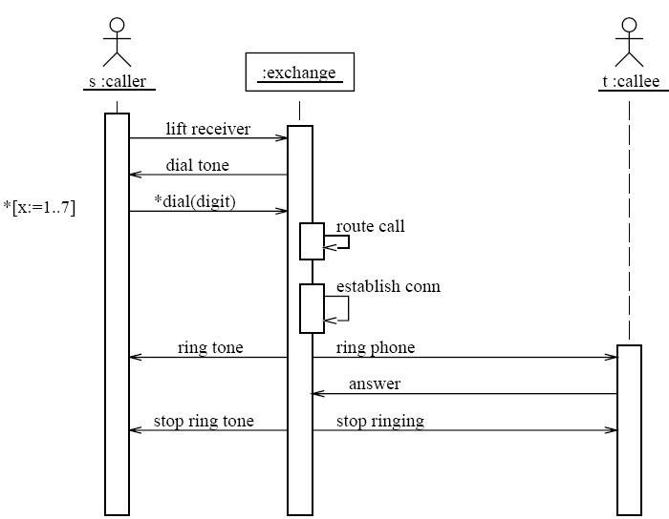
Sequence Diagram – An Example

Slide 45
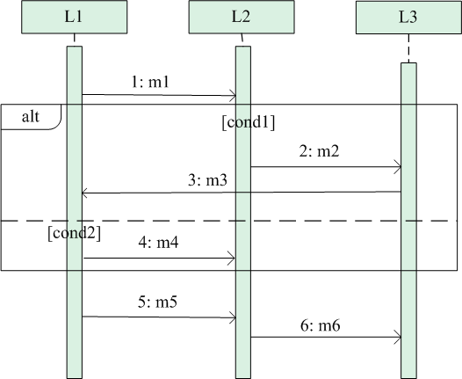
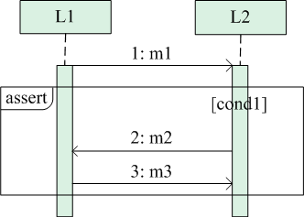
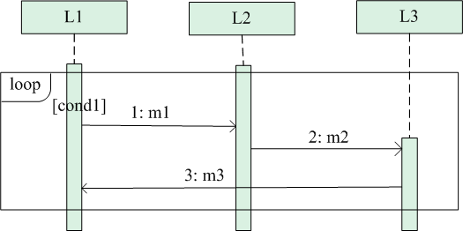
Sequence diagram – advanced features
Use Combined Fragments, which consists of a region of a sequence diagram, to represent
Branching: operator “alt”
Loop: operator “loop”
Assertion: operator “assert’’

Slide 46
The principles of object-oriented design
SRP，Single Responsibility Principle
LSP， Liskov Substitution Principle
ISP，The Interface Segregation Principle
OCP，Open-Closed Principle

Slide 47
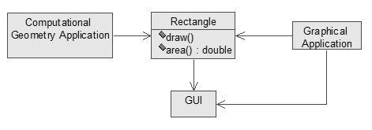
SRP: The Single – Responsibility Principle
A Class should have only single responsibility
Example:
The rectangle class has two responsibilities
This design violates the SRP.

Slide 48
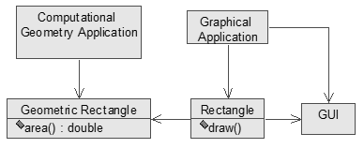
SRP: The Single – Responsibility Principle
Separating Coupled Responsibilities

Slide 49
LSP: The Liskov Substitution Principle
Subtypes must be substitutable for their base types
If for each object o1 of type S there is an object o2 of type T such that for all programs P defined in terms of T, the behavior of P is unchanged when o1 is substituted for o2 then S is a subtype of T [Liskov88].
If using implementation of T or subclass of T to instead of T, Software P which is associated with type T(interface or abstract class) can work well.
Example:
In real world , penguin and bird is a “is-a” relationship. If we design penguin is a subclass of bird class, we violate LSP principle .because bird can fly( ) while penguin can not fly. So how to change this design?

Slide 50
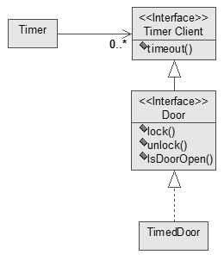
ISP: The Interface Segregation Principle
It is not suggested to extend interfaces.
Example

Slide 51
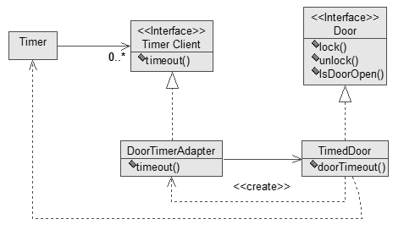
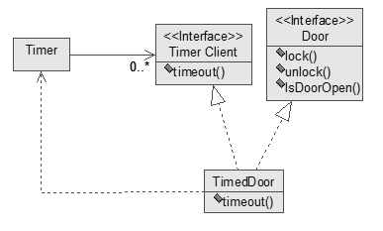
ISP: The Interface Segregation Principle

Slide 52
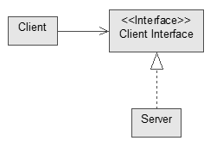

OCP: The Open-Closed Principle
Modules should be both open (for extension; adaptable) and closed (the module is closed to modification in ways that affect clients).
In OCP, "module" includes all discrete software elements, including methods, classes, subsystems, applications, and so forth
Example

Slide 53
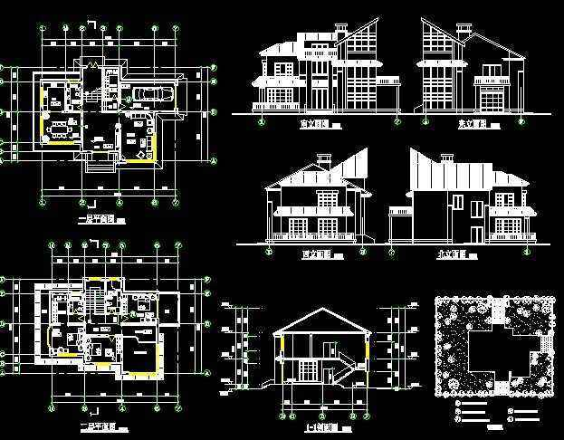

Architecture vs software engineering

Slide 54
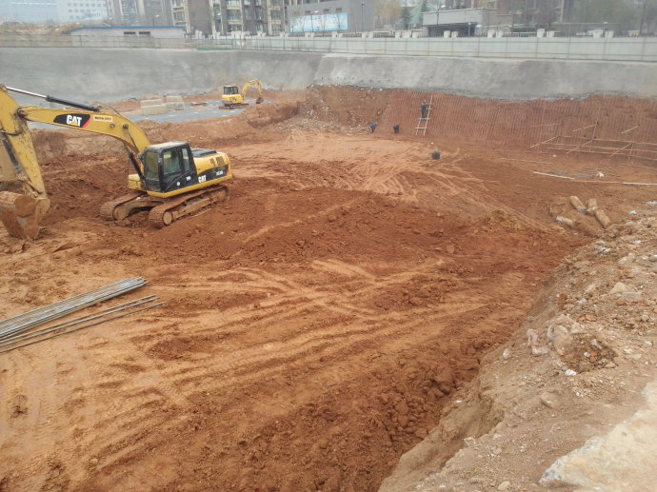
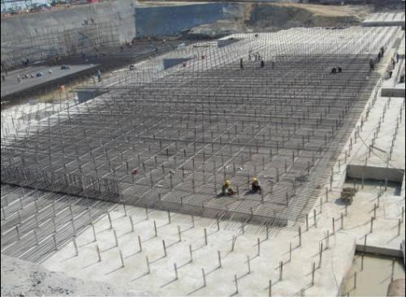
Architecture

Slide 55
Software development
The technical decisions of choosing a specific framework, language, or library can have significant impacts on your designs.
Even the changes in a specific framework, language, or library can have nontrivial impacts on your designs.
However, most books teach that you shall ignore such issues.
Requirements can change after you design a software, but sometime you do not have time to update your designs.

Slide 56
Designing a software is not easy
Some companies only design software, but outsourcing its implementations to other companies.
It needs much experience to write a feasible software design.
Many programmers do not implement code strictly according to designs, since it is impractical to respect some design details.
Some programmers read designs as detailed requirements.

Slide 57
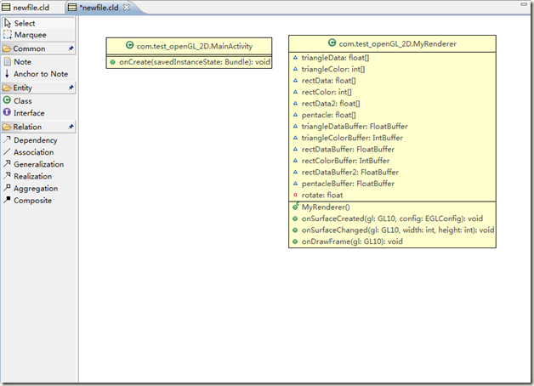
Design vs implementation
Automation
Bidirectional transformation
http://green.sourceforge.net/builds.html
How any specific source language construct should be represented in UML is not strictly defined.
Some mappings are not one-to-one.
Some code usages are not defined.
By their nature, an implementation has more details than its design.

Slide 58
This class
Software designer
UML
Use case diagram
Identification of use cases
Object oriented approach for design
Class diagram
Legend
Class Relationships
Sequence diagram
The Principles of Object-Oriented Design

Slide 59
Key steps in OOA
Define the domain model
Find the objects, classes
Define design class diagram
Find relationships between classes
Define the interaction diagrams
Describe the interaction between the objects

Slide 60
Class Relationships
Generalization
Aggregation
Composition
Dependency
Association

Slide 61

Next class
Programmer

