Slide 1
Programmer
Hao Zhong
Shanghai Jiao Tong University

Slide 2
Last class
Software designer
UML
Use case diagram
Identification of use cases
Object oriented approach for design
Class diagram
Legend
Class Relationships
Sequence diagram
The Principles of Object-Oriented Design

Slide 3
Objects
Definition
Discrete entities with well-defined boundaries
Data
Operations
Life Cycle
Construction (new shelf bought)
Running (loading books, removing books, move)
Runtime state: value of mutable data in the object
Destruction (shelf broken or removed)

Slide 4

Classes
Too many objects
Cannot define one by one in the system
Not general enough
Consider three clerks in the bookstore (John, Mike, Nancy)
Objects share similar features can be grouped as a Class
John, Mike, Nancy - > Sales Clerk
Thousands of different books - > Book

Slide 5
Key steps in OOA
Define the domain model
Find the objects, classes
Define design class diagram
Find relationships between classes
Define the interaction diagrams
Describe the interaction between the objects

Slide 6
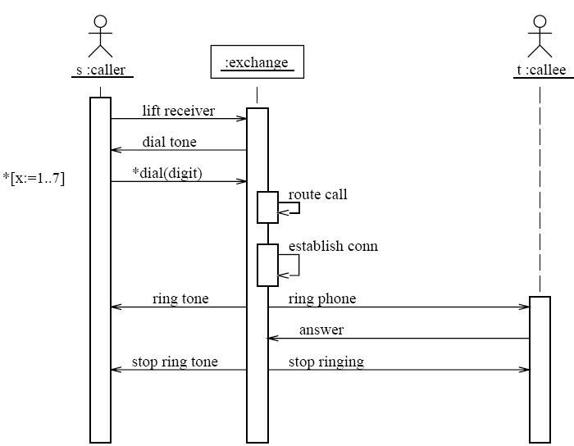
Sequence Diagram – An Example

Slide 7
Software process models
Requirements
engineering
Design
Implementation
Integration
The waterfall model

Slide 8
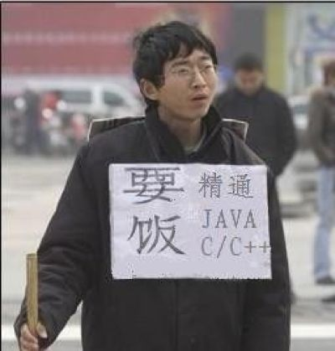

Programmer
A programmer, computer programmer, developer, coder, or software engineer is a person who creates computer software. The term computer programmer can refer to a specialist in one area of computer programming or to a generalist who writes code for many kinds of software.

Slide 9
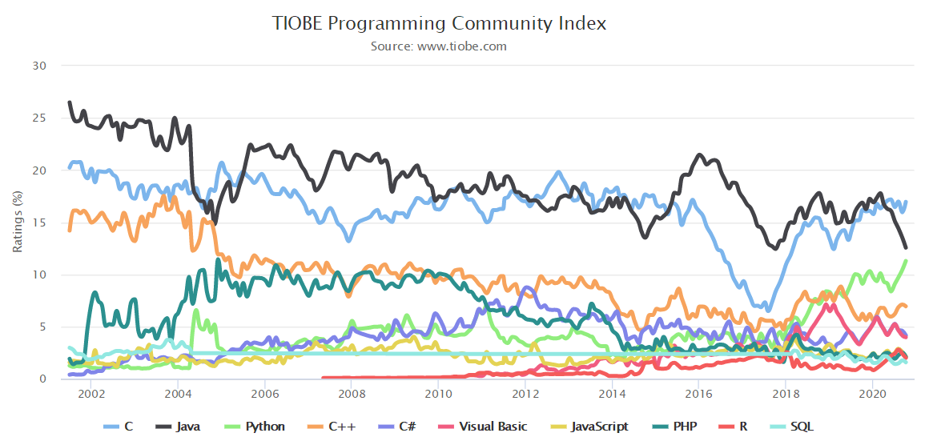
Programmer
How to program

Slide 10

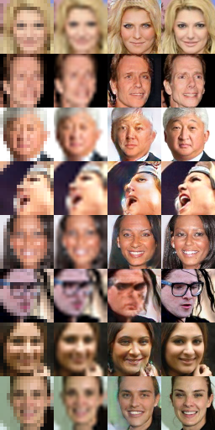


AI
http://deeplearninggallery.com/

Slide 11

AI→Software?
Automatic program repair
Automatic program synthesis

Slide 12
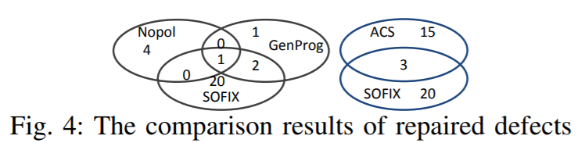
What did we achieve?
Xuliang Liu and Hao Zhong. Mining StackOverflow for program repair. In Proc. SANER, pages 118-129, 2018.
Yuepeng Wang, Xinyu Wang, and Isil Dillig. Relational Program Synthesis. In OOPSLA'18
Yu Feng, Ruben Martins, Osbert Bastani and Isil Dillig. Program Synthesis using Conflict-Driven Learning. In PLDI'18. (Distinguished paper award)
…

Slide 13



Underestimated?
Software
scale
Hardware
Many other tasks
time

Slide 14
Programmer
How to program
Java, C++, …
How to program with others
Coding style
Design patterns

Slide 15
Coding style
Why?
Easier to read: for others and yourself
Less mistakes and misunderstandings
Reduce the requirement for comments and documentation (self-documented)
Consistent with team members/underlying framework

Slide 16
Coding style
What?
Coding style is not a very well organized topic
A lot of scattered and conflicting tips given by experienced developers
private static URI[] libs() {
File f = new File("libs");
private static URI[] libs()
{
File f = new File("libs");

Slide 17
Coding style
Coding style can be specific to programming languages in some cases
Case sensitive / insensitive languages
Case sensitive: C family (including Java, python)
Case insensitive: Basic, Fortran, Pascal, Ada
Semantics for cases: Prolog (cap for var, low for names)
Indentation based compilation
Python, Haskell
General rules
E.g., should not use too simple variable names

Slide 18
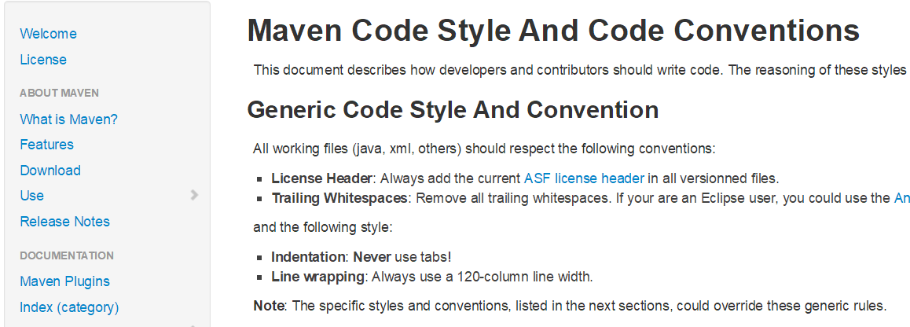
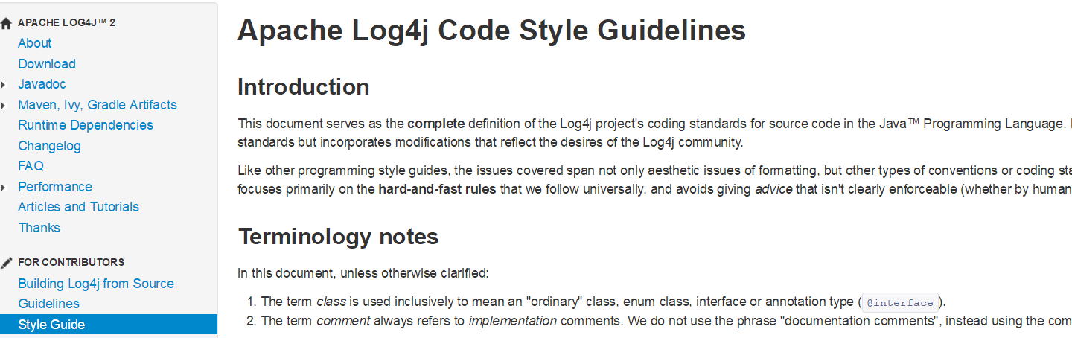
Code style

Slide 19
File
Source files are encoded in UTF-8.
Special characters
Whitespace ASCII horizontal space character (0x20)
Non-ASCII characters \u221e
Source file structure
Apache license
Package statement
Import statements
Order: java, javax, org, com
All static imports in a single group
Exactly one top-level class
Exactly one blank line separates each section that is present.

Slide 20
Class
Class members
static variables
instance variables
constructors
methods
Each type of members
public
protected
private
Class names
UpperCamelCase
Nouns or noun phrases.
Test classes are named starting with the name of the class they are testing, and ending with Test, e.g., HashIntegrationTest.

Slide 21
Methods
@Override public void method() {
if (condition()) {
try {
something();
} catch (ProblemException e) {
recover();
}
} else {
}
}
Method name
LowerCamelCase
verbs or verb phrases, e.g., sendMessage or stop.
Inside methods
No line break before the opening brace.
Line break after the opening brace.
Line break before the closing brace.
Line break after the closing brace if that brace terminates a statement or the body of a method, constructor or named class. For example, there is no line break after the brace if it is followed by else or a comma.
private static URI[] libs() {
File f = new File("libs");
private static URI[] libs()
{
File f = new File("libs");

Slide 22
Annotation
Annotations
Annotations applying to a class, method or constructor appear immediately after the documentation block
Each annotation is listed on a line of its own (that is, one annotation per line)
A single parameterless annotation may instead appear together with the first line of the signature
Multiple annotations on fields may be listed on the same line
@Override
@Nullable
public String getNameIfPresent() { ... }
@Override public int hashCode() { ... }
@Partial @Mock DataLoader loader;

Slide 23
Blocks
Block indentation: +4 spaces
One statement per line
Column limit: 120
Vertical Whitespace
Within method bodies, as needed to create logical groupings of statements.
Horizontal whitespace
Separating any reserved word, such as if, for or catch, from an open parenthesis (() that follows it on that line
Separating any reserved word, such as else or catch, from a closing curly brace (}) that precedes it on that line
…

Slide 24
Switch statements
Indentation. As with any other block, the contents of a switch block are indented +2.
No statements after conditions.
Fall-through: commented
switch (input) {
case 1:
case 2:
prepareOneOrTwo();
// fall through
case 3:
handleOneTwoOrThree();
break;
default:
handleLargeNumber(input);
}

Slide 25
Variables and Constants
Declarations
Every variable declaration (field or local) declares only one variable: declarations such as int a, b; are not used
Declared when needed, initialized as soon as possible
Variable name
LowerCamelCase
Nouns or noun phrases, e.g., computedValues or index.
Constant name
Constant names use CONSTANT_CASE: all uppercase letters, with words separated by underscores.
Nouns or noun phrases

Slide 26
Comment and Javadoc
A way to help other people and yourself to better understand your code later
Common rules
No need to comment everything
More important to explain variables than statements: Other developers know what the statement does, but do not know what the variable means…
Try to write complete sentences
Avoid code in comments, it make readers harder to read code
Exception: method/class comments of API library
int score = 100; // set score to 100
TERRIBLE COMMENT!
int score = 100; // the full score of the final exam is 100

Slide 27
Comments
Block comments are indented at the same level as the surrounding code
They may be in /* ... */ style or // ... style.
/* This is // And so /* Or you can
* okay. // is this. * even do this. */
*/

Slide 28
Javadoc
Formatting
Paragraphs
One blank line—that is, a line containing only the aligned leading asterisk (*)—appears between paragraphs
/** Multiple lines of Javadoc text are written here,
* wrapped normally...
*/
public int method(String p1) { ... }
/** An especially short bit of Javadoc. */

Slide 29
Javadoc
Where Javadoc is used
Javadoc is present for every public class, and every public or protected member of such a class
Exception: self-explanatory methods
Javadoc is optional for "simple, obvious" methods like getFoo
Exception: overrides
Javadoc is not always present on a method that overrides a supertype method.

Slide 30
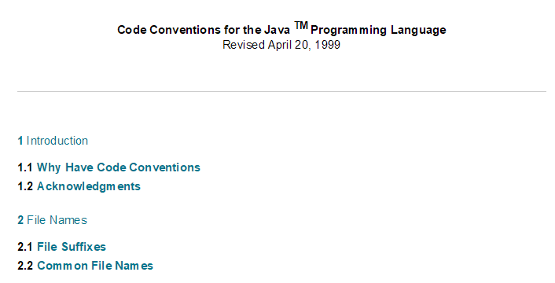
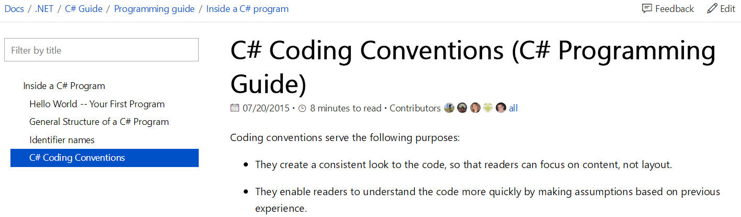
Code convention for companies / organizations
Most companies / organizations have their code conventions
Usually following the general rules of coding style
May set different line-length limits, 2 or 4 spaces, different ways to place braces, or whether to put spaces around operators or brackets, …
Some code convention examples:
http://www.oracle.com/technetwork/java/javase/documentation/codeconvtoc-136057.html
http://msdn.microsoft.com/en-us/library/vstudio/ff926074.aspx

Slide 31

Design Patterns
Best practice
Design Patterns: Elements of Reusable Object-Oriented Software. Gang of Four: Gamma, Erich; Richard Helm, Ralph Johnson, and John Vlissides
Provide solutions for common problems in micro-design
Prechelt, Lutz, Barbara Unger-Lamprecht, Michael Philippsen, and Walter F. Tichy. "Two controlled experiments assessing the usefulness of design pattern documentation in program maintenance." IEEE Transactions on Software Engineering 28, no. 6 (2002): 595-606.
…

Slide 32
Design Patterns
Anand Ashok Sawant et al. Why are Features Deprecated? An Investigation Into the Motivation Behind Deprecation. In Proc. ICSME 2018

Slide 33
Design patterns structure
Name
Important to know for easier communication between designers
Problem solved
When to apply the pattern
Solution
Usually a class diagram segment (sometimes attributes and operations)

Slide 34
Design patterns
Structure Patterns
Composite (组合模式)
Creation Patterns
Factory (工厂模式)
Behavioral Patterns
Visitor (访问者模式)

Slide 35
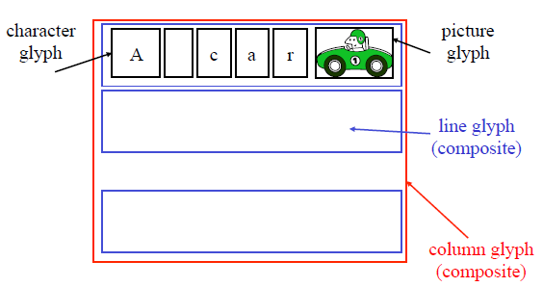
Running example
A Document Editor
Text and graphics can be freely mixed
Graphical user interface
Traversal operations: spell checking…

Slide 36
Composite pattern: problem
A document is represented by structure
Primitive glyphs
Characters, circles, pictures
Lines: A sequence of glyphs
Columns: A sequence of Lines
Pages: A sequence of Columns
Documents: A sequence of Pages

Slide 37
Possible designs?
Classes of Character, Circle, Pictures, lines, Columns, pages, document
Composition relationship between classes
Not so good, why?
A lot of duplication:
all classes has onClick, draw behavior
Difficult to add or remove levels in hierarchy
Traverse/display operations need to change for any change of the hierarchy
public class Car{
Engine engine;
…
public Car(){
engine = new Engine();
}
}

Slide 38
Alternate Designs
One class of Glyph
All elements are subclasses of Glyph
All elements uniformly present the same interface
How to draw
Computing bounds
Mouse hit detection
…
Make extending the class easier

Slide 39
Alternate Designs
Class Glyph {
private List< Glyph > children = new ArrayList< Glyph >(); public void Draw(Window w){…;} public void Intersect(Point p){…;} }
Class Character extends Glyph{
…
}
Class Picture extends Glyph{
…
}
Class Picture extends Line{
…
}

Slide 40
Composite Pattern
Applies to any hierarchy structure
Leaves and internal nodes have similar functionality
Pros:
Easy to add, remove new types
Clean interface
Cons:
Not straightforward for beginers

Slide 41
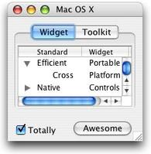
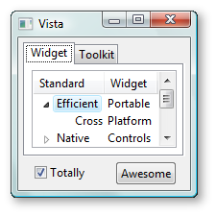
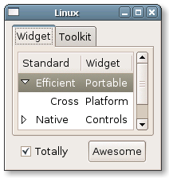
Factory: Supporting look-and-feel settings
Different look-and-feel standards
Appearance of scrollbars, menus, windows, etc., set by the user
We want to support them all
For example: having classes MotifScrollBar and WindowsScrollBar
Both are subclasses of ScrollBars
How should we create a new scrollbar in a window?

Slide 42
Factory Pattern
One method to create a look-and-feel dependent object
Define a GUIFactory Class
One GUIFactory object for each look and feel
Create itself using conditions set by the user

Slide 43
Factory Pattern
abstract class GUIFactory{
abstract ScrollBar CreateScrollBar();
abstract Menu CreateMenu();
...
}
class MotifFactory extends GUIFactory{
ScrollBar CreateScrollBar(){
return new MotifScrollBar()
}
Menu createMenu(){
return new MotifMenu();
}
...
}
GuiFactory factory;
if(style==MOTIF){
factory = new MotifFactory();
}else if(style==WINDOW){
factory = new WindowFactory();
}else{
...
}
ScrollBar bar = factory.createScrollBar();
Menu mn = factory.createMenu();

Slide 44
Factory Pattern
Applies to the object creation of a family of classes
The factory can be changed at runtime
Pros & Cons
Lift the conditional creation of objects to the creation of factories
Flexible for add new type of objects
Sometimes make the code more difficult to understand

Slide 45
Visitor: Spell Checking Problem
Considerations
Requires to traverse the document
Need to see every glyph in order
There may be other analyses that require traverse the document
Counting words, Grammar checking

Slide 46
Possible design
class Glyph{…
void spellCheck(char[] curWord):
for(int i = 0; i<this.children.length; i++):
this.children[i].spellCheck(curWord);
if(this isa character):
if(this == space):
Util.SpellCheck(curWord); curWord.clear();
else:
curWord.append(this);
…}

Slide 47
Other Actions
Document Stats
counting words,
counting pictures,
counting lines, columns, pages)
Find a word
Change line-break rules
…

Slide 48
Now we have
A large number of similar methods
All need to traverse the document
Code duplication always causes problems
change the data structure of “children” from array to list (better insertion and deletion)
Skip full-picture page to enhance performance for word-related tasks

Slide 49
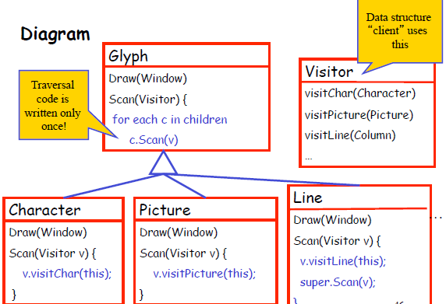
Solution
Visitor pattern
Decouple traverse process and action
Write traverse code only once
Each element in the hierarchy under traverse has an “action” code
class Glyph{…
void scan(Visitor v):
for(int i = 0; i<this.children.length; i++):
this.children[i].scan(v);
…}
We have different visitors:
SpellcheckVisitor, DocumentStatVisitor, etc.

Slide 50
A controversial pattern: singleton pattern
Problem
How to make sure a class only has one object
File system
Windows manager
…
The class itself is made responsible for keeping track of its instance. It can thus ensure that no more than one instance is created. This is the singleton pattern.

Slide 51
View points
We love singletons (getting weaker and weaker in the past 10 years)
Singletons are evil, actually an anti-pattern (many people believe this)
Use singletons carefully and only when no other alternatives, control the number of singleton classes in your project

Slide 52
This class
Programmer
How to program with others
Code style
variable, …, class
Design pattern
Good vs Evil

Slide 53

Next class
Quality engineer

