Slide 1
Quality engineer
Hao Zhong
Shanghai Jiao Tong University

Slide 2
Last class
Programmer
How to program with others
Code style
variable, …, class
Design pattern
Good vs Evil

Slide 3
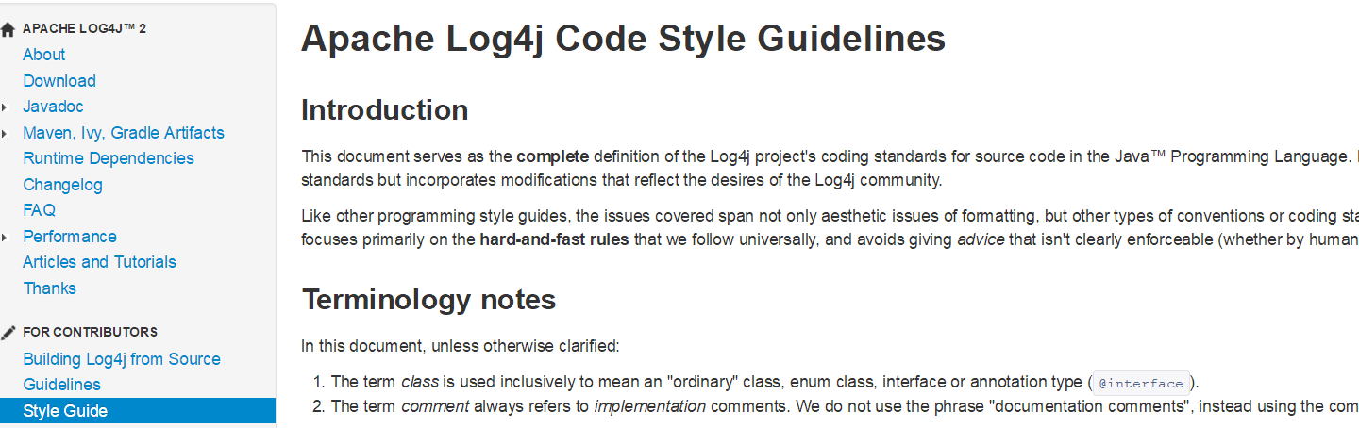
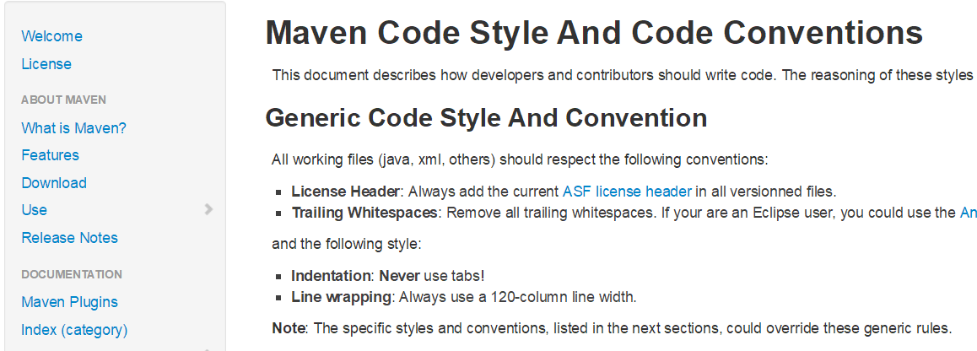
Code style

Slide 4
Design patterns
Structure Patterns
Composite
Creation Patterns
Factory
Behavioral Patterns
Visitor

Slide 5
Software process models
Requirements
engineering
Design
Implementation
Integration
The waterfall model

Slide 6

Role
A software quality analyst is responsible for applying the principles and practices of software quality assurance throughout the software development life cycle.
A software bug is an error, flaw, failure or fault in a computer program or system that causes it to produce an incorrect or unexpected result, or to behave in unintended ways.

Slide 7
Software bug
Errors can happen in any engineering discipline
Most product are put into the market with no or very few errors
Software is one of the most error-prone products of all engineering areas
Software can be really complex, undecidable problems are everywhere
On average, 1-5 bugs per KLOC (thousand lines of code)
In mature software
More than 10 bugs in prototypes
Windows2000
35MLOC
63K known bugs at the time of release
2 bugs per KLOC

Slide 8



Software bug
Mars Climate Orbiter ($165M, 1998)
Smashed to the planet: failing to convert between English measure to metric values
THERAC-25 Radiation Therapy (1985)
2 cancer patients at East Texas Cancer center received fatal overdoses
Boeing 737 max (2019)
Flight control
$59.5B loss due to bugs in US 2002 (estimation by NIST)
It is not feasible to remove all bugs
But try to reduce critical bugs

Slide 9
Approach to reduce bugs
Testing
Feed input to software and run it to see whether its behavior is as expected
Limitations
Impossible to cover all cases
Test oracles (what is expected)
Static checking
Identify specific problems (e.g., memory leak) in the software by scanning the code or all possible paths
Limitations
Limited problem types (oracles)
False positives

Slide 10
Approach to reduce bugs
Formal Proof
Formally prove that the program implements the specification
Limitations
Difficult to have a formal specification (oracle)
The proof does not guarantee the correctness of implementation
Inspection
Manually review the code to detect faults
Limitations:
Hard to evaluate (oracle)
Huge manual effort

Slide 11
Answer is testing, why?
“50% of my employees are testers, and the rest spends 50% of their time testing”
---- Bill Gates, 1995
More reliable than inspection, relatively cheap
You get what you pay (linear rewards)
Compared to other 3 approaches
Inspection, static checking, formal proof

Slide 12
Testing: Concepts
Test case
Test oracle
Test suite
Test script
Test driver
Test result
Test coverage

Slide 13
Testing: Concepts
Test case
An execution of the software with a given list of input values
Include:
Input values, sometimes fed in different steps
Output values
Test oracle
The expected outputs of software by feeding in a list of input values
A part of test cases
Hardest problem in auto-testing: test oracle problem

Slide 14
Testing: Concepts
Test suite
A collection of test cases
Usually these test cases share similar pre-requisites and configuration
Usually can be run together in sequence
Different test suites for different purposes
Smoke test, Certain platforms, Certain feature, performance, …
Test script
A script to run a sequence of test cases or a test suite automatically

Slide 15
Testing: Concepts
Test driver
A software framework that can load a collection of test cases or a test suite
It can usually handle the configuration and comparison between expected outputs and actual outputs
Test coverage
A measurement to evaluate how well the testing is done
The measure can be based on multiple elements
Line
Branch
…

Slide 16
Granularity of testing: V-model

Slide 17
Granularity of testing
Unit Testing
Test of a single module
Integration Testing
Test the interaction between modules
System Testing
Test the system as a whole, by developers on test cases

Slide 18
Unit testing
Testing of an basic module of the software
A function, a class
Typical problems revealed
Local data structures
Algorithms
Boundary conditions
Error handling

Slide 19
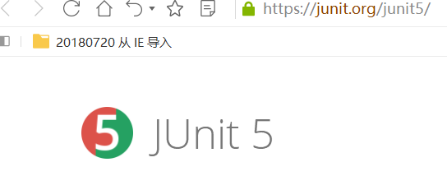
Unit test framework
xUnit
Created by Kent Beck in 1989
This is the same guy we mentioned in XP, design patterns
The first one was sUnit (for smalltalk)
Junit - The most popular xUnit framework
There are about 70 xUnit frameworks for corresponding languages

Slide 20
Unit Test Framework
System under test: the system/module/component we are testing
Test Method: The actual code of the test
Test Case: A collection of tests with common purpose/setup

Slide 21
Writing a Test Case
public class VectorTest extends TestCase { // extending Junit TestCase
protected Vector fEmpty;
protected Vector fFull;
protected void setUp() { // executed before every test
fEmpty= new Vector(); // Generate SUTs
fFull= new Vector();
}
@Test // annotation: tell Junit a test method
public void testCapacity() { // a test method
int size= fFull.size();
for (int i= 0; i < 100; i++){
fFull.addElement(new Integer(i));
}
assertTrue(fFull.size() == 100+size); //assertion, compare output with expected
}
protected void teardown{
fEmpty = null;
}
}

Slide 22
Overview
Test methods are independent in JUnit
The order of executing test methods should not affect the test results
Create an instance for each test method
setup and tear down
Fail assertion or unhandled exception
In JUnit, each test case is executed in a try-catch
Why?
Avoid one fail test to affect the following tests

Slide 23
Assertions
public void testCapacity() { // a test method
….
assertTrue(fFull.size() == 100+size); //assertion
}
If assertion fails:
Assertion failed: myTest.java:150 (expected true but was false)
Not so good!
Try: assertEquals(100+size, fFull.size()); //expected value first
Assertion failed: myTest.java:150 (expected 102 but was 103)
Better!
Try: assertEquals(“list length”, 100+size, fFull.size());
Assertion failed: myTest.java:150 (list length expected 102 but was 103)

Slide 24
Assertions
Extend TestCase and write your own assertions
AssertStringContains, AssertArrayEquals, …
Use fail(String) to fail a test with certain message
JUnit creates one instance of TestCase per test method
public void testRemoveAll() {
fFull.removeAllElements();
fEmpty.removeAllElements();
assertTrue(fFull.isEmpty());
assertTrue(fEmpty.isEmpty());
}

Slide 25
Setup and tear down
void setUp() {
File f = open(“foo”);
File b = open(“bar”);
}
void testAAA() {
try {
use f and b
} finally {
clean&close f, b
}
}
void testBBB() {
try {
use f and b
} finally {
clean&close f, b
}
}
Consider the following test code
void setUp() {
File f = open(“foo”);
File b = open(“bar”);
}
void testAAA() {
use f and b
}
void testBBB(){
use f and b
}
Better?
Problems?

Slide 26
Setup and tear down
Consider the following test code
void setUp() {
File f = open(“foo”);
File b = open(“bar”);
}
void testAAA() {
use f and b
}
void testBBB(){
use f and b
}
void tearDown{
clean&close f, b
}
void setUp() {
File f = open(“foo”);
File b = open(“bar”);
}
…
void tearDown{
try{
clean&close f
}catch{
…
}
the same for b
}
Even better

Slide 27
Tear down
If tear down is not complete, a test failure may affect the following test cases
Recover the changes done to global data that are not well handled by the setup
Database, files, network, global variables
Clean resources
Caution of exceptions in tear down itself

Slide 28
Integration Testing
Big Bang
Top down
Bottom Up

Slide 29
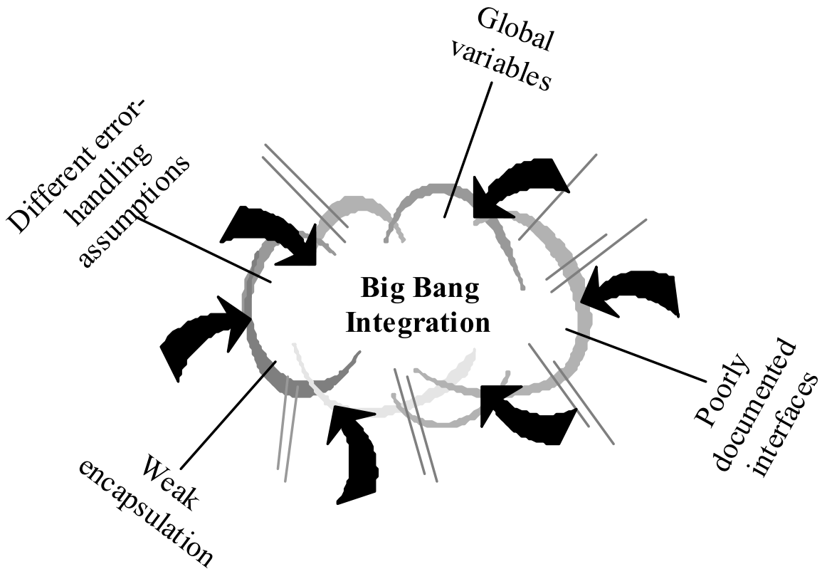
Big Bang!
Prepare all relevant components
Data, Global variables…
Pray!
Usage Scenario
Quite common in small projects
Requires no extra effort for integration
Difficult to locate a fault

Slide 30
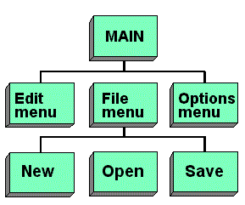
Top down strategy
Feature decomposition
A hierarchical structure of all software features

Slide 31
Top down strategy
Focus on the validation of the whole system first
Test an empty system with no components at first
All components are replaced with test doubles, e.g., stubs
Gradually add components
Until all components are added

Slide 32
Top down strategy
Advantages
Easier to understand the process of the integration
May have a working system earlier (or always have a working system): important for modern development, such as XP
Disadvantages
Requires to write test stubs
Centralized, and the integration cannot be done in parallel

Slide 33
Bottom-up strategy
Focus on the integration of lowest units at first
Start from an unit depending nothing else
When all sub-unit of a component are integrated, integrate the component
Until the whole system is built
33

Slide 34
Bottom-up strategy
Advantages
No test stub is required
Requires test driver but may re-use unit test cases (view the whole component as a unit)
Support parallel integration
Issues
No working system is available until the end
Some issues emerge at the end

Slide 35
System testing - functional
Test the system as a whole
Usually test against requirements (specifications)
For each item in the specification
Work out a test case and a test oracle
Test boundary values
Test with invalid inputs
Test with environment errors

Slide 36
GUI testing
Testing Graphics User Interface is easier
But harder to automate
And harder to compare results with oracles
Manual testing is still widely performed for GUI testing
Manually explore the user interface
Record the steps in the test for future testing
Observe the GUI for errors

Slide 37
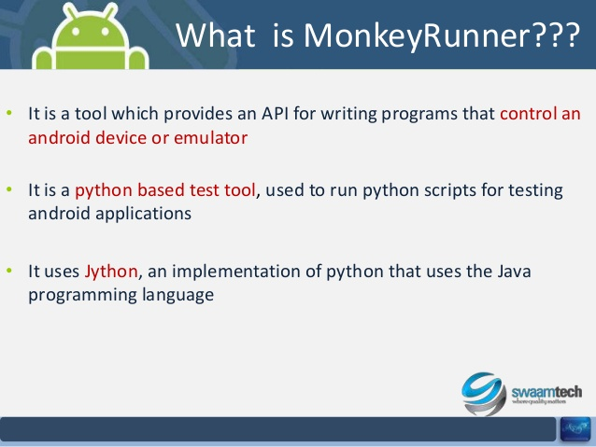
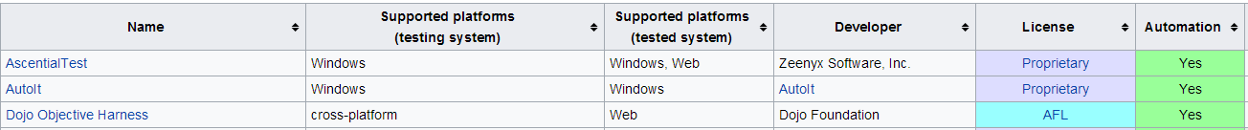
GUI testing
Record and Replay
Screen record and replay
Record click on the screen and keyboard inputs
Replay all the clicks and inputs
Not robust, affected by screen size, resolution, resize, …
Event record and replay
Record all the UI events in the UI framework (swing, MFC, android etc.), and outputs (texts) in the UI
Re-trigger all the events and compare the UI texts
More robust, but requires more preparation and overhead
https://en.wikipedia.org/wiki/Comparison_of_GUI_testing_tools

Slide 38
System testing - nonfunctional
Platforms
OS, database, application server, browser
Compatibility is a huge problem
Performance
Response time
Overload
…

Slide 39
Test Coverage
After we have done some testing, how do we know the testing is enough?
The most straightforward: input coverage
# of inputs tested / # of possible inputs
Unfortunately, # of possible inputs is typically difficult to determine
Not feasible, so we need approximations…

Slide 40
Code Coverage
Basic idea:
Bugs in the code that has never been executed will not be exposed
So the test suite is definitely not sufficient
Definition:
Divide the code to elements
Calculate the proportion of elements that are executed by the test suite
Criteria
Statement (basic block) coverage, are they the same?
Branch coverage (cover all edges in a control flow graph), same with basic block coverage?
Data flow coverage

Slide 41
Example
branch coverage vs statement coverage
public void method(int x, int y){
if(x==1||y==1){
doSomething();
else{
doOtherthing();
}
}

Slide 42
Example
branch coverage vs statement coverage
x==1, x!=1 vs x==1, x!=1, y==1, y!=1
public void method(int x, int y){
if(x==1||y==1){
doSomething();
else{
doOtherthing();
}
}

Slide 43
Statement coverage in practice
Microsoft reports 80-90% statement coverage
Safely-critical software must achieve 100% statement coverage
Usually about 85% coverage, 100% for large systems is usually very hard
Coverage is used to build the confidence on test suites
Coverage does not guarantee correctness

Slide 44
More metrics to measure test cases
Academy
Mutation test
Industry
Requirement coverage
program
mutated programs
test suite
requirement
test suite

Slide 45
This class
Quality engineer
Faults and their detection approaches
Test
Unit test
Integration test
System test
Test coverage

Slide 46
Next class
Quality engineer

