Slide 1
Static analysis
Hao Zhong
Shanghai Jiao Tong University

Slide 2
Last class
Quality engineer
Faults and their detection approaches

Slide 3
Approach to reduce bugs
Testing
Feed input to software and run it to see whether its behavior is as expected
Limitations
Impossible to cover all cases
Static checking
Identify specific problems (e.g., memory leak) in the software by scanning the code or all possible paths
Limitations
False positives

Slide 4
Approach to reduce bugs
Formal Proof
Formally prove that the program implements the specification
Limitations
The proof does not guarantee the correctness of implementation
Inspection
Manually review the code to detect faults
Limitations:
Huge manual effort

Slide 5
Testing: Concepts
Test case
An execution of the software with a given list of input values
Include:
Input values, sometimes fed in different steps
Output values
Test oracle
The expected outputs of software by feeding in a list of input values
A part of test cases
A hard problem in auto-testing: test oracle problem

Slide 6
Granularity of testing
Unit Testing
Test of a single module
Integration Testing
Test the interaction between modules
System Testing
Test the system as a whole, by developers on test cases

Slide 7
Writing a Test Case
public class VectorTest extends TestCase { // extending Junit TestCase
protected Vector vf;
protected void setUp() { // executed before every test
vf = new Vector(); // Generate SUTs
}
@Test // annotation: tell Junit a test method
public void test1() { // a test method
…
assertTrue(vf.size() == 100+size); //assertion, compare output with expected
}
@Test // annotation: tell Junit a test method
public void test2() { // a test method
… }
void tearDown{
vf.clear();
}
}

Slide 8
Test measures
Code Coverage
Definition:
Divide the code to elements
Calculate the proportion of elements that are executed by the test suite
Criteria
Statement coverage
Branch coverage
Data flow coverage
Mutation test
Requirement coverage
program
mutated programs
test suite
requirement
test suite

Slide 9
Software process models
Requirements
engineering
Programmer
Quality engineer
Design
Implementation
Integration
The waterfall model

Slide 10
Approach to reduce bugs
Testing
Feed input to software and run it to see whether its behavior is as expected
Limitations
Impossible to cover all cases
Static checking
Identify specific problems (e.g., memory leak) in the software by scanning the code or all possible paths
Limitations
False positives

Slide 11
Testing
code
compile
executable file
bugs
test case
oracle

Slide 12
Static bug detection
AST
code
parse
graph
check
bugs
model
oracle

Slide 13
Static bug detection
Static bug detection is a less popular approach for software quality assurance, compared with testing
Compared to testing
Sometimes not scalable
Generate false positives
Easy to start ( no setup, no install …)
Sometimes can guarantee the software to be free of certain kinds of bugs
No need for debugging
Some tools do not need compiled code

Slide 14
State-of-practice: static bug detection
Findbugs
A tool developed by researchers from UMD
Widely used in industry for code checking
The idea actually comes from Lint
Lint
A code style enforcing tool for C language
Find bad coding styles and raise warnings
Bad naming
Hard coded strings
…
Findbugs is adopted by a number of large companies such as Google
A statistics in Google 2009: More than 4000 issues are identified, in which 1700 bugs are confirmed, and 1100 are fixed.

Slide 15
Bad practice vs correctness
Method names
Høst, Einar W., and Bjarte M. Østvold. Debugging method names. In European Conference on Object-Oriented Programming, pp. 294-317. Springer, Berlin, Heidelberg, 2009.
Parameter and argument names
Hui Liu, Qiurong Liu, Cristian-Alexandru Staicu, Michael Pradel, Yue Luo. Nomen est Omen: Exploring and Exploiting Similarities between Argument and Parameter Names. The 38th International Conference on Software Engineering (ICSE 2016), 1063-1073

Slide 16
Defined oracles in Findbugs
Bad practice
DMI: Don't use removeAll to clear a collection
If you want to remove all elements from a collection c, use c.clear, not c.removeAll(c). Calling c.removeAll(c) to clear a collection is less clear, susceptible to errors from typos, less efficient and for some collections, might throw a ConcurrentModificationException.
Correctness
NP: Null pointer dereference
A null pointer is dereferenced here. This will lead to a NullPointerException when the code is executed.
Malicious code vulnerability
MS: Field isn't final and can't be protected from malicious code
A mutable static field could be changed by malicious code or by accident from another package.

Slide 17
Defined oracles in Findbugs
Performance
Dm: Method invokes inefficient Boolean constructor
Creating new instances of java.lang.Boolean wastes memory, since Boolean objects are immutable and there are only two useful values of this type. Use the Boolean.valueOf() method (or Java 1.5 autoboxing) to create Boolean objects instead.
Multithreaded correctness
SWL: Method calls Thread.sleep() with a lock held
This method calls Thread.sleep() with a lock held. This may result in very poor performance and scalability, or a deadlock, since other threads may be waiting to acquire the lock. It is a much better idea to call wait() on the lock, which releases the lock and allows other threads to run.

Slide 18
Defined oracles in Findbugs
Security
Dm: Hardcoded constant database password
This code creates a database connect using a hardcoded, constant password. Anyone with access to either the source code or the compiled code can easily learn the password.
…

Slide 19
Characters of Findbugs
More than 400 rules
Bug patterns include both legal and illegal usages
Most are illegal ones
Why?
Check code patterns locally: only do inner-procedure analysis
What are the advantages and disadvantages of doing so?
Perform bug ranking according to the probability and potential severity of bugs
Probability: the bug is likely to be true
Severity: the bug may cause severe consequence if not fixed
Sunghun Kim and Michael D Ernst. 2007. Which warnings should I fix first?. In Proc. ESEC/FSE. 45–54.
In this paper, we propose a history-based warning prioritization algorithm by mining warning fix experience that is recorded in the software change history.
The underlying intuition is that if warnings from a category are eliminated by fix-changes, the warnings are important. Our prioritization algorithm improves warning precision to 17%, 25%, and 67% respectively

Slide 20
Testing
code
compile
executable file
bugs
test case
oracle

Slide 21
Static bug detection
AST
code
parse
graph
check
bugs
model
oracle

Slide 22
General oracles
Divide by 0
a/b → b!=0
a.field → a!=null
a[x] → 0<=x<a.length()
p.malloc() → p.free()
lock(s) → unlock(s)
while(Condition) → F(!Condition)
Null Pointer Reference
Buffer Overflow
Memory Leak
deadlock
Infinite Loop

Slide 23
More Oracles?
Tools such as Findbugs already defined hundreds of rules.
Why insufficient?
API library
J2SE alone defines thousands of classes
Static tools handle APIs as black boxes
Project-specific rules
Outsiders rarely know
Static tools do not define project-specific rules
It is challenging to define such rules manually

Slide 24
Inference
Static symbolic execution
y = read();
y = 2 * y;
if (y <= 12)
y = 3;
else
y = y + 1;
print ("OK");
T (y=s), s is a symbolic variable for input
T (y=2*s)
T_{2*s<=12} (y = 3)
T_{!(2*s<=12)} (y= 2*s + 1)
T _{2*s<=12} (y= 3 ) | T_{!(2*s<=12)} (y=2*s + 1)
T _{s<=6} (y= 3 ) | T_{s>6} (y=2*s + 1)
API?

Slide 25
Mining specifications
Learning from correct usages
Inputs
Client code
Traces
Techniques:
Frequent sequential mining
Frequent subgraph mining
Grammar inference
…
Output
Automata
Frequent call sequences
Graphs

Slide 26
Mining
“Dynamically discovering likely program invariants to support program evolution” by Michael D. Ernst, Jake Cockrell, William G. Griswold, and David Notkin. IEEE Transactions on Software Engineering, vol. 27, no. 2, Feb. 2001, pp. 99-123.

Slide 27
Mining specifications
Learning from documents
Inputs
API doc
…
Techniques:
NLP
…
Outputs:
Inferring resource specifications from natural language API documentation Hao Zhong, Lu Zhang, Tao Xie, and Hong Mei In Proc. International Conference on Automated Software Engineering (ASE), pages 307-318, 2009.

Slide 28
Mining bug signature
Learning from bugs and bug fixes
Techniques
Frequency-based mining
Mining subgraph
Discriminative graph mining
Outputs:
Hao Zhong, Xiaoyin Wang, and Hong Mei. Inferring bug signatures to detect real bugs. IEEE Transaction on Software Engineering, pages to appear, 2020.

Slide 29
Oracle Types
Value Oracle
The value (s) of one or several variable (s) must satisfy a certain constraint
Temporal oracle
Two events (or a series of events) must (not) happen in a certain order
Specification
lock() → unlock()
file.open() → file.close() and file.open() → file.read()
Bug signature
file.close() → file.read()
Final Exam Score <= 100
sortedlist(0) >= sortedlist(1)
http_url.startsWith(“http”)

Slide 30
Oracle Types
Data flow specification
Data from a certain source must / must not flow to a certain sink
Android applications
! Contact Info → Internet
Password → encryption → Internet
Data Flow Specification are mainly for security usage

Slide 31
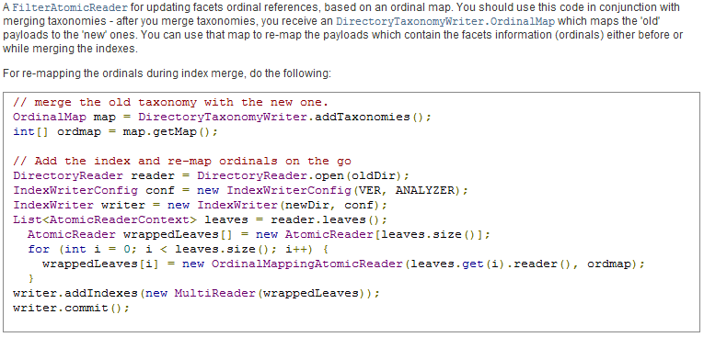

More oracles: Software document
Zhong, Hao. and Su, Zhendong., 2013, Detecting API documentation errors. In Proc. OOPSLA, pp. 803-816).
Natural language sentence with code names
Natural language sentence
Out-of-date code reference
Code example

Slide 32
More oracles: Differential testing
An application has multiple implementations
JVM: Sun J2SE, Open JDK, IBM J9, …
Compiler: gcc, llvm, …
SSH servers: Apache MINA SSHD, Dropbear, …
Linux: Ubuntu, Redhat,…
Database
Refactoring
One software has different implementations
Same inputs
Same outputs
Differential testing for software
McKeeman, William M.
Digital Technical Journal 10.1 (1998): 100-107.
Exposing behavioral differences in cross-language API mapping relations Hao Zhong, Suresh Thummalapenta, and Tao Xie In Proc. Fundamental Approaches to Software Engineering (ETAPS/FASE), pages 130-145, 2013.

Slide 33
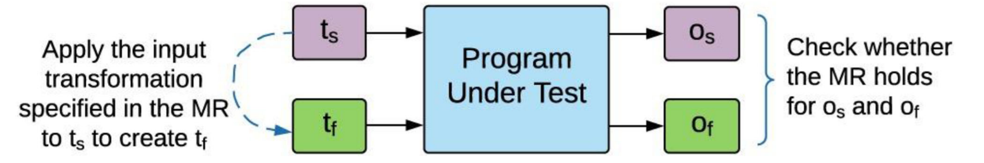
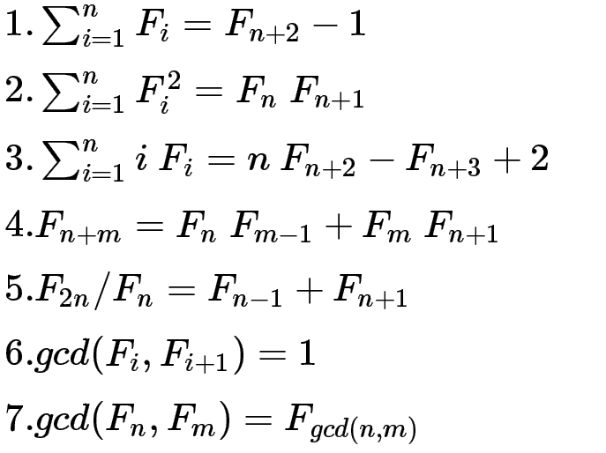
More oracles: Metamorphic Testing
Two or more values shall follow some constraints
Fibonacci sequence
F_{i}=F_{i−1}+F_{i−2},F₁=F₂=1

Slide 34

Your insights

Slide 35
What after you have oracles?
It is still nontrivial to check whether a program follow or violate oracle.
Static analysis is not fully correct.
How to determine the value of a variable?
How to determine the type of a variable?
How to determine the attributes of an object? (Python)

Slide 36
Static bug detection
AST
code
parse
graph
check
bugs
model
oracle

Slide 37
Graph-based analysis
Transform the program to graphs
WALA, SOOT
Compiler optimization
Detecting violations of specifications
traversing graphs
Detecting instances of bug signatures
identifying subgraphs

Slide 38
An example
Start
f is not closed
Checking whether a file is closed in all cases
boolean load(){
f.open();
line = f.read();
while(line!=null){
if(line.contains('key')){
f.close()
return true;
}else if(line.contains('value')){
f.close()
}
line = f.read();
}
return false;
}
opened
new line read
!=null
key
value
closed
none
==null
closed
ret

Slide 39
The challenges of bug analysis
Johnson, Brittany, Yoonki Song, Emerson Murphy-Hill, and Robert Bowdidge. "Why don't software developers use static analysis tools to find bugs?." In Proc. ICSE, pp. 672-681. 2013.
Some programmers hate false alarms
Legunsen O, Hassan Wu, Xu X, Roşu G, Marinov D. How good are the specs? A study of the bug-finding effectiveness of existing Java API specifications. In Proc. ASE 2016 (pp. 602-613).
182 manually written specs and 17 automatically mined specs
200 open source projects
JavaMOP (dynamic)
We reported 95 bugs, out of which developers already fixed 74.
Most violations, 82.81% of 652 and 97.89% of 200, were false alarms

Slide 40
This class
Static bug detection
Oracle
Value
Temporal
Data flow
Mining oracles
Existing client code
Existing buggy code
Documents
Code styles
Declaration before usage

Slide 41
Testing
code
compile
executable file
bugs
test case
oracle

Slide 42
Static bug detection
AST
code
parse
graph
check
bugs
model
oracle

Slide 43
General oracles
Divide by 0
a/b → b!=0
a.field → a!=null
a[x] → x<a.length()
p.malloc() → p.free()
lock(s) → unlock(s)
while(Condition) → F(!Condition)
Null Pointer Reference
Buffer Overflow
Memory Leak
deadlock
Infinite Loop

Slide 44
Oracle Types
Value Oracle
The value (s) of one or several variable (s) must satisfy a certain constraint
Temporal oracle
Two events (or a series of events) must (not) happen in a certain order
Specification
lock() → unlock()
file.open() → file.close() and file.open() → file.read()
Bug signature
file.close() → file.read()
What is the difference?
Final Exam Score <= 100
sortedlist(0) >= sortedlist(1)
http_url.startsWith(“http”)

Slide 45
Oracle Types
Data flow specification
Data from a certain source must / must not flow to a certain sink
Android applications
! Contact Info → Internet
Password → encryption → Internet
Data Flow Specification are mainly for security usage

Slide 46
More oracles: differential testing
An application has multiple implementations
JVM: Sun J2SE, Open JDK, IBM J9, …
Compiler: gcc, llvm, …
SSH servers: Apache MINA SSHD, Dropbear, …
Linux: Ubuntu, Redhat,…
Database
Refactoring
One software has different implementations
Same inputs
Same outputs
Differential testing for software
McKeeman, William M.
Digital Technical Journal 10.1 (1998): 100-107.
Exposing behavioral differences in cross-language API mapping relations Hao Zhong, Suresh Thummalapenta, and Tao Xie In Proc. Fundamental Approaches to Software Engineering (ETAPS/FASE), pages 130-145, 2013.

Slide 47
More oracles: Metamorphic Testing
Two or more values shall follow some constraints
Fibonacci sequence
F_{i}=F_{i−1}+F_{i−2},F₁=F₂=1

Slide 48

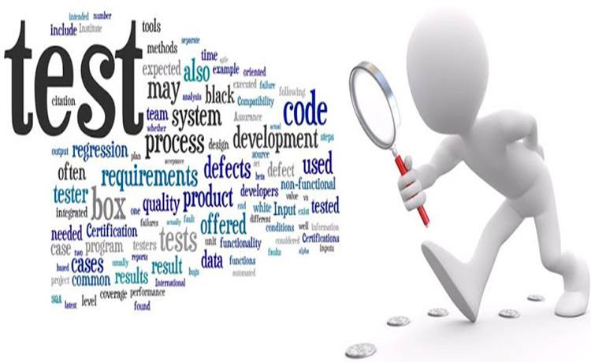
Next class
Debugging

