Slide 1
Debugging
Hao Zhong
Shanghai Jiao Tong University

Slide 2
Last class
Static bug detection
Findbugs
Oracle
Value
Temporal
Data flow
Mining oracles

Slide 3
Testing
code
compile
executable file
bugs
test case
oracle

Slide 4
Static bug detection
AST
code
parse
graph
check
bugs
model
oracle

Slide 5
General oracles
Divide by 0
a/b → b!=0
a.field → a!=null
a[x] → x<a.length()
p.malloc() → p.free()
lock(s) → unlock(s)
while(Condition) → F(!Condition)
Null Pointer Reference
Buffer Overflow
Memory Leak
deadlock
Infinite Loop

Slide 6
Oracle Types
Value Oracle
The value (s) of one or several variable (s) must satisfy a certain constraint
Temporal oracle
Two events (or a series of events) must (not) happen in a certain order
Specification
lock() → unlock()
file.open() → file.close() and file.open() → file.read()
Bug signature
file.close() → file.read()
Final Exam Score <= 100
sortedlist(0) >= sortedlist(1)
http_url.startsWith(“http”)

Slide 7
Oracle Types
Data flow specification
Data from a certain source must / must not flow to a certain sink
Android applications
! Contact Info → Internet
Password → encryption → Internet
Data Flow Specification are mainly for security usage

Slide 8
More oracles: differential testing
One software has different implementations
Same inputs
Same outputs
An application has multiple implementations
JVM: Sun J2SE, Open JDK, IBM J9, …
Compiler: gcc, llvm, …
SSH servers: Apache MINA SSHD, Dropbear, …
Linux: Ubuntu, Redhat,…
Database: MySQL, SQL server,…

Slide 9
Software process models
Requirements
engineering
Programmer
Quality engineer
Design
Implementation
Integration
The waterfall model

Slide 10
What happens after a bug is found
Bugs are found by testing
A test case can execute many lines of code
Where is the buggy code?
Test inputs can be too complicated
How to narrow down your test inputs?
Bugs are found by static analysis
How to trigger the bugs?
How to check the bugs?

Slide 11
Debugging -Testing
Sometimes the inputs is too complex
Quite common in real world (compiler, office, browser, database, OS, …)
Locate the relevant inputs
Some bugs are difficult to locate
Spectra-based fault localization
Automatic program repair
Some tests are flaky

Slide 12
Consider Mozilla Firefox
Taking html pages as inputs
A large number of bugs are related to loading certain html pages
Corner cases in html syntax
Incompatibility between browsers
Corner cases in Javascripts, css, …
Error handling for incorrect html, Javascript, css, …
…

Slide 13
How do we go from this
<SELECT NAME="op sys" MULTIPLE SIZE=7>
<OPTION VALUE="All">All<OPTION VALUE="Windows 3.1">Windows 3.1<OPTION VALUE="Windows 95">Windows 95<OPTION
VALUE="Windows 98">Windows 98<OPTION VALUE="Windows ME">Windows ME<OPTION VALUE="Windows 2000">Windows
2000<OPTION VALUE="Windows NT">Windows NT<OPTION VALUE="Mac System 7">Mac System 7<OPTION VALUE="Mac System
7.5">Mac System 7.5<OPTION VALUE="Mac System 7.6.1">Mac System 7.6.1<OPTION VALUE="Mac System 8.0">Mac System
8.0<OPTION VALUE="Mac System 8.5">Mac System 8.5<OPTION VALUE="Mac System 8.6">Mac System 8.6<OPTION VALUE="Mac
System 9.x">Mac System 9.x<OPTION VALUE="MacOS X">MacOS X<OPTION VALUE="Linux">Linux<OPTION
VALUE="BSDI">BSDI<OPTION VALUE="FreeBSD">FreeBSD<OPTION VALUE="NetBSD">NetBSD<OPTION
VALUE="OpenBSD">OpenBSD<OPTION VALUE="AIX">AIX<OPTION VALUE="BeOS">BeOS<OPTION VALUE="HP-UX">HPUX<
OPTION VALUE="IRIX">IRIX<OPTION VALUE="Neutrino">Neutrino<OPTION VALUE="OpenVMS">OpenVMS<OPTION
VALUE="OS/2">OS/2<OPTION VALUE="OSF/1">OSF/1<OPTION VALUE="Solaris">Solaris<OPTION
VALUE="SunOS">SunOS<OPTION VALUE="other">other</SELECT>
</td>
<td align=left valign=top>
<SELECT NAME="priority" MULTIPLE SIZE=7>
<OPTION VALUE="--">--<OPTION VALUE="P1">P1<OPTION VALUE="P2">P2<OPTION VALUE="P3">P3<OPTION
VALUE="P4">P4<OPTION VALUE="P5">P5</SELECT>
</td>
<td align=left valign=top>
<SELECT NAME="bug severity" MULTIPLE SIZE=7>
<OPTION VALUE="blocker">blocker<OPTION VALUE="critical">critical<OPTION VALUE="major">major<OPTION
VALUE="normal">normal<OPTION VALUE="minor">minor<OPTION VALUE="trivial">trivial<OPTION
VALUE="enhancement">enhancement<

Slide 14
To this…
<SELECT NAME="priority" MULTIPLE SIZE=7>

Slide 15
Delta Debugging
The problem definition
A program exhibit an error for an input
The input is a set of elements
e.g, a text file, an array, …
Find a smaller subset of the elements that still cause the failure
Benefit of simplification
Remove duplicates
Easy debugging
Involve less potentially buggy code
Shorter execution time

Slide 16
Delta Debugging
Binary search
Cut the input to halves
Try to reproduce the bug
Iterate
The set of elements in the bug-revealing input is I
Assumptions
Each subset of I is a valid input:
Each subset of I -> success / fail
A single input element E causes the failure
E will cause the failure in any cases (combined with any other elements) (Monotonic)

Slide 17

Delta Debugging
Go with the binary search process
Throw away half of the input elements, if the rest input elements still cause the failure

Slide 18

Delta Debugging
Throw away half of the input elements, if the rest input elements still cause the failure
A single element: we are done!

Slide 19
Delta Debugging
This is just binary search: easy to automate
The assumptions do not always hold
Let’s look at the assumptions:
It is interesting to see if this is not the case
(I1 U I2) =
-> I1 = and I2 =
or I1 = and I2 =

Slide 20
Case I: multiple failing branches
What happened if I1 = and I2 = ?
A subset of I1 fails and also a subset of I2 fails
We can simply continue to search I1 and I2
And we find two fail-causing elements
They may be due to the same bug or not

Slide 21
Case II: Interference
What happened if I1 = and I2 = ?
This means that a subset of I1 and a subset of I2 cause the failure when they combined
This is called interference
Handling trick
An element D1 in I1 and an element D2 in I2 cause the failure
We do binary search in I2 with I1
Split I2 to P1 and P2, try I1 U P1 and I1 U P2
Continue until you find D2, so that I1 U D2 cause the failure
Then we do binary search in I1 with D2 until find D1
Return D1 U D2

Slide 22
Advanced topics
Rely on the assumptions
Rely on good input elements, always providing valid inputs will enhance efficiency
Require automatic test oracles
Regehr, John, Yang Chen, Pascal Cuoq, Eric Eide, Chucky Ellison, and Xuejun Yang. "Test-case reduction for C compiler bugs." In Proc. PLDI, pp. 335-346. 2012.

Slide 23
Debugging -Testing
Sometimes the inputs is too complex
Quite common in real world (compiler, office, browser, database, OS, …)
Locate the relevant inputs
Some bugs are difficult to locate
Spectra-based fault localization
Automatic program repair
Some tests are flaky

Slide 24
Spectra-based fault localization
Basic Idea
Consider a number of test cases, some of which pass and some of which fail
If a statement is covered mostly by failed test cases, it is highly likely to be the buggy part of the code
Tarantula
Color = red + pass/(fail + pass) * (green )
Brightness = max (pass, fail)

Slide 25
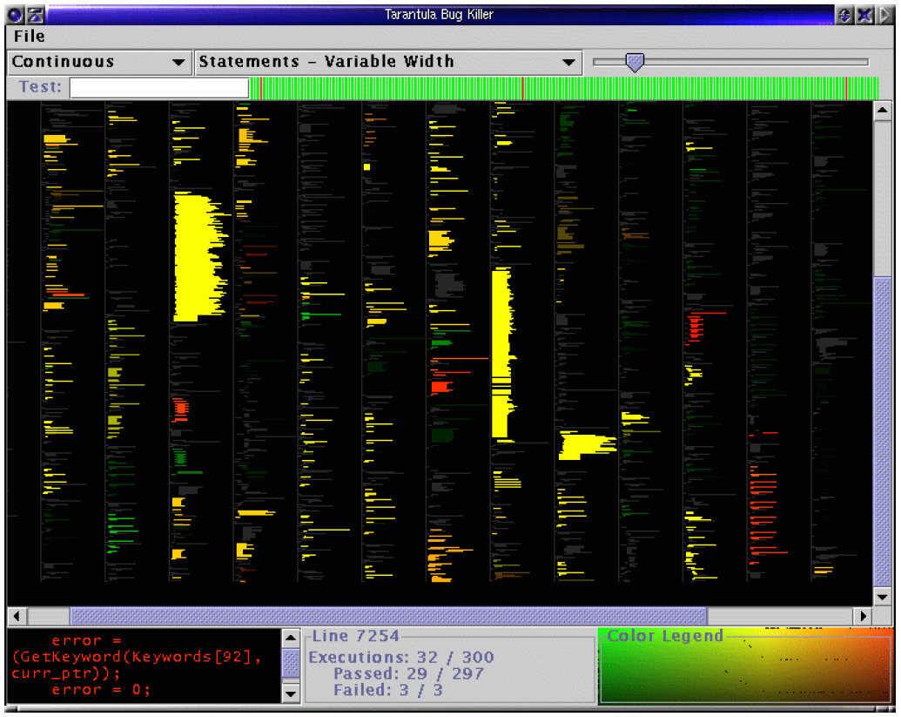

Statistical Debugging

Slide 26

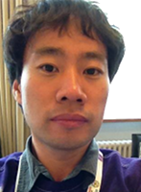


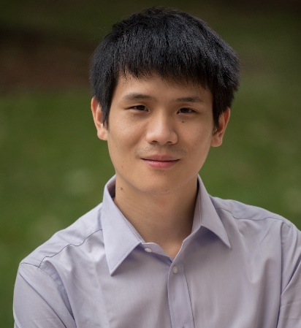
Automatic program repair
if (tcl == null) {
cd=…;
} else{
….
}
operator
fault location
mutation
Westley Weimer
Sung Kim
selection
if (tcl == null) {
cd=…;
} else if (…){
….
}
Automatic
Fixing unknown bugs
Martin Monperrus
Fan Long

Slide 27
Controversy
Le Goues, Claire, Michael Dewey-Vogt, Stephanie Forrest, and Westley Weimer. "A systematic study of automated program repair: Fixing 55 out of 105 bugs for $8 each." In Proc. ICSE, pp. 3-13. 2012.
Monperrus, Martin. "A critical review of automatic patch generation learned from human-written patches: essay on the problem statement and the evaluation of automatic software repair." In Proc. ICSE, pp. 234-242. 2014.
Qi, Yuhua, Xiaoguang Mao, Yan Lei, Ziying Dai, and Chengsong Wang. "The strength of random search on automated program repair." In Proc. ISSTA, pp. 254-265. 2014.
Qi, Zichao, Fan Long, Sara Achour, and Martin Rinard. “An analysis of patch plausibility and correctness for generate-and-validate patch generation systems.” In Proc. ISSTA, pp. 24-36. 2015.

Slide 28
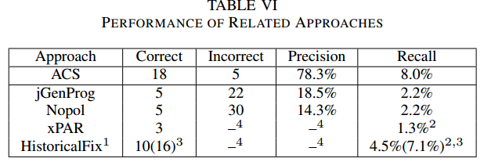
State of the art

Slide 29
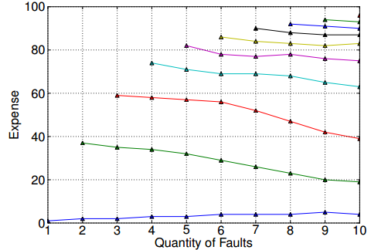
The limitation of fault localization
Nicholas DiGiuseppe and James A Jones. 2011. On the influence of multiple faults on coverage-based fault localization. In Proc. ISSTA. 210–220

Slide 30
Debugging -Testing
Sometimes the inputs is too complex
Quite common in real world (compiler, office, browser, database, OS, …)
Locate the relevant inputs
Some bugs are difficult to locate
Spectra-based fault localization
Automatic program repair
Some tests are flaky

Slide 31
Flakey tests
Definition
Same code revision, same input and configuration => Passes/fails non-deterministically
Search commit logs of all 151 Apache projects for “flak” and “intermit” keywords
1129 commit messages
Manually label likely distinct fixed flaky tests =>486 fixed flaky tests
Sample and inspect 161 commits in more detail
Luo, Q., Hariri, F., Eloussi, L. and Marinov, D., 2014, November. An empirical analysis of flaky tests. In Proceedings of the 22nd ACM SIGSOFT International Symposium on Foundations of Software Engineering (pp. 643-653). ACM.

Slide 32
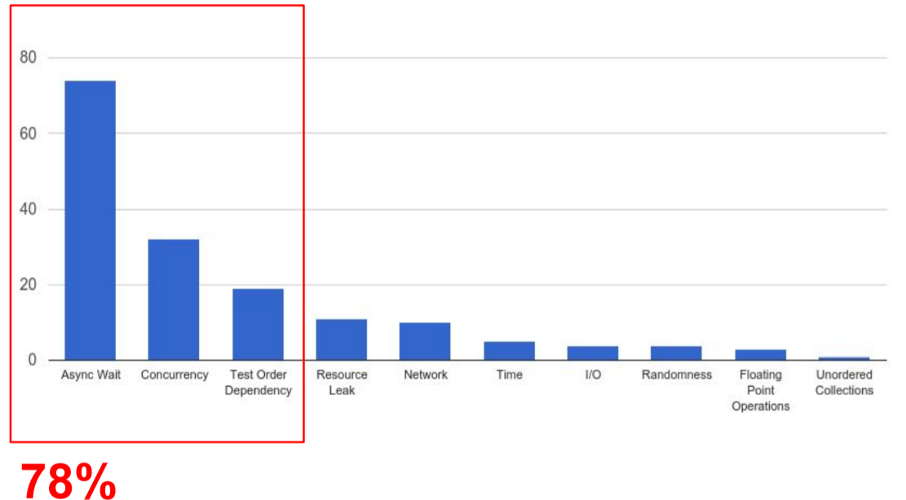
What are the root causes?

Slide 33
How are flaky tests introduced?
Most (126 out of 161) flaky tests are flaky the first time they are written
Flakiness is later introduced when:
A new test introduces dependency on old tests
Patching a bug/refactoring/adding new functionality
Thorve, Swapna, Chandani Sreshtha, and Na Meng. "An empirical study of flaky tests in android apps." 2018 IEEE International Conference on Software Maintenance and Evolution (ICSME). IEEE, 2018.
Bell, Jonathan, et al. "DeFlaker: Automatically detecting flaky tests." 2018 IEEE/ACM 40th International Conference on Software Engineering (ICSE). IEEE, 2018.
When vs How

Slide 34
Debugging-Static analysis
Some bugs are expensive to produce
Network, big data, database…
Stub, Faked object
Some bugs are not easy to check
More than return values
Mock

Slide 35
Test Stubs
Provide a fix value or fixed behavior for a certain method invocation
Always return 0 for a integer method
Do nothing for a void method
The value or behavior is hard coded in the Stub Class
public class OrderTest{
@Test
public void test(){
Order o = new order(new ShopStub());
o.add(1122, 3);
...
AssertEquals(expect, o.getTotal());
o.save();
}
}
public class ShopStub extends Shop{
public void save(Order o){
}
public double getShopDiscount(){
return 0.9;
}
}

Slide 36
Configurable Test Stubs
You may set different values for different test cases
public class ShopStub extends Shop{
private Exception saveExc;
private discount;
public setException(Exception e){
this.saveExc = e;
}
public setDicount(Float f){
this.discount = f;
}
public void save(Order o){
if(this.saveExc!=null){throw saveExc;}
}
public double getShopDiscount(){
return this.discount;
}
}
public class OrderTest{
@Test
public void testAbnormalDiscount(){
ShopStub stub = new ShopStub();
stub.setDiscount(1.1);
Order o = new order(stub);
o.add(1122, 3);
...
AssertEquals(expect, o.getTotal());
o.save();
}
}

Slide 37
Fake Objects
More powerful than stubs
A simplified implementation of the DOC
Example: a data table to fake a database
Example: use a greed algorithm to fake a complex optimized algorithm
Guidelines
Slow -> Fast
Complex -> Simple

Slide 38
Fake Objects
Need to double
Difficult to reproduce
Maybe slow
Affected by lots of factors
Tips for fake objects
As simple as possible (as long as not too time-consuming)
Go to a higher level if some object is hard to fake
URLStatus sts = HttpConnection.open("http://api.dropbox.com/files/myfile");
if(sts.status == 200){
return sts.data;
}else{
return “Error”;
}
public class FakeDropBoxApi{
private files = { };
public FakeUrlStatus read(fname){
if(files.contain(fname)){
return FakeUrlStatus(200, files[fname]);
}else{
return FakeUrlStatus(-1, "Error");
}
}
}
FakeURLStatus sts = FakeDropBoxApi.read("myfile");
if(sts.status == 200){
…

Slide 39
Debugging-Static analysis
Some bugs are expensive to produce
Network, big data, database…
Stub, Faked object
Some bugs are not easy to check
More than return values
Mock

Slide 40
Oracle Types
Value Oracle
The value (s) of one or several variable (s) must satisfy a certain constraint
Temporal oracle
Two events (or a series of events) must (not) happen in a certain order
Specification
lock() → unlock()
file.open() → file.close() and file.open() → file.read()
Bug signature
file.close() → file.read()
Final Exam Score <= 100
sortedlist(0) >= sortedlist(1)
http_url.startsWith(“http”)

Slide 41
Mock objects
Mock objects do behavior-based testing
Usually we only check return values or status
AssertEquals (expected, actual);
AssertEquals (expected, array.length);
Can we do something like this? Why?
Assert ( testObject.f1 calls DOC.f)
public class OrderTest{
@Test
public void test(){
Order o = new order(new ShopStub());
o.add(1122, 3);
...
AssertEquals(expect, o.getTotal());
o.save();
}
}
public class ShopStub extends Shop{
public void save(Order o){
}
public double getShopDiscount(){
return 0.9;
}
}
Problems???

Slide 42
Mock objects
@Test
public void testOrder() {
//initialize
Shop sp = EasyMock.CreateMock(Shop.class);
Order o = new Order(sp);
o.add(1234, 1);
o.add(4321, 3);
//record
EasyMock.expect(sp.getDiscount()).andReturn(0.9);
sp.save(o);
EasyMock.expectLastCall();
//replay
EasyMock.replay(sp);
AssertEquals(expect, o.getTotal());
o.Save();
EasyMock.verify(sp)
}
EasyMock

Slide 43
Mock objects
Verifies whether the expected methods are actually invoked
Exception: missing, expected save(0xaaaa)
Verifies whether the expected methods are invoked in an expected way
Exception: save(null) expected save(0xaaaa)
More details
isA: ignore the value of argument
EasyMock.expect(sp.save(isA(Order.class)))
find: expect the argument to contain a certain substring
EasyMock.expect(mock.call(find(“pattern”)))
Geq: expect a number larger than the given value
EasyMock.expect(mock.call(Geq(1000)))

Slide 44
Mock objects
Record phase:
Read expectation as specifications
Instead of directly generating code, the mock object generates an internal presentation, e.g. Automaton
Replay phase:
Check the real invocations
with the internal presentation

Slide 45
This class
Debugging
Debugging-Testing
Inputs are too complex
Bugs are not located
Flaky tests
Debugging-Static analysis
How to trigger a bug
How to check a bug

Slide 46

Next class
Project manager

