Slide 1
Controlled Experiment
Hao Zhong
Shanghai Jiao Tong University

Slide 2
Controlled experiment
A controlled experiment is one in which everything is held constant except for one variable or one treatment.
A set of data/subjects is taken to be two groups
normal or usual state,
one or more other groups are examined where all conditions are identical to the control group and to each other except for one variable.

Slide 3
Variable vs Treatment
A problem can be considered as f(x, ….) = y, change x to see its impacts on y
The same algorithm
Two sets of data
Observe the performance
A problem can be considered as f(x, ….) = y, change f to see its impacts on y
Two sort algorithms
The same set of data
Observe the performance

Slide 4
The problems of variable
What if a variable introduces bias?

Slide 5
The problems of variable
What if a variable introduces bias?
Human

Slide 6
The problems of variable
What if a variable introduces bias?
Human
What if a variable is random?

Slide 7
The problems of variable
What if a variable introduces bias?
Human
What if a variable is random?
Weather prediction

Slide 8
The problems of variable
What if a variable introduces bias?
Human
What if a variable is random?
Weather prediction
What if a variable cannot be aligned?

Slide 9
The problems of variable
What if a variable introduces bias?
Human
What if a variable is random?
Weather prediction
What if a variable cannot be aligned?

Slide 10
The problems of variable
What if a variable introduces bias?
Human
What if a variable is random?
Weather prediction
What if a variable cannot be aligned?
f(x, y) vs f(x)
f(x) vs f(y)

Slide 11
The problems of variable
What if a variable introduces bias?
Human
What if a variable is random?
Weather prediction
What if a variable cannot be aligned?
f(x, y) vs f(x)
f(x) vs f(y)
What if a variable is too expensive?

Slide 12
The problems of variable
What if a variable introduces bias?
Human
What if a variable is random?
Weather prediction
What if a variable cannot be aligned?
f(x, y) vs f(x)
f(x) vs f(y)
What if a variable is too expensive?
Human
Hardware

Slide 13
The problems of outputs
What if an output is random?

Slide 14
The problems of outputs
What if an output is random?
Weather prediction

Slide 15
The problems of outputs
What if an output is random?
Weather prediction
What if an output is too expensive?

Slide 16
The problems of outputs
What if an output is random?
Weather prediction
What if an output is too expensive?
Time
Human life

Slide 17
The problems of outputs
What if an output is random?
Weather prediction
What if an output is too expensive?
Time
Human life
What if two outputs cannot be compared?

Slide 18
The problems of outputs
What if an output is random?
Weather prediction
What if an output is too expensive?
Time
Human life
What if two outputs cannot be compared?
Social impact
Human feedback

Slide 19
Example 1
Hao Zhong, Lu Zhang, and Hong Mei. An experimental study of four typical test suite reduction techniques. Information and software technology 50(6) 534-546, 2008.
Test suite reduction
My first journal paper

Slide 20
Problem definition
 | req 1 | req 2 | … | req 3
test 1 | 1 | 0 | … | …
test 2 | 0 | 1 | … | …
… | … | … | … | …
test n | … | … | … | …
 | req 1 | req 2 | … | req 3
test 1 | 1 | 0 | … | …
test 2 | 0 | 1 | … | …
… | … | … | … | …
test m | … | … | … | …
vs
n>m

Slide 21
Existing approaches
Greedy:
M.J. Harrold, R. Gupta, M.L. Soffa, A methodology for controlling the size of a test suite, ACM Transactions on Software Engineering and Methodology 2 (3) (1993) 270–285
T.Y. Chen, M. Lau, A new heuristic for test suite reduction, Information and Software Technology 40 (5-6) (1998) 347–354.
Genetic algorithm:
N. Mansour, K. El-Fakih, Simulated annealing and genetic algorithms for optimal regression testing, Journal of Software Maintenance 11 (1) (1999) 19–34
ILP:
J. Black, E. Melachrinoudis, D. Kaeli, Bi-criteria models for all-uses test suite reduction, in: Proceedings of 26th International Conference on Software Engineering, IEEE Computer Society, Washington,DC, USA, 2004, pp. 106–115

Slide 22
The variable
 | req 1 | req 2 | … | req 3
test 1 | 1 | 0 | … | …
test 2 | 0 | 1 | … | …
… | … | … | … | …
test n | … | … | … | …
Random->Real

Slide 23
The variable
 | req 1 | req 2 | … | req 3
test 1 | 1 | 0 | … | …
test 2 | 0 | 1 | … | …
… | … | … | … | …
test n | … | … | … | …
A problem can be considered as f(x, ….) = y, change f to see its impacts on y
The same algorithm
Two sets of data
Observe the performance
Random->Real

Slide 24
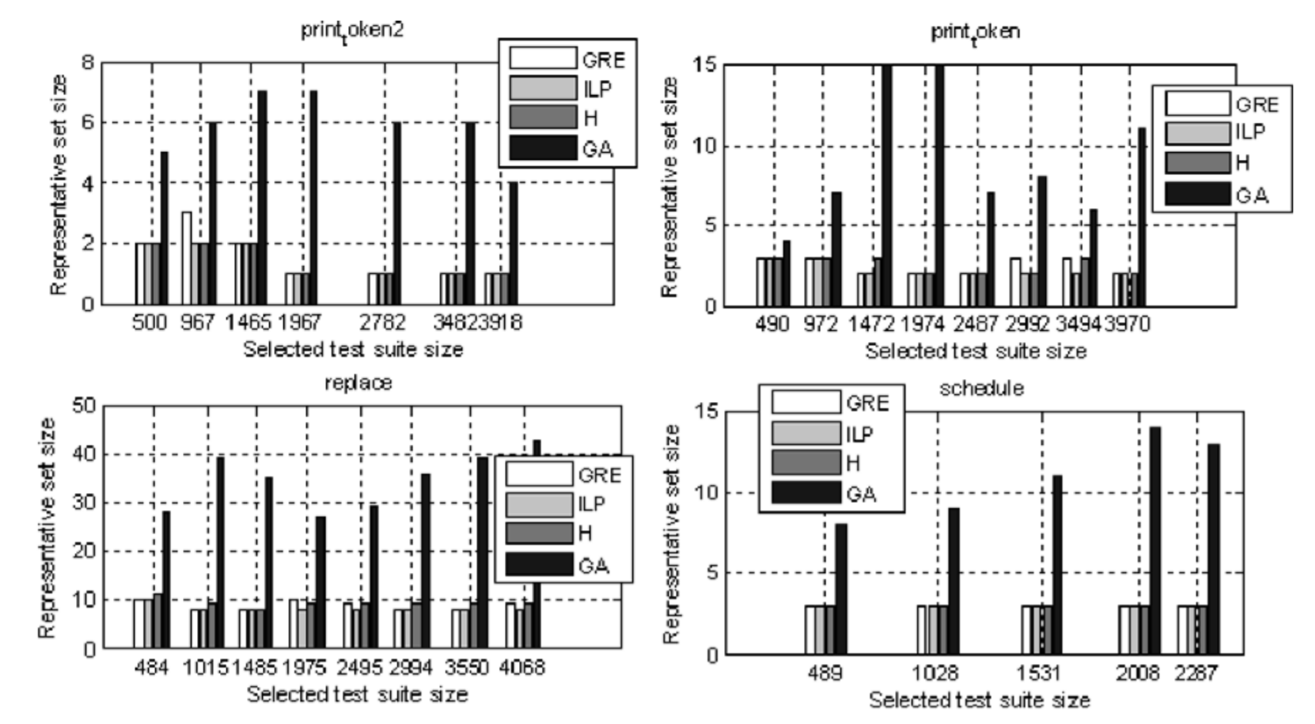
The results

Slide 25
Example 2
Hao Zhong, Tao Xie, Lu Zhang, Jian Pei, and Hong Mei. MAPO: Mining and recommending API usage patterns. In Proc. European Conference on Object-Oriented Programming (ECOOP), pages 318-343, 2009.

Slide 26
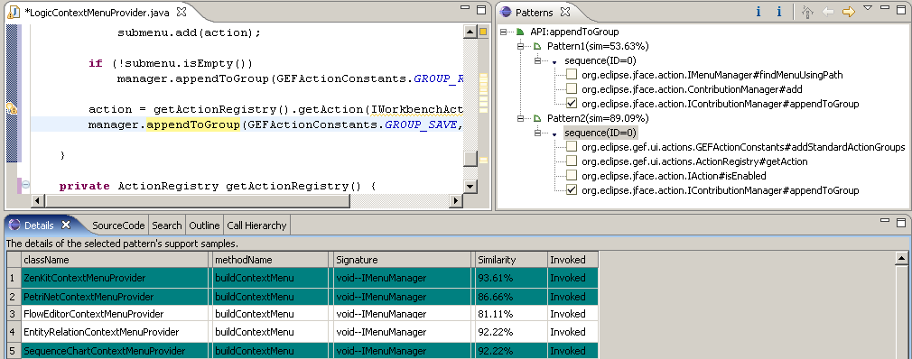
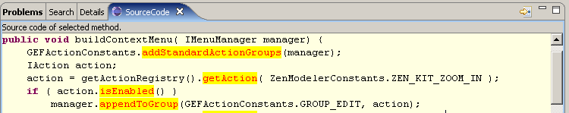
API usage recommendation
Pattern
Pattern rank
Clicked sequence
API of interest
Clicked sequence
Contexts of methods
Whether the API is invoked in this sample
Similarity to the current programming context
Click
Methods with the clicked sequence
Highlighted with background color
Methods without the clicked sequence

Slide 27
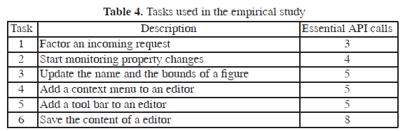
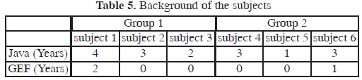
Experiment

Slide 28
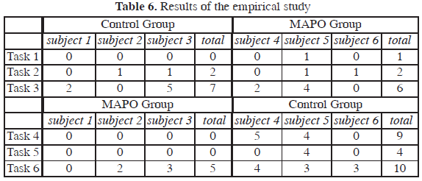
Experiment

