Slide 1
Evaluation
Hao Zhong
Shanghai Jiao Tong University

Slide 2



Local slangs
Experiment
Evaluation
Experiment

Slide 3
Evaluation vs Controlled experiment
A problem can be considered as f(x, ….) = y, change f to see its impacts on y
Two algorithms
The same set of data
Observe the performance/effectiveness
What if you are the first one to propose an approach?
What if there is no baseline?

Slide 4
The purpose of evaluations
Show the effectiveness of your approach

Slide 5
The purpose of evaluations
Show the effectiveness of your approach
To what degree can your approach solve your target problem?

Slide 6
The purpose of evaluations
Show the effectiveness of your approach
To what degree can your approach solve your target problem?
How to do that?

Slide 7
The purpose of evaluations
Show the effectiveness of your approach
To what degree can your approach solve your target problem?
How to do that?
Real data vs simulated data?

Slide 8
The purpose of evaluations
Show the effectiveness of your approach
To what degree can your approach solve your target problem?
How to do that?
Real data vs simulated data?
Measure?

Slide 9
The purpose of evaluations
Show the effectiveness of your approach
To what degree can your approach solve your target problem?
How to do that?
Real data vs simulated data?
Measure?
Human feedbacks?

Slide 10
The purpose of evaluations
Show the effectiveness of your approach
To what degree can your approach solve your target problem?
How to do that?
Real data vs simulated data?
Measure?
Human feedbacks?
Show the impacts of your internal techniques

Slide 11
The purpose of evaluations
Show the effectiveness of your approach
To what degree can your approach solve your target problem?
How to do that?
Real data vs simulated data?
Measure?
Human feedbacks?
Show the impacts of your internal techniques
To understand which steps or technical details matter.

Slide 12
The purpose of evaluations
Show the effectiveness of your approach
To what degree can your approach solve your target problem?
How to do that?
Real data vs simulated data?
Measure?
Human feedbacks?
Show the impacts of your internal techniques
To understand which steps or technical details matter.
To build your theory.

Slide 13
The purpose of evaluations
Show the effectiveness of your approach
To what degree can your approach solve your target problem?
How to do that?
Real data vs simulated data?
Measure?
Human feedbacks?
Show the impacts of your internal techniques
To understand which steps or technical details matter.
To build your theory.

Slide 14
The purpose of evaluations
Show the effectiveness of your approach
To what degree can your approach solve your target problem?
How to do that?
Real data vs simulated data?
Measure?
Human feedbacks?
Show the impacts of your internal techniques
To understand which steps or technical details matter.
To build your theory.
Turn off and on your internal techniques

Slide 15
The purpose of evaluations
Show the effectiveness of your approach
To what degree can your approach solve your target problem?
How to do that?
Real data vs simulated data?
Measure?
Human feedbacks?
Show the impacts of your internal techniques
To understand which steps or technical details matter.
To build your theory.
Turn off and on your internal techniques
What are your ideas?

Slide 16


Controlled Experiment vs Evaluation
Performance
The correctness and potential of a direction are much more important than its performance!!

Slide 17
How good is enough?
Hao Zhong, Xiaoyin Wang, and Hong Mei. Inferring bug signatures to detect real bugs. IEEE Transaction on Software Engineering, pages to appear, 2020.
O. Legunsen, W. U. Hassan, X. Xu, G. Ros¸u, and D. Marinov. How good are the specs? a study of the bug-finding effectiveness of existing Java API specifications. In Proc. ASE, pages 602–613, 2016.
F. Pendlebury, F. Pierazzi, R. Jordaney, J. Kinder, and L. Cavallaro. T ESSERACT: Eliminating experimental bias in malware classification across space and time. In Proc. USENIX Security, pages 729–746, 2019

Slide 18



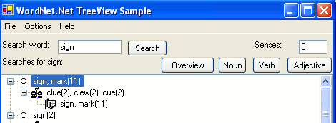
Example
Zhong, Hao, Suresh Thummalapenta, Tao Xie, Lu Zhang, and Qing Wang. "Mining API mapping for language migration." In Proceedings of the 32nd ACM/IEEE International Conference on Software Engineering-Volume 1, pp. 195-204. 2010.

Slide 19
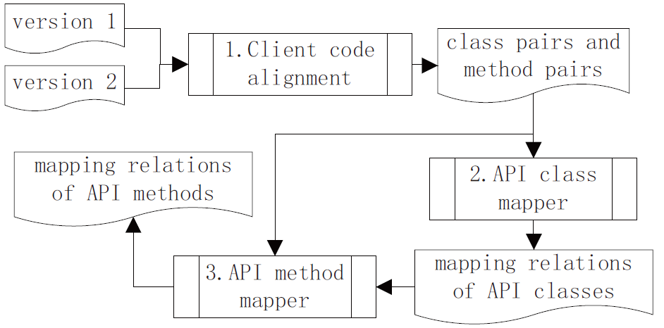
Approach

Slide 20
Approach
“index”:System.String
Step1
Line 11
filename:System.String
“index”:java.lang.String
System.IO.FileInfo.FileInfo()
Step2
arg0:java.lang.String
null: System.IO.FileInfo
java.io.File.File()
Line 6
INDEX_DIR:
System.IO.FileInfo
INDEX_DIR:
System.IO.FileInfo
null:java.io.File
receiver:
System.IO.FileInfo
receiver:
System.IO.FileInfo
INDEX_DIR:java.io.File
System.IO.FileInfo.getFullFile()
System.IO.FileInfo.getFullFile()
receiver :
java.io.File
receiver :
java.io.File
Line 14
null:System.String
Line 17
null:System.String
java.io.File.exists()
Line 8
java.io.File.delete()
Line 9
path:System.String
path:System.String
Step4
null:boolean
System.IO.File.Exists()
Step4
System.IO.Directory.Exists()
null:boolean
null:System.Boolean
null:System.Boolean
Step3
Step3
Step3
(b)
(a)
mapping functionalities

Slide 21
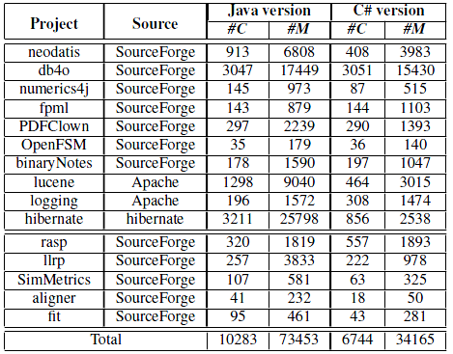
Evaluation
Mining API mapping.
RQ1: How effectively can our approach mine various API mapping relations?
Language migration.
RQ2: How much benefit can the mined API mapping relations offer in aiding language
translation?

Slide 22
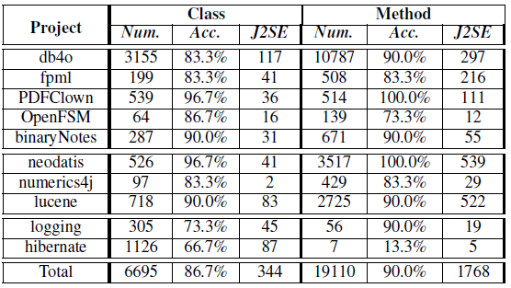
Evaluation
RQ1: How effectively can our approach mine various API mapping relations?
Num.: the numbers of mined mapping relations
Acc.: accuracies of the first 30 mined API mapping relations
(i.e., percentages of correct mapping relations).
J2SE: the number of mined API mapping relations between J2SE APIs and .NET framework APIs
Our approach mines a large number of API mapping relations.
Our approach achieves high accuracies, except for the hibernate library.

Slide 23
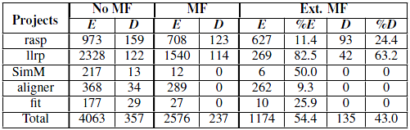
Evaluation
RQ2: How much benefit can the mined API mapping relations offer in aiding language translation?
No MF: Without mapping files
MF: With default mapping files
Ext. MF: With mined and default mapping files
The mined API mapping relations help effectively reduce compilation errors and API related defects in the translated projects.

