Slide 1
Empirical study - in its narrow meaning
Hao Zhong
Shanghai Jiao Tong University

Slide 2
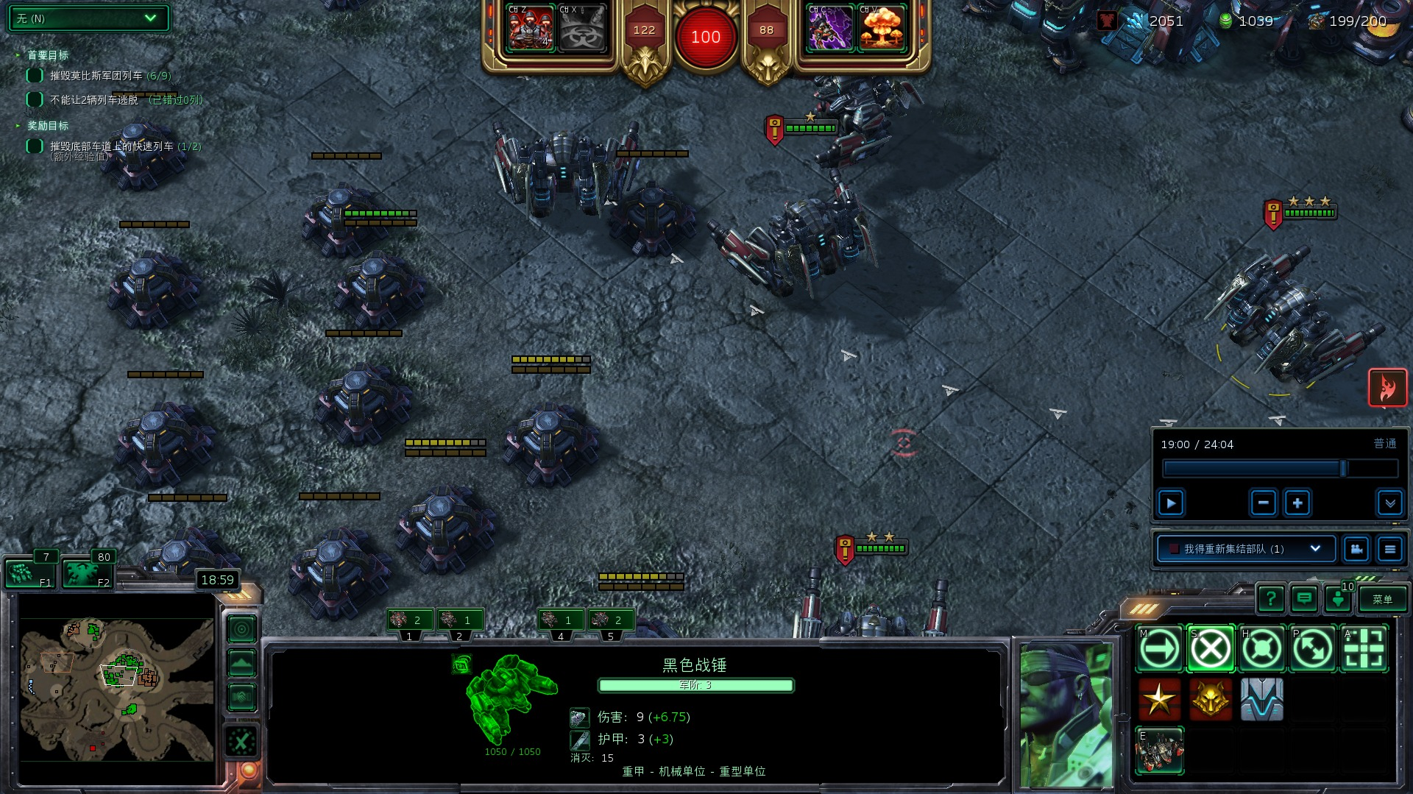
Empirical study

Slide 3
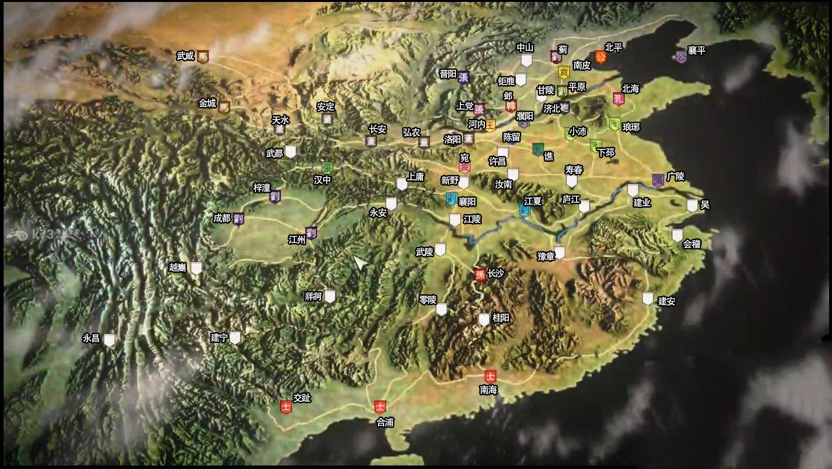
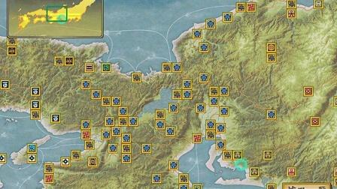
The purpose of empirical study
Where are golds and where are pitfalls?
To motivate the follow-up work
Software engineering
Some other research fields

Slide 4
What to analyze?
Source files

Slide 5
What to analyze?
Source files
Evolution data

Slide 6
What to analyze?
Source files
Evolution data
Documents

Slide 7
What to analyze?
Source files
Evolution data
Documents
…

Slide 8
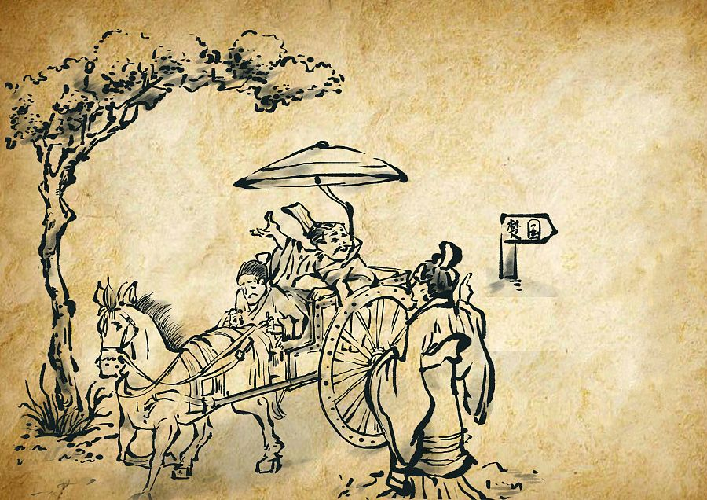
Why shall I do that?

Slide 9
Why shall I do that?
Your research questions!!
Why are they interesting?
Why are they important?
…

Slide 10
How to analyze?
Automatic

Slide 11
How to analyze?
Automatic
Manual

Slide 12
How to analyze?
Automatic
Manual
Semi-automatic

Slide 13
Your answers and your findings
What do you observe?

Slide 14
Your answers and your findings
What do you observe?
Statistic analysis

Slide 15
Example 1
Hao Zhong, Na Meng, Zexuan Li, and Li Jia. An empirical study on API parameter rules. In Proc. International Conference on Software Engineering (ICSE), pages to appear, 2020.
Automatic
API code and documents
API parameter rules

Slide 16
API parameter rules in documents
public static TopFieldDocs nearest(IndexSearcher searcher, String field, double latitude, double longitude, int n) throws IOException
Finds the n nearest indexed points to the provided point, according to Haversine distance.
This is functionally equivalent to running MatchAllDocsQuery with a LatLonDocValuesField.newDistanceSort(java.lang.String, double, double), but is far more efficient since it takes advantage of properties the indexed BKD tree. Currently this only works with Lucene60PointsFormat (used by the default codec). Multi-valued fields are currently not de-duplicated, so if a document had multiple instances of the specified field that make it into the top n, that document will appear more than once.
Documents are ordered by ascending distance from the location. The value returned in FieldDoc for the hits contains a Double instance with the distance in meters.
Parameters:
searcher - IndexSearcher to find nearest points from.
field - field name. must not be null.
latitude - latitude at the center: must be within standard +/-90 coordinate bounds.
longitude - longitude at the center: must be within standard +/-180 coordinate bounds.
n - the number of nearest neighbors to retrieve.
Returns:
TopFieldDocs containing documents ordered by distance, where the field value for each FieldDoc is the distance in meters
Throws:
IllegalArgumentException - if the underlying PointValues is not a Lucene60PointsReader (this is a current limitation), or if field or searcher is null, or if latitude, longitude or n are out-of-bounds
IOException - if an IOException occurs while finding the points.
Parameter rule: must not be null
Parameter rule: must be within standard +/- 90 coordinate bounds
https://lucene.apache.org/core/6_2_0/sandbox/org/apache/lucene/document/LatLonPoint.html

Slide 17
API parameter rules in code
public static TopFieldDocs nearest(IndexSearcher searcher, String field, double latitude, double longitude, int n) throws IOException {
GeoUtils.checkLatitude(latitude);
GeoUtils.checkLongitude(longitude);
if (n < 1) {
throw new IllegalArgumentException("n must be at least 1; got " + n);
}
if (field == null) {
throw new IllegalArgumentException("field must not be null");
}
if (searcher == null) {
throw new IllegalArgumentException("searcher must not be null");
}…
}
Parameter rule: must be at least 1
Parameter rule: must not be null

Slide 18
Tool- Document analysis
Identifying document rules
Parsing sentences with the Stanford parser.
The sentence uses at least one modal verb
must, shall, should, can, may
The modal verb does not appear in sub-clauses
root escher container from which escher records must be taken
Not rules
nsubj
compound
neg
det
aux
dobj
The
base
URL
must
not
contain
parameters
DT
NN
NN
MD
RB
VB
NNS

Slide 19
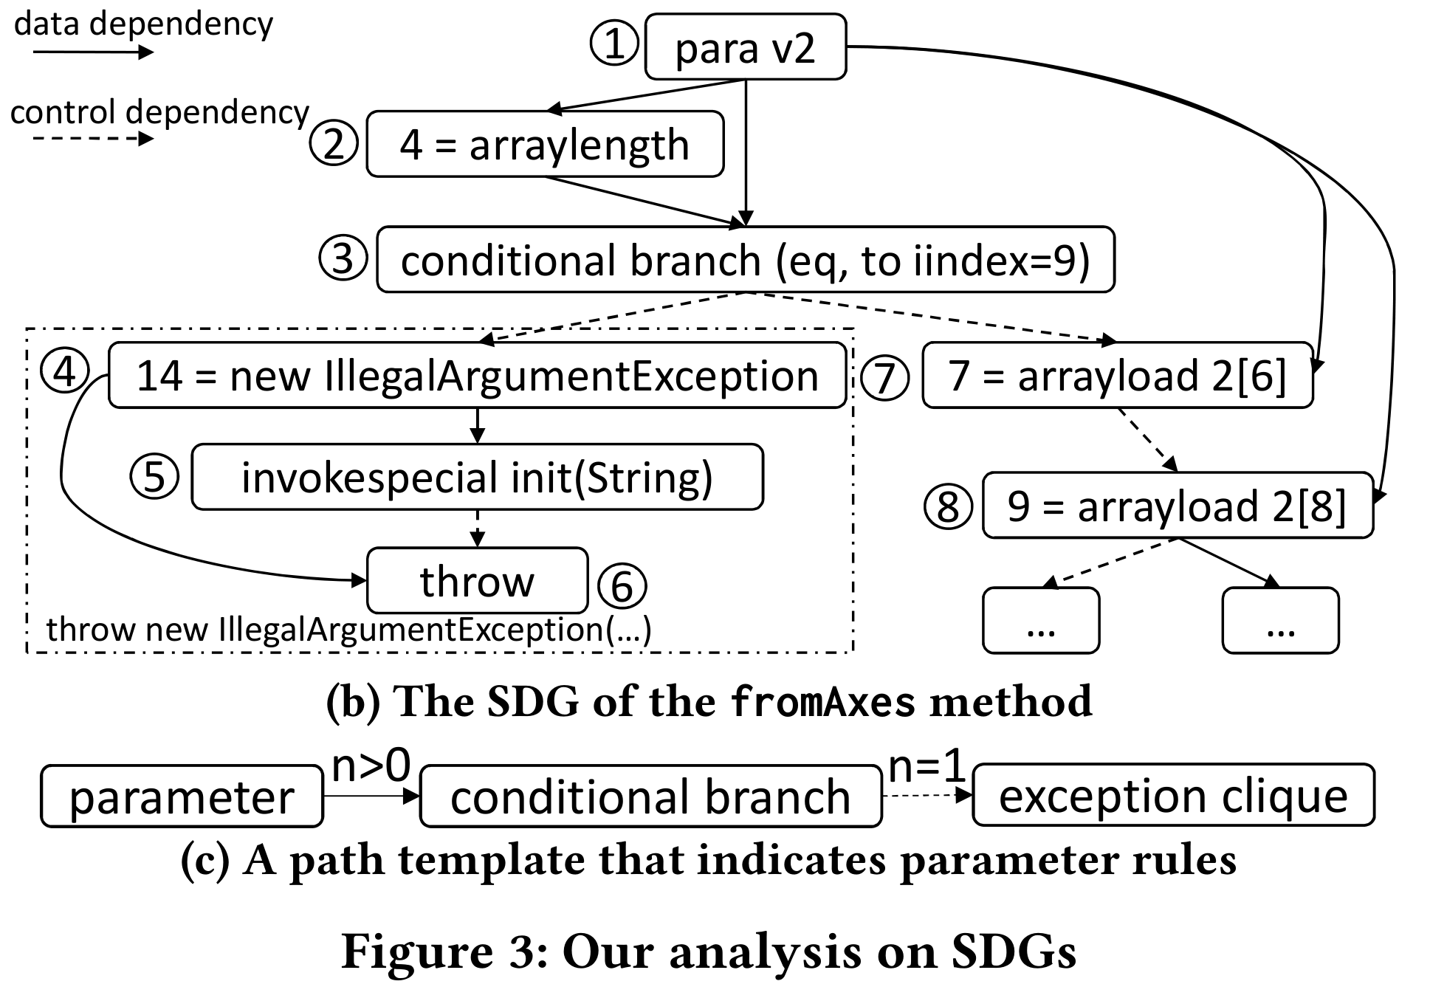
Tool- Code analysis
Identifying code rules
Building SDGs with WALA.
Exceptions are thrown when parameters meet some criteria
Assertations on parameters.

Slide 20
Tool- Effectiveness
Setting
Two Phd students manually identified the parameter rules of 20 source files from 9 projects.
20X9 = 180 files are manually inspected.
Name | Precision | Recall | F-score
commons-io | 98.00% | 94.20% | 96.10%
pdfbox | 92.90% | 88.10% | 90.40%
shiro | 95.50% | 96.90% | 96.20%
itext | 89.90% | 94.70% | 92.20%
poi | 98.80% | 96.40% | 95.20%
jfreechart | 95.30% | 83.60% | 89.10%
lucene | 85.20% | 100.00% | 92.00%
asm | 98.90% | 96.90% | 97.90%
jmonkey | 93.80% | 88.40% | 91.00%

Slide 21
One of our findings
Finding 3. In total, 86.2% of parameters have only code rules, and 10.3% of parameters have only document rules.

Slide 22
Example 2
Daohan Song, Hao Zhong, and Li Jia. The symptom, cause and repair of workaround. In Proc. International Conference on Automated Software Engineering (ASE), late result track, pages to appear, 2020.
Manual
Workaround

Slide 23
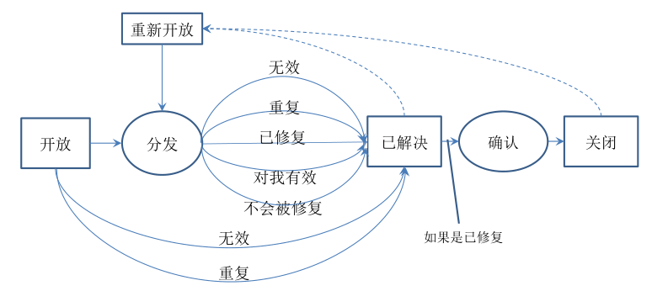
The standard process

Slide 24
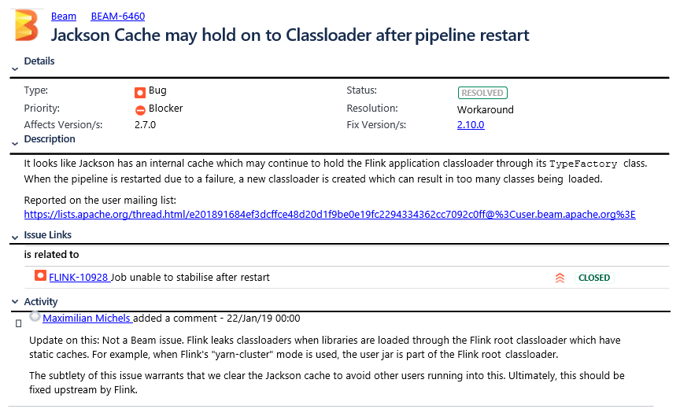
Workaround
变通

Slide 25
Motivation
Lamothe and Shang. When APIs are Intentionally Bypassed: An Exploratory Study of API Workarounds. ICSE 2020
模式一 功能扩展：用户扩展接口现有的行为，为该接口添加其尚不具备的功能，或修改某接口的现有的行为以符合他们的需求。
模式二 深度拷贝：用户复制接口的数据，以在本地使用一个自定义的该接口的副本，而不是直接使用该接口。
模式三 多版本：用户使用两个或多个版本的接口，来解决缺陷或引入只在某单独的版本中存在的功能。
模式四 不必要的变通
只分析了对软件库的变通，只分析了40个，只归纳了4种软件库的变通模式
分析一般意义的变通，分析更多的变通

Slide 26
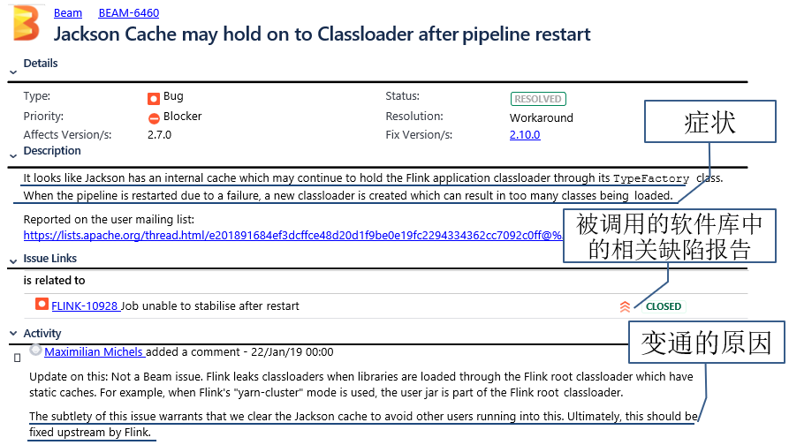
How to analyze?

Slide 27
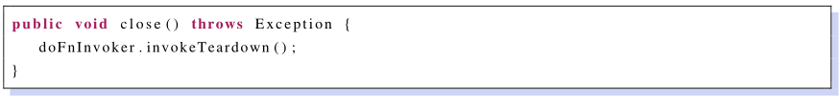
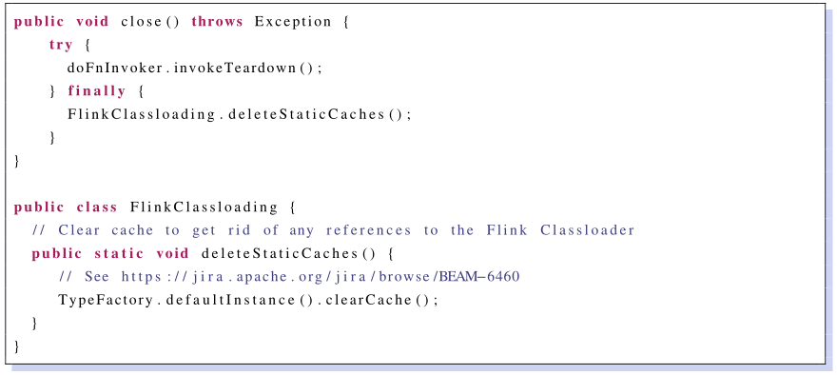
How to analyze?
一处有缺陷的代码：
修复后的代码：

Slide 28
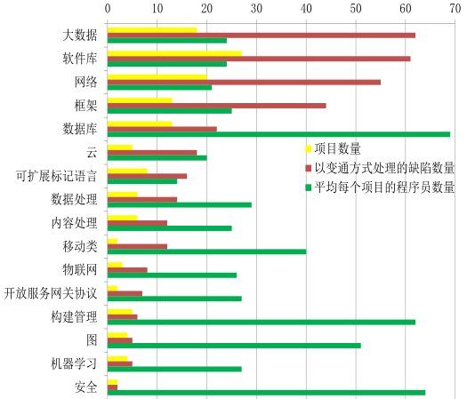
Dataset
从事务跟踪系统中搜索所有类型为缺陷且处理方式为变通的事务报告。且缺陷报告的状态必须是已解决的或关闭的。共收集了来源于88个项目的221份以变通方式处理的缺陷报告。

Slide 29
主要结论
问题一. 什么症状的缺陷会以变通方式修复？
症状为崩溃 (41.18%) 和非预期行为 (31.67%) 的缺陷报告以变通的方式修复。
问题二. 为什么缺陷会以变通的方式处理？
发现四表明，大多数缺陷报告之所以采用变通的方式修复，是因为它们的问题存在于多个项目间 (38.01%) 或存在于运行环境中 (21.27%)。
发现三表明虽然有一些变通的问题 (37.56%) 存在于被报告的项目中，但它们很难完全和完美地修复。
发现二表明有一些缺陷报告 (9.50%) 被标记为变通是因为它们的问题已经解决。

Slide 30
主要结论
问题三. 如何以变通的方式修复缺陷？
发现七表明大多数变通 (42.99%) 修改了项目之间的接口，比如切换软件库的版本，或更改调用接口的方式。
发现六表明，当变通的修改发生在报告缺陷的项目内部，除了修改配置文件等非源代码文件，对源代码的修改通常属于技术债务。
发现五表明少量变通没有产生任何修改，这是因为两个完全相反的原因造成的：已被修复，则不会被修改。
问题四. 变通的症状、原因和修复之间的相关性如何？
体现了变通的内在逻辑，比如客户代码问题常常通过修改接口调用方式解决。

Slide 31
问题二 原因
1. 已修复的问题
2. 项目内问题
3. 项目间问题
4. 环境问题

Slide 32
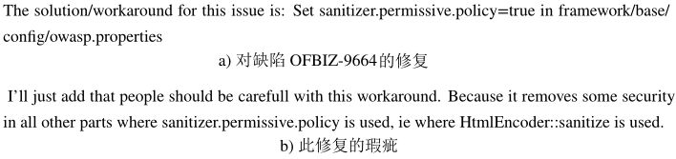

原因2. 项目内问题
不能完全或完美地修复项目内的一些问题时，只好采用变通的方式解决。
例如，一份OFBiz的缺陷报告 [6] 抱怨一些信息不能显示在用户界面上。报告者随后指出，通过将sanitizer.permissive.policy 的值设置为true，可以解决该问题。但是这种解决方法是有问题的，因为它造成了安全隐患。
[5] Automating change-level self-admitted technical debt determination. TSE 2018
[6] https://issues.apache.org/jira/browse/OFBIZ-9664

Slide 33
评分标准
递进式的项目
比较的方法是否具有代表性
讲清楚所提方法与已有方法的区别
讲清楚所提方法为何可以提升已有方法
实验设计合理
实验结果能够支持之前的解释

Slide 34
评分标准
新颖的项目
讲清楚问题的重要性和相关性
讲清楚与软件工程的关系
解释为何别人未注意到这个问题
验证设计合理
结果表明能在一定程度上解决提出的问题

Slide 35
评分标准
经验分析的项目
讲清楚问题的重要性和相关性
讲清楚与软件工程的关系
讲清楚之前有无类似的分析
分析数据合理
结果表明能在一定程度上回答提出的问题
如有之前的分析
需讲清楚与你的工作的关系
有无新的发现

