Slide 1
Questionnaire and interview
Hao Zhong
Shanghai Jiao Tong University

Slide 2

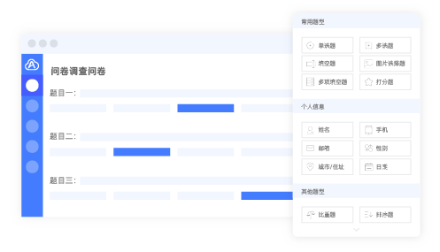

Questionnaire and interview

Slide 3
Why to conduct?

Slide 4
Why to conduct?
Software is developed by people and used by people.
Feedbacks from professionals.
Feedbacks from users.

Slide 5
Why to conduct?
Software is developed by people and used by people.
Feedbacks from professionals.
Feedbacks from users.
To verify your findings
Whether practitioners agree your findings?
Why?

Slide 6
Pinpoint your target demographic
What are their backgrounds?

Slide 7
Pinpoint your target demographic
What are their backgrounds?
Are they representative?

Slide 8
Pinpoint your target demographic
What are their backgrounds?
Are they representative?
Sample size?

Slide 9
Pinpoint your target demographic
What are their backgrounds?
Are they representative?
Sample size?
Do they have the professional knowledge to answer the questions?

Slide 10
Pinpoint your target demographic
What are their backgrounds?
Are they representative?
Sample size?
Do they have the professional knowledge to answer the questions?
Are they biased?

Slide 11
How to analyze the results
Bar graph, pie graph, …
Statistics

Slide 12
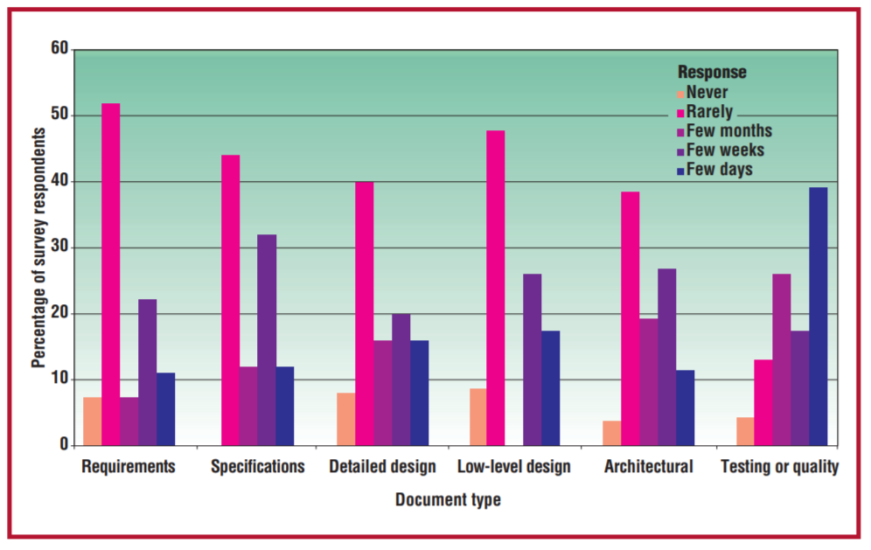
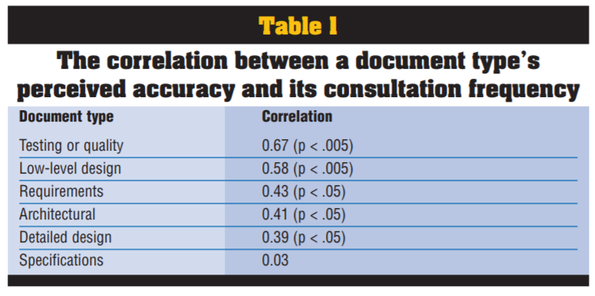
Example
Lethbridge, Timothy C., Janice Singer, and Andrew Forward. "How software engineers use documentation: The state of the practice." IEEE software 20, no. 6 (2003): 35-39.
The first study consisted of interviews at 12 corporate sites and one government site. …The interview questionnaire (see wwwsel.iit.nrc. ca/~singer/main.html) had three parts: background information, task analysis, and tools wish list. The sidebar lists some of the interviewees’ assessments of documentation.
We conducted the second study at a large telecommunications company. It involved software engineers maintaining and enhancing a large, profitable telecommunications system written in a proprietary high-level language.
The final study comprised a 50-question survey that focused on many documentation aspects.

Slide 13
Example
Nischal Shrestha, Colton BottaNorth, Titus BarikMicrosoft, Chris Parnin. Here We Go Again: Why Is It Difficult for Developers to Learn Another Programming Language? ICSE 2020
Participants. We used purposive sampling [65] to recruit 16 professional programmers who were learning a new programming language within the past 6 months
We conducted semi-structured interviews either onsite or remotely, within 60 minute time blocks

