Slide 1
Incremental Approach
Hao Zhong
Shanghai Jiao Tong University

Slide 2

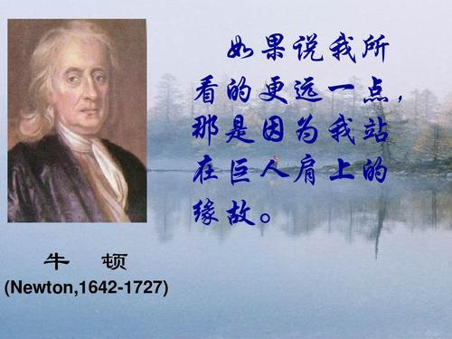
Incremental Approaches

Slide 3
Incremental Approaches
There is a state-of-the-art approach
It attacks a known problem.
For simplicity, we model its problem as a function:
f(x₁, x₂,… x_{n}) = y

Slide 4
How to make an improvement?
Tuning parameters

Slide 5
How to make an improvement?
Tuning parameters
Preprocessing

Slide 6
How to make an improvement?
Tuning parameters
Preprocessing
Postprocessing

Slide 7
How to make an improvement?
Tuning parameters
Preprocessing
Postprocessing
More advanced techniques

Slide 8
How to make an improvement?
Tuning parameters
Preprocessing
Postprocessing
More advanced techniques
Better algorithms

Slide 9
How to provide evidences?

Slide 10
How to provide evidences?
Controlled experiments!!

Slide 11
Example
Zijian Jiang, Ye Wang, Hao Zhong, and Na Meng. Automatic method change suggestion to complement multi-entity edits. Journal of Systems & Software, pages to appear, 2019.
Recommending co-change entities.
T. Zimmermann, P. Weisgerber, S. Diehl, A. Zeller, Mining version histories to guide software changes, in: Proc. ICSE, 2004, pp. 563–572
T. Rolfsnes, S. D. Alesio, R. Behjati, L. Moonen, D. W. Binkley, Generalizing the analysis of evolutionary coupling for software change impact analysis, in: Proc. SANER, 2016, pp. 201–212.
M. A. Islam, M. M. Islam, M. Mondal, B. Roy, C. K. Roy, K. A. Schneider, [research paper] detecting evolutionary coupling using transitive association rules, in: Proc. SCAM, 2018, pp. 113–122

Slide 12
How we make the improvements
We conducted an empirical study on *CM→AF and *CM→AM edits, and revealed that the co-changed methods for an added field or method usually access existing fields or methods in common.
We developed an approach CMSuggester that suggests complementary changes for *CM→AF and *CM→AM edits

Slide 13
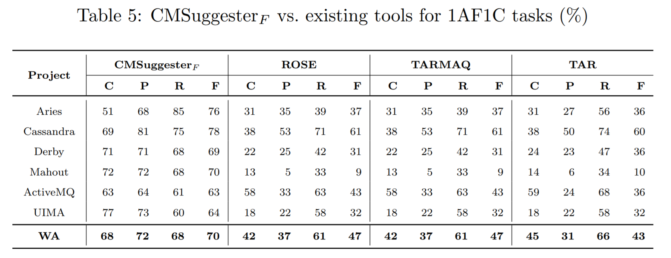
Result
Coverage, Precision, Recall, F-score

