Slide 1
Novel (the first) Approach
Hao Zhong
Shanghai Jiao Tong University

Slide 2


Novel approaches
The first approach that attacks a problem
Often are highly cited.

Slide 3
Vision

Slide 4

New Problems
What color is snow?

Slide 5
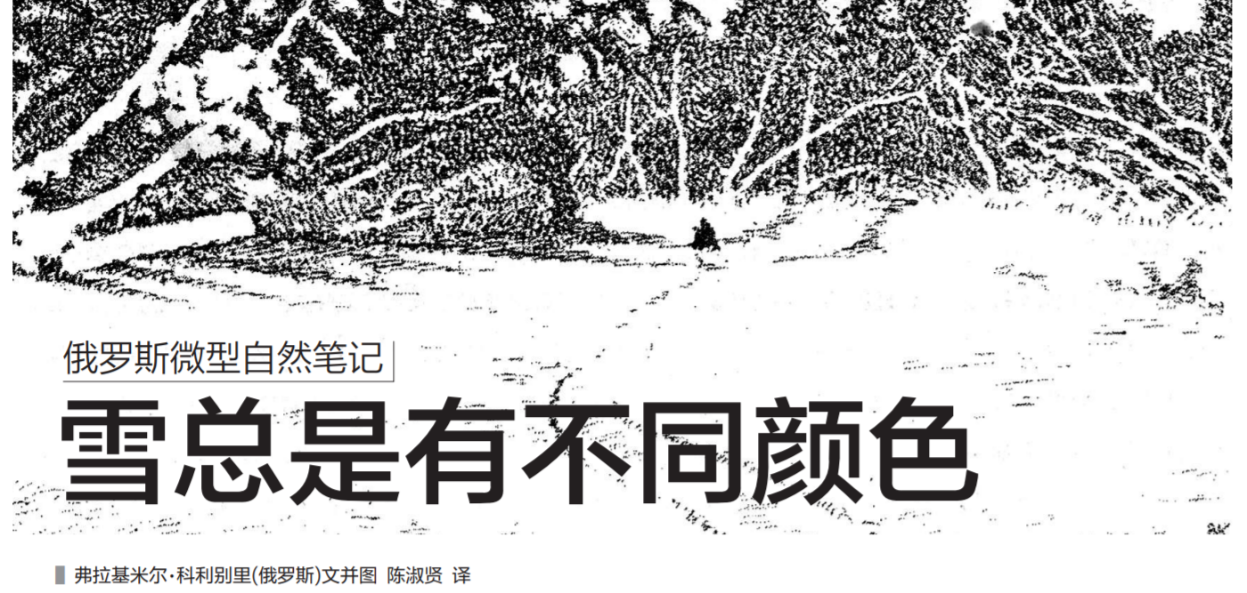
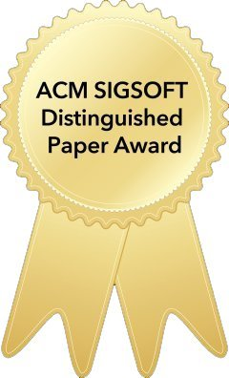
New Problems
What color is snow?
Here We Go Again: Why Is It Difficult for Developers to Learn Another Programming Language?
Nischal Shrestha, Colton BottaNorth, Titus BarikMicrosoft, Chris Parnin
ICSE 2020

Slide 6
My work
Hao Zhong, Suresh Thummalapenta, Tao Xie, Lu Zhang, and Qing Wang. Mining API mapping for language migration. In Proc. International Conference on Software Engineering (ICSE), pages 195-204, 2010.
The first approach that mines cross-language mappings
Hao Zhong and Zhengdong Su. Detecting API documentation errors. In Proc. Object-Oriented Programming, Systems, Languages & Applications (OOPSLA), pages 803-816, 2013.
The first approach that detects errors in software engineering documents
Hao Zhong, Lu Zhang, Tao Xie, and Hong Mei. Inferring resource specifications from natural language API documentation. In Proc. International Conference on Automated Software Engineering (ASE), pages 307-318, 2009.
The first approach to mine specifications from API documents

Slide 7
My work
Hao Zhong, Tao Xie, Lu Zhang, Jian Pei, and Hong Mei. MAPO: Mining and recommending API usage patterns. In Proc. European Conference on Object-Oriented Programming (ECOOP), pages 318-343, 2009.
One of the pioneer papers in mining software repository.
Xiao Cheng, Zhiming Peng, Lingxiao Jiang, Hao Zhong, Hai bo Yu, and Jianjun Zhao. Mining revision histories to detect cross-language clones without intermediates. In Proc. International Conference on Automated Software Engineering (ASE), pages 696--701, 2016.
The first approach to mine cross-language clones.

Slide 8
Your work
Is this a real problem?
Is this problem important?
Why is it not discovered by other researchers?
…

Slide 9

Hard Problems
Known problems, but all researchers bypass them!!

Slide 10
Wisdom

Slide 11
Partial code analysis
Hao Zhong and Xiaoyin Wang. Boosting complete-code tool for partial program. In Proc. International Conference on Automated Software Engineering (ASE), pages 671-681, 2017.
The first approach that is able to build accurate system dependency graphs from partial code.
Hao Zhong, Xiaoyin Wang, and Hong Mei. Inferring bug signatures to detect real bugs. IEEE Transaction on Software Engineering, pages to appear, 2020.
The first approach that has detected many real bugs with inferred bug signatures.

Slide 12
Your work
What is the problem?
Why is it so difficult?
How do others handle the problem?
...

