Slide 1
UI designer
Hao Zhong
Shanghai Jiao Tong University

Slide 2
Last class
Project manager
Responsibility
Cost estimation
Planning
Risk
CVS
Issue tracker (open source)

Slide 3
Role
User interface design (UI) or user interface engineering is the design of user interfaces for machines and software, such as computers, home appliances, mobile devices, and other electronic devices, with the focus on maximizing usability and the user experience.
User experience design (UX, UXD, UED or XD) is the process of enhancing user satisfaction with a product by improving the usability, accessibility, and pleasure provided in the interaction with the product. User experience design encompasses traditional human–computer interaction (HCI) design, and extends it by addressing all aspects of a product or service as perceived by users

Slide 4
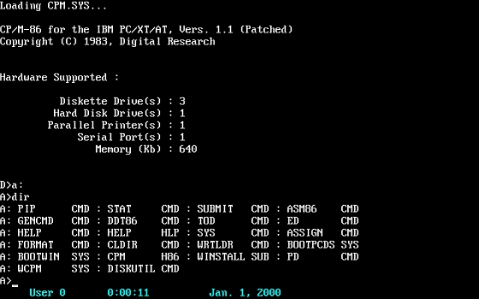
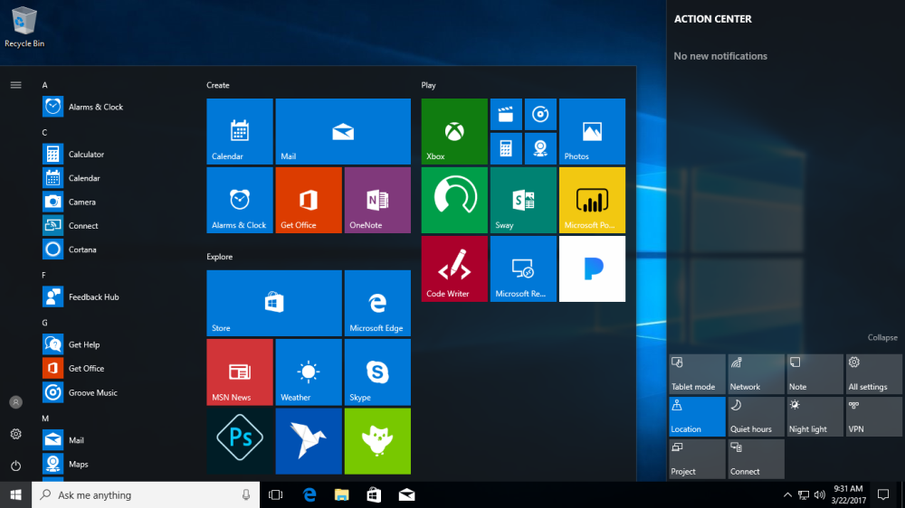
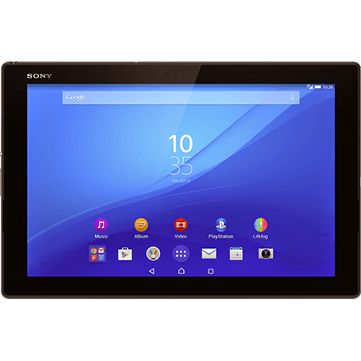

UI
?

Slide 5

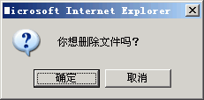

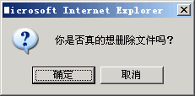
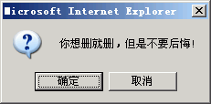
Why it matter
System users often judge a system by its interface rather than its functionality
A poorly designed interface can cause a user to make catastrophic errors
Poor user interface design is the reason why so many software systems are never used

Slide 6
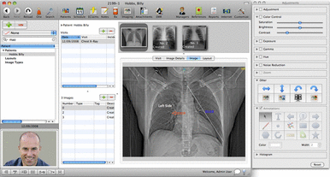
UI design principles
User familiarity
The interface should be based on user-oriented terms and concepts rather than computer concepts
E.g., an office system should use concepts such as letters, documents, folders etc. rather than directories, file identifiers, etc.

Slide 7
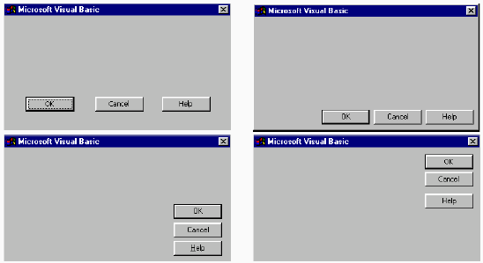
UI design principles
Consistency
The system should display an appropriate level of consistency
Commands and menus should have the same format, command punctuation should be similar, etc.

Slide 8
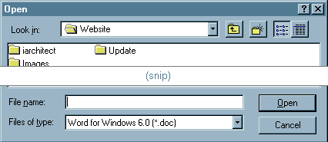
UI design principles
Minimal surprise
If a command operates in a known way, the user should be able to predict the operation of comparable commands

Slide 9
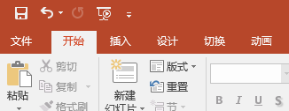
UI design principles
Recoverability
The system should provide some resilience to user errors and allow the user to recover from errors
This might include an undo facility, confirmation of destructive actions, 'soft' deletes, etc.

Slide 10
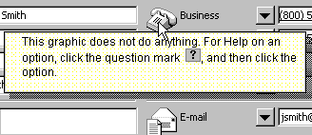
UI design principles
User guidance
Some user guidance such as help systems, on-line manuals, etc. should be supplied

Slide 11

UI design principles
User diversity
Interaction facilities for different types of user should be supported
E.g., some users have seeing difficulties and so larger text should be available

Slide 12
UI design principles
Meaningful feedback
Programmers often use UI to debug

Slide 13
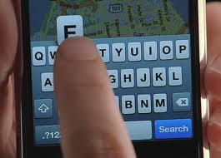
User-system interaction
Two problems must be addressed in interactive systems design
How should information from the user be provided to the computer system?
How should information from the computer system be presented to the user?
User interaction and information presentation may be integrated through a coherent framework such as a user interface metaphor

Slide 14
Some methods to achieve good usability:
Paper prototyping
Show users various UI menus and ask them to group the ones that are similar, to see what UI tasks are seen as being related by users.
Code prototyping
User testing / field studies
having users use the product and gathering data
Evaluations and reviews by UI experts

Slide 15
User interface design process

Slide 16
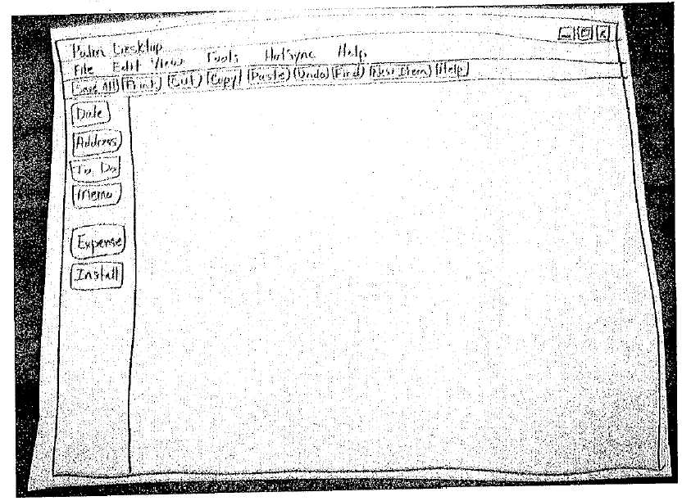
Creating a paper prototype
Your requirements and designs?
Identify the screens in your UI
consider use cases, inputs and outputs to user
Think about how to get from one screen to next this will help choose between tabs, dialogs, etc.
Drawing the background

Slide 17
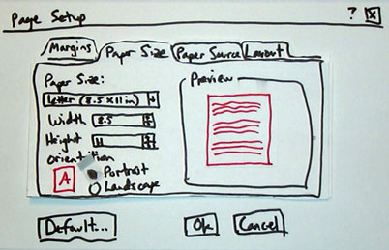
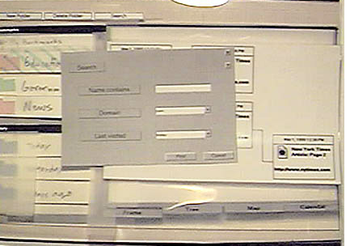
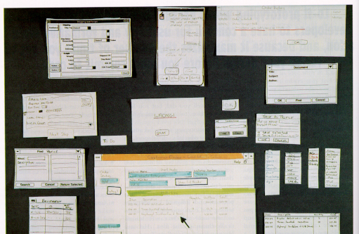
Representing a changing UI

Slide 18
Code prototype
UI builders (Visual Studio, ...)
Draw a GUI visually by dragging/dropping UI controls on screen
No real implementation
The logic chain, with faked data
Depth of menu
Determine whether the underlying framework supports the paper prototype
Implement a customized UI is difficult
APIs
Need art designers

Slide 19
Simple evaluation techniques
Questionnaires for user feedback
Video recording of system use and subsequent tape evaluation.
Instrumentation of code to collect information about facility use and user errors.
Analyze help desk logs
Analyze access logs for web apps

Slide 20
Usability attributes
Learnability
How easy is it for users to accomplish basic tasks the first time they encounter the design?
Efficiency
Once users have learned the design, how quickly can they perform tasks?
Memorability
When users return to the design after a period of not using it, how easily can they reestablish proficiency?
Errors
How many errors do users make, how severe are these errors, and how easily can they recover from the errors?
Satisfaction
How pleasant is it to use the design?

Slide 21
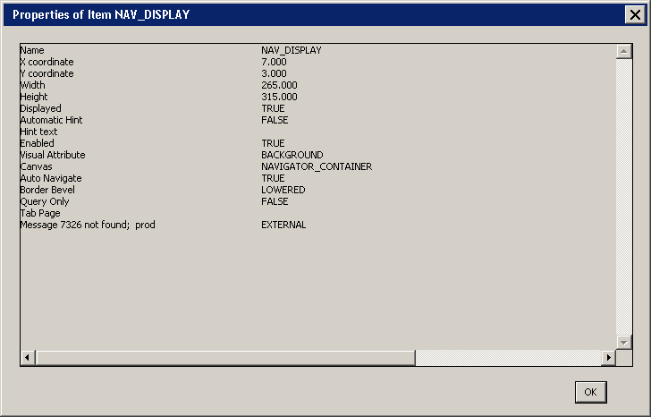
UI Hall of Fame or Shame?
Help window from Dept. of Commerce CBS/CAMS system

Slide 22

Internationalization
Why should a team want to internationalize / localize its app?
reach a wider audience
make more money
Is it worth it to localize?
May need to evaluate cost/benefit:
What fraction of our users speak that language?
Are they also fluent in English?
Are they already able to use the site now?
Open-source software is often translated for free by community
Maybe you can post your code and let them do it ...

Slide 23
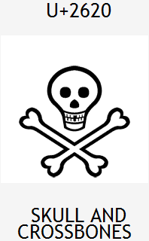
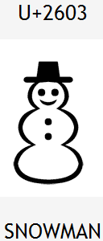
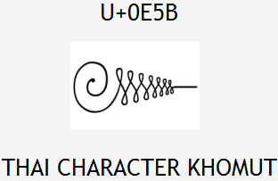
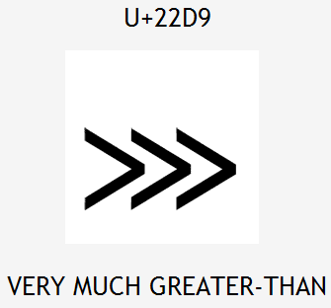
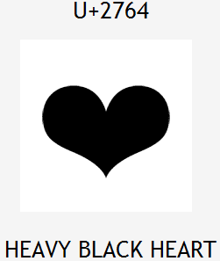
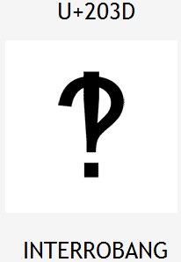

Unicode
Unicode: Standard for storing, encoding, numbering over 107,000 chars from > 90 languages.
created in 1991 by non-profit Unicode Consortium
standard character ? integer mappings
Translation Formats (UTF-*) to store chars as bytes
supported by languages (Java,.NET,Python), browsers
important for localization because it defines int'l chars and encodings we will use to present localized text

Slide 24
Locales
locale: A geographic/cultural location targeted for localization.
A locale consists of:
a language (e.g. English)
often expressed as an ISO-639-1 code: de, en, fr, ja
a location or variant (e.g. United States, UK)
often expressed as an ISO-3166-1 code: CA, US, GB, DE, ES, JP
Why isn't it enough to specify just the language?
Different locations may use different conventions, spelling, etc.
"color" (US) vs. "colour" (UK)
"localize" (US) vs. "localise" (UK)
Other differences (dates, currency, numbers, time zone, etc.)

Slide 25
Differences between locales
language English vs. German
spelling "color" vs. "colour"
slang "line" vs. "queue"
number formatting
telephone number format (206) 949-0504 vs. +1.206.949.0504
decimal separator, digit groups
currency units/formatting $123.45 vs. 123,45€
date formatting 3/14/10 vs. 2010/Mar/14
keyboard shortcuts
text direction hello vs. שָׁלוֹם
left-to-right ("LTR") vs. right-to-left ("RTL"), AKA "bidi" issues
multimedia: spoken audio; video subtitles

Slide 26
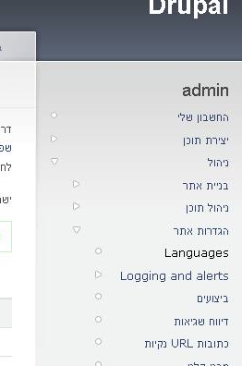
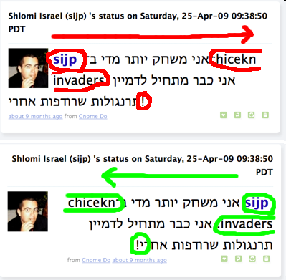
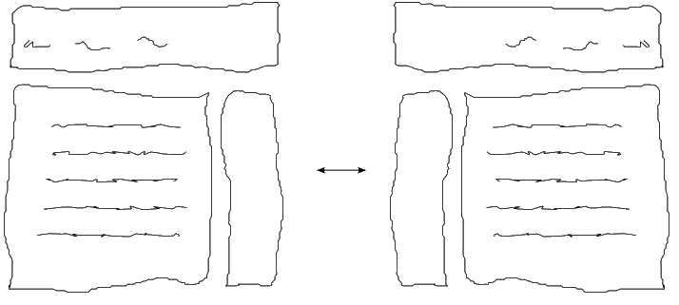
Right-to-Left (RTL)
Some languages begin lines on the right side and go left
Arabic, Farsi/Persian, Hebrew, Kurdish, Punjabi, Somali, ...
Often handled by supplying separate .css files for RTL locales
Can lead to lots of subtle UI bugs based on coders' LTR assumptions

Slide 27
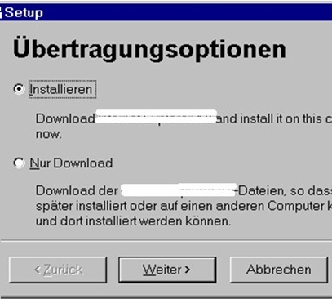
Localization gotchas
Some languages (e.g. German) use long words
buttons/labels get too wide for space provided
Some Unicode characters look like ASCII ones
U+00A0 "non-breaking space" character
"-" vs. U+2014 "em-dash" —, U+2013 "en-dash" –
Some fonts don't have all characters
but a smart OS can use font substitution
Regular expressions / text searches may not match i18n input
ex. \w "word boundary" doesn't match Unicode word delimiters
Web server might return text that has not been localized (Ajax)

Slide 28
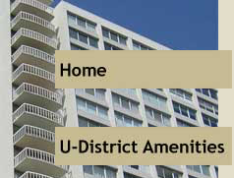


Things to avoid
Don't hard-code widths/heights in CSS or GUI
Avoid images that look like text.
Avoid using symbols that have no meaning in other locales.
USA "STOP sign"
Hand up for "Wait"
(If localizing to RTL locales) Avoid hard-coding the notion that "left" means "start" and "right" means "end".
example: Left for "Back", right for "Forward"
example: Left for "less", right for "more"

Slide 29
How to internationalize software
Program internationalize code
pull all strings out of code and into separate resource files
call methods that localize/format strings, numbers before printing
use libraries (e.g. gettext) to help localize messages
Wang, Xiaoyin, Lu Zhang, Tao Xie, Hong Mei, and Jiasu Sun. "Locating need-to-externalize constant strings for software internationalization with generalized string-taint analysis." IEEE Transactions on Software Engineering 39, no. 4 (2013): 516-536.
Localizers (maybe not programmers) localize resource files
often hired to localize an app for a particular locale at a time
web app: look up localized strings when generating each page
Model-view separation is very important for web applications

Slide 30
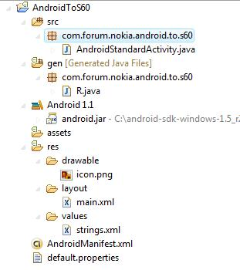
Android localization
Android apps store resources in res/ folder
text strings go in strings.xml files:
res/values/strings.xml (defaults)
res/values-en/strings.xml (English)
res/values-fr/strings.xml (French)
Testing locales:
(on a real Android device) Home → Menu → Settings → Locale & text → Select locale
(on the emulator using adb) adb -e shell # setprop persist.sys.language [language code];setprop persist.sys.country [country code];stop;sleep 5;start

Slide 31
strings.xml example
<!-- res/values/strings.xml -->
<?xml version="1.0" encoding="utf-8"?>
<resources>
<string name="greeting">Hello!</string>
<string name="login">User %1 logged in.</string>
</resources>
<!-- layout XML file that uses string in View -->
<TextView
android:layout_width="fill_parent"
android:layout_height="wrap_content"
android:text="@string/greeting" />
// in-app Java code that grabs a resource string
Resources res = getResources();
String greet = res.getString(R.string.greeting);
String msg = String.format(
res.getString(R.string.login), userName);

Slide 32


Other resources
Images are in res/drawable
res/drawable/company-logo.png (English)
res/drawable-fr/company-logo.png (French)
<!-- layout XML file that uses image in View -->
<ImageView
android:layout_height="wrap_content"
android:layout_width="wrap_content"
android:src="@drawable/company-logo" />
Layouts are in res/layout
Menus are in res/menu
Colors are in res/values/colors.xml

Slide 33
Formatting dates
Differences in how to display dates across locales:
names of the months/days (Monday vs. Lundi)
ordering of days (what day does a week start/end)
relative order of y/m/d (3/14/2010 vs. 2010/Mar/14)
time zone (usually offset from UTC/GMT)
12 vs. 24 hour time (5:00 PM vs. 17:00)
java.text.DateFormat formats dates
styles: DateFormat.DEFAULT, FULL, LONG, MEDIUM, SHORT
DateFormat fmt = DateFormat.getDateTimeInstance(
DateFormat.LONG, DateFormat.SHORT, locale);
String s = fmt.format(new Date());
Date d = fmt.parse(dateText.trim()); // parse a date

Slide 34
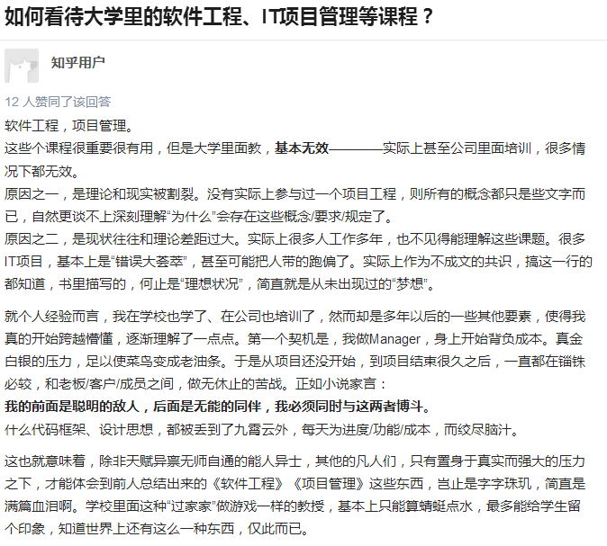
Some discussions on SE
Role: Project manager
MBA
Role is different in companies
Small companies may not define roles
Outsourcing
Quality, real matter?

Slide 35
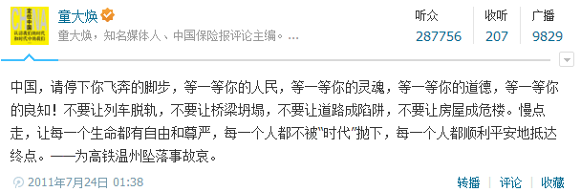
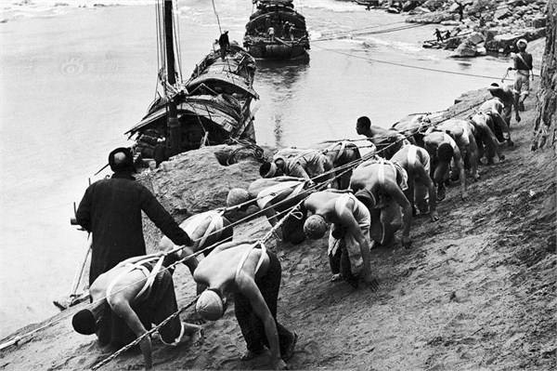
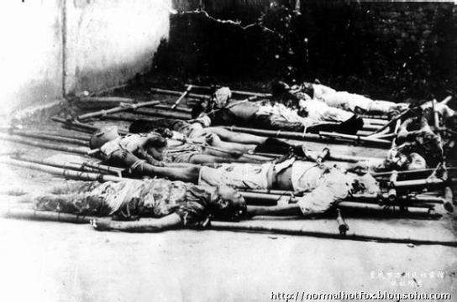
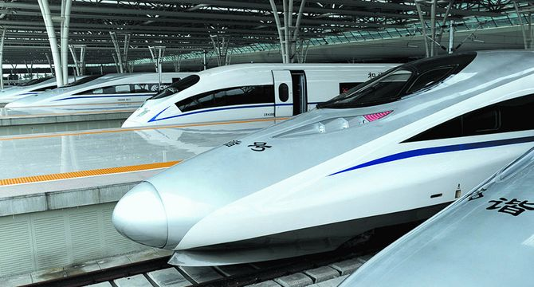


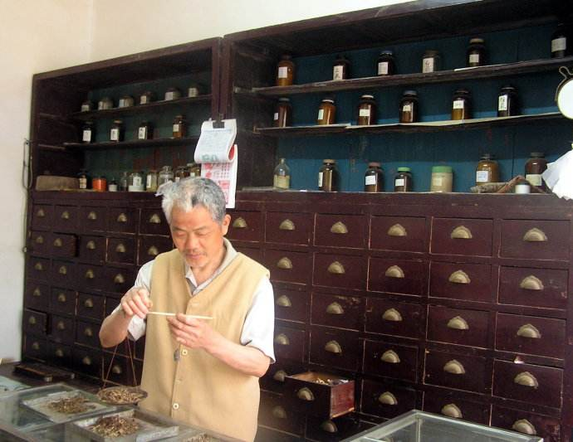
Some discussions on science and applications

Slide 36
This class
UI designer
Responsibility
UI design
Principle
Process
Evaluation
Internationalization
Language
Locale

