Slide 1
Programmer
Hao Zhong
Shanghai Jiao Tong University

Slide 2
Last class
Software designer
UML
Use case diagram
Identification of use cases
Object oriented approach for design
Class diagram
Legend
Class Relationships
Sequence diagram
The Principles of Object-Oriented Design

Slide 3
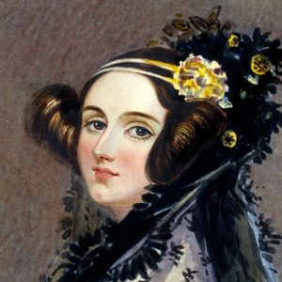
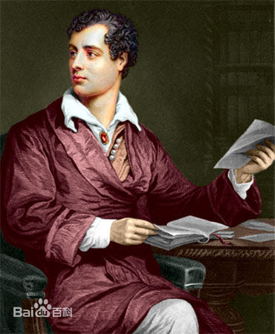
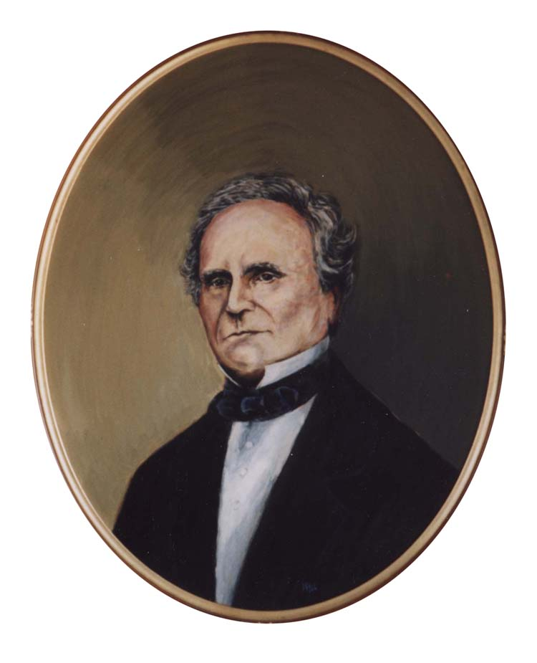
Programmer
A programmer, computer programmer, developer, coder, or software engineer is a person who creates computer software. The term computer programmer can refer to a specialist in one area of computer programming or to a generalist who writes code for many kinds of software.
Ada Lovelace
George Gordon Byron
Charles Babbage

Slide 4


Programmer
How to program
Java, C++, …

Slide 5
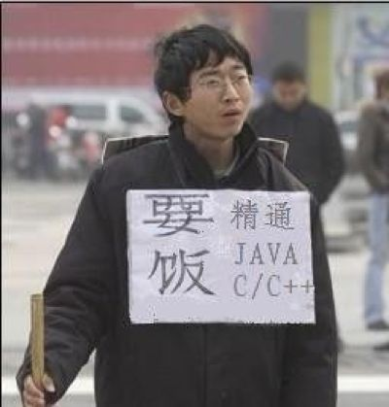

Programmer
How to program
Java, C++, …
How to program with others
Coding style
Design Patterns

Slide 6


Programmer
How to program
Java, C++, …
How to program with others
Coding style
Design Patterns

Slide 7
Coding style
Why?
Easier to read: for others and yourself
Less mistakes and misunderstandings
Reduce the requirement for comments and documentation (self-documented)
Bad names can indicate bugs
Hui Liu, Qiurong Liu, Cristian-Alexandru Staicu, Michael Pradel, Yue Luo. Nomen est Omen: Exploring and Exploiting Similarities between Argument and Parameter Names. The 38th International Conference on Software Engineering (ICSE 2016), 1063-1073

Slide 8
Coding style
What?
Coding style is not a very well organized topic
A lot of scattered and conflicting tips given by experienced developers
We organize all these tips from the smallest to the largest code elements (Identifier to File)
private static URI[] libs() {
File f = new File("libs");
private static URI[] libs()
{
File f = new File("libs");

Slide 9
Coding style
Coding style is mostly general
E.g., should not use too simple variable names
Coding style can be specific to programming languages in some cases
Case sensitive / insensitive languages
Case sensitive: C family (including Java, python)
Case insensitive: Basic, Fortran, Pascal, Ada
Semantics for cases: Prolog (cap for var, low for names)
Indentation based compilation
Python, Haskell
Different code structures
Classes in OO languages, recursions in functional languages

Slide 10
Variables and Constants
Variable (function, method) Naming
Do not use names with no meanings (e.g., a, b, ac, xyz)
Do not use names with general meanings (e.g., do, run, it, value, temp)
Do not differentiate variables with simple number indexes (e.g., name_1, name_2, name_3)
Full words is better than abbreviations (e.g., use phone_number instead of tel)
Use underscore or Capitalized letter to separate words (e.g., phone_number or phoneNumber)

Slide 11
Variables and Constants
Hungarian Notations
Each variable has a prefix to indicate its type
lAccountNum (long)
arru8NumberList (array, unsigned 8 bit)
Quite useful in C, and is used widely in C++ and C#
MS code and Windows APIs use Hungarian Notations a lot
Not very necessary in OO languages with modern IDEs, because the type of a variable is complex in itself, and easy to know

Slide 12
Variables and Constants
Constants
If global, collect all constants somewhere (e.g, Config class, or a configuration file)
Conventionally, the name for a class/file-wide constant is all Capitalized words, concatenated by underscore (e.g., MAX_DAY_LIMIT), be careful of case-insensitive languages

Slide 13
Variables and Constants
String Constants
Try to avoid string constants in your code
Especially if they are related to UI (visible strings), system (paths), database (sql statements), or any environments
Put them in different configuration files according to their usage
So that you can change them later to generate different releases (different OS, regions, etc.)
Wang, Xiaoyin, Lu Zhang, Tao Xie, Hong Mei, and Jiasu Sun. "Locating need-to-externalize constant strings for software internationalization with generalized string-taint analysis." IEEE Transactions on Software Engineering 39, no. 4 (2013): 516-536.

Slide 14
Expressions
Avoid Complex expressions
Give names to intermediate results
int totalAmount = (hasDiscount() && validForDiscount(user)) ? discountRate() * getPrice() * getNum() : getPrice() * getNum();
boolean validDiscount = hasDiscount() && validForDiscount(user);
int price = validDiscount ? getPrice() * discountRate() : getPrice();
int totalAmount = price * getNum();

Slide 15
Expressions
Avoid corner cases (uncommon operators)
Rules are complex, maybe changed (careful of updates!!)
int a[] = {0, 5}; int i = 0; a[i++] = i++; print (a[0]+"," + a[1]+","+i);
What will be printed?
Add brackets even when you think it is unnecessary (except for + and * which is so well known)
Conditional Expressions
Avoid abbreviation in some languages
e.g., use if (x!=0) instead of if (x)

Slide 16
Statements/Lines
One statement per line
Line breaks
Set a maximum length for lines
Break lines at binary operators, commas, etc.
Put the binary operator at the beginning of the following line, why?
Indent the following sub-lines to differentiate with other code
if(long condition 1
&& long condition 2){
do something;
}

Slide 17
Blocks
Indentation
Do indentation for blocks (in method, loop, if-else conditions)
Pay more intention to indentation in Python and Haskell, it is a right or wrong thing!!
Try to avoid using tab, why?
Tabs are translated to 2 or 4 spaces in different editors or settings, resulting in global coding style problems, and the case is even worse for Python
2 (Lua, scala, ruby, …) or 4 spaces (others), usually depending on the language you use and the team convention you decided on

Slide 18
Blocks
Single statement blocks for loop and conditions
Add curly brackets around, why?
Logic blocks
Divide a basic block to several logic blocks, add an empty line between them
if(a > 1)
// do something; Error!!
another statement;
int validDiscountRate = …;
int finalAmount = validDiscountRate * amount;
print getReceiptHeader();
print finalAmount;

Slide 19
Methods
Size
Smaller, and smaller, and even smaller …
Usually less than 20 lines, and never exceed 100 lines
Why?
easier to understand
easier to reuse: less code clones
Signatures
Avoid too many parameters
Group parameters to a new class
Contents
Try to avoid side effect
Try to not use global variables, especially writing global variables

Slide 20
File Structure
Follows the common structure of the language (e.g., imports, class decl, fields, methods in Java, includes, macros, structs, functions in C)
Keep it small
Usually no more than 500 lines
Should break a module to multiple sub-modules (it is also a design issue)
Put public methods before private methods
Easier for other people to read public methods

Slide 21
Comments
A way to help other people and yourself to better understand your code later
Common rules
No need to comment everything
More important to explain variables than statements: Other developers know what the statement does, but do not know what the variable means…
Try to write complete sentences
Avoid code in comments, it make readers harder to read code
Exception: method/class comments of API library
Hao Zhong and Zhengdong Su. Detecting API documentation errors. In Proc. Object-Oriented Programming, Systems, Languages & Applications (OOPSLA), pages 803-816, 2013.

Slide 22
Comments for statements
Two types of statements especially require comments
Declaration statements
Statements with complex expressions
No meaningless comments
int score = 100; // set score to 100
TERRIBLE COMMENT!
int score = 100; // the full score of the final exam is 100

Slide 23
Comments for Methods
A well-structured format for each public method
What the method does
What does the return value mean
What does the parameters represent
What are restrictions on parameters
What are the exceptions, and what input will result in exceptions
/**
* Fetch a sub-array from an item array. The range
* is specified by the index of the first item to
* fetch, and ranges to the last item in the array.
*
* @param list represents the item list to fetch from
* it should not be null.
* @param start represents the start index of the
* fetching range it should be between
* 0 and the length of list
* @return the fetched subarray
*/
public List<Item> getRange(List<Item> list, int start){

Slide 24
Comments for Classes/Files
A well-structured comment for each class / file
Author (s)
Generating time and version
Version of the file
A description of the class/file about its main features, and usage specifications / examples
/**
* A mutable sequence of characters. The principal operations on a StringBuilder
* are the append and insert methods. The append method always adds these
* characters at the end of the builder; the insert method adds the characters at
* a specified point.
*
* For example, if z refers to a string builder object whose current contents are
* "start", then the method call z.append("le") would cause the string builder to
* contain "startle", whereas z.insert(4, "le") would alter the string builder to
* contain "starlet".
*
* author : John Smith
* generate: Oct.1st.2013
* version : 1.0
* @since : 2.2
*/
public class StringBuilder{

Slide 25
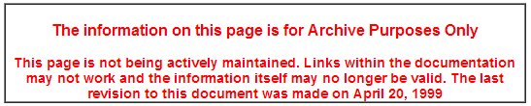
Code convention for companies / organizations
Most companies / organizations have their code conventions
Usually following the general rules of coding style
May set different line-length limits, 2 or 4 spaces, different ways to place braces, or whether to put spaces around operators or brackets, …
Some code convention examples:
http://www.oracle.com/technetwork/java/javase/documentation/codeconvtoc-136057.html
http://msdn.microsoft.com/en-us/library/vstudio/ff926074.aspx

Slide 26

Design Patterns
Best practice
Design Patterns: Elements of Reusable Object-Oriented Software. Gang of Four: Gamma, Erich; Richard Helm, Ralph Johnson, and John Vlissides
Provide solutions for common problems in micro-design
Prechelt, Lutz, Barbara Unger-Lamprecht, Michael Philippsen, and Walter F. Tichy. "Two controlled experiments assessing the usefulness of design pattern documentation in program maintenance." IEEE Transactions on Software Engineering 28, no. 6 (2002): 595-606.
…

Slide 27
Design Patterns Structure
Name
Important to know for easier communication between designers
Problem solved
When to apply the pattern
Solution
Usually a class diagram segment (sometimes attributes and operations)

Slide 28
Design Patterns
Structure Patterns
Composite
Creation Patterns
Factory
Behavioral Patterns
Visitor

Slide 29
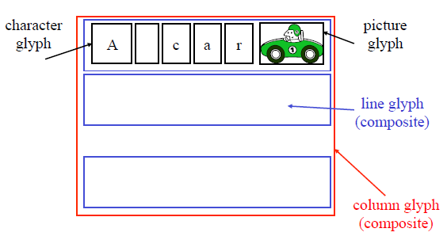
Running Example
A Document Editor
Text and graphics can be freely mixed
Graphical user interface
Support different look-and-feel GUI styles
Traversal operations: spell checking

Slide 30
Composite Pattern: Problem
A document is represented by structure
Primitive glyphs
Characters, circles, pictures
Lines: A sequence of glyphs
Columns: A sequence of Lines
Pages: A sequence of Columns
Documents: A sequence of Pages

Slide 31
Possible Designs?
Classes of Character, Circle, Pictures, lines, Columns, pages, document
Composition relationship between classes
Not so good, why?
A lot of duplication:
all classes has onClick, draw behavior
Difficult to add or remove levels in hierarchy
Traverse/display operations need to change for any change of the hierarchy

Slide 32
Alternate Designs
One class of Glyph
All elements are subclasses of Glyph
All elements uniformly present the same interface
How to draw
Computing bounds
Mouse hit detection
…
Make extending the class easier

Slide 33
Alternate Designs
Class Glyph {
private List< Glyph > children = new ArrayList< Glyph >(); public void Draw(Window w){…;} public void Intersect(Point p){…;} }
Class Character extends Glyph{
…
}
Class Picture extends Glyph{
…
}
Class Picture extends Line{
…
}

Slide 34
Composite Pattern
Applies to any hierarchy structure
Leaves and internal nodes have similar functionality
Pros:
Easy to add, remove new types
Clean interface
Cons:
Enforce certain type of elements only have certain types of children

Slide 35
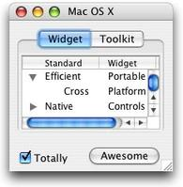
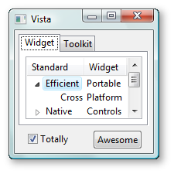
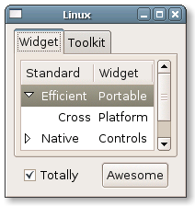
Factory: Supporting look-and-feel settings
Different look-and-feel standards
Appearance of scrollbars, menus, windows, etc., set by the user
We want to support them all
For example: having classes MotifScrollBar and WindowsScrollBar
Both are subclasses of ScrollBars
How should we create a new scrollbar in a window?

Slide 36
Factory Pattern
One method to create a look-and-feel dependent object
Define a GUIFactory Class
One GUIFactory object for each look and feel
Create itself using conditions set by the user

Slide 37
Factory Pattern
abstract class GUIFactory{
abstract ScrollBar CreateScrollBar();
abstract Menu CreateMenu();
...
}
class MotifFactory extends GUIFactory{
ScrollBar CreateScrollBar(){
return new MotifScrollBar()
}
Menu createMenu(){
return new MotifMenu();
}
...
}
GuiFactory factory;
if(style==MOTIF){
factory = new MotifFactory();
}else if(style==WINDOW){
factory = new WindowFactory();
}else{
...
}
ScrollBar bar = factory.createScrollBar();
Menu mn = factory.createMenu();

Slide 38
Factory Pattern
Applies to the object creation of a family of classes
The factory can be changed at runtime
Pros & Cons
Lift the conditional creation of objects to the creation of factories
Flexible for add new type of objects
Sometimes make the code more difficult to understand

Slide 39
Visitor: Spell Checking Problem
Considerations
Requires to traverse the document
Need to see every glyph in order
There may be other analyses that require traverse the document
Counting words, Grammar checking

Slide 40
Possible design
class Glyph{…
void spellCheck(char[] curWord):
for(int i = 0; i<this.children.length; i++):
this.children[i].spellCheck(curWord);
if(this isa character):
if(this == space):
Util.SpellCheck(curWord); curWord.clear();
else:
curWord.append(this);
…}

Slide 41
Other Actions
Document Stats
counting words,
counting pictures,
counting lines, columns, pages)
Find a word
Change line-break rules
…

Slide 42
Now we have
A large number of similar methods
All need to traverse the document
Code duplication always causes problems
change the data structure of “children” from array to list (better insertion and deletion)
Skip full-picture page to enhance performance for word-related tasks

Slide 43
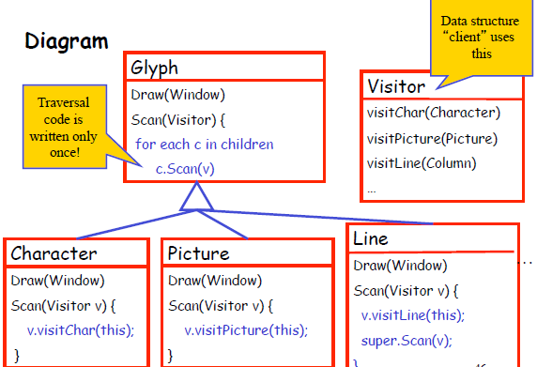
Solution
Visitor pattern
Decouple traverse process and action
Write traverse code only once
Each element in the hierarchy under traverse has an “action” code
class Glyph{…
void scan(Visitor v):
for(int i = 0; i<this.children.length; i++):
this.children[i].scan(v);
…}
We have different visitors:
spellcheckVisitor, documentStatVisitor, etc.

Slide 44
A controversial pattern: singleton pattern
Problem
How to make sure a class only has one object
File system
Windows manager
…
The class itself is made responsible for keeping track of its instance. It can thus ensure that no more than one instance is created. This is the singleton pattern.

Slide 45
View points
We love singletons (getting weaker and weaker in the past 10 years)
Singletons are evil, actually an anti-pattern (many people believe this)
Use singletons carefully and only when no other alternatives, control the number of singleton classes in your project

Slide 46





The research on programmers

Slide 47
This class
Programmer
How to program with others
Code style
variable, …, class
Design pattern
Good vs Evil

Slide 48

Next class
Quality engineer

