Slide 1
Quality engineer and programmer Debugging
Hao Zhong
Shanghai Jiao Tong University

Slide 2
Last class
Static bug detection
Oracle
Value
Temporal
Data flow
Detection techniques
Symbolic execution
Graph-based approaches
Mining oracles
Existing client code
Existing buggy code
Documents
Code styles
Declaration before usage

Slide 3
Debugging
Sometimes the inputs is too complex
Quite common in real world (compiler, office, browser, database, OS, …)
Locate the relevant inputs
Some bugs are expensive to produce
Network, big data, database…
Stub, Faked object
Some bugs are not easy to check
More than return values
Mock
Some bugs are not easy to trigger
Occurs within loops
Xcode
…

Slide 4
Consider Mozilla Firefox
Taking html pages as inputs
A large number of bugs are related to loading certain html pages
Corner cases in html syntax
Incompatibility between browsers
Corner cases in Javascripts, css, …
Error handling for incorrect html, Javascript, css, …
…

Slide 5
How do we go from this
<SELECT NAME="op sys" MULTIPLE SIZE=7>
<OPTION VALUE="All">All<OPTION VALUE="Windows 3.1">Windows 3.1<OPTION VALUE="Windows 95">Windows 95<OPTION
VALUE="Windows 98">Windows 98<OPTION VALUE="Windows ME">Windows ME<OPTION VALUE="Windows 2000">Windows
2000<OPTION VALUE="Windows NT">Windows NT<OPTION VALUE="Mac System 7">Mac System 7<OPTION VALUE="Mac System
7.5">Mac System 7.5<OPTION VALUE="Mac System 7.6.1">Mac System 7.6.1<OPTION VALUE="Mac System 8.0">Mac System
8.0<OPTION VALUE="Mac System 8.5">Mac System 8.5<OPTION VALUE="Mac System 8.6">Mac System 8.6<OPTION VALUE="Mac
System 9.x">Mac System 9.x<OPTION VALUE="MacOS X">MacOS X<OPTION VALUE="Linux">Linux<OPTION
VALUE="BSDI">BSDI<OPTION VALUE="FreeBSD">FreeBSD<OPTION VALUE="NetBSD">NetBSD<OPTION
VALUE="OpenBSD">OpenBSD<OPTION VALUE="AIX">AIX<OPTION VALUE="BeOS">BeOS<OPTION VALUE="HP-UX">HPUX<
OPTION VALUE="IRIX">IRIX<OPTION VALUE="Neutrino">Neutrino<OPTION VALUE="OpenVMS">OpenVMS<OPTION
VALUE="OS/2">OS/2<OPTION VALUE="OSF/1">OSF/1<OPTION VALUE="Solaris">Solaris<OPTION
VALUE="SunOS">SunOS<OPTION VALUE="other">other</SELECT>
</td>
<td align=left valign=top>
<SELECT NAME="priority" MULTIPLE SIZE=7>
<OPTION VALUE="--">--<OPTION VALUE="P1">P1<OPTION VALUE="P2">P2<OPTION VALUE="P3">P3<OPTION
VALUE="P4">P4<OPTION VALUE="P5">P5</SELECT>
</td>
<td align=left valign=top>
<SELECT NAME="bug severity" MULTIPLE SIZE=7>
<OPTION VALUE="blocker">blocker<OPTION VALUE="critical">critical<OPTION VALUE="major">major<OPTION
VALUE="normal">normal<OPTION VALUE="minor">minor<OPTION VALUE="trivial">trivial<OPTION
VALUE="enhancement">enhancement<

Slide 6
To this…
<SELECT NAME="priority" MULTIPLE SIZE=7>

Slide 7

Delta Debugging
The problem definition
A program exhibit an error for an input
The input is a set of elements
E.g., a sequence of API calls, a text file, a serialized object, …
Find a smaller subset of the input that still cause the failure
Benefit of simplification
Easy to communicate
Remove duplicates
Easy debugging
Involve less potentially buggy code
Shorter execution time
Prof. Andreas Zeller

Slide 8
How do people handle this problem?
Binary search
Cut the input to halves
Try to reproduce the bug
Iterate
The set of elements in the bug-revealing input is I
Assumptions
Each subset of I is a valid input:
Each Subset of I -> success / fail
A single input element E causes the failure
E will cause the failure in any cases (combined with any other elements) (Monotonic)

Slide 9

Delta Debugging
Go with the binary search process
Throw away half of the input elements, if the rest input elements still cause the failure

Slide 10

Delta Debugging
Throw away half of the input elements, if the rest input elements still cause the failure
A single element: we are done!

Slide 11
Delta Debugging
This is just binary search: easy to automate
The assumptions do not always hold
Let’s look at the assumptions:
It is interesting to see if this is not the case
(I1 U I2) =
-> I1 = and I2 =
or I1 = and I2 =

Slide 12
Case I: multiple failing branches
What happened if I1 = and I2 = ?
A subset of I1 fails and also a subset of I2 fails
We can simply continue to search I1 and I2
And we find two fail-causing elements
They may be due to the same bug or not

Slide 13
Case II: Interference
What happened if I1 = and I2 = ?
This means that a subset of I1 and a subset of I2 cause the failure when they combined
This is called interference
Handling trick
An element D1 in I1 and an element D2 in I2 cause the failure
We do binary search in I2 with I1
Split I2 to P1 and P2, try I1 U P1 and I1 U P2
Continue until you find D2, so that I1 U D2 cause the failure
Then we do binary search in I1 with D2 until find D1
Return D1 U D2

Slide 14
Limitations of Delta debugging
Rely on the assumptions
Monotonicity does not always hold
Rely on good input elements, always providing valid inputs will enhance efficiency
Require automatic test oracles
Regehr, John, Yang Chen, Pascal Cuoq, Eric Eide, Chucky Ellison, and Xuejun Yang. "Test-case reduction for C compiler bugs." In Proc. PLDI, pp. 335-346. 2012.

Slide 15
Debugging
Sometimes the inputs is too complex
Quite common in real world (compiler, office, browser, database, OS, …)
Locate the relevant inputs
Some bugs are expensive to produce
Network, big data, database…
Stub, Faked object
Some bugs are not easy to check
More than return values
Mock
Some bugs are not easy to trigger
Occurs within loops
Xcode
…

Slide 16
Test Stubs
Provide a fix value or fixed behavior for a certain method invocation
Always return 0 for a integer method
Do nothing for a void method
The value or behavior is hard coded in the Stub Class
public class OrderTest{
@Test
public void test(){
Order o = new order(new ShopStub());
o.add(1122, 3);
...
AssertEquals(expect, o.getTotal());
o.save();
}
}
public class ShopStub extends Shop{
public void save(Order o){
}
public double getShopDiscount(){
return 0.9;
}
}

Slide 17
Configurable Test Stubs
You may set different values for different test cases
public class ShopStub extends Shop{
private Exception saveExc;
private discount;
public setException(Exception e){
this.saveExc = e;
}
public setDicount(Float f){
this.discount = f;
}
public void save(Order o){
if(this.saveExc!=null){throw saveExc;}
}
public double getShopDiscount(){
return this.discount;
}
}
public class OrderTest{
@Test
public void testAbnormalDiscount(){
ShopStub stub = new ShopStub();
stub.setDiscount(1.1);
Order o = new order(stub);
o.add(1122, 3);
...
AssertEquals(expect, o.getTotal());
o.save();
}
}

Slide 18
Fake Objects
More powerful than stubs
A simplified implementation of the DOC
Example: a data table to fake a database
Example: use a greed algorithm to fake a complex optimized algorithm
Guidelines
Slow -> Fast
Complex -> Simple

Slide 19
Fake Objects
Need to double
Difficult to reproduce
Maybe slow
Affected by lots of factors
Tips for fake objects
As simple as possible (as long as not too time-consuming)
Go to a higher level if some object is hard to fake
URLStatus sts = HttpConnection.open("http://api.dropbox.com/files/myfile");
if(sts.status == 200){
return sts.data;
}else{
return “Error”;
}
public class FakeDropBoxApi{
private files = { };
public FakeUrlStatus read(fname){
if(files.contain(fname)){
return FakeUrlStatus(200, files[fname]);
}else{
return FakeUrlStatus(-1, "Error");
}
}
}
FakeURLStatus sts = FakeDropBoxApi.read("myfile");
if(sts.status == 200){
…

Slide 20
Debugging
Sometimes the inputs is too complex
Quite common in real world (compiler, office, browser, database, OS, …)
Locate the relevant inputs
Some bugs are expensive to produce
Network, big data, database…
Stub, Faked object
Some bugs are not easy to check
More than return values
Mock
Some bugs are not easy to trigger
Occurs within loops
Xcode
…

Slide 21
Mock objects
Mock objects do behavior-based testing
Usually we only check return values or status
AssertEquals (expected, actual);
AssertEquals (expected, array.length);
Can we do something like this? Why?
Assert ( testObject.f1 calls DOC.f)
public class OrderTest{
@Test
public void test(){
Order o = new order(new ShopStub());
o.add(1122, 3);
...
AssertEquals(expect, o.getTotal());
o.save();
}
}
public class ShopStub extends Shop{
public void save(Order o){
}
public double getShopDiscount(){
return 0.9;
}
}
Problems???

Slide 22
Mock objects
@Test
public void testOrder() {
//initialize
Shop sp = EasyMock.CreateMock(Shop.class);
Order o = new Order(sp);
o.add(1234, 1);
o.add(4321, 3);
//record
EasyMock.expect(sp.getDiscount()).andReturn(0.9);
sp.save(o);
EasyMock.expectLastCall();
//replay
EasyMock.replay(sp);
AssertEquals(expect, o.getTotal());
o.Save();
EasyMock.verify(sp)
}
EasyMock

Slide 23
Mock objects
Verifies whether the expected methods are actually invoked
Exception: missing, expected save(0xaaaa)
Verifies whether the expected methods are invoked in an expected way
Exception: save(null) expected save(0xaaaa)
More details
isA: ignore the value of argument
EasyMock.expect(sp.save(isA(Order.class)))
Find: expect the argument to contain a certain substring
EasyMock.expect(mock.call(find(“pattern”)))
Geq: expect a number larger than the given value
EasyMock.expect(mock.call(Geq(1000)))

Slide 24
Mock objects
Record phase:
Read expectation as specifications
Instead of directly generating code, the mock object generates an internal presentation, e.g. Automaton
Replay phase:
Check the real invocations
with the internal presentation

Slide 25
The Recent Research on
Automatic Program Repair

Slide 26
Spectra-based fault localization
Basic Idea
Consider a number of test cases, some of which pass and some of which fail
If a statement is covered mostly by failed test cases, it is highly likely to be the buggy part of the code
Tarantula
Color = red + pass/(fail + pass) * (green )
Brightness = max (pass, fail)

Slide 27
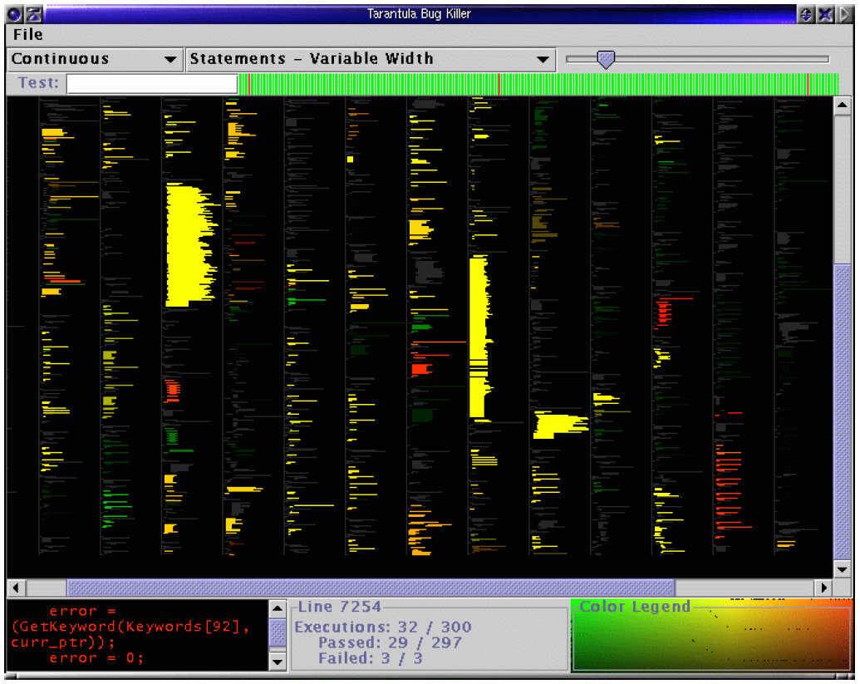

Statistical Debugging

Slide 28

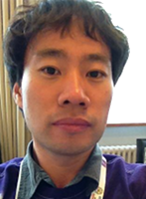


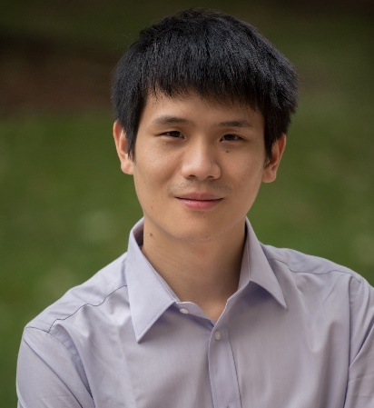
Automatic program repair
if (tcl == null) {
cd=…;
} else{
….
}
operator
fault location
mutation
Westley Weimer
Sung Kim
selection
if (tcl == null) {
cd=…;
} else if (…){
….
}
Automatic
Fixing unknown bugs
Martin Monperrus
Fan Long

Slide 29
Controversy
Le Goues, Claire, Michael Dewey-Vogt, Stephanie Forrest, and Westley Weimer. "A systematic study of automated program repair: Fixing 55 out of 105 bugs for $8 each." In Proc. ICSE, pp. 3-13. IEEE, 2012.
Monperrus, Martin. "A critical review of automatic patch generation learned from human-written patches: essay on the problem statement and the evaluation of automatic software repair." In Proc. ICSE, pp. 234-242. ACM, 2014.
Qi, Yuhua, Xiaoguang Mao, Yan Lei, Ziying Dai, and Chengsong Wang. "The strength of random search on automated program repair." In Proc. ISSTA, pp. 254-265. 2014.
Qi, Zichao, Fan Long, Sara Achour, and Martin Rinard. “An analysis of patch plausibility and correctness for generate-and-validate patch generation systems.” In Proc. ISSTA, pp. 24-36. 2015.

Slide 30
Latest progress
About 20% of existing bugs can be repaired.
Zhong, Hao, and Zhendong Su. "An empirical study on real bug fixes." In Proc. ICSE, pp. 913-923. 2015.
More operators from doc
Xiong, Yingfei, Jie Wang, Runfa Yan, Jiachen Zhang, Shi Han, Gang Huang, and Lu Zhang. "Precise condition synthesis for program repair." InProceedings of the 39th International Conference on Software Engineering, pp. 416-426. IEEE Press, 2017.
More operators from past fixes
Long, Fan, and Martin Rinard. "Automatic patch generation by learning correct code." In Proc. POPL, 2016.
Zhong, Hao, and Na Meng. "Poster: An Empirical Study on Using Hints from Past Fixes.“ In Proc. ICSE, 2017

Slide 31
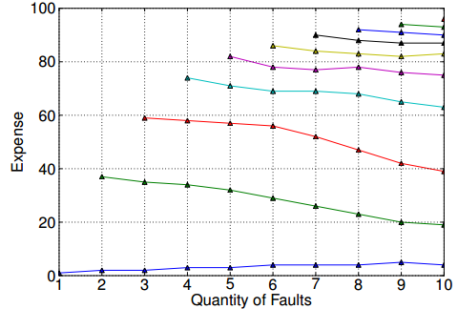
Statistical Debugging
Nicholas DiGiuseppe and James A Jones. 2011. On the influence of multiple faults on coverage-based fault localization. In Proc. ISSTA. 210–220

Slide 32
Latest progress
Benchmark
Just, R., Jalali, D. and Ernst, M.D., 2014, July. Defects4J: A database of existing faults to enable controlled testing studies for Java programs. In Proc. ISSTA pp. 437-440).
Better test suites
Yang, Jinqiu, Alexey Zhikhartsev, Yuefei Liu, and Lin Tan. "Better test cases for better automated program repair." In Proc. ESEC/FSE, pp. 831-841. 2017.
Partial program analysis
Hao Zhong, Xiaoyin Wang, Analyzing partial programs using whole program static analysis tools. In Proc. ASE, to appear, 2017.

Slide 33
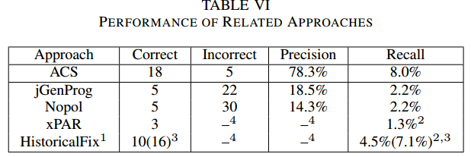
State of the art

Slide 34
This class
Debugging
Delta debugging
Stub, Fake object
Mock
Automatic program repair
A recent hot research topic
Cons and Pros
Latest progress
State of the art

Slide 35

Next class
Project manager

