Slide 1



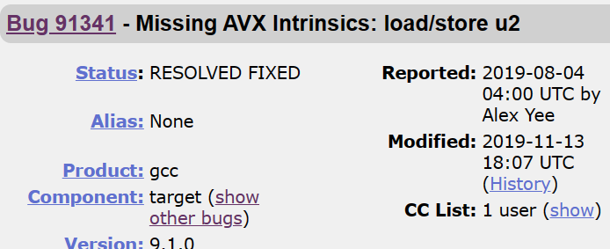

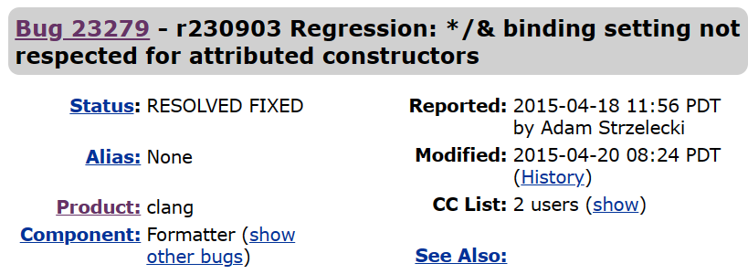
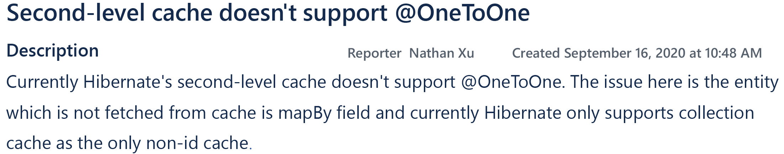
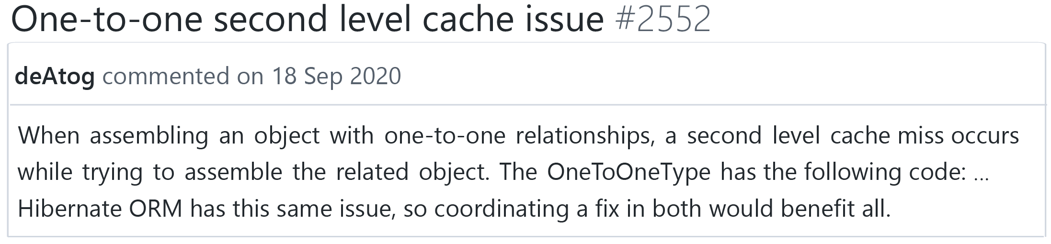

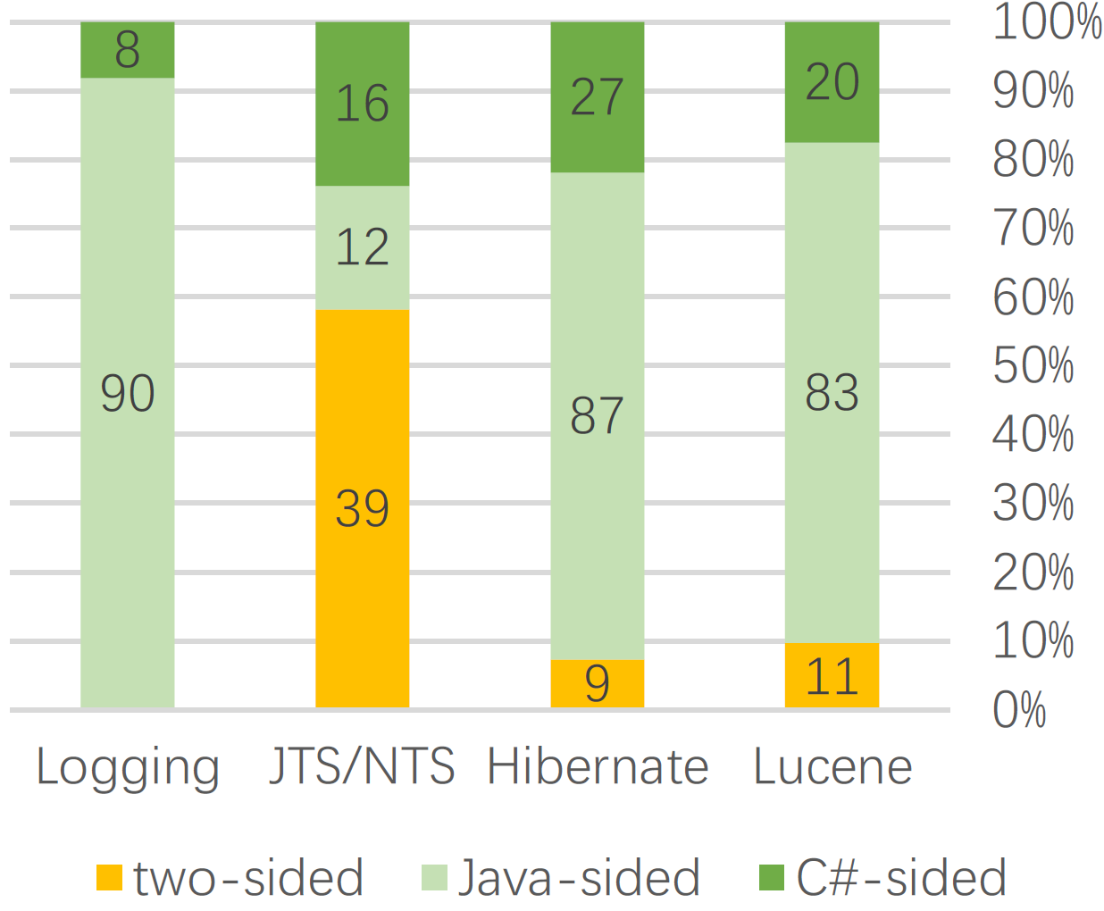
An Empirical Study on Cross-language Clone Bugs
Honghao Chen, Ye Tang, and Hao Zhong
Department of Computer Science and Engineering, Shanghai Jiao Tong University, China
{chenhonghao,tangye_22,zhonghao}@sjtu.edu.cn
Motivation from bug detection
Motivation from empirical study
Bug report
Test
snippet1
modify
snippet1
snippet2
modify
snippet2
Bug report
Test
snippet3
modify
clone
clone
snippet3
Testing compilers with bug reports of other compilers
Code clones become dissimilar with evolution
Hao Zhong, Enriching compiler testing with real program from bug report, In Proc. ASE, 2022
Miryung Kim et al. An empirical study of code clone genealogies. In Proc. ESEC/FSE, 2005
What if projects are in different languages?
What if clones are cross-language?
Similar symptoms
Mirror Bug
Similar report dates
HHH-14216 (bug report)
NHibernate#2552 (bug report)
1 public Objectassemble(...) ... {
2 − return resolve(session.getContextEntityIdentifier(owner), session,
owner);
3 + Serializableid = (Serializable)getIdentifierType(session).assemble(oid,
session, null);
4 + if(id == null){ return null; }
5 + return resolveIdentifier(id, session);
6 } …
1 public overrideobject Assemble(...) {
2 − return ResolveIdentifier(session.GetContextEntityIdentifier(owner),
session, owner);
3 + objectid = GetIdentifierType(session).Assemble(cached, session, null);
4 + if(id == null) { return null; }
5 + return ResolveIdentifier(id, session);
6 } …
Similar modifications
Identical modifications
The patch for HHH-14216 (Java)
The patch for NHibernate#2552 (C#)
Early Result
RQ1. How many mirror bugs are there?
RQ2. How mirror bugs are reported and fixed?
Latest versions
Sample
Reported: Bugs are reported to both sides
Port
Identified: Bugs are reported to one side. Programmers actively learned bug reports of the other language and fixed them
Java
C#
Unfixed: Our identified unfixed mirror bugs
There are more recent mirror bugs if the latest versions are still similar.
If programmers actively learn bugs in the other language, they can fix more mirror bugs.
Work Plan
Why do some bugs have (no) mirror bugs?
How to find more mirror bugs?
Why does this bug not appear in other language?
What if we report our found unfixed mirror bugs?
Will this bug appear in other language?
Can we detect more mirror bugs?

