Slide 1
Instructions:
The following PowerPoint contains all the necessary information to determine the identity of two bacteria. Following the prompts, click on the step you would like to follow. This will direct you to the results of that media or test. Make sure to be keeping detailed notes of each step you follow as you will still be required to turn in a detailed write up outlining your evidence.
Click to Follow

Slide 2
You have forwarded without clicking the embedded link. Please click below to return to the beginning.
Start

Slide 3
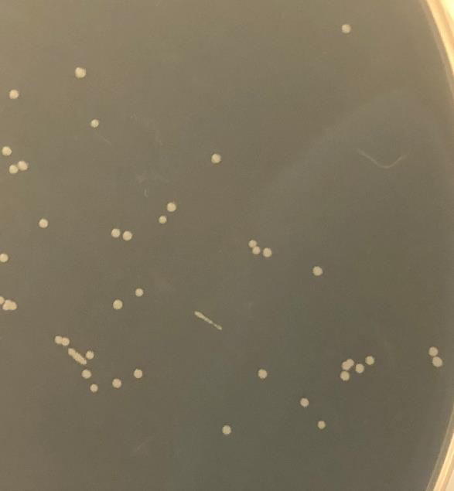
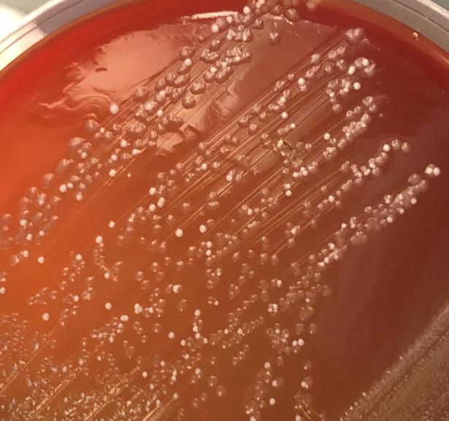
Streak for Isolation:
After streaking for isolation, you receive the following plates. Please choose a colony to continue with. Any tests you choose to do will follow this same colony until you are asked to return to this slide to pick another colony to identify.
2B
4N
1B
3B
1N
2N
3N
4B
1N
2N
1B
2B
3N
4N
3B
4B

Slide 4
You have forwarded without clicking the embedded link. Please click below to return to the beginning.
Start

Slide 5
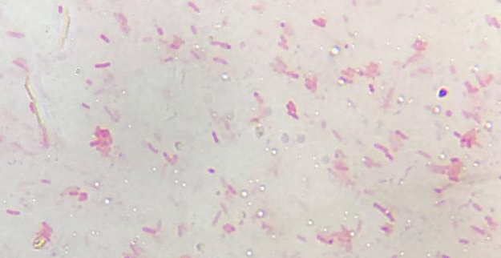
1N
Gram Stain Result:
You then perform a Gram Stain on colony 1N and view your slide using the 100x objective on your microscope.
ANY TESTS PERFORMED FROM THIS POINT ON WILL FOLLOW THE COLONY 1N.
Please choose the proper Gram Result to move forward.
Gram Positive
Gram Negative
Indeterminant
(Return to Streak)

Slide 6
You have forwarded without clicking the embedded link. Please click below to return to the beginning.
Start

Slide 7
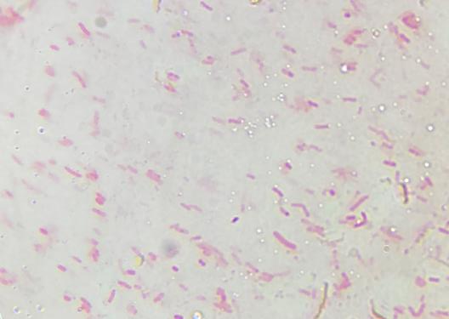
2N
Gram Stain Result:
You then perform a Gram Stain on colony 2N and view your slide using the 100x objective on your microscope.
ANY TESTS PERFORMED FROM THIS POINT ON WILL FOLLOW THE COLONY 2N.
Please choose the proper Gram Result to move forward.
Gram Positive
Gram Negative
Indeterminant
(Return to Streak)

Slide 8
You have forwarded without clicking the embedded link. Please click below to return to the beginning.
Start

Slide 9
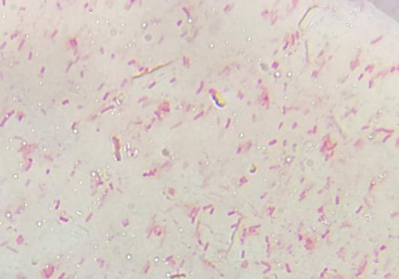
2B
Gram Stain Result:
You then perform a Gram Stain on colony 2B and view your slide using the 100x objective on your microscope.
ANY TESTS PERFORMED FROM THIS POINT ON WILL FOLLOW THE COLONY 2B.
Please choose the proper Gram Result to move forward.
Gram Positive
Gram Negative
Indeterminant
(Return to Streak)

Slide 10
You have forwarded without clicking the embedded link. Please click below to return to the beginning.
Start

Slide 11
Gram Positive Test Options:
MSA
PEA
Blood
Bile
Other Options
PICK A NEW COLONY

Slide 12
You have forwarded without clicking the embedded link. Please click below to return to the beginning.
Start

Slide 13
Gram Negative Test Options:
TSI
Motility
MAC
HEK
EMB
Citrate
Other Options
PICK A NEW COLONY

Slide 14
You have forwarded without clicking the embedded link. Please click below to return to the beginning.
Start

Slide 15
Other Test Options:
Oxidase Test
Catalase Test
Endospore Stain
Coagulase Test
Simple Stain
Negative Stain
All
Options
PICK A NEW COLONY

Slide 16
You have forwarded without clicking the embedded link. Please click below to return to the beginning.
Start

Slide 17
All Test Options:
MSA
PEA
Blood
Bile
MAC
EMB
HEK
TSI
Motility
Citrate
Coagulase Test
Simple Stain
Negative Stain
Oxidase Test
Endospore Stain
Catalase Test
PICK A NEW COLONY

Slide 18
You have forwarded without clicking the embedded link. Please click below to return to the beginning.
Start

Slide 19
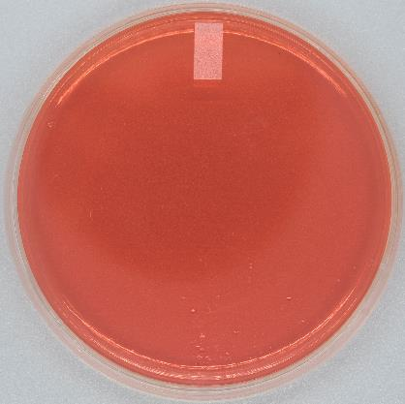
MSA Results:
Gram Positive Test Options
Gram Negative Test Options
Other Test Options
All Test Options

Slide 20
You have forwarded without clicking the embedded link. Please click below to return to the beginning.
Start

Slide 21
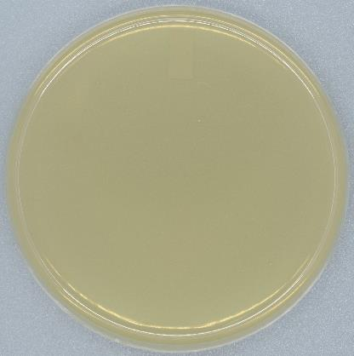
PEA Results:
Gram Positive Test Options
Gram Negative Test Options
Other Test Options
All Test Options

Slide 22
You have forwarded without clicking the embedded link. Please click below to return to the beginning.
Start

Slide 23
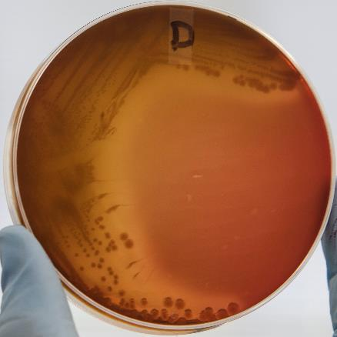
Blood Results:
Gram Positive Test Options
Gram Negative Test Options
Other Test Options
All Test Options

Slide 24
You have forwarded without clicking the embedded link. Please click below to return to the beginning.
Start

Slide 25
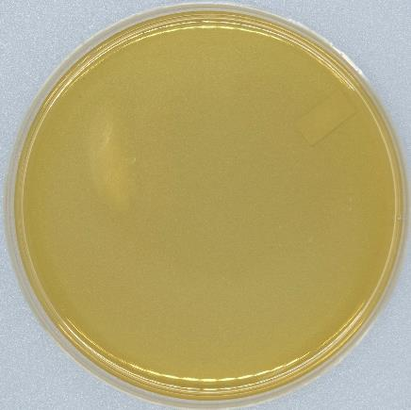
Bile Results:
Gram Positive Test Options
Gram Negative Test Options
Other Test Options
All Test Options

Slide 26
You have forwarded without clicking the embedded link. Please click below to return to the beginning.
Start

Slide 27
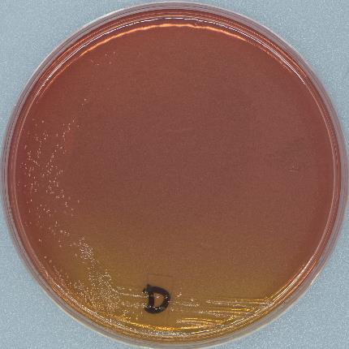
MAC Results:
Gram Positive Test Options
Gram Negative Test Options
Other Test Options
All Test Options

Slide 28
You have forwarded without clicking the embedded link. Please click below to return to the beginning.
Start

Slide 29
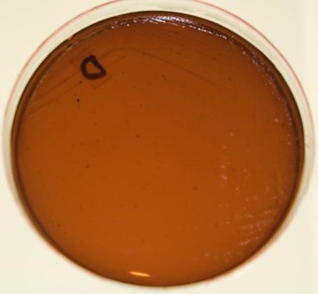
EMB Results:
Gram Positive Test Options
Gram Negative Test Options
Other Test Options
All Test Options

Slide 30
You have forwarded without clicking the embedded link. Please click below to return to the beginning.
Start

Slide 31
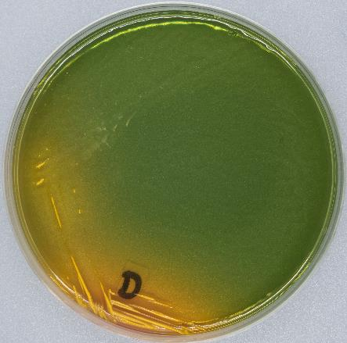
HEK Results:
Gram Positive Test Options
Gram Negative Test Options
Other Test Options
All Test Options

Slide 32
You have forwarded without clicking the embedded link. Please click below to return to the beginning.
Start

Slide 33
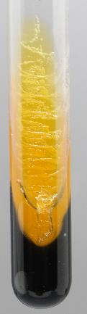
TSI Results:
Gram Positive Test Options
Gram Negative Test Options
Other Test Options
All Test Options

Slide 34
You have forwarded without clicking the embedded link. Please click below to return to the beginning.
Start

Slide 35
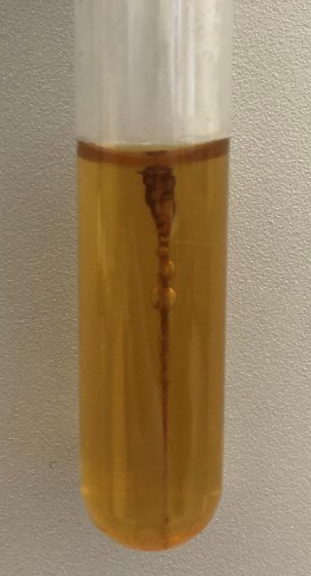
Motility Results:
Gram Positive Test Options
Gram Negative Test Options
Other Test Options
All Test Options

Slide 36
You have forwarded without clicking the embedded link. Please click below to return to the beginning.
Start

Slide 37
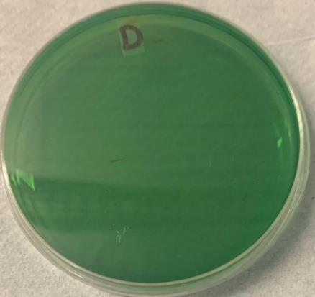
Citrate Results:
Gram Positive Test Options
Gram Negative Test Options
Other Test Options
All Test Options

Slide 38
You have forwarded without clicking the embedded link. Please click below to return to the beginning.
Start

Slide 39
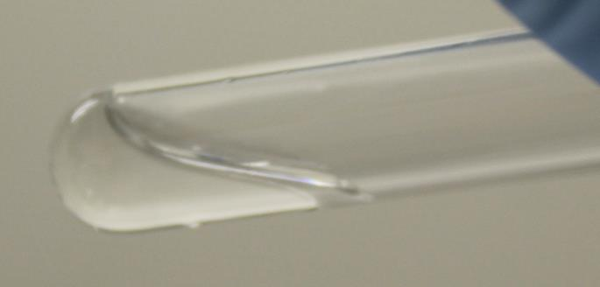
Coagulase Test Results:
Gram Positive Test Options
Gram Negative Test Options
Other Test Options
All Test Options

Slide 40
You have forwarded without clicking the embedded link. Please click below to return to the beginning.
Start

Slide 41
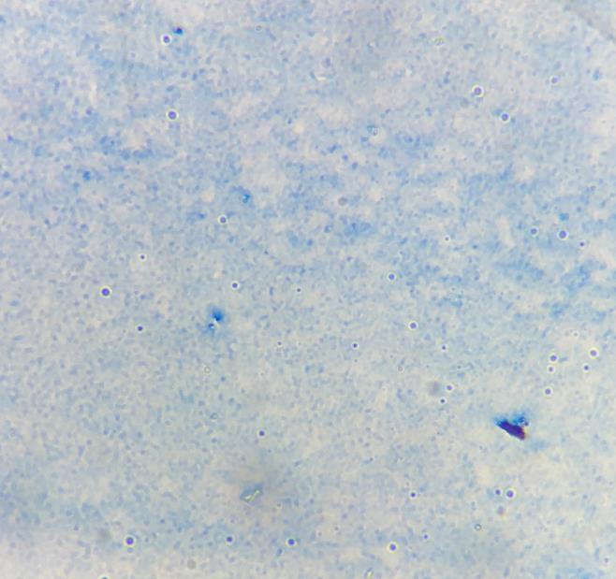
Simple Stain Results:
Gram Positive Test Options
Gram Negative Test Options
Other Test Options
All Test Options

Slide 42
You have forwarded without clicking the embedded link. Please click below to return to the beginning.
Start

Slide 43
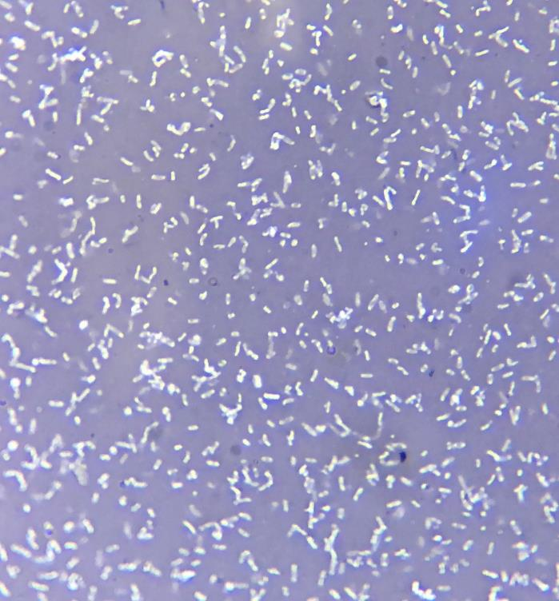
Negative Stain Results:
Gram Positive Test Options
Gram Negative Test Options
Other Test Options
All Test Options

Slide 44
You have forwarded without clicking the embedded link. Please click below to return to the beginning.
Start

Slide 45
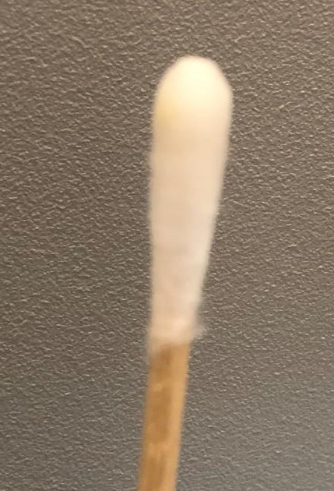
Oxidase Test Results:
Gram Positive Test Options
Gram Negative Test Options
Other Test Options
All Test Options

Slide 46
You have forwarded without clicking the embedded link. Please click below to return to the beginning.
Start

Slide 47
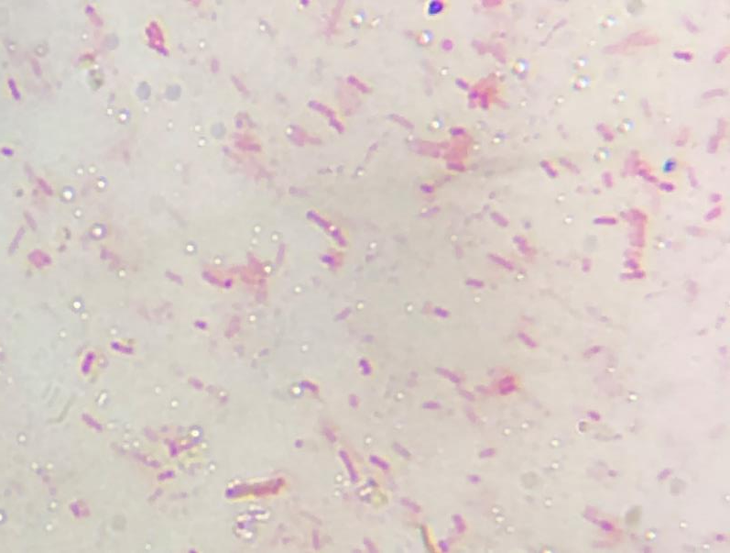
Endospore Stain Results:
Gram Positive Test Options
Gram Negative Test Options
Other Test Options
All Test Options

Slide 48
You have forwarded without clicking the embedded link. Please click below to return to the beginning.
Start

Slide 49

Catalase Test Results:
Gram Positive Test Options
Gram Negative Test Options
Other Test Options
All Test Options

Slide 50
You have forwarded without clicking the embedded link. Please click below to return to the beginning.
Start

Slide 51
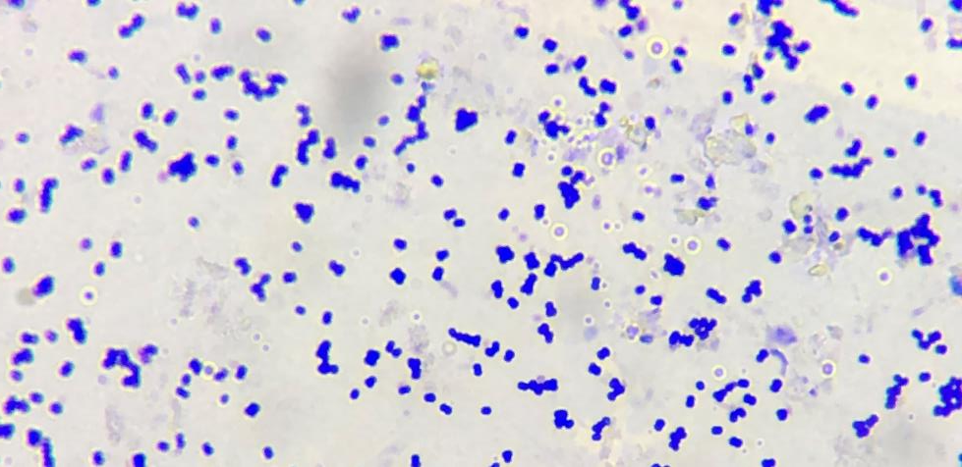
4N
Gram Stain Result:
You then perform a Gram Stain on colony 4N and view your slide using the 100x objective on your microscope.
ANY TESTS PERFORMED FROM THIS POINT ON WILL FOLLOW THE COLONY 4N.
Please choose the proper Gram Result to move forward.
Gram Positive
Gram Negative
Indeterminant
(Return to Streak)

Slide 52
You have forwarded without clicking the embedded link. Please click below to return to the beginning.
Start

Slide 53
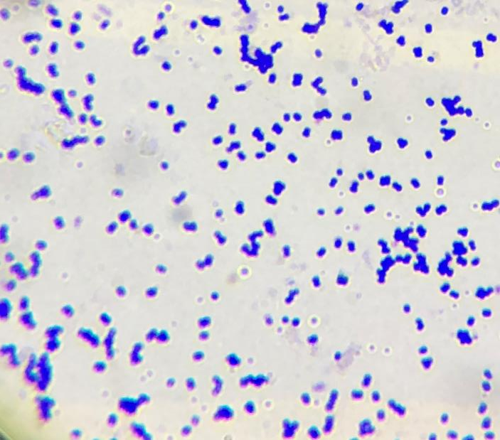
1B
Gram Stain Result:
You then perform a Gram Stain on colony 1B and view your slide using the 100x objective on your microscope.
ANY TESTS PERFORMED FROM THIS POINT ON WILL FOLLOW THE COLONY 1B.
Please choose the proper Gram Result to move forward.
Gram Positive
Gram Negative
Indeterminant
(Return to Streak)

Slide 54
You have forwarded without clicking the embedded link. Please click below to return to the beginning.
Start

Slide 55
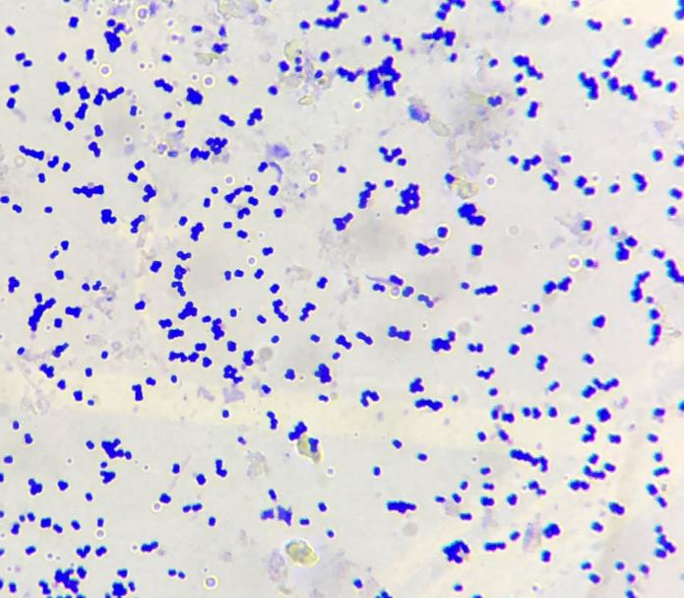
3B
Gram Stain Result:
You then perform a Gram Stain on colony 3B and view your slide using the 100x objective on your microscope.
ANY TESTS PERFORMED FROM THIS POINT ON WILL FOLLOW THE COLONY 3B.
Please choose the proper Gram Result to move forward.
Gram Positive
Gram Negative
Indeterminant
(Return to Streak)

Slide 56
You have forwarded without clicking the embedded link. Please click below to return to the beginning.
Start

Slide 57
Gram Positive Test Options:
MSA
PEA
Bile
Blood
Other Options
PICK A NEW COLONY

Slide 58
You have forwarded without clicking the embedded link. Please click below to return to the beginning.
Start

Slide 59
Gram Negative Test Options:
MAC
EMB
Motility
HEK
TSI
Citrate
Other Options
PICK A NEW COLONY

Slide 60
You have forwarded without clicking the embedded link. Please click below to return to the beginning.
Start

Slide 61
Other Test Options:
Coagulase Test
Simple Stain
Negative Stain
Oxidase Test
Endospore Stain
Catalase Test
All
Options
PICK A NEW COLONY

Slide 62
You have forwarded without clicking the embedded link. Please click below to return to the beginning.
Start

Slide 63
All Test Options:
MSA
PEA
Blood
Bile
MAC
EMB
HEK
TSI
Motility
Citrate
Coagulase Test
Simple Stain
Negative Stain
Oxidase Test
Endospore Stain
Catalase Test
PICK A NEW COLONY

Slide 64
You have forwarded without clicking the embedded link. Please click below to return to the beginning.
Start

Slide 65
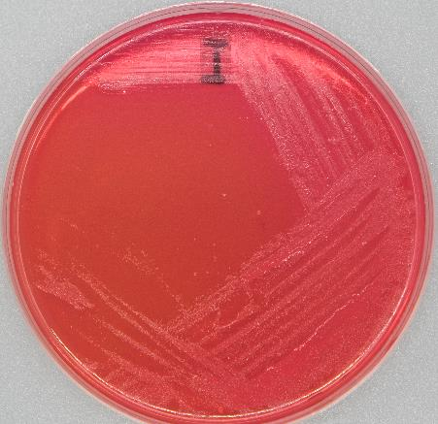
MSA Results:
Gram Positive Test Options
Gram Negative Test Options
Other Test Options
All Test Options

Slide 66
You have forwarded without clicking the embedded link. Please click below to return to the beginning.
Start

Slide 67
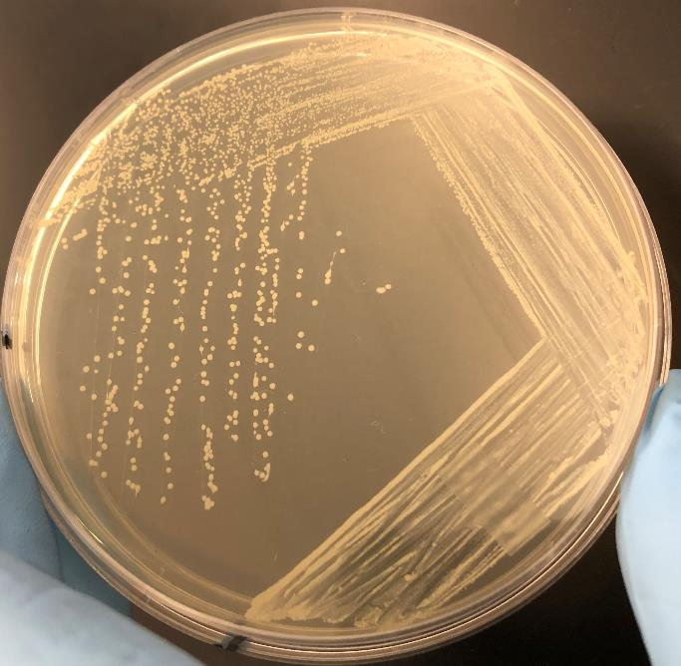
PEA Results:
Gram Positive Test Options
Gram Negative Test Options
Other Test Options
All Test Options

Slide 68
You have forwarded without clicking the embedded link. Please click below to return to the beginning.
Start

Slide 69
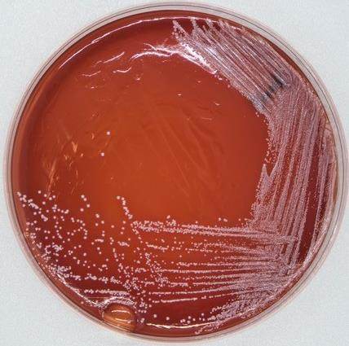
Blood Results:
Gram Positive Test Options
Gram Negative Test Options
Other Test Options
All Test Options

Slide 70
You have forwarded without clicking the embedded link. Please click below to return to the beginning.
Start

Slide 71
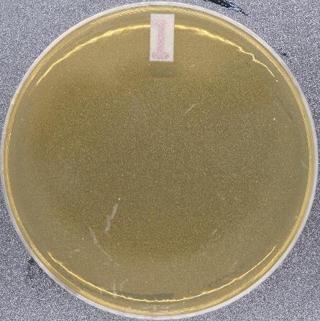
Bile Results:
Gram Positive Test Options
Gram Negative Test Options
Other Test Options
All Test Options

Slide 72
You have forwarded without clicking the embedded link. Please click below to return to the beginning.
Start

Slide 73
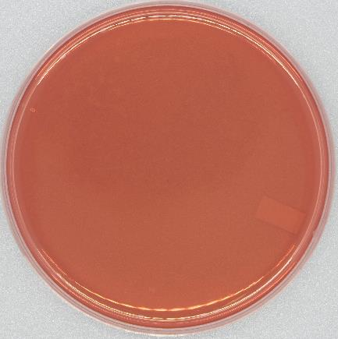
MAC Results:
Gram Positive Test Options
Gram Negative Test Options
Other Test Options
All Test Options

Slide 74
You have forwarded without clicking the embedded link. Please click below to return to the beginning.
Start

Slide 75
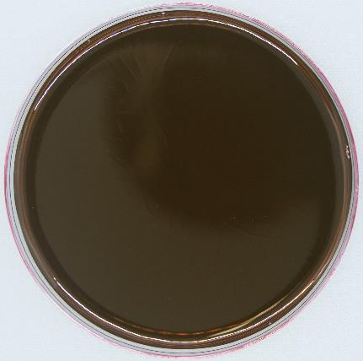
EMB Results:
Gram Positive Test Options
Gram Negative Test Options
Other Test Options
All Test Options

Slide 76
You have forwarded without clicking the embedded link. Please click below to return to the beginning.
Start

Slide 77
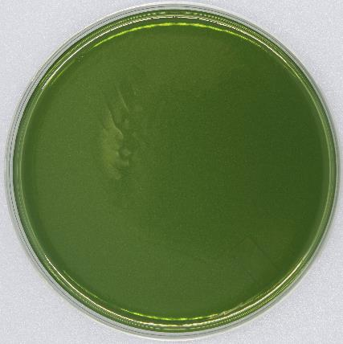
HEK Results:
Gram Positive Test Options
Gram Negative Test Options
Other Test Options
All Test Options

Slide 78
You have forwarded without clicking the embedded link. Please click below to return to the beginning.
Start

Slide 79
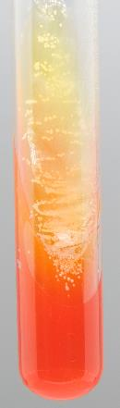
TSI Results:
Gram Positive Test Options
Gram Negative Test Options
Other Test Options
All Test Options

Slide 80
You have forwarded without clicking the embedded link. Please click below to return to the beginning.
Start

Slide 81
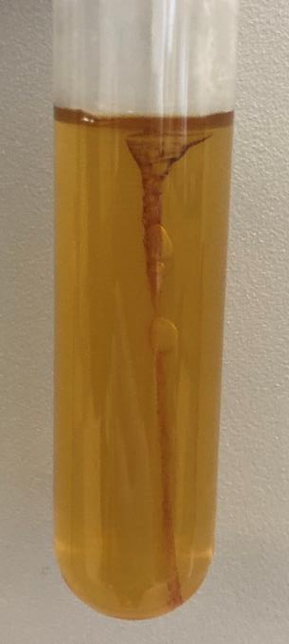
Motility Results:
Gram Positive Test Options
Gram Negative Test Options
Other Test Options
All Test Options

Slide 82
You have forwarded without clicking the embedded link. Please click below to return to the beginning.
Start

Slide 83
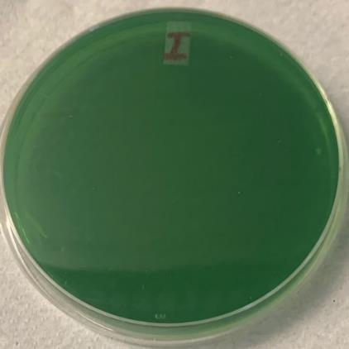
Citrate Results:
Gram Positive Test Options
Gram Negative Test Options
Other Test Options
All Test Options

Slide 84
You have forwarded without clicking the embedded link. Please click below to return to the beginning.
Start

Slide 85
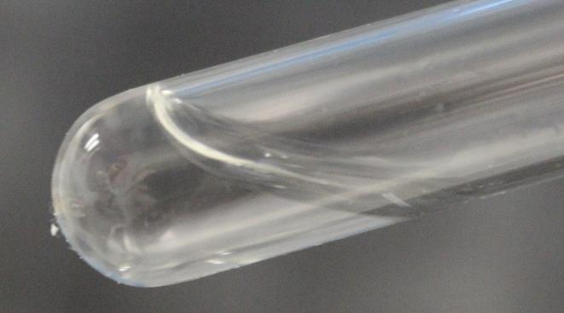
Coagulase Test Results:
Gram Positive Test Options
Gram Negative Test Options
Other Test Options
All Test Options

Slide 86
You have forwarded without clicking the embedded link. Please click below to return to the beginning.
Start

Slide 87
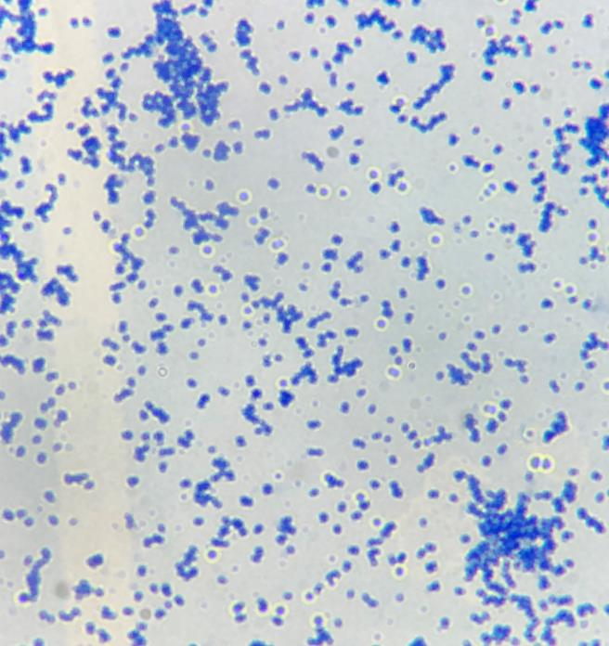
Simple Stain Results:
Gram Positive Test Options
Gram Negative Test Options
Other Test Options
All Test Options

Slide 88
You have forwarded without clicking the embedded link. Please click below to return to the beginning.
Start

Slide 89
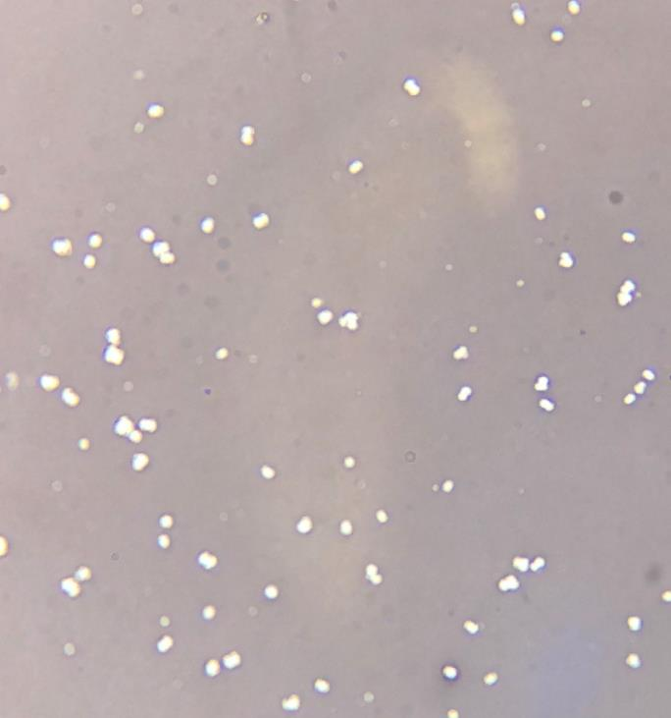
Negative Stain Results:
Gram Positive Test Options
Gram Negative Test Options
Other Test Options
All Test Options

Slide 90
You have forwarded without clicking the embedded link. Please click below to return to the beginning.
Start

Slide 91
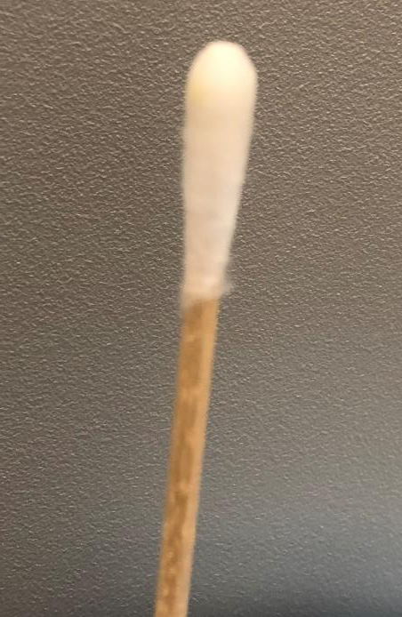
Oxidase Test Results:
Gram Positive Test Options
Gram Negative Test Options
Other Test Options
All Test Options

Slide 92
You have forwarded without clicking the embedded link. Please click below to return to the beginning.
Start

Slide 93
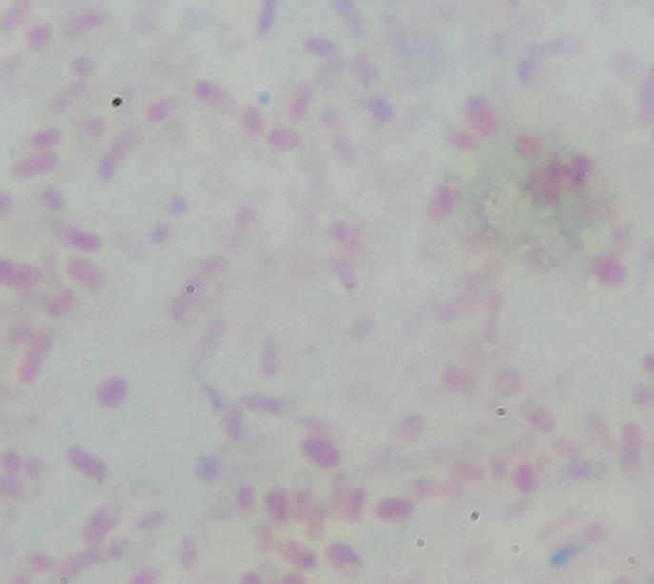
Endospore Stain Results:
Gram Positive Test Options
Gram Negative Test Options
Other Test Options
All Test Options

Slide 94
You have forwarded without clicking the embedded link. Please click below to return to the beginning.
Start

Slide 95

Catalase Test Results:
Gram Positive Test Options
Gram Negative Test Options
Other Test Options
All Test Options

Slide 96
You have forwarded without clicking the embedded link. Please click below to return to the beginning.
Start

Slide 97
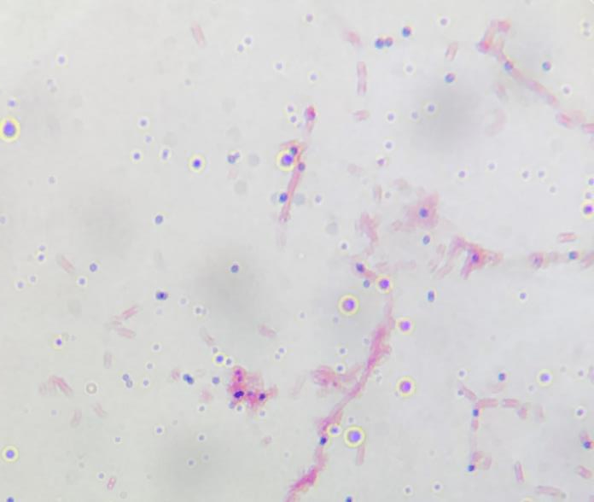
4B
Gram Stain Result:
You then perform a Gram Stain on colony 4B and view your slide using the 100x objective on your microscope.
ANY TESTS PERFORMED FROM THIS POINT ON WILL FOLLOW THE COLONY 4B.
Please choose the proper Gram Result to move forward.
Gram Positive
Gram Negative
Indeterminant
(Return to Streak)

Slide 98
You have forwarded without clicking the embedded link. Please click below to return to the beginning.
Start

Slide 99
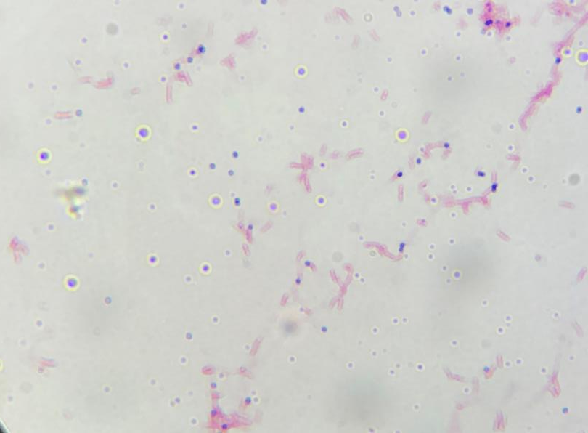
3N
Gram Stain Result:
You then perform a Gram Stain on colony 3N and view your slide using the 100x objective on your microscope.
ANY TESTS PERFORMED FROM THIS POINT ON WILL FOLLOW THE COLONY 3N.
Please choose the proper Gram Result to move forward.
Gram Positive
Gram Negative
Indeterminant
(Return to Streak)

Slide 100
You have forwarded without clicking the embedded link. Please click below to return to the beginning.
Start

Slide 101
Gram Positive Test Options:
MSA
PEA
Blood
Bile
Other Options
PICK A NEW COLONY

Slide 102
You have forwarded without clicking the embedded link. Please click below to return to the beginning.
Start

Slide 103
Gram Negative Test Options:
MAC
EMB
HEK
Motility
TSI
Citrate
Other Options
PICK A NEW COLONY

Slide 104
You have forwarded without clicking the embedded link. Please click below to return to the beginning.
Start

Slide 105
Other Test Options:
Coagulase Test
Simple Stain
Catalase Test
Oxidase Test
Endospore Stain
Negative Stain
All
Options
PICK A NEW COLONY

Slide 106
You have forwarded without clicking the embedded link. Please click below to return to the beginning.
Start

Slide 107
All Test Options:
MSA
PEA
Blood
Bile
MAC
EMB
HEK
TSI
Motility
Citrate
Coagulase Test
Simple Stain
Negative Stain
Oxidase Test
Endospore Stain
Catalase Test
PICK A NEW COLONY

Slide 108
You have forwarded without clicking the embedded link. Please click below to return to the beginning.
Start

Slide 109
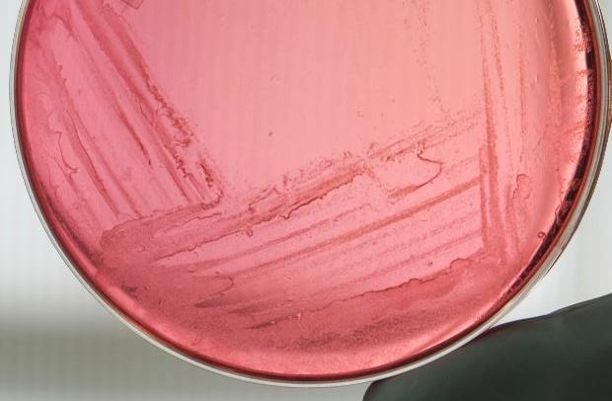
MSA Results:
Gram Positive Test Options
Gram Negative Test Options
Other Test Options
All Test Options

Slide 110
You have forwarded without clicking the embedded link. Please click below to return to the beginning.
Start

Slide 111
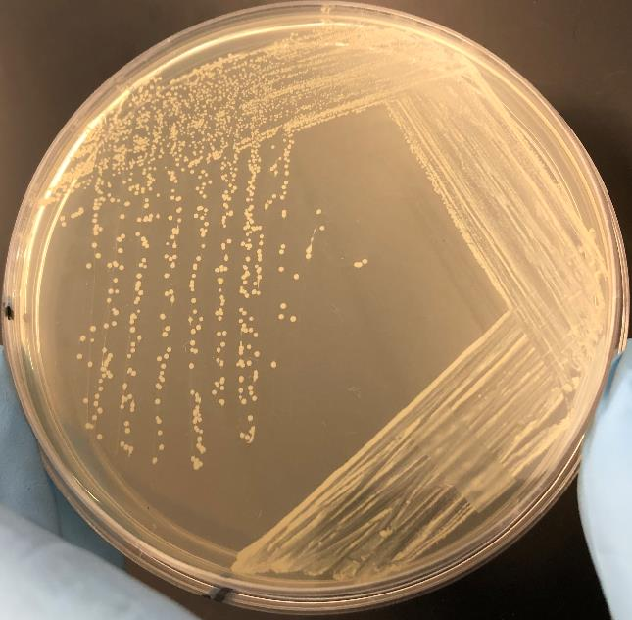
PEA Results:
Gram Positive Test Options
Gram Negative Test Options
Other Test Options
All Test Options

Slide 112
You have forwarded without clicking the embedded link. Please click below to return to the beginning.
Start

Slide 113
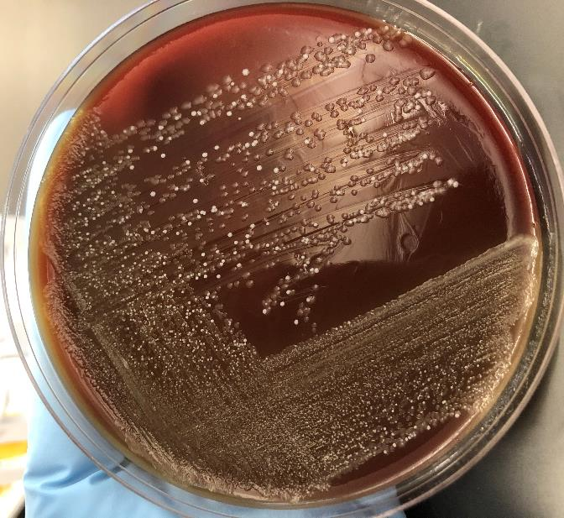
Blood Results:
Gram Positive Test Options
Gram Negative Test Options
Other Test Options
All Test Options

Slide 114
You have forwarded without clicking the embedded link. Please click below to return to the beginning.
Start

Slide 115
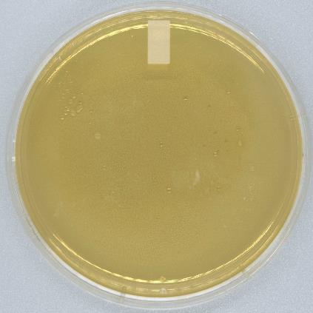
Bile Results:
Gram Positive Test Options
Gram Negative Test Options
Other Test Options
All Test Options

Slide 116
You have forwarded without clicking the embedded link. Please click below to return to the beginning.
Start

Slide 117
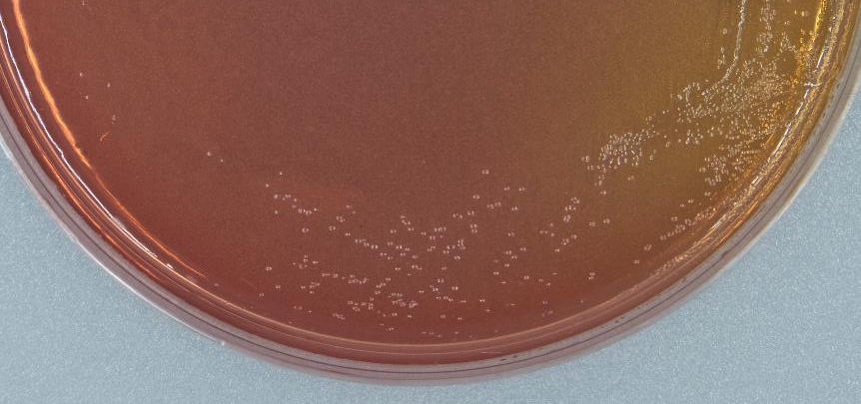
MAC Results:
Gram Positive Test Options
Gram Negative Test Options
Other Test Options
All Test Options

Slide 118
You have forwarded without clicking the embedded link. Please click below to return to the beginning.
Start

Slide 119
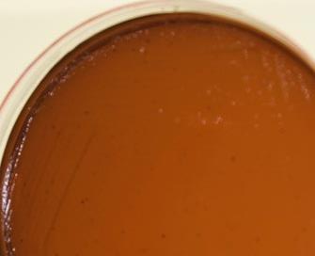
EMB Results:
Gram Positive Test Options
Gram Negative Test Options
Other Test Options
All Test Options

Slide 120
You have forwarded without clicking the embedded link. Please click below to return to the beginning.
Start

Slide 121
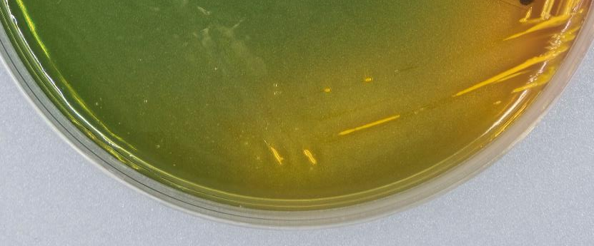
HEK Results:
Gram Positive Test Options
Gram Negative Test Options
Other Test Options
All Test Options

Slide 122
You have forwarded without clicking the embedded link. Please click below to return to the beginning.
Start

Slide 123
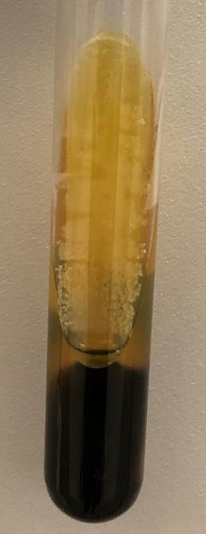
TSI Results:
Gram Positive Test Options
Gram Negative Test Options
Other Test Options
All Test Options

Slide 124
You have forwarded without clicking the embedded link. Please click below to return to the beginning.
Start

Slide 125
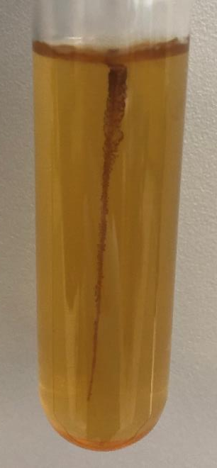
Motility Results:
Gram Positive Test Options
Gram Negative Test Options
Other Test Options
All Test Options

Slide 126
You have forwarded without clicking the embedded link. Please click below to return to the beginning.
Start

Slide 127
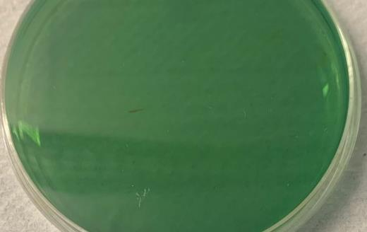
Citrate Results:
Gram Positive Test Options
Gram Negative Test Options
Other Test Options
All Test Options

Slide 128
You have forwarded without clicking the embedded link. Please click below to return to the beginning.
Start

Slide 129

Coagulase Test Results:
Gram Positive Test Options
Gram Negative Test Options
Other Test Options
All Test Options

Slide 130
You have forwarded without clicking the embedded link. Please click below to return to the beginning.
Start

Slide 131

Simple Stain Results:
Gram Positive Test Options
Gram Negative Test Options
Other Test Options
All Test Options

Slide 132
You have forwarded without clicking the embedded link. Please click below to return to the beginning.
Start

Slide 133

Negative Stain Results:
Gram Positive Test Options
Gram Negative Test Options
Other Test Options
All Test Options

Slide 134
You have forwarded without clicking the embedded link. Please click below to return to the beginning.
Start

Slide 135

Oxidase Test Results:
Gram Positive Test Options
Gram Negative Test Options
Other Test Options
All Test Options

Slide 136
You have forwarded without clicking the embedded link. Please click below to return to the beginning.
Start

Slide 137

Endospore Stain Results:
Gram Positive Test Options
Gram Negative Test Options
Other Test Options
All Test Options

Slide 138
You have forwarded without clicking the embedded link. Please click below to return to the beginning.
Start

Slide 139

Catalase Test Results:
Gram Positive Test Options
Gram Negative Test Options
Other Test Options
All Test Options

Slide 140
You have forwarded without clicking the embedded link. Please click below to return to the beginning.
Start

Slide 141
Would you like to perform any other tests?
YES
NO

Slide 142
You have forwarded without clicking the embedded link. Please click below to return to the beginning.
Start

Slide 143
Congratulations!
You have reached the end of the simulation. Press FINISH to end the show. Press START to return to the beginning.
Finish
Start

