Slide 1
PLC2: General Overview
Zachary, Tucker, Jiaqi, Alexander James

Slide 2
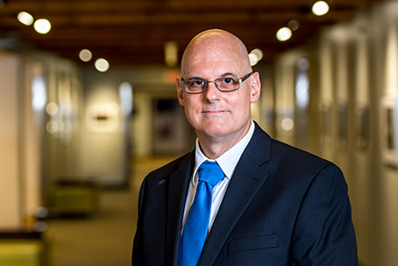
Who wants PLC2?
Client: Claude Anderson
Stakeholders: Future Students of CSSE304

Slide 3
What’s wrong with PLC1?
PLC Grading Server is currently unmanageable
Unmaintainable by current students (written in Ruby on Rails)
Documentation ranges from poor to non-existent
Client loses sleep over if the server will still be running the next day
Notes:
The PLC grading server is unmanagable. This is due to several issues in how the current system is written.
The current server is written in Ruby on Rails. Nobody knows Ruby on Rails because it’s not taught here.
There is no documentation, so even if students did know Ruby on Rails, it would be an uphill battle figuring out what’s going on.
The current deployment rests upon a House of Cards, Dr. Anderson lives in a constant state of fear that if the system goes down for some reason, then he won’t be able to get it to start again.

Slide 4
What’s good with PLC2?
Make the PLC Grading Server easier to maintain
Rewrite it using technologies and languages current students might know
Document the system so future development and management is possible
Allow peace of mind by building a stable system resilient to errors and changes
Notes:
How do we fix this? Easy, we just make the server easier to maintain.
We do this by rewriting it using things students may know. Mostly, we’re reaching into CSSE280 web services, but we also have some CSSE333 Databases sprinkled in there.
But knowing the language the thing is written in is only half the battle, you also need to understand what you’re reading as plain english.
Claude would like to not worry about the state of the server and, if it goes down, then he can easily redeploy it and debug it if necessary.

Slide 5
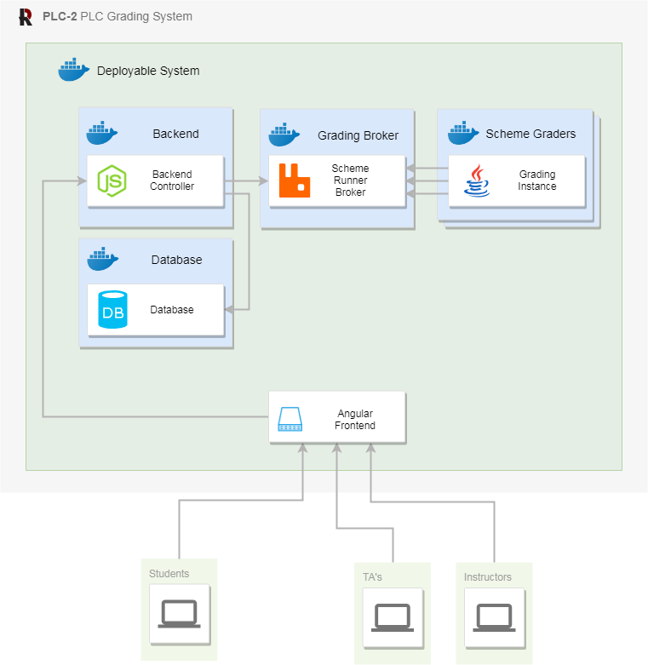
Architecture
Overview
Notes:
We wanted to separate our concerns, and form our design to be scalable in the places that mattered and simple in the places it didn’t.
For example, our architecture separates the backend and the scheme runner by a pub/sub queue to ensure that nothing blocks the speed of the backend - even a slow running piece of student code.
We also do this to allow scalability for grading submissions. Reading and writing to databases and handling requests is easy, but grading scheme submissions can take time. So with a queue, multiple graders can be subscribed to distribute the work load across multiple physical computers.
Docker is important here because it provides each component with portability and isolation. This is particularly important because we are executing foreign code on a regular basis and we want that to be as isolated as possible. Docker also provides stability and easy deployment.
We designed our system to utilize technologies like NodeJS, Angular, MySQL, and Java because classes involving them are taught here at Rose which allows future students to be able to maintain the system.

Slide 6
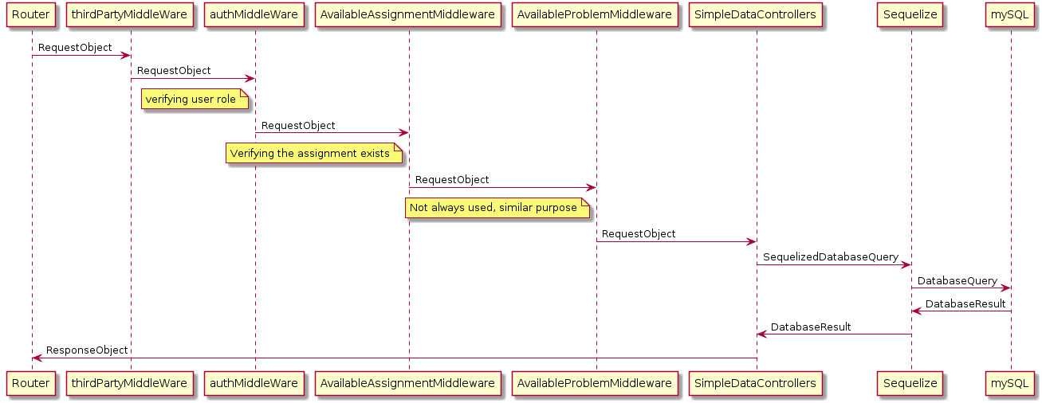
The Path of a Request
Notes:
For those unfamiliar with Express, everything that deals with or mutates a request and corresponding response is a middleware layer.
Express maintains a stack of middlewares that a request flows through in order to generate a response.
Explain AuthMiddleware
Explain Assignment and Problem Availability Middleware
Explain how controllers are also technically middleware but they’re the last in the stack so we don’t think of them like that.
Sequelize is our ORM layer which basically brings the ActiveRecord pattern into Javascript (objects correspond directly to database rows)

Slide 7
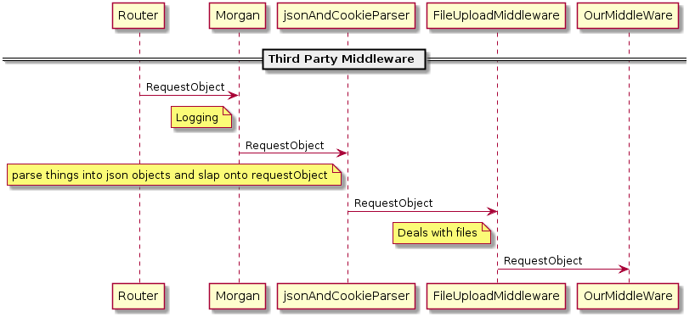
But What is Third Party Middleware?
Notes:
The nice thing about Express is that you don’t have to write all of the middleware. Sometimes a problem is so common, others write and publish middleware for you.
So you can plug things in like logging frameworks, body and cookie parsers, even file upload nonsense! By the time it hits our middleware, the request is nice and formatted for us to deal with.
We use morgan for logging

Slide 8
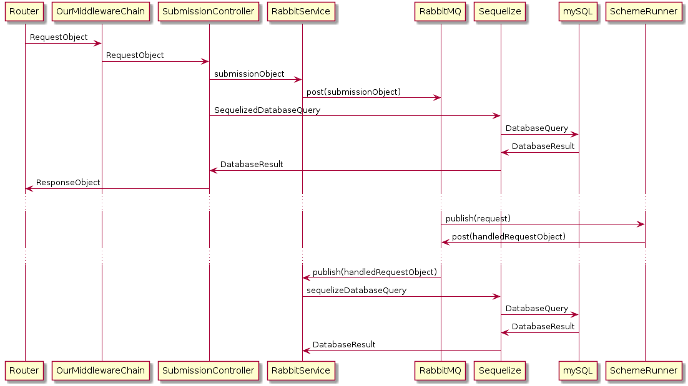
The Journey Of A Request
Notes:
For those unfamiliar with Express, everything that deals with or mutates a request and corresponding response is a middleware layer.
Express maintains a stack of middlewares that a request flows through in order to generate a response.
Explain AuthMiddleware
Explain Assignment and Problem Availability Middleware
Explain how controllers are also technically middleware but they’re the last in the stack so we don’t think of them like that.
Sequelize is our ORM layer which basically brings the ActiveRecord pattern into Javascript (objects correspond directly to database rows)
Let’s talk about how something is graded. File uploads to be graded.
First, we unpack the file that was sent. Was it a zip file or a single scheme file? We make an object to pass to the scheme grader.
We make this very large object to be graded and put it in the grading queue to be graded. We make a submission object in the database and return to the user that the submission was accepted for grading.
At some point, the scheme runner grades the code we’ve submitted and puts the result on a return queue.
At some point, the backend will pick up the result object and store it in the submission object. Now when the user requests that submission, the grade report (if visible to the user) will come with it.

Slide 9
What is a controller?
Contains endpoints for the router to route requests to
Interprets the objects and does some error checking
Executes its functionality (CRUD, create, read, update, delete)
Returns a response object
Notes:
Controllers primarily do the above functions, some are slightly more elaborate in that they also do some messing around with our rabbit messaging queue but most are this simple. They are the backbone and handlers of requests.

Slide 10
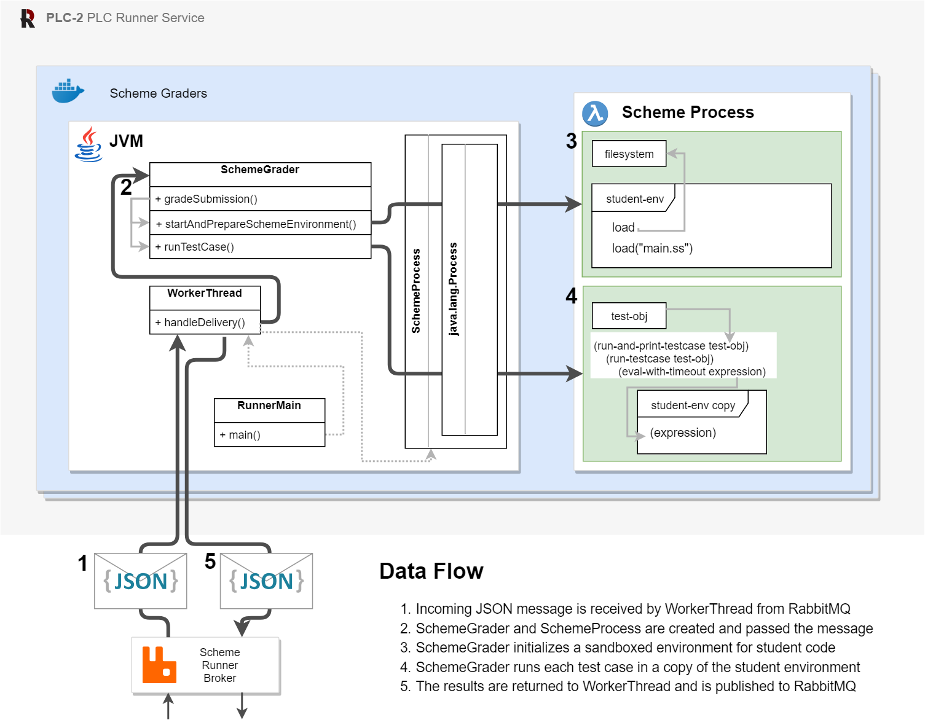
What’s a SchemeRunner?
Notes:
Big Function
Extendability
Availability and Integrity

Slide 11
What’s a SchemeRunner?
Notes:
Availability:
Broker pattern allows for scale which reduces overall response time
If a runner fails, other runners can take over
Integrity:
Student code is sandboxed several times and made separate from grading code
Students are run in separate processes
Maintainability:
Separation of concerns makes easy to make changes

Slide 12
Maintenance of Frontend
Pages are separated into components
Routes give overview of structure of website
All data management goes through services
Mocked backend used to develop and test
Mocked backend separated into several controllers (assignment, submission, user, etc.)
Notes:
Goal: Maintainable
Angular/Typescript: Similar to Java, easy to pick up. Used in Rose classes
Structure of angular project is easily maintainable, easy to find things
Pages broken up into components, like header, sidebar, content. Reuse components without duplicating code.
Traditional websites uses the a tag and href attribute to link to another html file, but angular has routes.
Angular loads entire project, routes, or url, determine which components to display.
A route can have child routes.
Routes setup give overview of structure of website and which component you’re looking for.
Services (singleton classes) used to manage data and communicate to backend
Fake backend with mock data - frontend can develop independently of the backend.
More portable development, faster building and testing time.
Fake backend separated into controllers, one for each endpoint, easier to find and change code.

Slide 13
How does design meet your goals?
Maintainability
Documentation
Resilience
Notes:
Using easy to learn languages, ones taught in Rose
Good 374 design principles, no code duplication, single responsibility classes.
Good 477 quality attributes of maintainability, usability, extensibility
Extensibility - scheme runners are swappable
Usability - Feedback from client drives design
Documentation provided. API endpoint, VM access, deploy.
Rely on Docker’s error handling to keep the server stable, restart containers if they fail.

Slide 14
Are there any design flaws?

Slide 15
You Betcha!
Known Design Issues
Scheme runner could error on professor input.
Docker containerization can be difficult to explain to new developers
It is possible for there to be no scheme runners alive
A user is required to create scheme runners
Bootstrapping aka “the first user” problem
Less Known Design Issues
Not HTTPs / SSL
Potential unexpected bottlenecks (MySQL)
We’re not distributed so a machine crashing crashes a part of the system
Notes:
Admin needs to manually spool up scheme runners. When restarting and when during exams.

Slide 16
Questions?

