Slide 1
Lattice Core
Daniel Huffman
dhuffman@malwarebytes.com
Cosmos Team
Clearwater office
https://github.com/drhuffman12/presentations/tree/master/lattice-core

Slide 2
Lattice Core
Realtime-first web framework
Based on
Crystal, Kemal, WebSockets,
Baked File System, etc.
Jason Landry
https://github.com/jasonl99

Slide 3
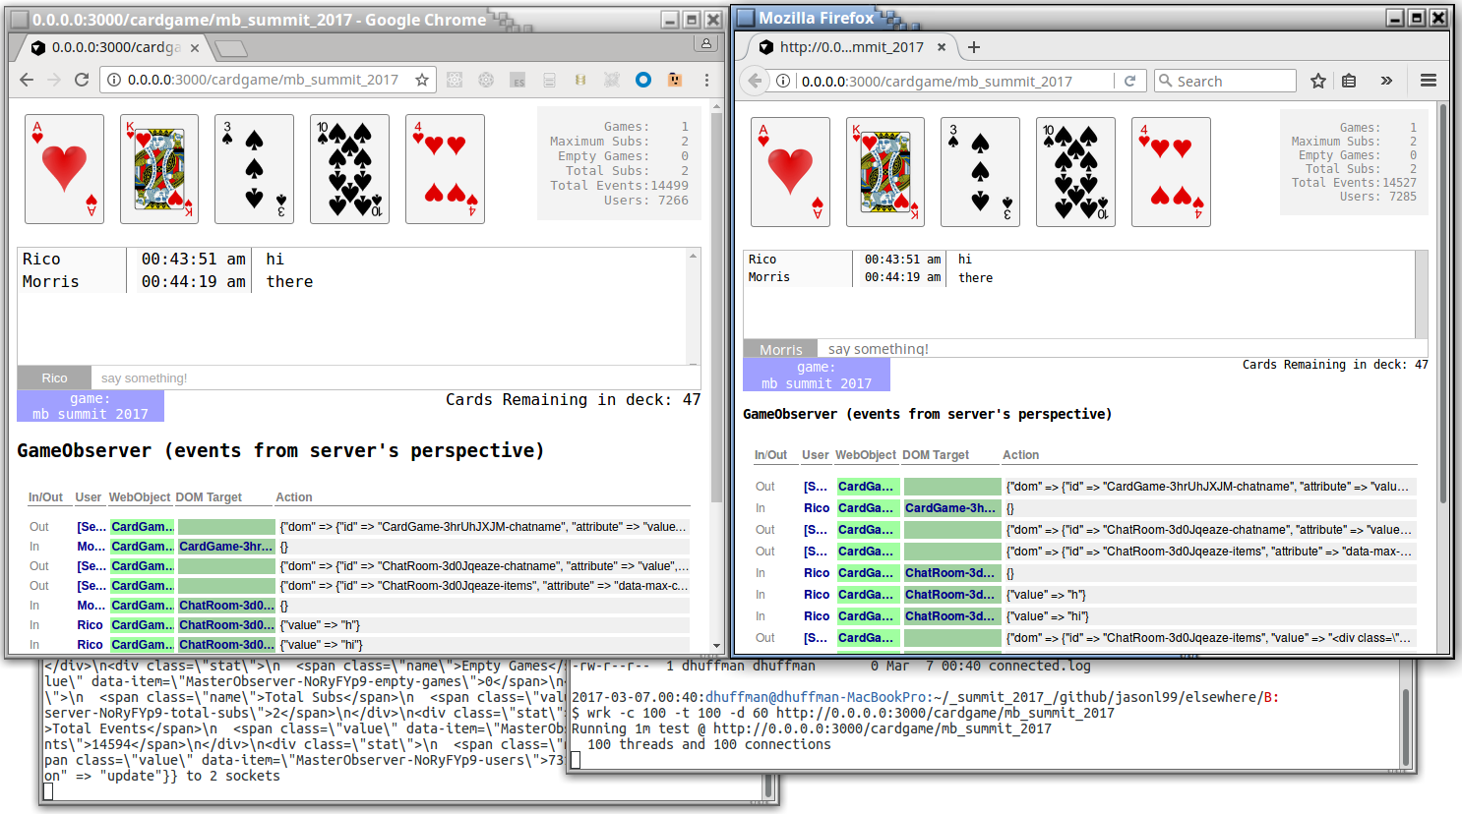
Lattice Core Realtime-first web framework
https://github.com/drhuffman12/presentations/blob/master/lattice-core/
LatticeCore.CardGame.mp4
Clickable Events
Chat Area
Event Log
App Server
Stats Counters of connections and events
Wrk to add MANY connections ‘live’

Slide 4
Lattice Core Realtime-first web framework
Server-side:
Ruby-like developer-friendly source code syntax
C-like speed
Single compiled application binary
Web assets bundled
Browser session connected to server WebSocket
Cross-platform (WIP)

Slide 5
Lattice Core Realtime-first web framework
Client-side:
Multiple users
Multiple content subscriptions per user session
Sessions/WebSockets tied to content subscribers
All subscribers' content areas dynamically updated

Slide 6
Lattice Core Realtime-first web framework
Lattice Core
https://github.com/jasonl99/lattice-core
Crystal-lang
https://crystal-lang.org/
Kemal
http://kemalcr.com/
Baked File System
https://github.com/schovi/baked_file_system
Card Game (Example Lattice Core App)
https://github.com/jasonl99/card_game

Slide 7
Lattice Core Realtime-first web framework
Install Git
https://git-scm.com/
Install Crystal
https://crystal-lang.org/docs/installation/index.html
Clone Card Game
git clone https://github.com/jasonl99/card_game.git
Update dependencies
shards update
Compile App
crystal build --release src/card_game.cr
[Optional] Deploy only binary
mkdir -p ../elsewhere
cp card_game ../elsewhere
cd ../elsewhere
# … or to AWS or etc.
Run server binary
./card_game
Browse Web App
http://0.0.0.0:3000/cardgame/<game_room>

Slide 8
Lattice Core Realtime-first web framework
https://github.com/drhuffman12/presentations/blob/master/lattice-core/
LatticeCore.CardGame.mp4
Clickable Events
Chat Area
Event Log
App Server
Stats Counters of connections and events
Wrk to add MANY connections ‘live’

Slide 9
Lattice Core Realtime-first web framework
https://github.com/drhuffman12/presentations/blob/master/lattice-core/
LatticeCore.CardGame.mp4

Slide 10
Lattice Core Realtime-first web framework
Therefore, I think we should take
a deeper look at new technologies that are
developer friendly and highly performant like
Lattice-core, Kemal, Crystal, and WebSockets,
so that we can keep our
developers productive and our
customers' experience zippy.

