Slide 1
Computability-and-Complexity-Theory

Slide 2
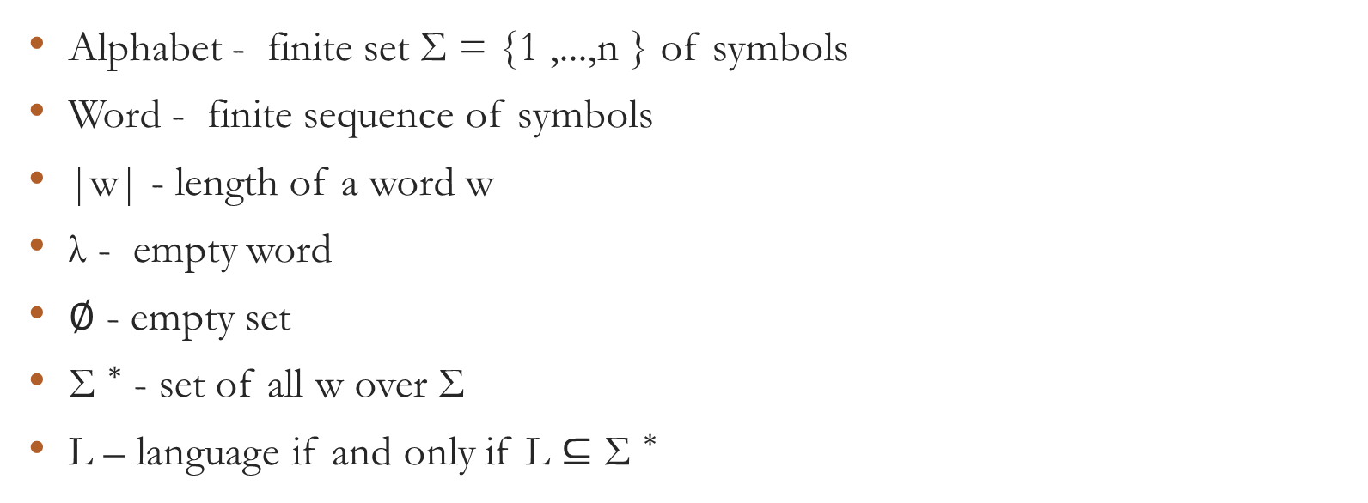
Words and Languages
Alphabet - finite set Σ = {1 ,...,n } of symbols
Word - finite sequence of symbols
|w| - length of a word w
λ - empty word
∅ - empty set
${\text{Σ} }^{∗}$ - set of all w over Σ
L – language if and only if L ⊆ ${\text{Σ} }^{∗}$

