Slide 1
Android development using Java

Slide 2
Content
How android application work?
App components
Creating a activity

Slide 3
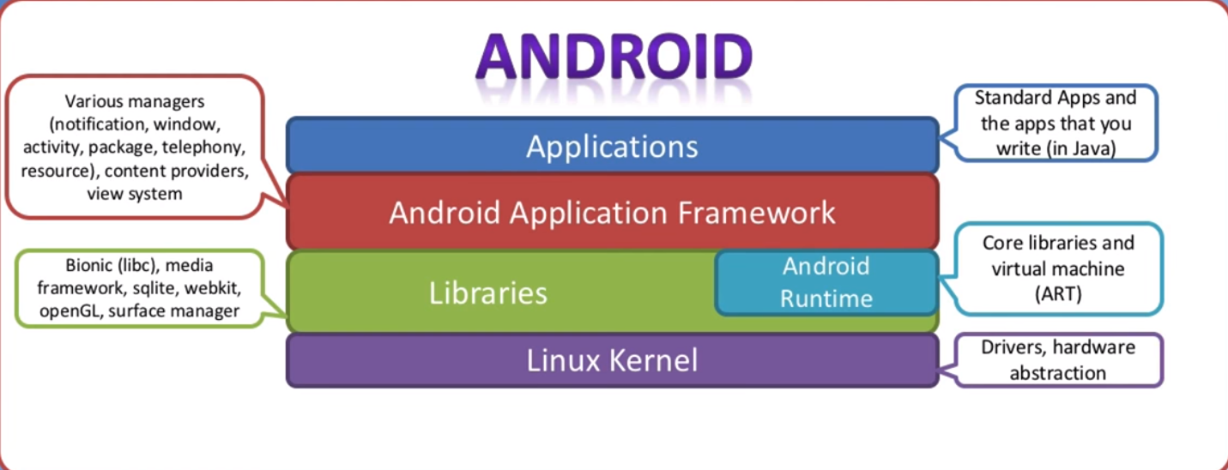
How android application work?

Slide 4
App components
Activities – User interface
Services - keeping an app running in the background
Broadcast receivers - enables the system to deliver events to the app outside of a regular user flow
Content providers - manages a shared set of app data that you can store in the file system
The manifest file - declare all its components for android to know they exist
App resources – where multimedia stored

Slide 5
Two Content Layout with SmartArt
First bullet point here
Second bullet point here
Third bullet point here
Group A
Task 1
Task 2
Group B
Task 1
Task 2
Group C
Task 1
Task 2

