Slide 1

Anubis
Seeing is believing

Slide 2
What’s the point?
Global coordination among multiple agents that take local actions based on local decisions
We consider agents that are programmed to react to conditions detected in a system
Sometimes agents need to take actions that are consistent or coordinated with other agents
Sometimes parts of the system fails, leading to impossibility issues with respect to detection
Sometimes the agents that need to be coordinated cannot see each other or the same parts of the system
Consistent state observation = consistent decisions

Slide 3
Introduction
The Theory
  Timed Asynchronous Distributed Systems Model
  Fail-Awareness
  Partitions
  State Observation
The Implementation
  Timed Connections
  Connection Set
  Partition Manager
  Timed Messages
  State Manager
  Interface
  Tools

Slide 4
The Theory

Slide 5
Timed-Asynchronous Distributed Systems
A realistic theoretical model of distributed systems
  Known as “timed model” for short
  Actually a characterisation of real distributed systems
A distributed system is:
  Processing nodes with clocks
  Processes on processing nodes with access to local clock
  Datagram networks between processing nodes
Assumptions
  Almost always, clocks are monotonically increasing
  Almost always, clocks have bound drift rate
  In general, Processes are scheduled with bound delay
  But, processes can crash
  In general, datagrams are communicated with bound delay
  But, datagrams can be lost

Slide 6
Fail-Aware
Fail-awareness is the ability to know when a given semantic model applies (or the system adheres to the specification)
  Exploit semantics when they hold
  Understand when they don’t
Fail-awareness can be used to exploit the timed model in reality
  Interpret everything as timing properties
Fail-aware timed model
  Clocks are monotonically increasing and have bound drift rate
  Processes are scheduled within bound delay
  Datagrams are communicated within a bound delay
If any of the above does not hold set an exception indicator

Slide 7
Partitions
A system is composed of processing nodes :
  System – the set of all processing nodes
  We adopt the timed model except to say clocks have bound divergence (skew)
We establish a timeliness relationship between processing nodes
We say p considers q to be timely at a given moment iff
  p receives messages from q within a bound time (δ)
  p’s clock has a bound difference to q’s clock (ε)
  p meets its scheduling delay bound (η)
We denote timeliness by:
  timely_{p}(q, t) – p consider q timely at time t
In practice, we approximate timeliness by a time bound for:
  The difference between a datagram timestamp and the time it is processed in the receiving process
  Δ = δ + ε + η
  There are other measures for timeliness, this is an implementation choice

Slide 8
Partitions
A connection view is relative to a processing node:
The connection view of p is:
  The collection all processing nodes that are timely wrt p
  CView_{p}(t) – the connection view of p at time t
Each processing node shares its connection view:
  Passed in messages
  When timely, messages are received within Δ
  timely_{p}(q, t) implies p knows CView_{q}(t’) for some t-Δ ≤ t’ ≤ t
A connection set is relative to a processing node:
  The connection set is the collection of connection views from all the processing nodes in the local connection view
  CSView_{p}(q,t) – the connection view of q as known to p at time t
  CSView_{p}(q,t) = CView_{q}(t’) for some t-Δ ≤ t’ ≤ t
  CS_{p}(t) – the connection set of p at time t
  CS_{p}(t) = { CSView_{p}(q, t) ⎜ timely_{p}(q,t) }

Slide 9
Partitions
Stability is relative to a processing node
A processing node is stable iff:
  All connection views in its connection set are the same, and
  The connection set has remained unchanged for Δ
  Stable_{p}(t) ⇒
  ( ∀q∈CView_{p}(t) • CSView_{p}(q, t) = CView_{p}(t) ) ∧
  ( ∀s∈[t-Δ, t]• CS_{p}(s) = CS_{p}(t) )
Each processing node derives a partition view with the following properties:
  If p is stable then the partitions of all nodes are either subsets of its partition or do not intersect it
  ∀q∈System • ( Stable_{p}(t) ⇒
  partition_{q}(t) ⊆ partition_{p}(t) ∨ partition_{q}(t) ∩ partition_{p}(t) = ∅ )
  (Note that if two nodes are stable their partitions are the same or disjoint)
  If p has remained stable for Δ then all nodes in its partition stabilised with the same partition
  (∀s ∈ [t-Δ, t] • Stable_{p}(s) ) ⇒
  (∀q ∈ partition_{p}(t) • Stable_{q}(t-Δ) ∧ partition_{p}(t) = parittion_{q}(t-Δ) )

Slide 10
Partitions
Stable partitions define the semantic model for our distributed system
Stability is our fail-aware indicator

Slide 11
State Observation
State is represented by a state variable and its value:
  The variable is uniquely named and can be created and removed
  The value is any arbitrary structure and may change
  Where clear from the context, we use the term state to mean either:
    A particular value of a particular variable, or
    The state variable
  By state change we mean a change of value for a given variable
Processing nodes have state variables
  The variable names are unique
  The values represent states
Processing nodes can observe state variables
  Processing nodes observe their own states
  Processing nodes can chose to observe the states of other nodes
  States from within the observers partition can be observed
  States from outside the observers partition are not observed
  When an observer cannot observe a state (variable) we say it observes the absence of the state (variable)

Slide 12
State Observation
Information about states can be communicated within a partition within time Δ
  Known from partition semantics
  There is a consistency between the state and its observers:
    Observers observe the state within Δ, or
    Observe its absence within Δ
  There is a consistency between observers of a state:
    Observers either observe the same states within Δ of each other, or
    Observe the absence of the state within Δ
We say an observer knows about a state that it has observed
  The knowledge of states that occur Δ or more in the past is consistent among all observers:
    Either they know the states or not
    They do not have contradictory knowledge
Within a stable partition observers can derive something of each others knowledge:
  When an observer observes a state it does not know if other observers know it
  After Δ the observer can be sure all observers know it
  After 2Δ the observer can be sure all observers know all observers know it
  Etc…
  When an observer observes a state it knows that any observer not in its partition does not observe the state
State observation, stability and partitions are sufficient to solve many global coordination problems

Slide 13
The Implementation

Slide 14
Anubis Layers
Locator
State Manager
Partition Manager
Partition
Connection Set
Timed Connections
X Transport
TCP/UDP

Slide 15
View
A view is a representation of the system relative to a particular viewpoint
  The viewpoint is always an Anubis server
A view has:
  A set of Anubis servers (identified by node id)
  Stability
  Timestamp
Set operations can be performed on views
  Contains (both node or view), overlap, equal
There are two important views:
  Connection view
  Partition view

Slide 16
Timed Connections
A timed connection represents a remote server:
  Its identity
  Its timeliness with respect to the local server
  Its connection view (described later)
  Its leader candidate
It is a timing relationship
  not a message passing relationship
  But - it can be extended to be a message passing relationship
A server is always timely with respect to itself
  It has a timed connection to itself

Slide 17
Timed Connections
Connections implement HeartbeatProtocol
  HeartbeatProtocol extends View
HeartbeatProtocol determines timeliness and quiescence
  Timely ⇒ meeting timing reqs
  Quiesced ⇒ gone quiet
Anubis connections extend HeartbeatProtocolAdapter
  Protocol is a plug-in
  Default impl can be replaced
  Easy to pass protocol state from one connection to another
isNotTimely(…)
isQuiesced(…)
HeartbeatProtocol
Adapter
isNotTimely(…)
isQuiesced(…)
HeartbeatProtocolImpl

Slide 18
Connection Set
The connection set maintains a view of timing:
  The set of servers that are timely with respect to the local server
  The connection set implements the local connection view
Each timed connection is also a connection view
  The connection view of the remote server
  If a connection is timely its connection view is timely
The local connection set is consistent when:
  All timely connection views agree on membership
The local connection view is stable when:
  The connection set is consistent, and
  The stability time is reached (see next bullet)
The local connection view timestamp identifies its stability time
  Initially, first moment of consistency + stability interval
  Then adjusted to minimum of all timely connection view timestamps
  Undefined when inconsistent

Slide 19
Connection Set
ConnectionSet implements View
ConnectionSet contains a collection of timed connections
  These also implement View (HeartbeatProtocol extend View)
The job of ConnectionSet is to implement the connection view
  Identifies the timely connections
  Identifies set consistency
  Identifies view stability
  Identifies the view stability time
ConnectionSet
TimedConnection
TimedConnection
TimedConnection
TimedConnection

Slide 20
Connection Set - Timeliness
Heartbeats are delivered to the appropriate connection by the connection set.
If a corresponding connection does not exist, a new one is created
  Heartbeat delivered to the new connection
  If timely, added to the connection view
Heartbeat Coms
ConnectionSet
TimedConnection
TimedConnection
TimedConnection
TimedConnection

Slide 21
Connection Set - Timeliness
IntervalExec orchestrates periodic operations
Connections are periodically checked for timeliness and quiescence
  Untimely connections are removed from the connection view
  Quiesced connections are removed from the connection set
A heartbeat is periodically sent by multicast
Heartbeat Coms
IntervalExec
ConnectionSet
TimedConnection
TimedConnection
TimedConnection
TimedConnection

Slide 22
Connection Set - Stability
Heartbeats contain the connection view of the sending server
If a remote connection view changes, the heartbeat protocol of the timed connection will notify the ConnectionSet
ConnectionSet will destabilise its connection view
ConnectionSet is also notified if the timestamp of a remote connection set view changes
Heartbeat Coms
ConnectionSet
TimedConnection
TimedConnection
TimedConnection
TimedConnection

Slide 23
Connection Set - Stability
When unstable, the connection set periodically checks for consistency
  Less expensive than checking on every change
If consistent, initiate a stability interval
  Set timestamp to now + stability interval
  or the earliest of all timestamps
If new timestamps are reported the local timestamp may be adjusted
IntervalExec
ConnectionSet
TimedConnection
TimedConnection
TimedConnection
TimedConnection

Slide 24
Partition Manager
The partition protocol identifies the local partition view
  It is a view
  It implements the partition semantics
The partition protocol operates as follows:
  Members evicted if not timely (same as connection view)
  Members evicted if they do not view local server as timely
  Stability matches connection view stability
  Members are only added when the connection view is stable
The partition protocol also identifies the leader
  Leader election on every partition change

Slide 25
Partition Manager
ConnectionSet notifies PartitionProtocol when
  Untimely connection
  Lack of reciprocated timeliness
  Unstable notification
  Stable notification
PartitionProtocol directs leader election on changes
  Election protocol created by factory
  Can be changed
PartitionProtocol
ConnectionSet
TimedConnection
TimedConnection
TimedConnection
TimedConnection

Slide 26
Partition Manager
PartitionManager provides:
  registerPartitionNotification(PartitionNotification)
  deregisterPartitionNotification(PartitionNotification)
  Notification upcalls to:
    PartitionNotification.partitionNotification(view, leader)

Slide 27
Timed Messages
MessageConnection is an alternative implementation of timed connections that provides timely, ordered message delivery
Connection-oriented protocol
  Connections set-up/tear-down by switching HeartbeatConnection to MessageConnection and back
  Connection set-up either end needs it
  Connection tear-down neither end needs
  All failures interpreted as timing failures (untimely)
The need for a connection is indicated in heartbeats
  Same end always initiates TCP connect and disconnect
  (the one with the lower id)

Slide 28
Message Connection
MessageConnection extends HeartbeatProtocolAdapter
Has own TCP socket connection
  Receives heartbeats from TCP
  Receives messages from TCP
  All messages ordered
Drops heatbeats that come from UDP multicast
TCP failures lead to an untimely connection
MessageConnection
HeartbeatProtocolImpl
TCP Socket

Slide 29
Message Connection – Set-up
Set-up is initiated at either end
  Mark heartbeats
  Only if timely
ConnectionSet constructs MessageConnection passing the HeartbeatProtocolImpl from the old HeartbeatConnection
MessageConnection immediately open for messages
  Output messages buffered until they can be sent
TCP connection follows set-up
ConnectionSet
HeartbeatConnection
MessageConnection
HeartbeatProtocolImpl

Slide 30
Message Connection – Set-up
If at TCP connect end
Construct MessageConnection
  At user request, or
  When heartbeat marked
Construction initiates asynchronous TCP Socket creation using MessageConnectionInitiator
  TCP connect
  Send initial heartbeat
  Assign new socket back to MessageConnection
ConnectionSet
HeartbeatConnection
HeartbeatConnection
HeartbeatConnection
MessageConnection
TCP Socket
ConnectionServer
MessageConnectionInitiator

Slide 31
Message Connection – Set-up
If at TCP accept end
Construct MessageConnection
  If user requests
Construction does not create TCP Socket
ConnectionServer accepts connection and receives initial heartbeat
If no MessageConnection, construct one with socket, otherwise just deliver socket
ConnectionSet
HeartbeatConnection
HeartbeatConnection
HeartbeatConnection
MessageConnection
TCP Socket
ConnectionServer

Slide 32
Message Connection – Set-up
Tear-down initiated by TCP connect end
When no marking in heartbeats
  Send close msg
  Wait for close return
  Revert to HeartbeatConnection
Can be re-initiated at any point
  E.g. due to new markings received during close
ConnectionSet
HeartbeatConnection
HeartbeatConnection
HeartbeatConnection
MessageConnection
TCP Socket

Slide 33
Partition Manager Interface
PartitionManager provides:
  registerPartitionNotification(PartitionNotification)
  deregisterPartitionNotification(PartitionNotification)
PartitionNotification has upcalls for:
  partitionNotification(View partition, int leader)
  objectNotification(Object object, int sender, long timestamp)
To use the partition manager:
  implement the PartitionNotification interface, and
  Register
You will be notified of:
  partition and leader changes via partitionNotification(…)
  Object delivery (messages) via objectNotification(…)

Slide 34
Partition Manager Interface
PartitionManager also provides:
  connect(node_id) – returns MessageConnection
MessageConnection provides:
  disconnect()
  sendObject(object)
MessageConnection can only be set-up between servers that have a mutual timeliness
  If its not in the partition view, you can not send messages to it
All MessageConnection failures are timing failures
  Reported as a partition change!
  If a new partition is reported, all missing connections have been closed, so stop using the handle

Slide 35
State Manager
GlobalRegister
LocalRegister
Object notifications routed to local / global register request queues
Locator
Links
Partition notifications go to “stability queue”
MessageConnections (links) created and removed as needed
Partition Manager

Slide 36
State Manager – registration
New Provider or Listener is registered (locator interface)
  Provider shown here
Locator creates LocalRegister request
If this is the first provider/listener with the given name at this server the LocalRegister informs the GlobalRegister
  There is one global register
  The server registers with the global register, not the listener/provider
GlobalRegister
LocalRegister
Listener
Provider
Locator
Links
Partition Manager
MessageConnection
GlobalRegister
LocalRegister
Listener
Provider
Locator
Links
Partition Manager
MessageConnection

Slide 37
State Manager – binding
If ever the global register identifies a new match between servers it informs only the server with the provider(s)
The local register with the provider(s) notes the binding and sends updates to the server with the listener(s)
  Binding record is ProxyListener
  One update for each provider
The local register with the listener(s) notes the binding and updates the listener(s)
  Binding record is ProxyProvider
GlobalRegister
LocalRegister
Listener
Fred
Provider
Locator
Links
Partition Manager
MessageConnection
Fred
GlobalRegister
LocalRegister
Listener
Provider
Locator
Links
Partition Manager
MessageConnection

Slide 38
State Manager – delivering state values
Fred
User sets value on provider
  Provider notifies locator
Locator creates local register request
Local register sends updates to:
  local listeners, and
  Bound remote servers
Remote local register
  Updates its local listeners
GlobalRegister
LocalRegister
Listener
Provider
Fred
Locator
Links
Partition Manager
MessageConnection
Fred
GlobalRegister
LocalRegister
Listener
Provider
Locator
Links
Partition Manager
MessageConnection

Slide 39
State Manager – global register failover
When notified of new leader the partition will be unstable, immediately:
  Non-leader clears its register
  New leader resets its register
When the partition stabilises
  All servers re-register
Guarantees global is available before it is used
GlobalRegister
LocalRegister
Listener
Provider
Locator
Links
Partition Manager
MessageConnection
GlobalRegister
LocalRegister
Listener
Provider
Locator
Links
Partition Manager
MessageConnection

Slide 40
State Manager – deregistration
Provider or Listener is deregistered (locator interface)
  Provider shown here
If there are any bindings the local register sends deregister notifications to the servers
  In provider and listener cases
If this was the last provider / listener with the name, send deregister to the global register
If a provider, local registers remove values from listeners
GlobalRegister
LocalRegister
Listener
Fred
Provider
Locator
Links
Partition Manager
MessageConnection
Fred
GlobalRegister
LocalRegister
Listener
Provider
Locator
Links
Partition Manager
MessageConnection

Slide 41
State Manager Interfaces
AnubisLocator interface:
  registerProvider(AnubisProvider provider)
  deregisterProvider(AnubisProvider provider)
  registerListener(AnubisListener listener)
  deregisterListener(AnubisListener listener)
AnubisProvider interface:
  setValue(Object object) – must be serializable
AnubisListener interface:
  newValue(AnubisValue value)
  removeValue(AnubisValue value)
  createValue(ProviderInstance instance)
AnubisValue interface:
  newValue()
  removeValue()

Slide 42
State Manager Interfaces
To use the state management part of Anubis
Create providers by extending AnubisProvider
Create listeners by extending AnubisListener
  If you want you can also extend AnubisValue to create objects to deal with values – need to over-ride createValue(…) factory method

Slide 43
Tools
You all know how to run Anubis
  The sf files for the service and the tools are at the end of this presentation
There are two debugging tools
  AnubisPartitionManager
  AnubisTestConsole
AnubisPartitionManager
  Provides a graphical view of what is going on in the partition protocol
AnubisTestConsole
  Provides the ability to observe the local server’s state manager and dynamically create, update and remove providers and listeners

Slide 44
Anubis Partition Manager
Start AnubisPartitionManager anywhere
  It will snoop on multicast traffic to find servers
  It will only see what is visible from its location
  It must be set with the same multicast address and magic number etc.
Servers can be started with testable set to true or false
  If true you get much more information from this tool
  If false you only get connection view information
This tool can be used to:
  Fake network partitions
  Observe the partition protocol
  Check for real multicast network partitions and clock synchronisation problems
  Tune the heartbeat timeout settings

Slide 45
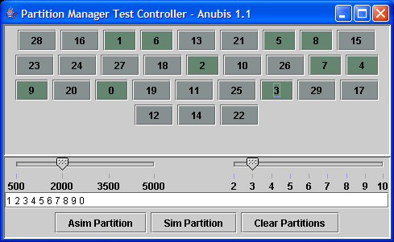
Anubis Partition Manager
Main screen shows all visible nodes. If testable, these will be coloured according to their partiton
Black numbers = stable
Yellow numbers = unstable
Italic numbers = something wrong with time
Slide-bar to control heartbeat interval
Slide-bar to control heartbeat timeout (multiple of interval)
Input lists of servers here
Set asymetric partitons
Set symetric partitions
Clear partitions

Slide 46
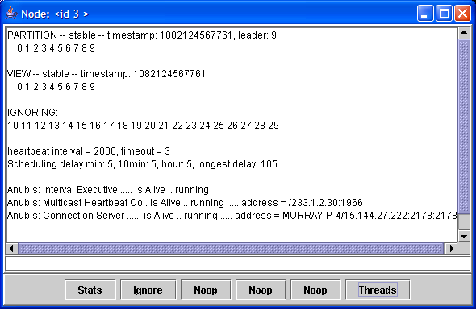
Anubis Partition Manager
Click on a server button for a pop-up window with additional information
Click on “Threads” to get information about main threads (remains for 10 seconds)
partition view
connection view
Currently ignoring these servers
Timeouts and stats on scheduling delays refreshed periodically,
click on “stats” to refresh immediately
Input a list of servers and click on “ignore” to set the ignored set of servers

Slide 47
Anubis Test Console
Start AnubisTestConsole in the same JVM as a server
  It needs to find the locator interface (set in sf file)
This tool can be used to:
  Observe contents of global and local registers
  Dynamically register and deregister providers and listeners
  Set provider values
Example
  Start along side your application and view the states it creates
  Inject state observations into an application by registering an appropriate provider
  Observe specific states of your application by registering and appropriate listener

Slide 48
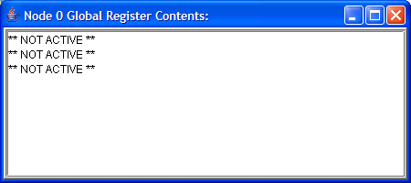
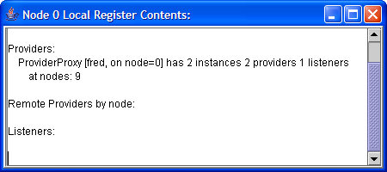
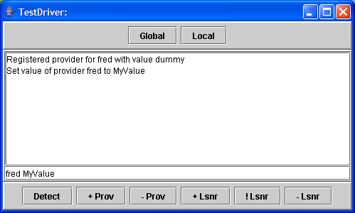
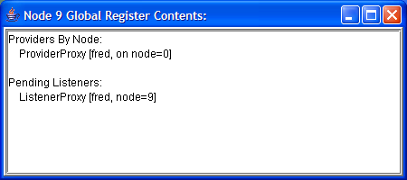
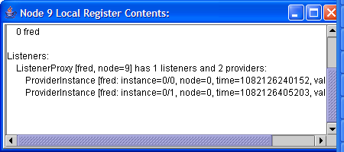
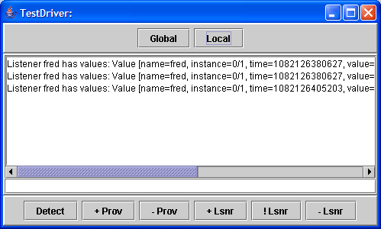
Anubis Test Console
Click on “Global” and “Local” to get pop-up windows on the registers
Only the leader has an active global register
Main screen shows interaction through State Manager Interfaces
Enter a name and click on add (+) or remove (-) Provider to register/deregister providers – likewise for listeners.
(use <name> <valueString> to assign values)

Slide 49
Global Predicate Evaluation
I have not described the detector and do not intend to, except to say…
Detector is a global predicate evaluator that can identify distributed states according to the consistency properties of Anubis Partitioned Knowledge Spaces
DO NOT USE IT!
  It does not correctly implement the semantics
It is entirely above the Anubis State Manager interfaces and therefore does not affect the Anubis service

Slide 50
Example SmartFrog Files
#include "org/smartfrog/services/anubis/components.sf“
// deploys four AnubisServer components with an AnubisTestConsole
// component attatched to two of them (nodes 0 and 3)
TestNode extends AnubisService {
testable "true";
}
sfConfig extends Compound {
n0 extends TestNode { node 0; }
n1 extends TestNode { node 1; }
n2 extends TestNode { node 2; }
n3 extends TestNode { node 3; }
console0 extends AnubisTestConsole {
locator LAZY ATTRIB n0:locator;
}
console3 extends AnubisTestConsole {
locator LAZY ATTRIB n3:locator;
}
}
#include "org/smartfrog/services/anubis/components.sf“
// deploys an AnbuisPartitionMonitor console
sfConfig extends AnubisPartitionTestConsole {
}

Slide 51

HP logo

