Slide 1
How to write really small TCP/IP stacks
... and make them survive slashdottings
  Adam Dunkels
  Tekn Lic, Researcher, Swedish Institute of Computer Science
  NUCCC 2005, Uppsala
  16 April 2005

Slide 2
What this talk will be about...
The “useful” stuff:
  TCP/IP for embedded systems
  Implementing TCP/IP in small amounts of memory
The cool stuff:
  Hacks that make TCP/IP do wonders on tiny computational hardware
    ... and handle weird overload situations

Slide 3
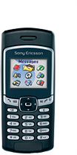
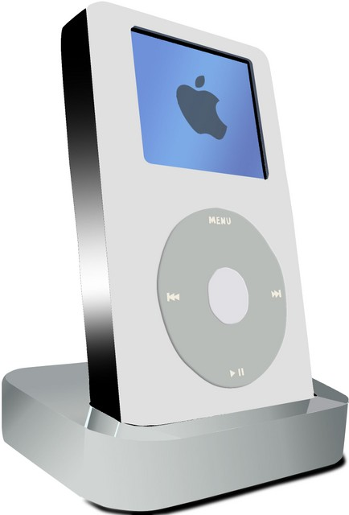
Computers are becoming invisible!
We used to have one PC ...
  ... now we have cell phones,
  MP3 players, hand held games, ...
Embedded systems are everywhere!
  Stereo equipment
  Dishwashers
  Toys
  ...

Slide 4

"You have to know the past to understand the present."
Dr. Carl Sagan (American astronomer, writer and scientist, 1934-1996)

Slide 5
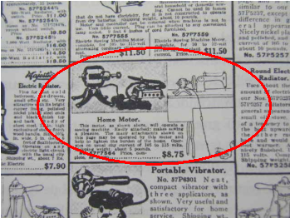
1918 – The Home Motor
“... will operate a sewing machine”

Slide 6

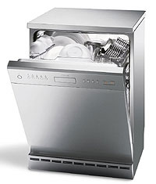
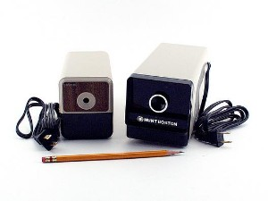

Today – motors have become
invisible!
Motors are everywhere – we don't think of them as “motors”
  This is what has happened to computers!

Slide 7

“Ubiquitous computing”
Dr. Mark Weiser, Xerox Parc, 1988:
“[...] invisible, everywhere computing [...]”
  “This is a challenge that affects all of computer science. “

Slide 8
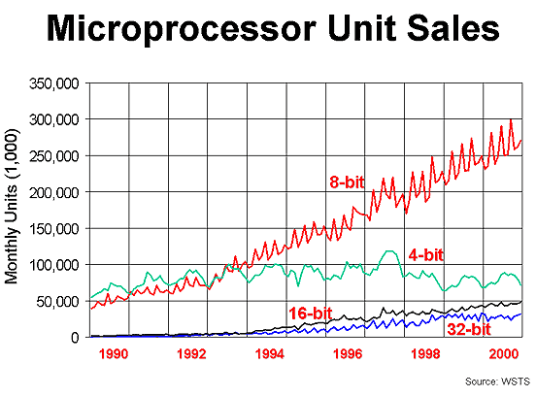
The global CPU market
PC microprocessors constitute less than 2% of the market

Slide 9
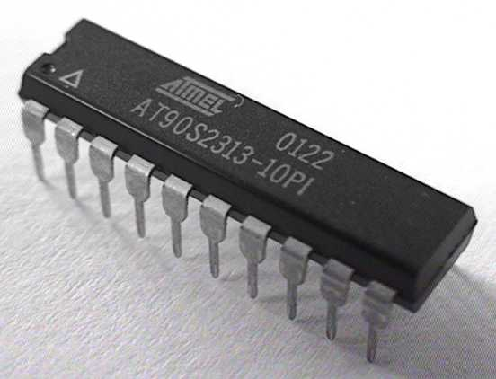
Typical embedded systems
Small microcontroller (microprocessor + I/O)
  8- and 16-bit processors
  Typical memory size
    1 – 100 k Flash ROM for code
    0.1 – 10 k RAM for data
  Typical speed
    1 – 10 MHz
8051, AVR, MSP430, Z80, 6502, ARM, ...

Slide 10
And we want them to communicate...
The vision:
  Network these embedded systems, unleash their inherent power!
  The intelligent office, ambient intelligence, pervasive gaming, ubiquitous computing
Today:
  Swipe your ICA kundkort, communicate with cash register machine
  Data logging from your truck

Slide 11
What is my role in this?
I have written some embedded TCP/IP software
  3-clause BSD license
  Quite well-known (google for stuff like tcp/ip stack, embedded tcp/ip, etc.)
  Used by well over 60 companies
lwIP – lightweight IP (quite small)
µIP – micro IP (really small)

Slide 12

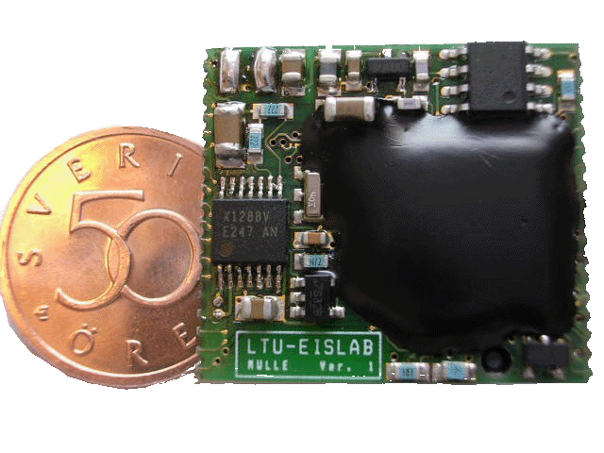
The Arena Project (1999-2000)
LTU, Telia, Ericsson, SICS
Hockey players with wireless sensors
  Bluetooth sensors, camera on helmet
Spectators with direct access to sensor readings
I wrote the TCP/IP stack used on the sensors
  lwIP
Luleå Hockey lost with 1-4...

Slide 13
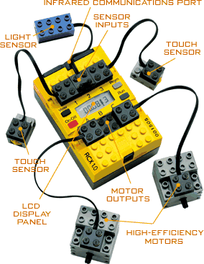
First TCP/IP-enabled Lego brick
The first public appearance of µIP
Lego Mindstorms RCX
  Hitachi H8 microcontroller, 32k RAM
29 January 2002
  µIP ported to LegOS
Completely useless
  But cool

Slide 14
Background – the TCP/IP stack
Application
UDP – best-effort datagrams
TCP – connection oriented, reliable byte-stream, full-duplex
  Flow control, congestion control, etc
IP – best-effort packet delivery
  Forwarding, fragmentation
The hard parts are IP and TCP
UDP
TCP
IP
ICMP
Network

Slide 15
The design of a small TCP/IP stack
Application driven
Application
lwIP – lightweight IP
  “Application driven” => larger
µIP – micro IP
  “Network driven” => smaller
UDP
TCP
Application
Stack
Network
IP
ICMP
Network
Network driven
Network
Stack
Application

Slide 16
lwIP – Application driven
Application
lwIP – lightweight IP
First release late 2000
40k code, 40k RAM
Application driven design
  Similar to Linux, BSD stacks
Suitable for “16-bit systems”
UDP
TCP
IP
ICMP
Network
Application driven
Application
Stack
Network

Slide 17
µIP – The smallest “full” TCP/IP stack in the world
Application
First release 2001
3 - 5k code, 100 bytes - 2k RAM
“Full” TCP/IP (RFC compliant)
Unconventional design
The secrets:
  Shared packet buffer
  Lower throughput
  Event-driven application interface
UDP
TCP
Network driven
IP
ICMP
Stack
Application
Network
Network

Slide 18
The secrets of µIP
Shared packet buffer
Lower throughput
Event-driven application programming interface

Slide 19
The secrets of µIP part I –
A shared packet buffer
All packets – both outbound and inbound – use the same buffer
  Size of buffer determines throughput
Outbound packet
Incoming packet
Packet buffer

Slide 20
The secrets of µIP part I –
A shared packet buffer II
Implicit locking: single-threaded access
  Grab packet from network – put into buffer
  Process packet
    Put reply packet in the same buffer
  Send reply packet into network
Packet buffer

Slide 21
The secrets of µIP part II –
Throughput
µIP trades throughput for RAM
  Low RAM usage = low throughput
Small systems = not that much data!
Ability to communicate more important than throughput!

Slide 22

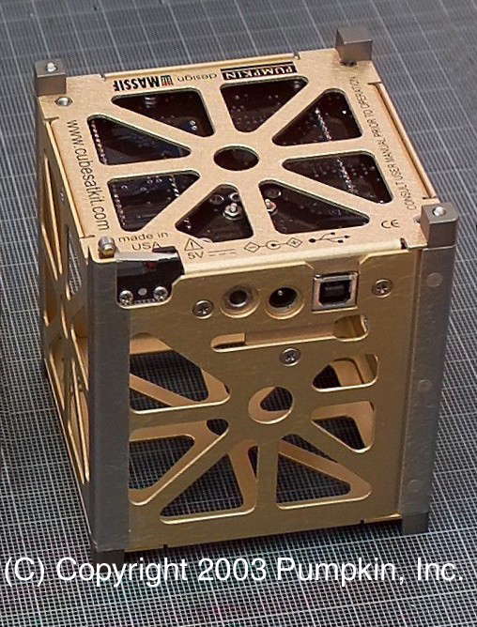
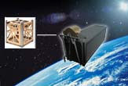
The smallest µIP configuration (that I know of)
CubeSat kit by Pumpkin Inc
  Pico satellite construction kit
128 bytes of RAM for µIP

Slide 23
The secrets of µIP part III –
Application Programming Interface I
µIP does not have BSD sockets
  BSD sockets are built on threads
  Threads induce overhead (RAM)
Instead – event-driven API
Execution is always initiated by µIP
  Applications are called by µIP, call must return
Protosockets – BSD socket-like API based on protothreads

Slide 24
The secrets of µIP part III –
Application Programming Interface II
void example2_app(void) {
struct example2_state *s =
(struct example2_state *)uip_conn->appstate;
if(uip_connected()) {
s->state = WELCOME_SENT;
uip_send("Welcome!\n", 9);
return;
}
if(uip_acked() &&
s->state == WELCOME_SENT) {
s->state = WELCOME_ACKED;
}
if(uip_newdata()) {
uip_send("ok\n", 3);
}
if(uip_rexmit()) {
switch(s->state) {
case WELCOME_SENT:
uip_send("Welcome!\n", 9);
break;
case WELCOME_ACKED:
uip_send("ok\n", 3);
break;
}
}
}

Slide 25
The secrets of µIP part III –
Application Programming Interface III
Event-driven API sometimes is problematic
  Not all programs are well-suited to it
  Programs are explicit state machines
Protosockets: sockets-like API using protothreads
  Extremely lightweight stackless threads
  2 bytes per-thread state, no stack
Protothreads allow “blocking” functions, even when called from µIP

Slide 26
The secrets of µIP part III –
Application Programming Interface IV
PT_THREAD(smtp_protothread(void))
{
PSOCK_BEGIN(s);
PSOCK_READTO(s, '\n');
if(strncmp(inputbuffer, “220”, 3) != 0) {
PSOCK_CLOSE(s);
PSOCK_EXIT(s);
}
PSOCK_SEND(s, “HELO ”, 5);
PSOCK_SEND(s, hostname, strlen(hostname));
PSOCK_SEND(s, “\r\n”, 2);
PSOCK_READTO(s, '\n');
if(inputbuffer[0] != '2') {
PSOCK_CLOSE(s);
PSOCK_EXIT(s);
}

Slide 27
The secrets of µIP part III –
Application Programming Interface V
API built from the bottom (network) and up
Protothreads and protosocket API provides sequential programming
Less overhead than “real” threads and the “real” socket API

Slide 28
And now for the cool stuff...

Slide 29
How to make a really, REALLY, small TCP/IP stack
(Below the 3k code, 128 bytes RAM barrier)

Slide 30
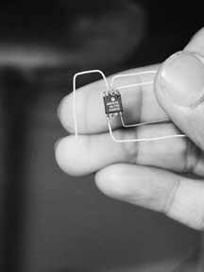
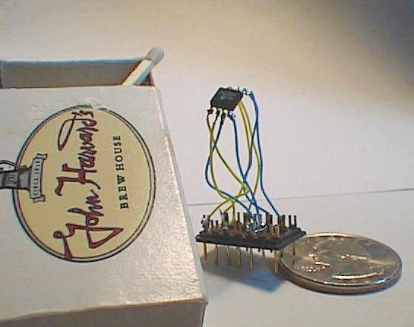
14 July 1999: iPic
“I'd like to announce what is a really tiny implementation of TCP/IP stack and a really really tiny web-server. This is currently running on a PIC, a puny 12C5609 8-pin device”
TCP/IP, HTTP in 256 12-bit bytes, 40 bytes RAM
Pictures from http://www-ccs.cs.umass.edu/~shri/iPic.html

Slide 31
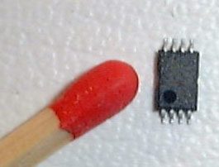
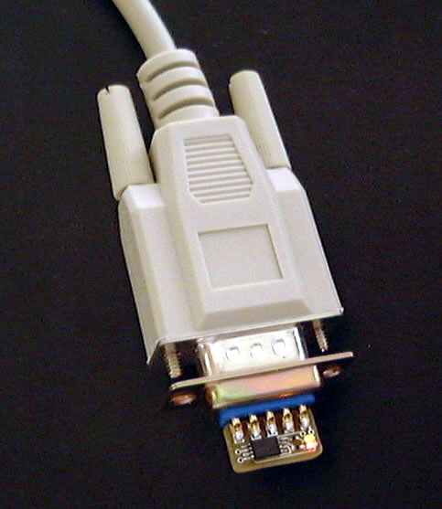
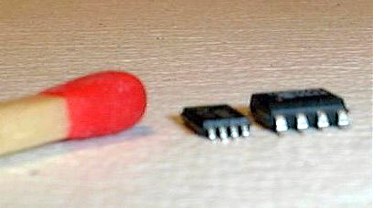
20 October 1999: WebACE
TCP/IP, HTTP, 1000 bytes code, 64 bytes RAM
Pictures from http://d116.com/ace/

Slide 32
How did they achieve this?
Not “full” TCP/IP
  Application specific – web server only
  Not RFC compliant – only works with a PC at the other end
Implementational techniques
  Precomputed packets – with headers
  Precomputed checksums
  Only parts of the TCP state machine

Slide 33
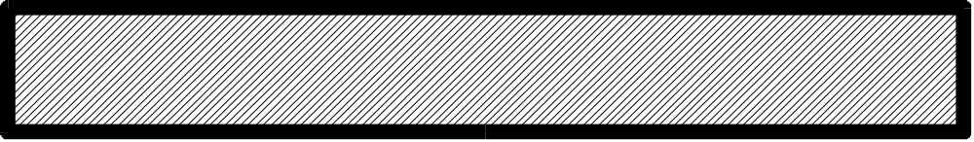
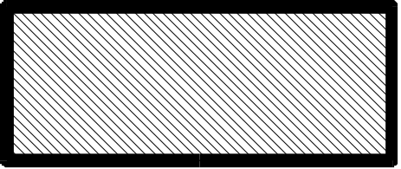
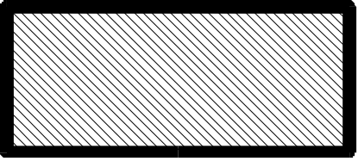
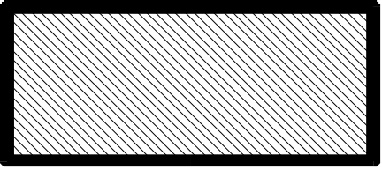

Precomputed headers
The file
The same file in ROM with precomputed headers

Slide 34
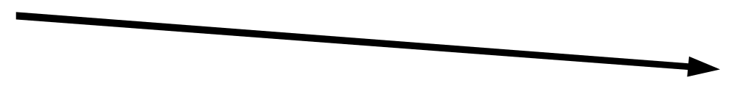
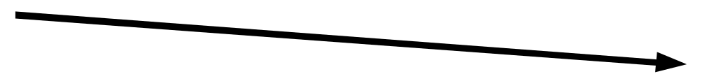
Parts of the TCP state machine
Web client
Web server
SYN
SYN, ACK
ACK, HTTP GET
FIN, web page data
FIN, ACK
ACK

Slide 35
C64 web server
Using these techniques, my Commodore 64 server has served tens of thousands of visitors
  Continued serving web pages during three slashdottings
The µIP stack (without optimizations) has withstood four additional slashdottings
  Three while running under my Contiki OS

Slide 36
“This is the FIRST site I can still access, full 15 minutes after a Slashdot article! Maybe a lesson in it for all bloatware.”
Comment to a Slashdot arcticle, about the Contiki web server. By jkrise, 3rd July, 2003.

Slide 37
Proof-of-concept TCP/IP stacks
phpstack – TCP/IP stack, webserver written in PHP http://www.sics.se/~adam/phpstack/
miniweb – TCP/IP stack, webserver using 30 bytes of RAM
http://www.sics.se/~adam/miniweb/

Slide 38
This is cool, but is it useful in practice?
NO!

Slide 39
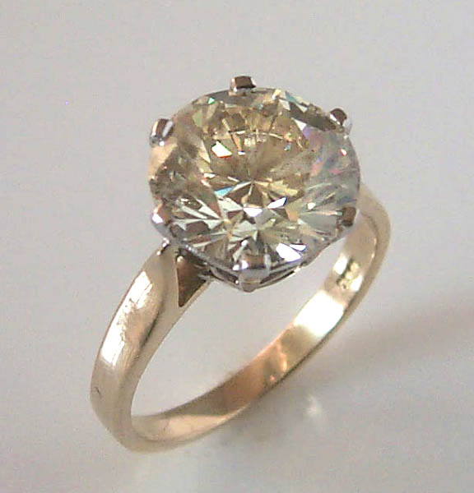
But it is far from worthless!
Great hacks are the diamonds of computer science!
  “Useless”, yet priceless!

Slide 40
Conclusions
Embedded systems are everywhere
  We're making them talk to each other!
TCP/IP can be implemented in 5k code, 1k RAM
  First shown by µIP
Great hacks are the diamonds of computer science
  “Useless”, yet priceless!

Slide 41
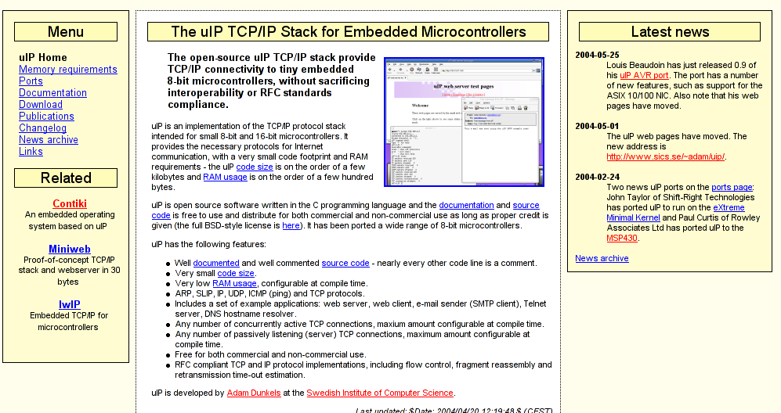
Thank you!
http://www.sics.se/~adam/uip/

