Slide 1
Lab AI: The Cambio Problem
2018-2019
Olivier Van den Eede & Dries Kennes

Slide 2
Content
Data Structures
  Request, Zone & Car objects
  Solution object
  Overlap Matrix
Algorithm
  Greedy Assign
  Local Moves
  Metaheuristic
Results
  Performance
  Search space
  Possible improvements

Slide 3
Request, Zone & Car objects
Parsed from input once
Immutable objects for Request & Zone
Car is a string
Request & Zone stored as
  Immutable list
  id→object maps

Slide 4
Solution class
Car→Zone & Request→Car maps
Only object copied for each local move
  Input data is not copied
  If local move was not successful no new copy

Slide 5
Overlap Matrix
Pre-calculates overlapping requests
  Calculated only once
Stored in 2D boolean matrix
Used in local moves
Allows for faster feasibility check

Slide 6
Content
Data Structures
  Request, Zone & Car objects
  Solution object
  Overlap Matrix
Algorithm
  Greedy Assign
  Local Moves
  Metaheuristic
Results
  Performance
  Search space
  Possible improvements

Slide 7
Greedy Assign
Loop over unassigned requests
  Find suitable car assigned to zone
  Find suitable car assigned to neighbor
  Assign a new car to zone
  Leave unassigned
Used for initial solution
Guaranties a feasible solution
Called after each local move

Slide 8
Local Moves
Moves
  Move request from ‘optimal’ zone to neighbor
  Move request from neighbor to ‘optimal’ zone
  Swap car assigned to request with another car
  Unassign 1 car from all its requests †
  Unassign 1 request †
All guarantie a feasible solution
†: Twice as likely to be picked

Slide 9
Metaheuristic
Simulated annealing
  Random initial solution
  Generate new solution with random local move
  Solution accepted
    if cost is lower; or
    with ever decreasing random probability
  Go back to 2 unless stop condition reached
"Ideal" parameters found after a lot of testing†
†: See results on cambio.dries007.net/sa_parameter_tests

Slide 10
Content
Data Structures
  Request, Zone & Car objects
  Solution object
  Overlap Matrix
Algorithm
  Greedy Assign
  Local Moves
  Metaheuristic
Results
  Performance
  Search space
  Possible improvements

Slide 11
Results
Results generated with 300 seconds on 2 threads.
Median of a number of runs
Impressive, or so we think 😀
Input File | Toledo | Our Score | Improvement
100_5_14_25 | 10015 | 8795 | 12.18%
100_5_19_25 | 6700 | 6045 | 9.78%
210_5_33_25 | 14325 | 11180 | 21.95%
210_5_44_25 | 5890 | 4045 | 31.32%
360_5_71_25 | 12955 | 7490 | 42.18%

Slide 12
Performance
Performance is key!
  Python generators
  Limiting copying to absolute minimum
  Profiling of the algorithm
  No feasability check!
    Not required
    Overlap checking is still expensive, even with matrix.
12k; 10k; 5k lm/s for 100; 210; 360 requests
  Complete simulated annealing takes ~10 seconds

Slide 13
Search space
Greety assign after every move
  Limits search space
  Example: No unassign two cars without attempting to assigning requests to them.
Limited local moves
No crossing "gaps of infeasibility"

Slide 14
Possible improvements
Remove search space limitations
Multipliers for local moves
  Picked 2x on unassign moves with limited testing

Slide 15
Questions?

Slide 16
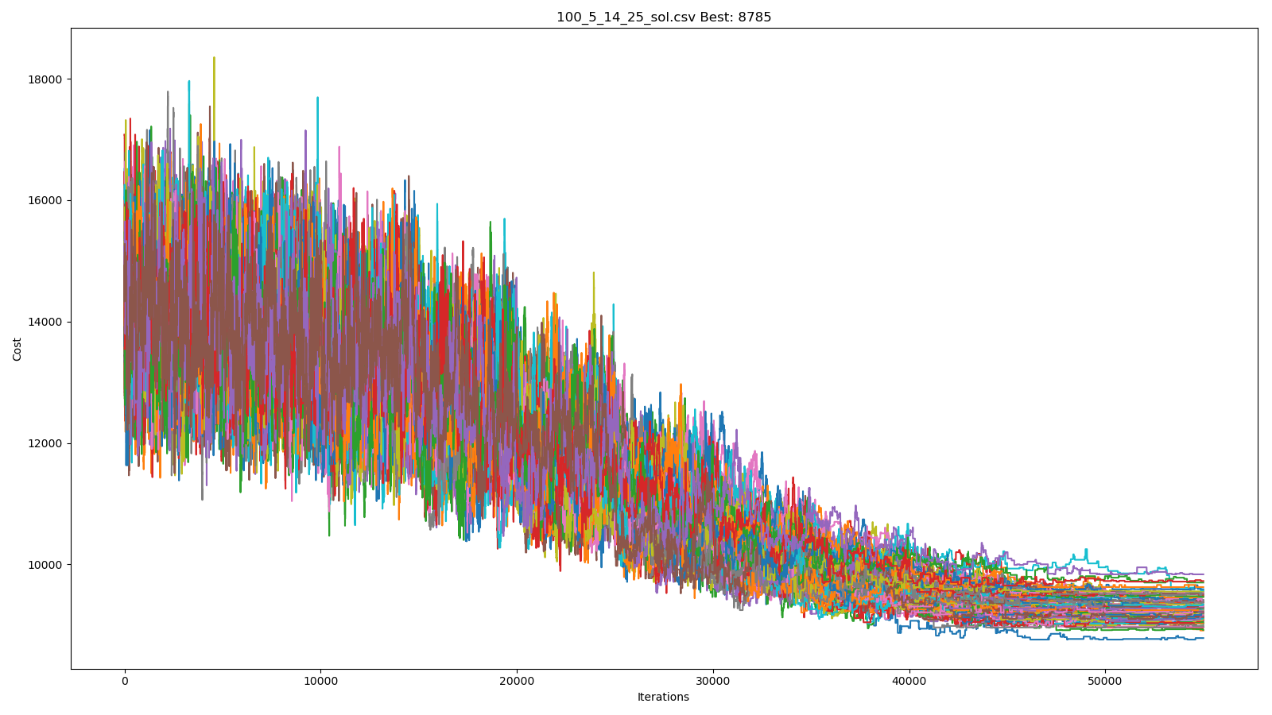
Example results for 100_5_14_25

Slide 17
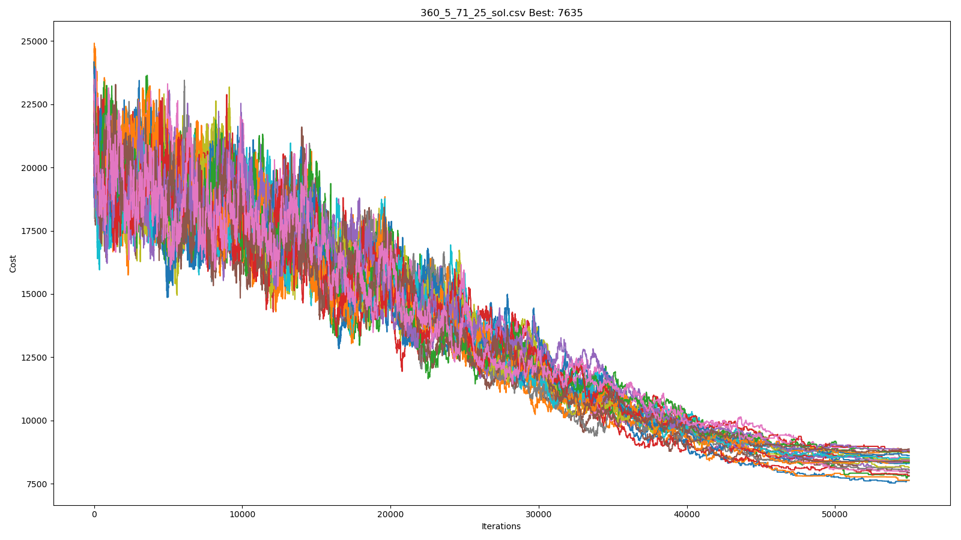
Example results for 360_5_71_25

