Slide 1
Final Project
Learning Machine
김주현 황유빈 최혜린
멀티캠퍼스
인공지능 기반의 빅데이터 분석 시스템 개발자 과정

Slide 2
Final Project Learning Machine
POWER POINT PRESENTATION Enjoy your stylish business and campus life with BIZCAM
 | Contents
 | Contents
 | Contents
 | Contents
 | Contents
 | Contents
 | Contents
 | Contents
 | Contents
 | Contents
01
주제 선정
기본 코드 Data Set
Crew
02
Model별 설명
03
Best Model
04
발전 방안

Slide 3



Final Project Learning Machine
 | Contents
 | Contents
 | Contents
 | Contents
 | Contents
 | Contents
 | Contents
 | Contents
 | Contents
 | Contents
김주현
전자전기공학부
황유빈
산업공학부
최혜린
컴퓨터학부

Slide 4
Final Project Learning Machine
 | Contents
 | Contents
 | Contents
 | Contents
 | Contents
 | Contents
 | Contents
 | Contents
 | Contents
 | Contents
90%
주제 선정
CNN 활용을 통한
글자에 숨겨진 숫자 이미지를 예측
79%

Slide 5
Final Project Learning Machine
 | Contents
 | Contents
 | Contents
 | Contents
 | Contents
 | Contents
 | Contents
 | Contents
 | Contents
 | Contents
공모전 진행 방식
제공 되는 Data
train.csv 훈련 데이터 2048개
Test.csv 검증 데이터 20480개
Submission.csv 제출 양식
CNN 모델을 생성하고
오직 train만 학습
Test.csv를 predict하여
Submission 양식에 맞춰서 예측 값을 제출
1일 3회 제출 가능
평가 방식: Accuracy
외부 데이터 사용 불가
사전 학습 모델 사용 불가

Slide 6
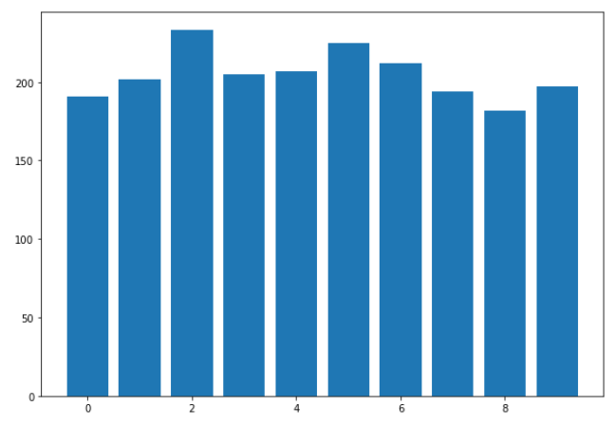
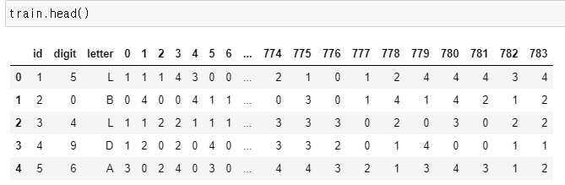
Final Project Learning Machine
 | Contents
 | Contents
 | Contents
 | Contents
 | Contents
 | Contents
 | Contents
 | Contents
 | Contents
 | Contents
Training Data Set

Slide 7
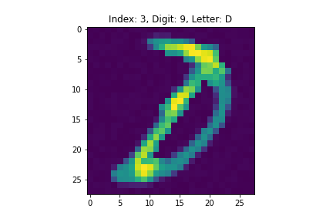
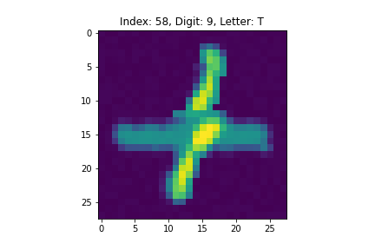
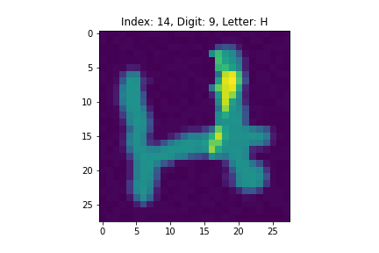
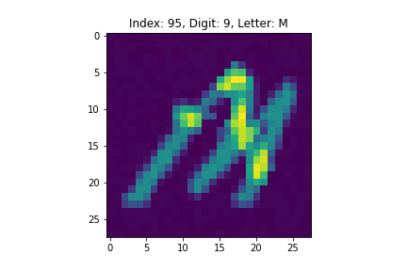
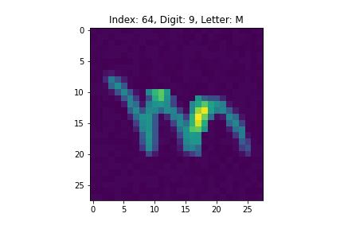
Final Project Learning Machine
 | Contents
 | Contents
 | Contents
 | Contents
 | Contents
 | Contents
 | Contents
 | Contents
 | Contents
 | Contents
숨겨진 숫자 9 예시

Slide 8
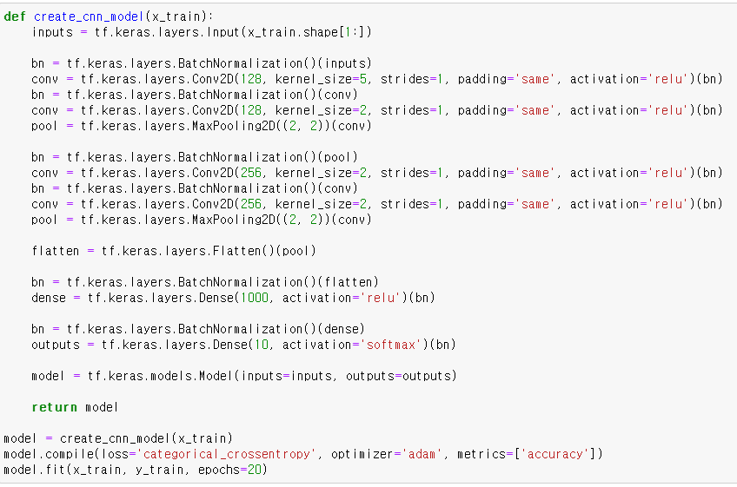
Final Project Learning Machine
 | Contents
 | Contents
 | Contents
 | Contents
 | Contents
 | Contents
 | Contents
 | Contents
 | Contents
 | Contents
Base Line CNN Model
79%

Slide 9
Final Project Learning Machine
 | Contents
 | Contents
 | Contents
 | Contents
 | Contents
 | Contents
 | Contents
 | Contents
 | Contents
 | Contents
Base Network
Conv2D
BatchNormalization
MaxPooling
Flatten, Dense
Dropout

Slide 10
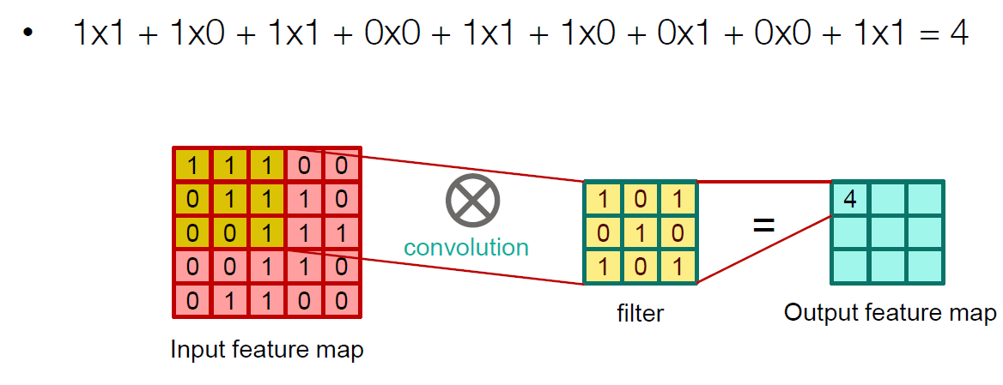
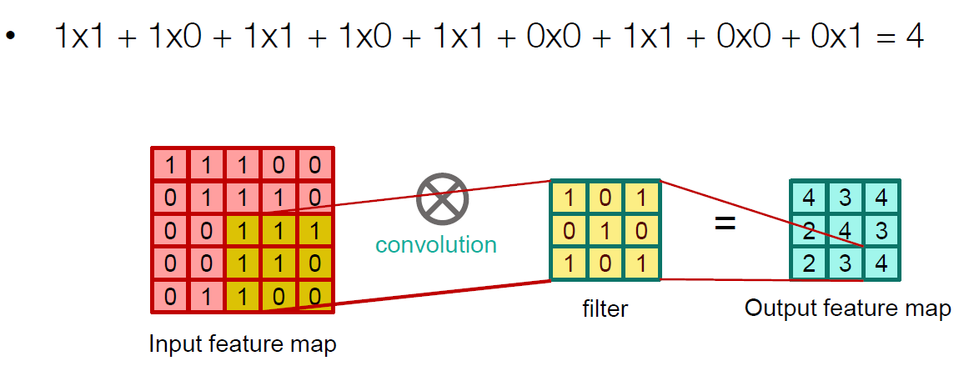
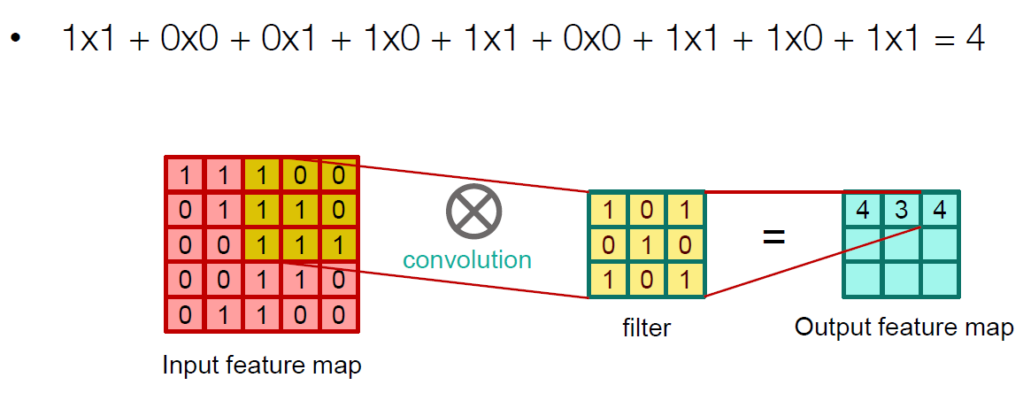
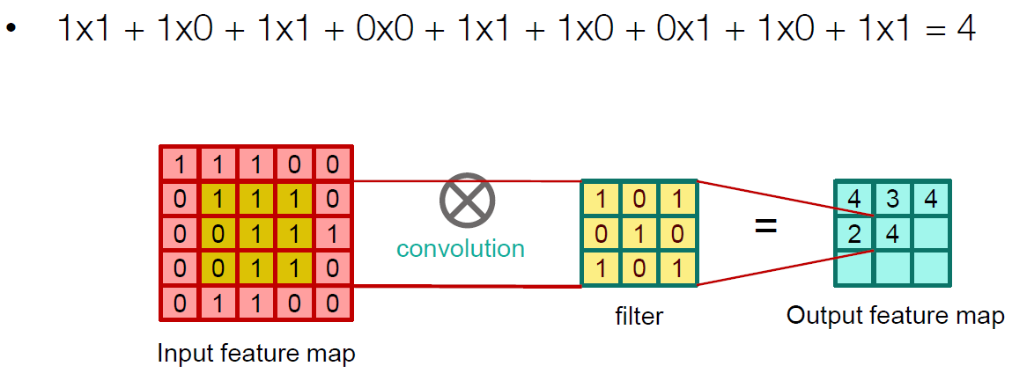
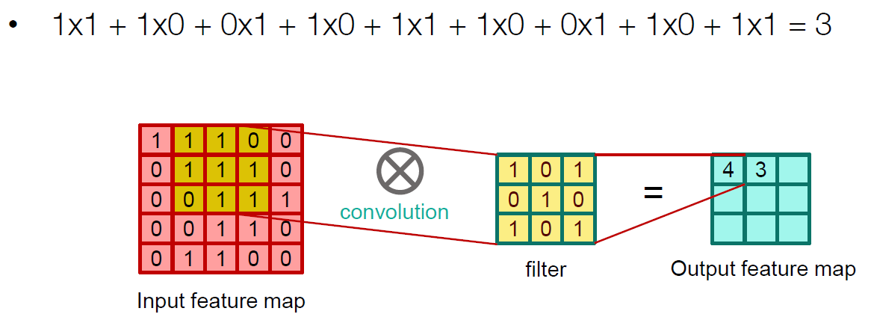
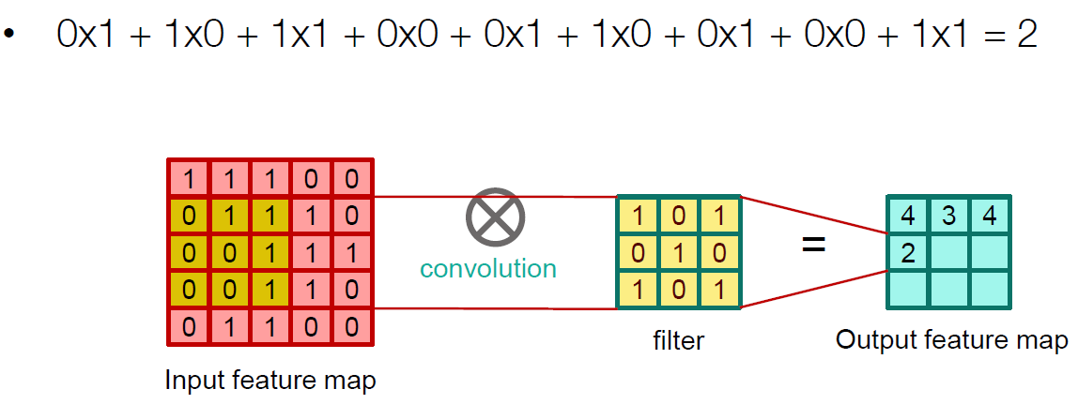
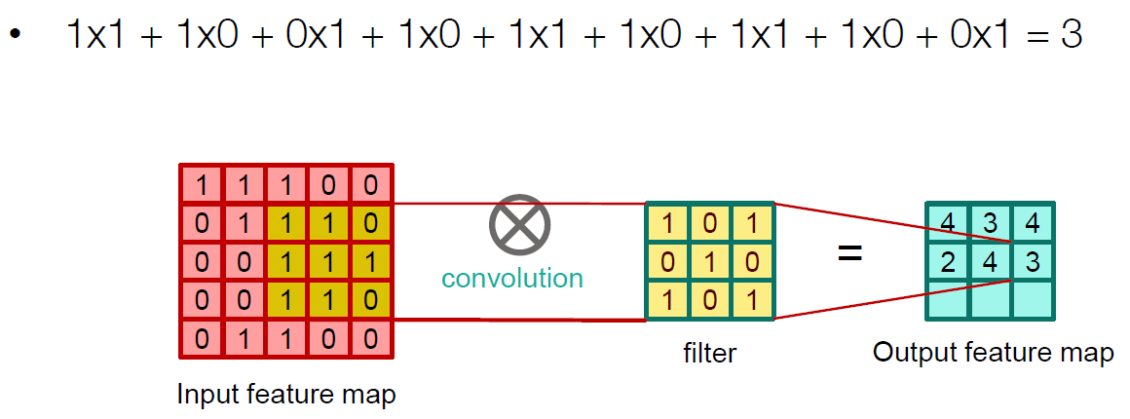
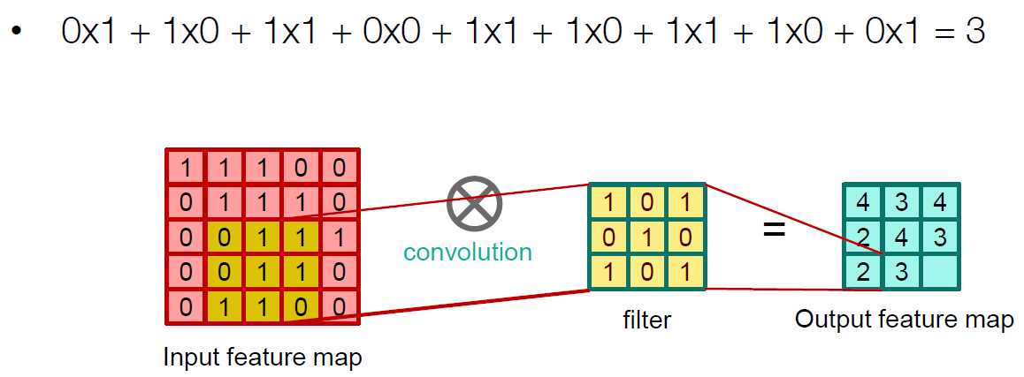
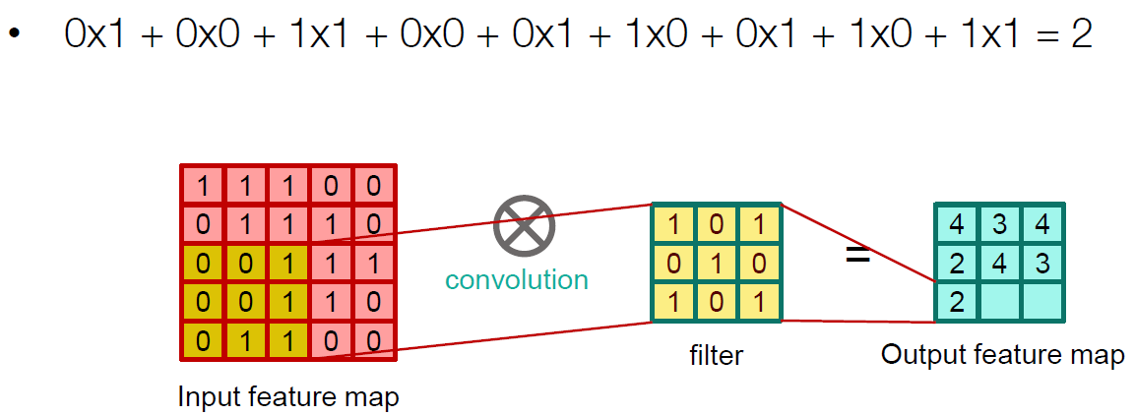
Final Project Learning Machine
 | Contents
 | Contents
 | Contents
 | Contents
 | Contents
 | Contents
 | Contents
 | Contents
 | Contents
 | Contents
Conv2D Layer

Slide 11
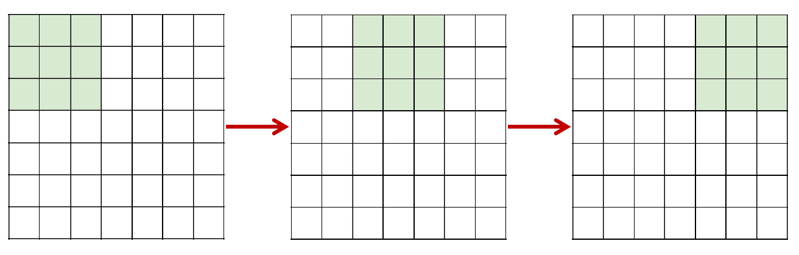
Final Project Learning Machine
 | Contents
 | Contents
 | Contents
 | Contents
 | Contents
 | Contents
 | Contents
 | Contents
 | Contents
 | Contents
Conv2D Layer
Strides

Slide 12
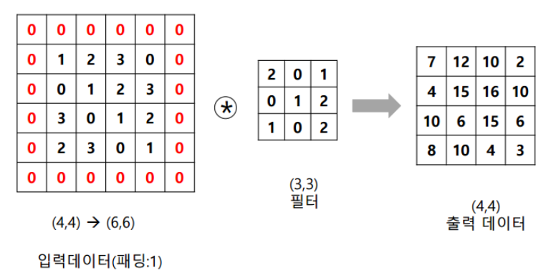
Final Project Learning Machine
 | Contents
 | Contents
 | Contents
 | Contents
 | Contents
 | Contents
 | Contents
 | Contents
 | Contents
 | Contents
Conv2D Layer
Padding

Slide 13
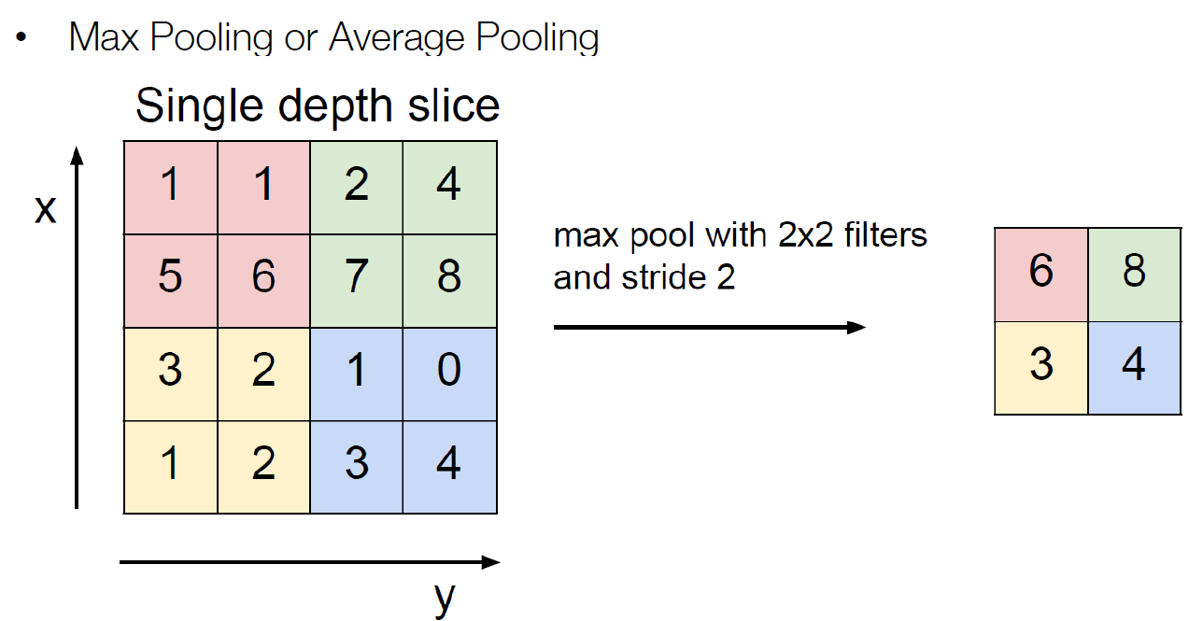
Final Project Learning Machine
 | Contents
 | Contents
 | Contents
 | Contents
 | Contents
 | Contents
 | Contents
 | Contents
 | Contents
 | Contents
MaxPooling

Slide 14
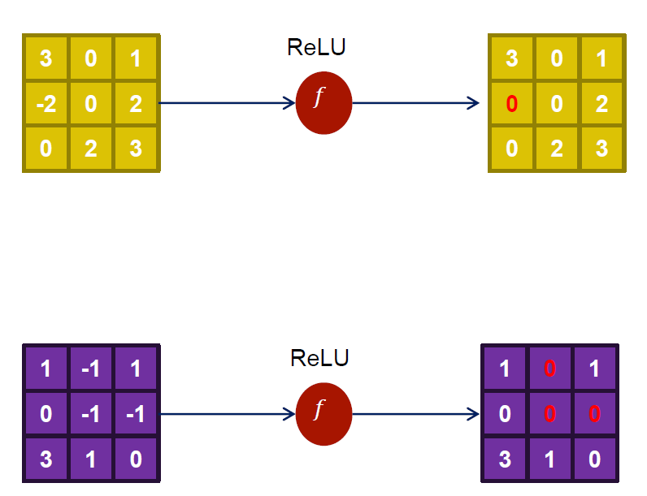
Final Project Learning Machine
 | Contents
 | Contents
 | Contents
 | Contents
 | Contents
 | Contents
 | Contents
 | Contents
 | Contents
 | Contents
Activation

Slide 15
Final Project Learning Machine
 | Contents
 | Contents
 | Contents
 | Contents
 | Contents
 | Contents
 | Contents
 | Contents
 | Contents
 | Contents
BatchNormalization
Network의 각 층이나 Activation 마다 input의 distribution이 달라지는 현상이 발생한다.
각 층 input의 distribution을 평균 0, 표준편차 1인 input으로 normalization 시켜 이 문제를 해결한다.

Slide 16
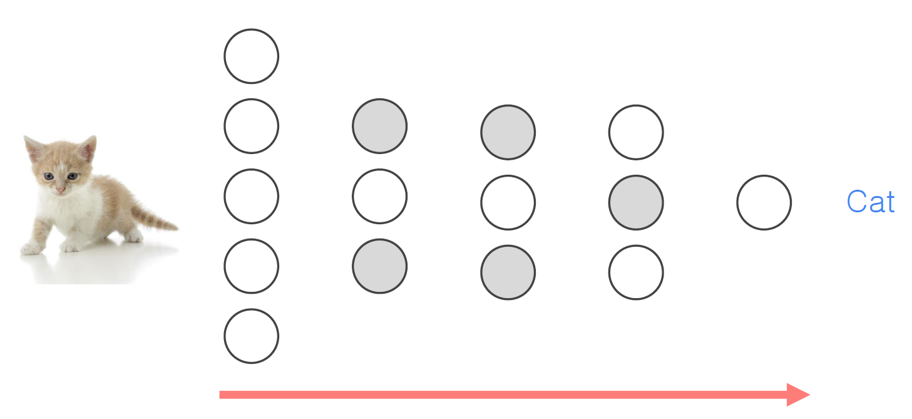
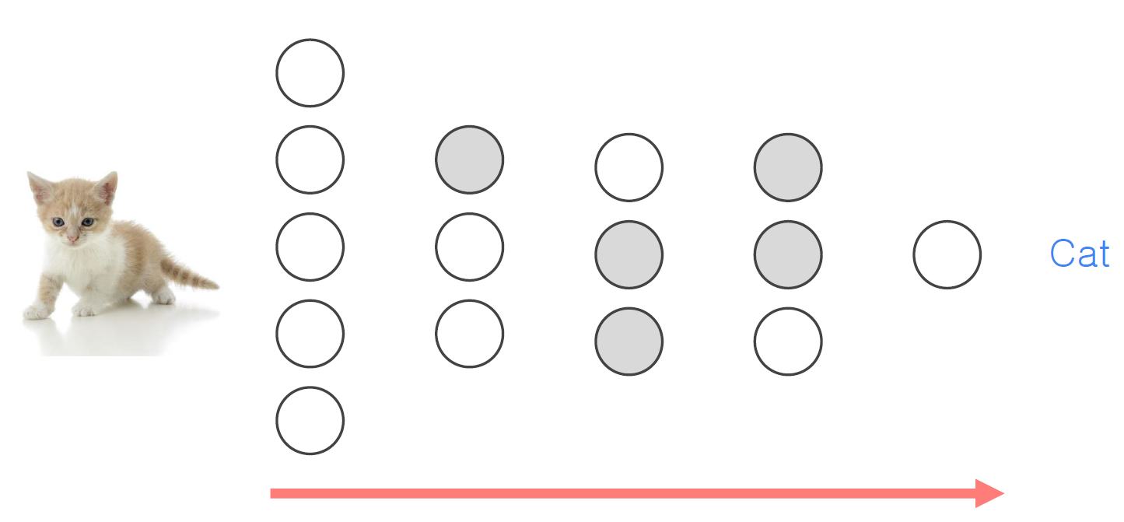
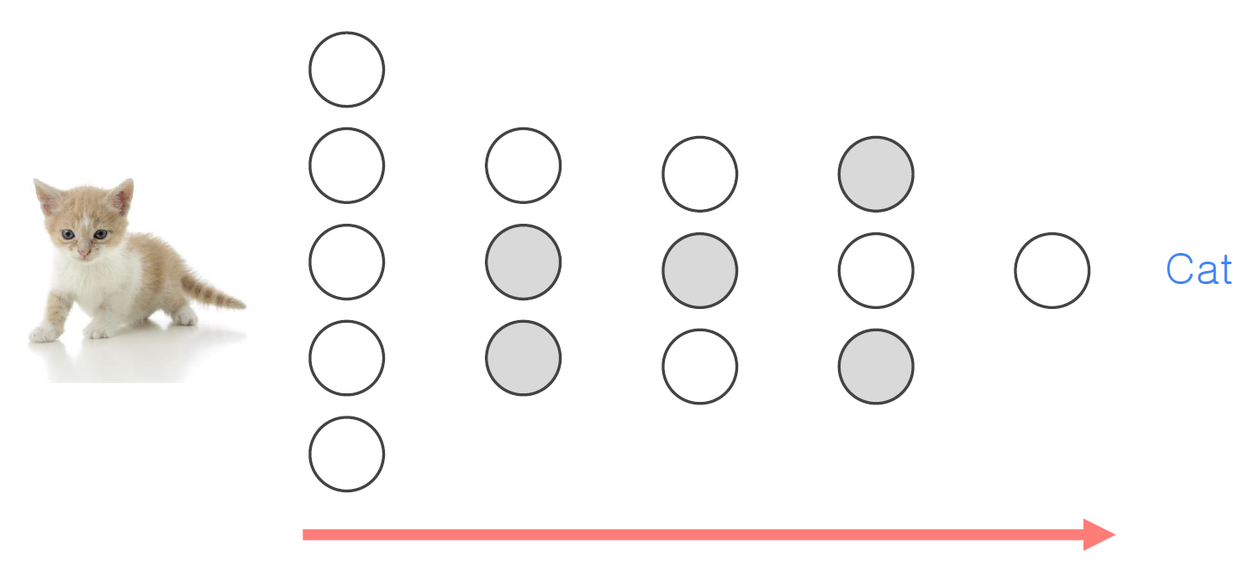
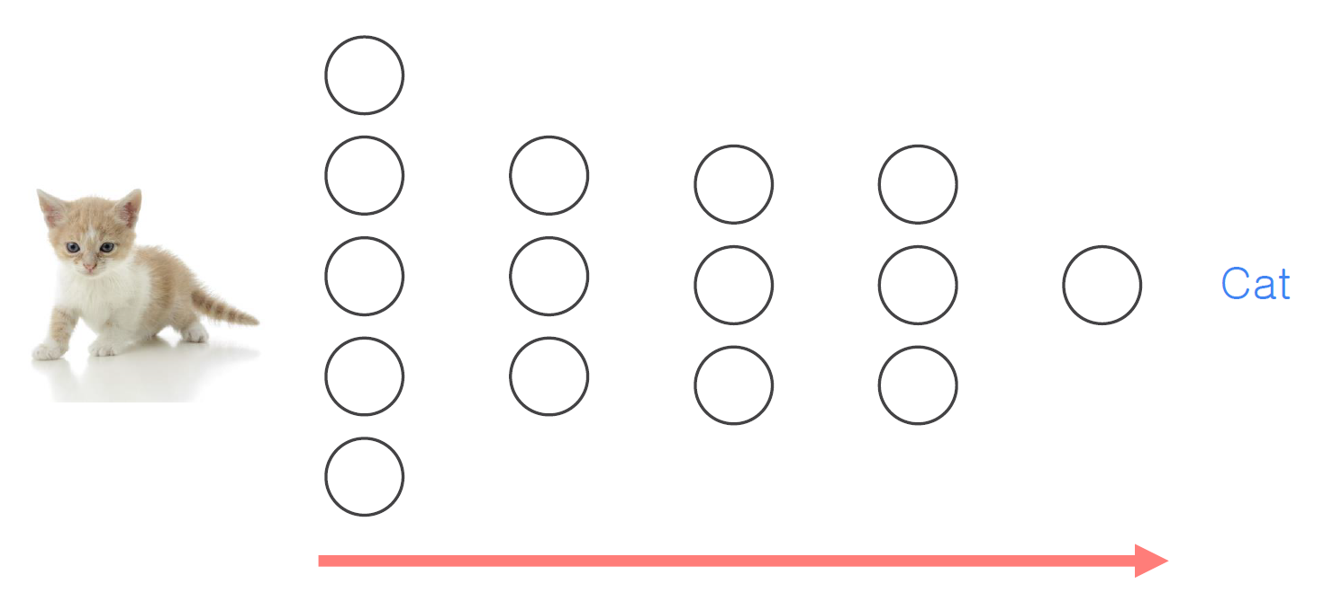
Final Project Learning Machine
 | Contents
 | Contents
 | Contents
 | Contents
 | Contents
 | Contents
 | Contents
 | Contents
 | Contents
 | Contents
Dropout

Slide 17
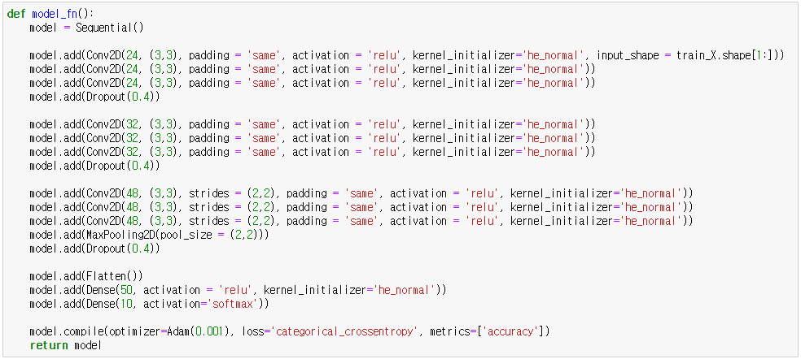
Final Project Learning Machine
 | Contents
 | Contents
 | Contents
 | Contents
 | Contents
 | Contents
 | Contents
 | Contents
 | Contents
 | Contents
Model 2

Slide 18
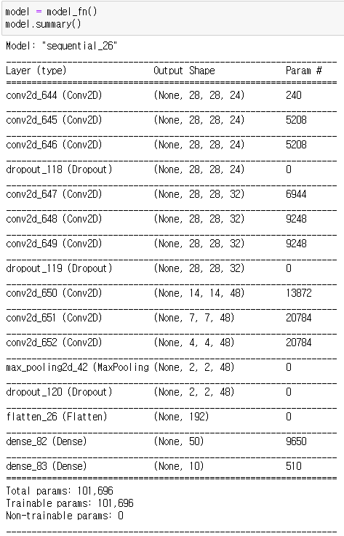
Final Project Learning Machine
 | Contents
 | Contents
 | Contents
 | Contents
 | Contents
 | Contents
 | Contents
 | Contents
 | Contents
 | Contents
Model 2

Slide 19
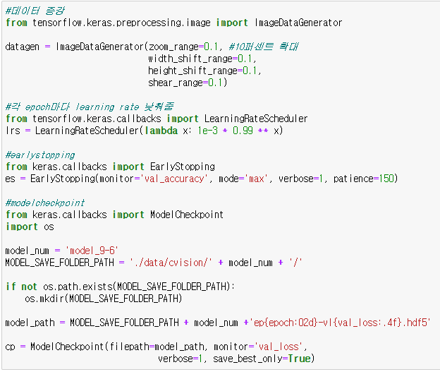
Final Project Learning Machine
 | Contents
 | Contents
 | Contents
 | Contents
 | Contents
 | Contents
 | Contents
 | Contents
 | Contents
 | Contents
Model 2

Slide 20
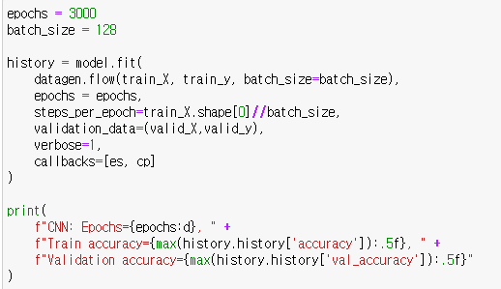
Final Project Learning Machine
 | Contents
 | Contents
 | Contents
 | Contents
 | Contents
 | Contents
 | Contents
 | Contents
 | Contents
 | Contents
Model 2

Slide 21
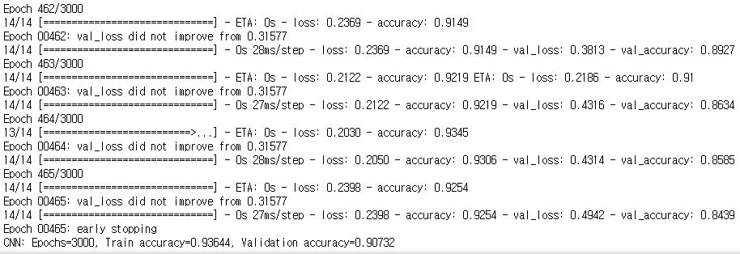
Final Project Learning Machine
 | Contents
 | Contents
 | Contents
 | Contents
 | Contents
 | Contents
 | Contents
 | Contents
 | Contents
 | Contents
Model 2

Slide 22
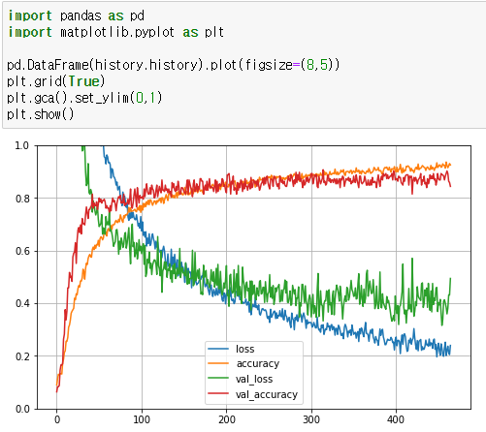
Final Project Learning Machine
 | Contents
 | Contents
 | Contents
 | Contents
 | Contents
 | Contents
 | Contents
 | Contents
 | Contents
 | Contents
Model 2

Slide 23
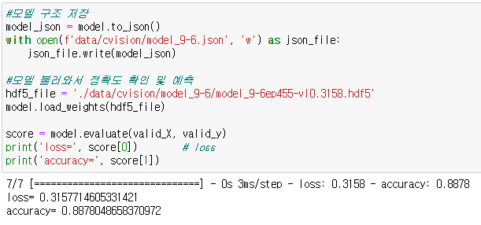
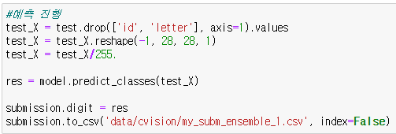
Final Project Learning Machine
 | Contents
 | Contents
 | Contents
 | Contents
 | Contents
 | Contents
 | Contents
 | Contents
 | Contents
 | Contents
Model 2

Slide 24
Final Project Learning Machine
 | Contents
 | Contents
 | Contents
 | Contents
 | Contents
 | Contents
 | Contents
 | Contents
 | Contents
 | Contents
Model 2 Accuracy
Base Model Accuracy
89%
79%

Slide 25
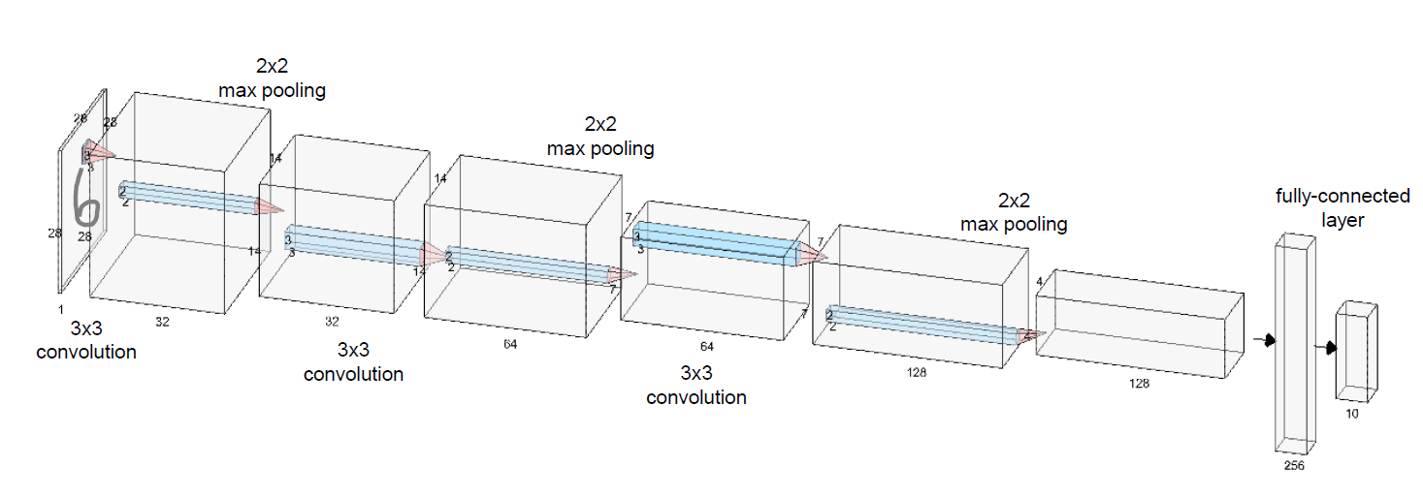
Final Project Learning Machine
 | Contents
 | Contents
 | Contents
 | Contents
 | Contents
 | Contents
 | Contents
 | Contents
 | Contents
 | Contents
Model 3

Slide 26
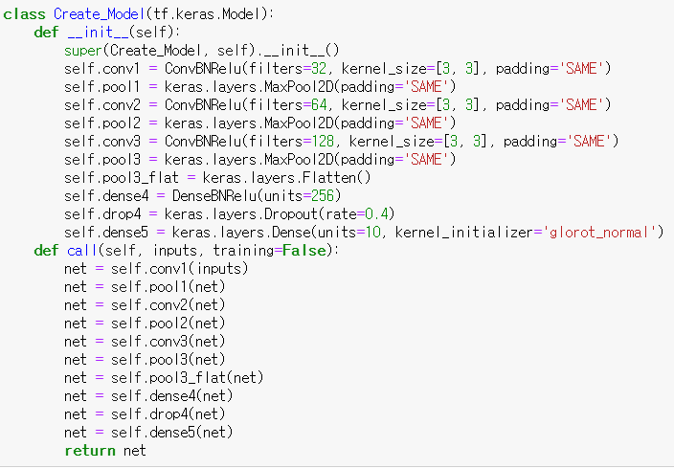
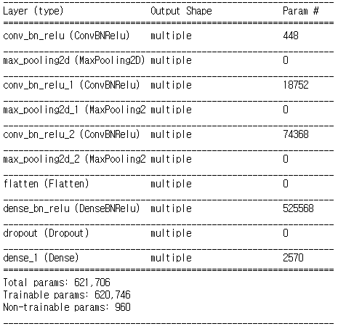
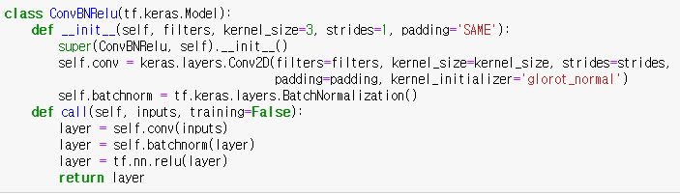
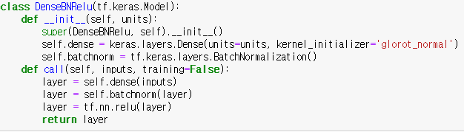
Final Project Learning Machine
 | Contents
 | Contents
 | Contents
 | Contents
 | Contents
 | Contents
 | Contents
 | Contents
 | Contents
 | Contents
Model Layer

Slide 27
Final Project Learning Machine
 | Contents
 | Contents
 | Contents
 | Contents
 | Contents
 | Contents
 | Contents
 | Contents
 | Contents
 | Contents
Model 3 Accuracy
Base Model Accuracy
79%
79%

Slide 28
Final Project Learning Machine
 | Contents
 | Contents
 | Contents
 | Contents
 | Contents
 | Contents
 | Contents
 | Contents
 | Contents
 | Contents
개선 방안
Train Data 늘리기
Deep CNN Model
Ensemble

Slide 29
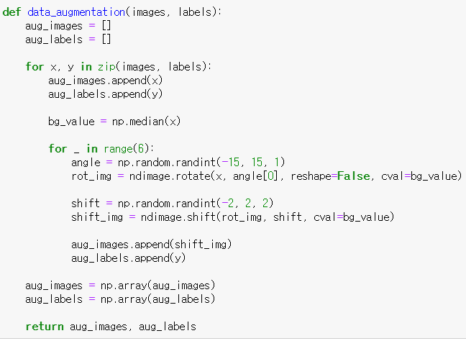
Final Project Learning Machine
 | Contents
 | Contents
 | Contents
 | Contents
 | Contents
 | Contents
 | Contents
 | Contents
 | Contents
 | Contents
Train Data 늘리기

Slide 30
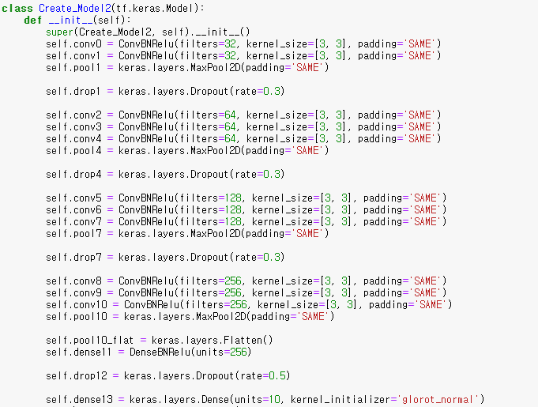
Final Project Learning Machine
 | Contents
 | Contents
 | Contents
 | Contents
 | Contents
 | Contents
 | Contents
 | Contents
 | Contents
 | Contents
Deep CNN Model

Slide 31
Final Project Learning Machine
 | Contents
 | Contents
 | Contents
 | Contents
 | Contents
 | Contents
 | Contents
 | Contents
 | Contents
 | Contents
Deep CNN Model

Slide 32
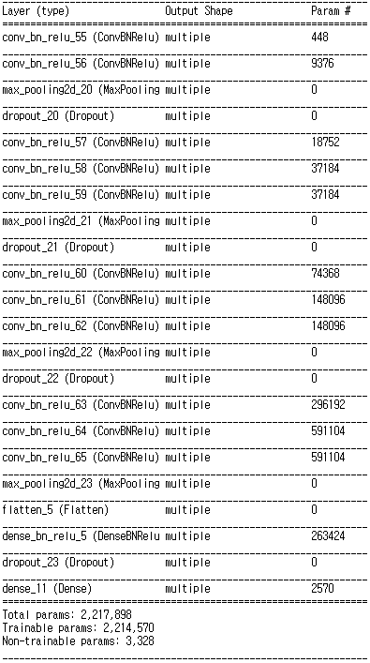
Final Project Learning Machine
 | Contents
 | Contents
 | Contents
 | Contents
 | Contents
 | Contents
 | Contents
 | Contents
 | Contents
 | Contents
Deep CNN Model

Slide 33
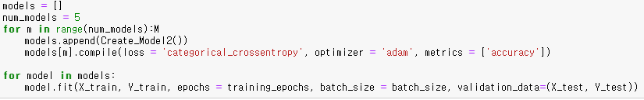
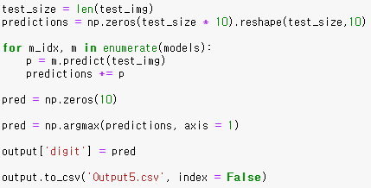
Final Project Learning Machine
 | Contents
 | Contents
 | Contents
 | Contents
 | Contents
 | Contents
 | Contents
 | Contents
 | Contents
 | Contents
Ensemble

Slide 34
Final Project Learning Machine
 | Contents
 | Contents
 | Contents
 | Contents
 | Contents
 | Contents
 | Contents
 | Contents
 | Contents
 | Contents
Model 4 Accuracy
Model 3 Accuracy
93.13%
79%

Slide 35
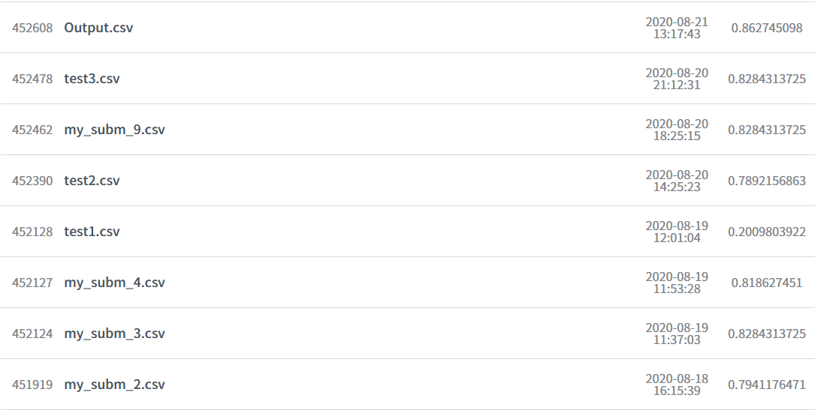
Final Project Learning Machine
 | Contents
 | Contents
 | Contents
 | Contents
 | Contents
 | Contents
 | Contents
 | Contents
 | Contents
 | Contents
Accuracy List

Slide 36
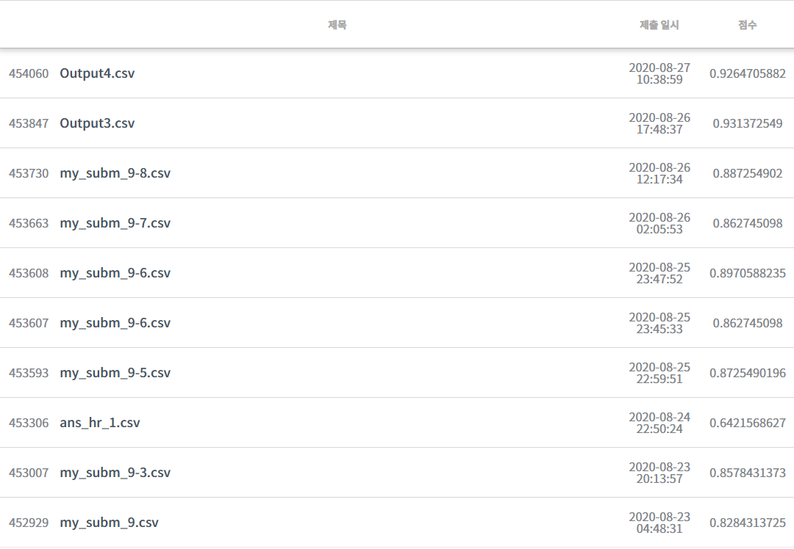
Final Project Learning Machine
 | Contents
 | Contents
 | Contents
 | Contents
 | Contents
 | Contents
 | Contents
 | Contents
 | Contents
 | Contents
Accuracy List

Slide 37
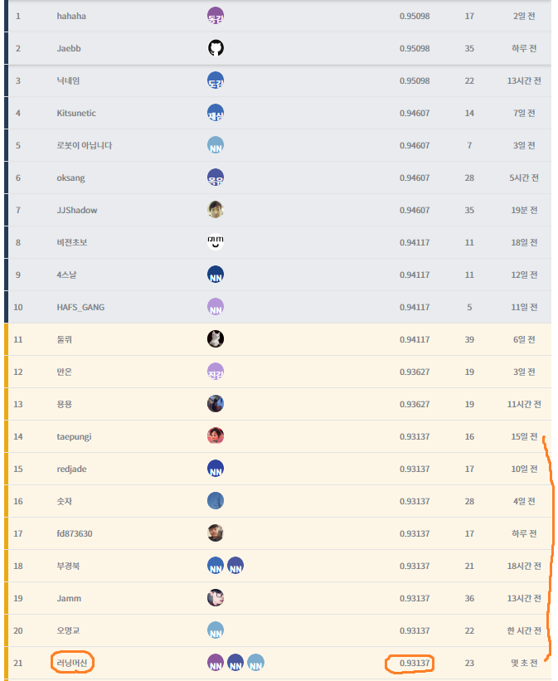
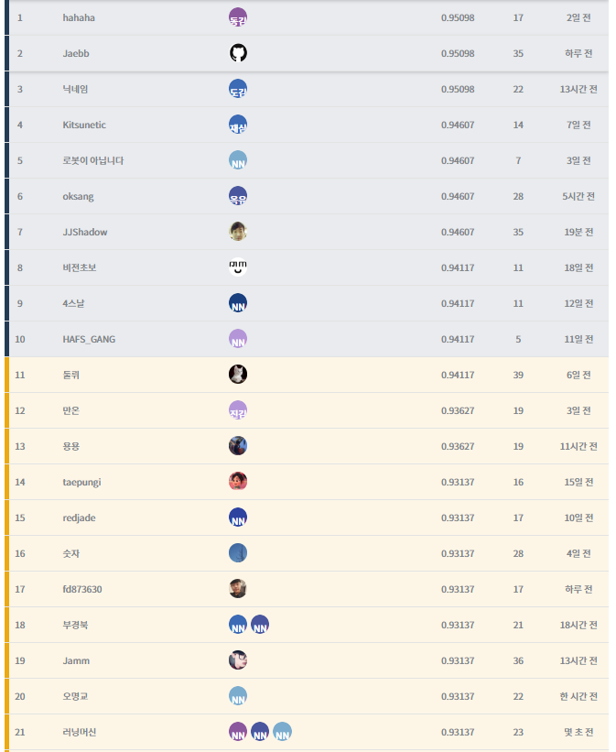
Final Project Learning Machine
 | Contents
 | Contents
 | Contents
 | Contents
 | Contents
 | Contents
 | Contents
 | Contents
 | Contents
 | Contents

