Slide 1
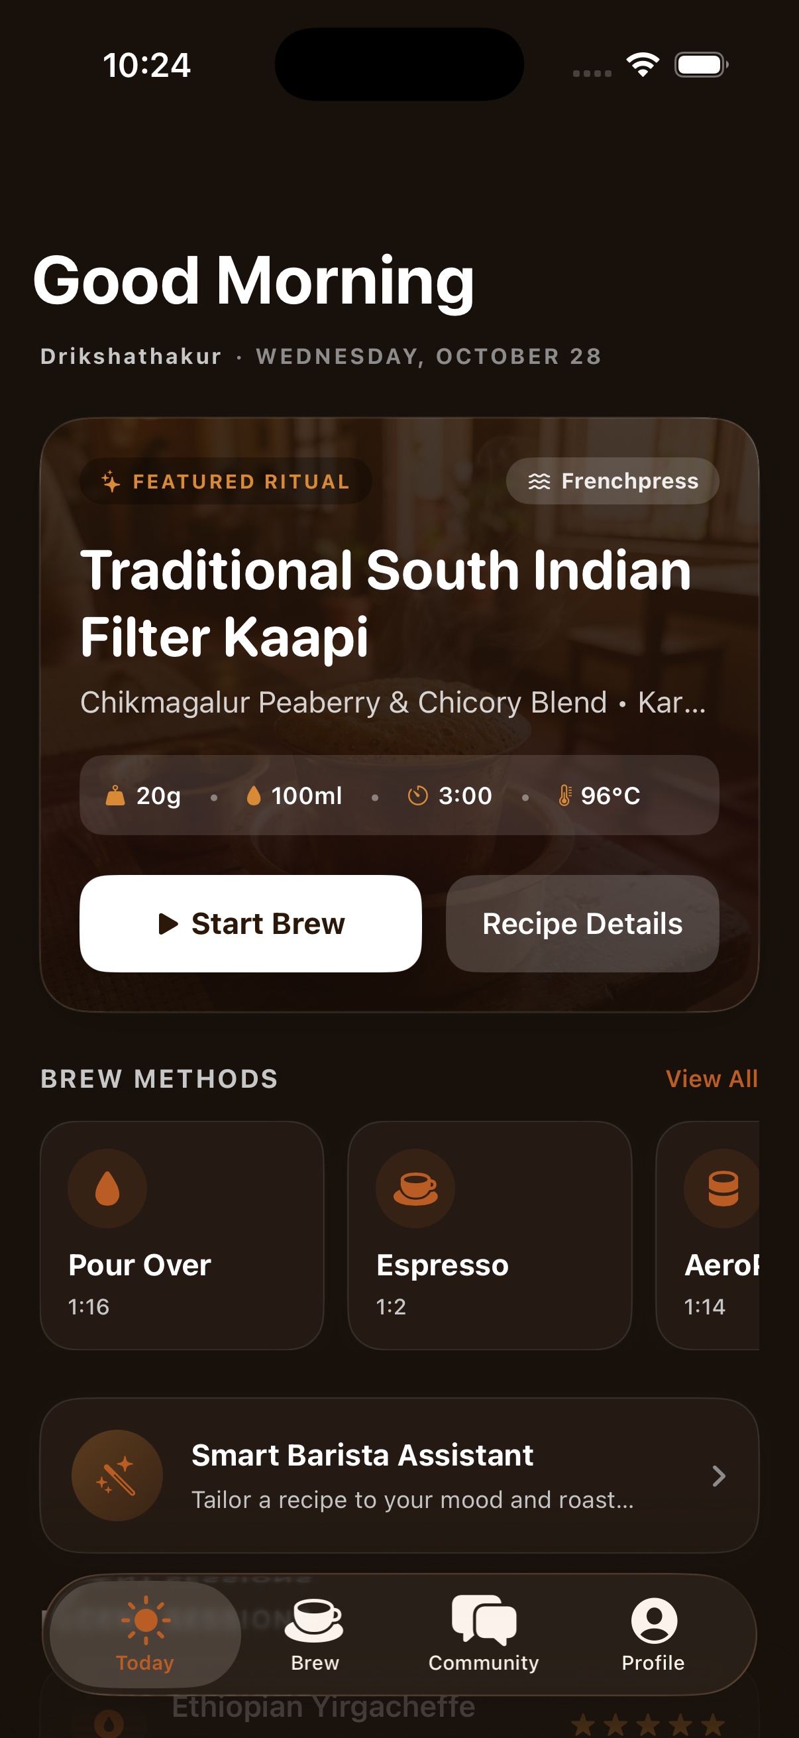

EXPLORATORY PROJECT | EP PRESENTATION
BEANS & BITES
Your Personal Coffee Ritual, Perfected.
Saurabh Singh Seerat Sharma Driksha Thakur Mahi Awasthi
Supervised by Dr. Swati Goel
Department of CSE, Chitkara University, Punjab
1 / 11

Slide 2
BEANS & BITES
OUR STORY
“
It started with a bad cup of coffee.
We had just bought a bag of specialty beans — the kind that cost Rs. 800 and promised blueberry and jasmine notes. We brewed it. It tasted like regret.
The problem? Ratio, grind size, bloom time, water temperature — nobody tells you these things. You spend months on YouTube, or you drink bad coffee forever.
And yes — when we said we were building a specialty coffee app for India, people laughed. 'India is a chai country,' they said.
But India's specialty coffee market is growing at 14% year-on-year. Third-wave cafes are opening in every metro city. Gen Z is already brewing at home. The craze is here. It just does not have a tool yet. That is Beans & Bites.
14%
YoY Growth
Specialty Coffee India
50 M+
Home Coffee Brewers
in Urban India
0
Dedicated Indian
Specialty Brewing Apps
2 / 11

Slide 3
BEANS & BITES
THE PROBLEM
Home brewers are flying blind.
NO STEP-BY-STEP GUIDANCE
NO TASTE MEMORY
No app walks you through brewing. Ratios, timers, pour weights — scattered across dozens of blogs and YouTube videos.
You brewed something excellent last week. You have no way to replicate it — ratio, grind, timing, water temp — all forgotten.
FOOD PAIRING IS GUESSWORK
NO COMMUNITY FOR INDIAN BREWERS
Nobody tells you which food complements your bean. The pairing knowledge exists — but it is locked away in barista training manuals.
Indian specialty coffee lovers have no shared space to post rituals, exchange recipes, or discover new beans together.
3 / 11

Slide 4
BEANS & BITES
OUR SOLUTION
One app. Every ritual.
Beans & Bites is a premium iOS app that guides specialty coffee lovers through every step — from choosing a recipe, through the brew, to logging the taste and sharing with a community. All offline. All on-device.
GUIDED BREW SESSIONS
RECIPE CREATION
Timers and step cards for 8 methods
Build and save your own custom recipes
SMART FOOD PAIRING
TASTE PROFILE
Curated pairings matched to bean and roast
Radar chart built from your brew history
BREW COMMUNITY
FULLY OFFLINE
Channels and feed to share rituals
No server, no login wall — works anywhere
4 / 11

Slide 5
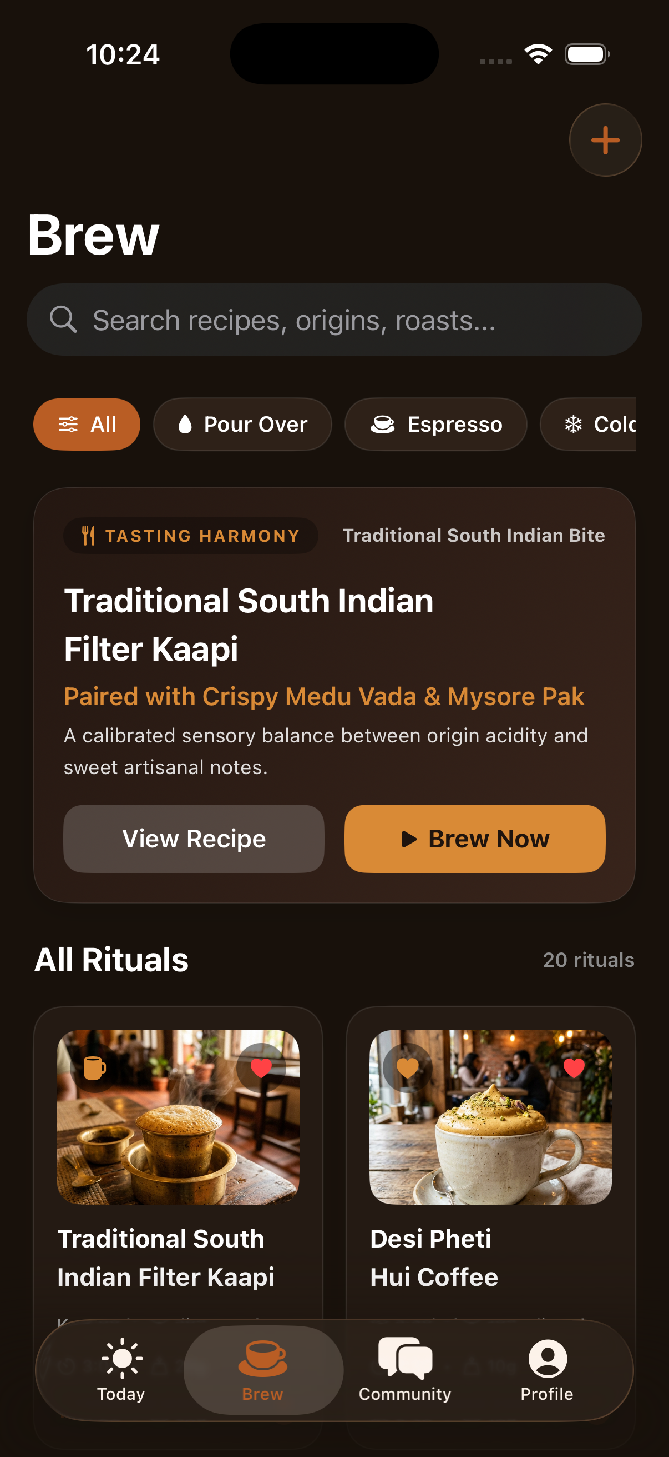
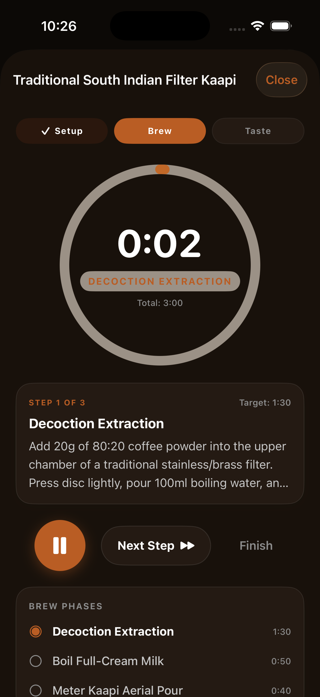
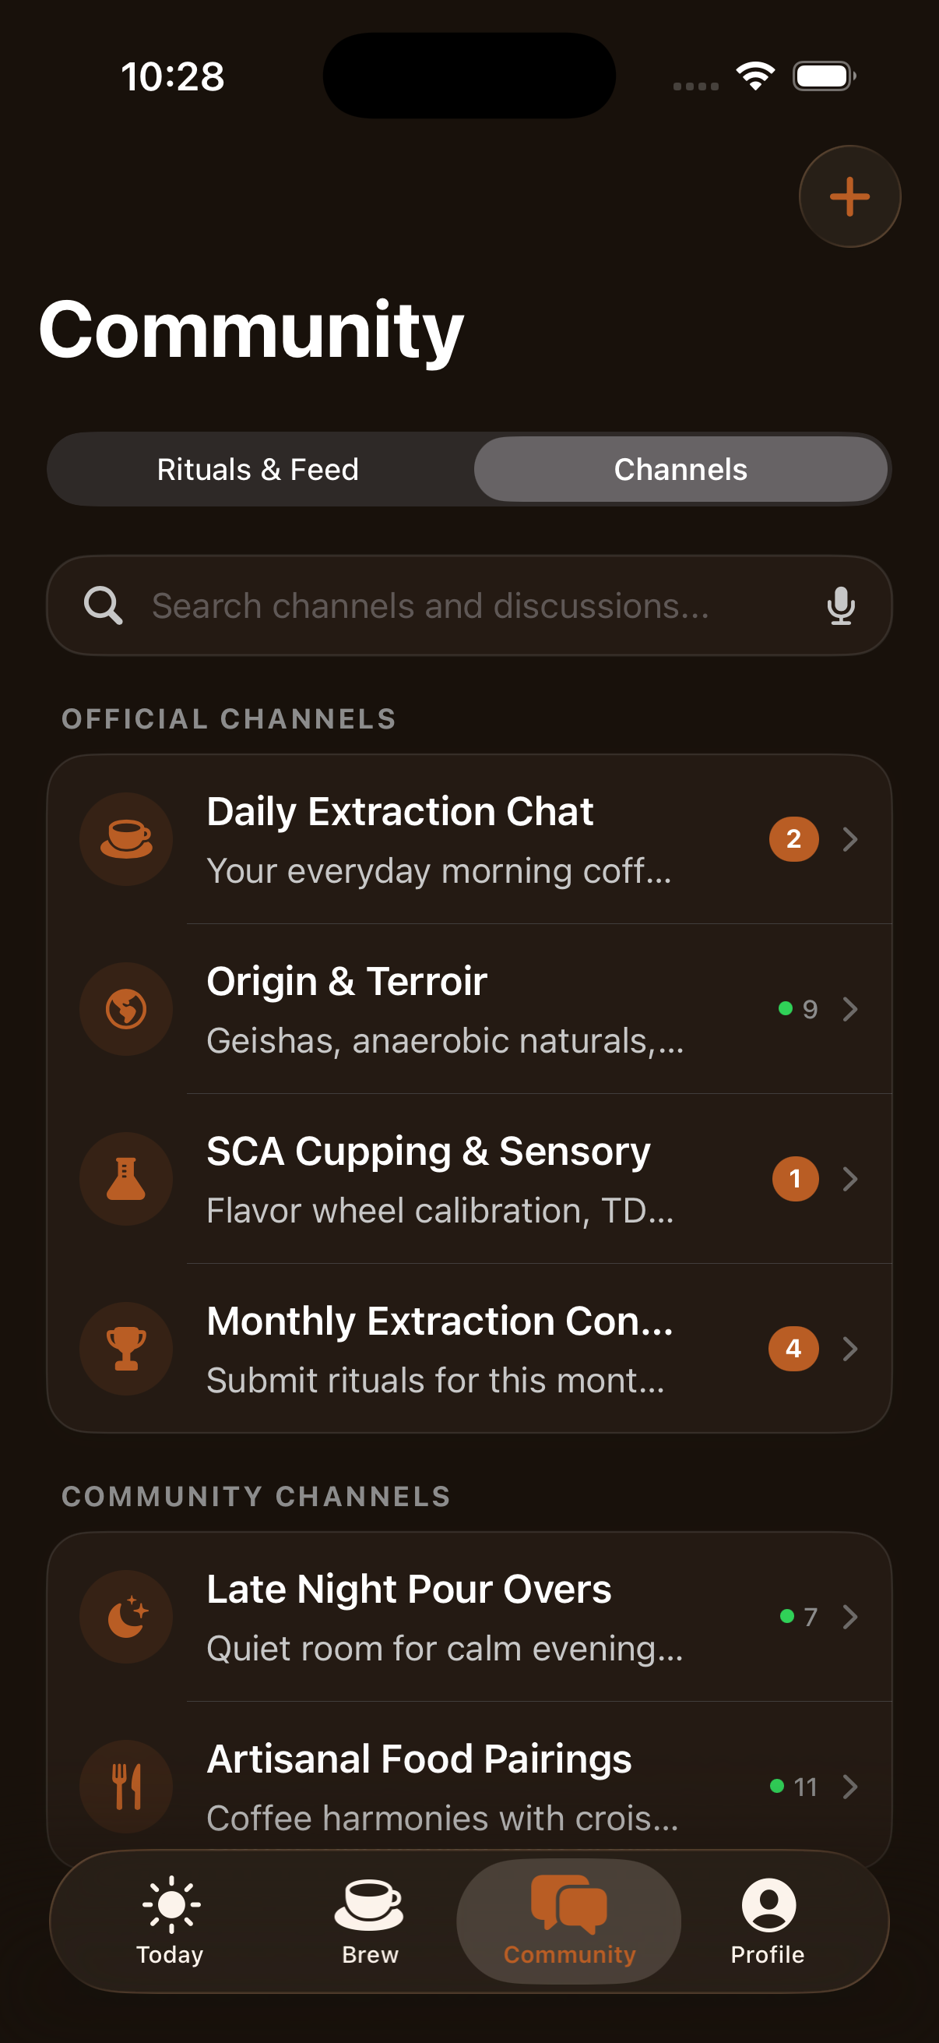
BEANS & BITES
See It in Action
HOME
BREW
TIMER
5 / 11
COMMUNITY

Slide 6
BEANS & BITES
KEY FEATURES
Built for the serious home brewer.
GUIDED BREW WITH PRECISION TIMER
Each recipe runs through named phases — Decoction, Bloom, Pour — with a live countdown timer, step-by-step instructions, and haptic feedback on each transition.
RECIPE CREATION FLOW
Users can build custom recipes from scratch: choose coffee base, roast level, grind type, add a photo and tasting notes. Saved locally via SwiftData.
SMART FOOD PAIRING CATALOG
A JSON-powered engine cross-references bean origin and roast against a curated library of pairings — surfaced directly on the brew detail card.
SCA FLAVOR WHEEL
After every session, an interactive Specialty Coffee Association flavor wheel lets users log precise tasting notes that build their taste profile over time.
6 / 11

Slide 7
BEANS & BITES
TECH STACK
100% Native. Zero Servers.
Swift 5 + SwiftUI
MVVM Architecture
SwiftData / SQLite
Native iOS user interface
Separation of concerns across all modules
Local persistence of brew sessions and recipes
Swift Charts
Canvas + Path
Combine
Brew analytics and taste radar visualisation
Custom SCA radar chart and flavor wheel
Reactive state management throughout app
UIKit Haptics
Codable + JSON
Git
Tactile feedback during brewing steps
Offline pairing catalog and recipe data
Version control across 6-week sprint
7 / 11

Slide 8
BEANS & BITES
ARCHITECTURE
Layered, Offline-First MVVM
SwiftUI Views
Home | Brew | Community | Profile | Onboarding
ViewModels (Combine)
AppDataStore | BrewVM | CommunityVM | ProfileVM
Data Model Managers
Auth | Coffee | Brew | Community | Profile Managers
Persistence Layer
SwiftData (SQLite) | JSON Files | Device Documents Directory
Supporting Services
Swift Charts | UIKit Haptics | CoffeeTheme Design System
8 / 11

Slide 9
BEANS & BITES
METHODOLOGY
Iterative development — module by module.
W1
Requirement Analysis
User flows, data models, feature scoping
W2
UI / UX Design
CoffeeTheme system, component library, dark and light mode
W3-4
Auth, Home & Brew
Login/Signup, HomeScreen, 8 brew methods with timers
W5-6
Pairing, Recipe & Discover
Pairing engine, recipe creation flow, discover screen
W7
Community & Profile
Channels, ritual feed, taste radar, achievements
W8
Testing & Documentation
Xcode simulator testing, edge case coverage, SCA review
9 / 11

Slide 10
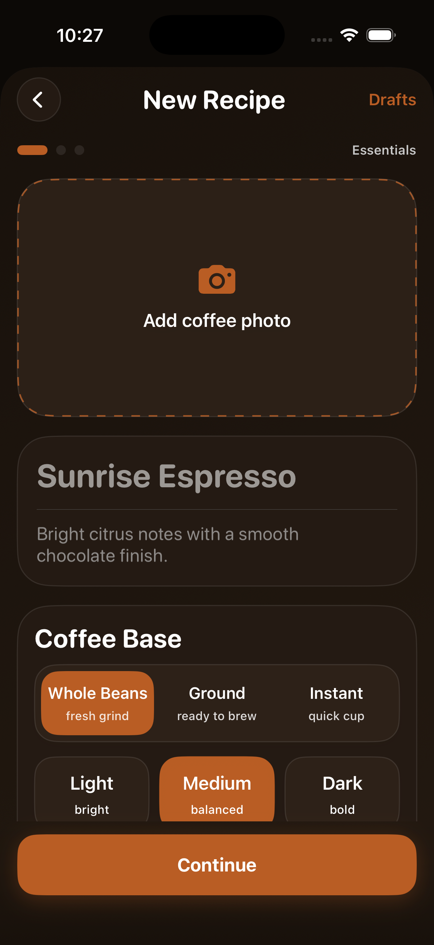
BEANS & BITES
COMMUNITY & RECIPE
Your rituals, shared.
Official channels — Daily Chat, Origin, SCA Cupping
Community channels — Pairings, Late Night Pours
Create and share custom recipes with photos
Choose roast level, grind type and base
Save drafts and publish to the community feed
10 / 11

Slide 11
BEANS & BITES
Your Personal Coffee Ritual, Perfected.
Offline-First | MVVM | SwiftData | SCA Flavor Wheel
Thank You
Saurabh Singh | Seerat Sharma | Driksha Thakur | Mahi Awasthi
Supervised by Dr. Swati Goel | Chitkara University, Punjab

