Slide 1
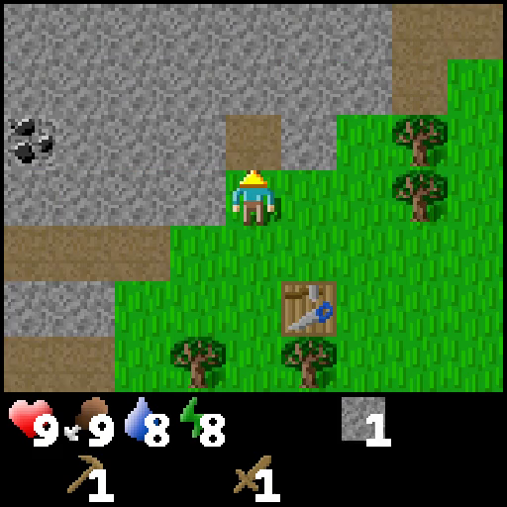
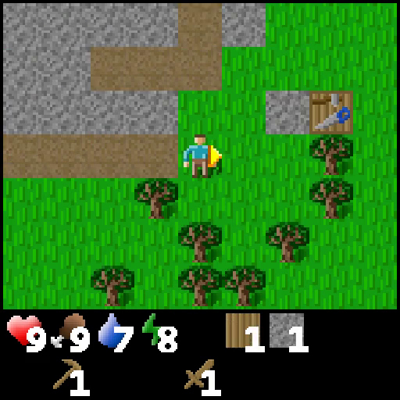
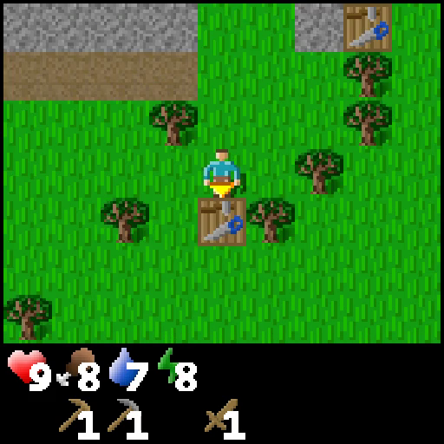
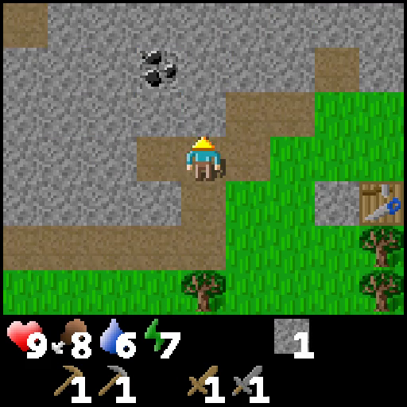
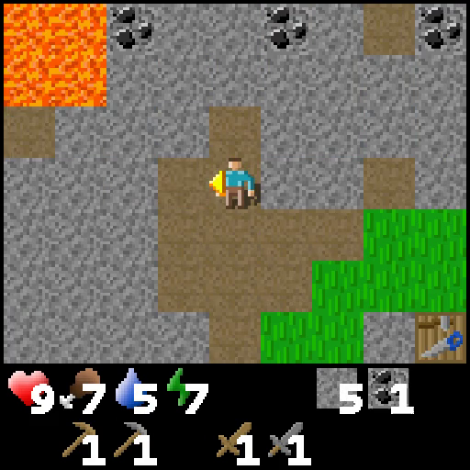
Intra-Trajectory Achievement Prediction
Collect Stone
Make Stone Pickaxe
Collect Coal
Buffer

Slide 2
Intra-Trajectory Achievement Prediction
Collect Stone
Make Stone Pickaxe
Collect Coal
Buffer

Slide 3
Intra-Trajectory Achievement Prediction
Collect Stone
Make Stone Pickaxe
Collect Coal
Buffer
Positive
Anchor
Negative

Slide 4
Intra-Trajectory Achievement Prediction
Collect Stone
Make Stone Pickaxe
Collect Coal
Buffer
Positive
Anchor
Negative

Slide 5
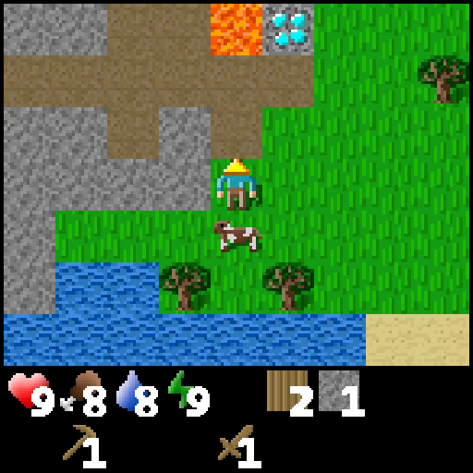
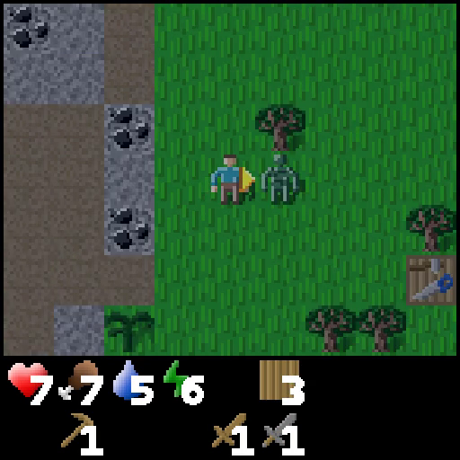
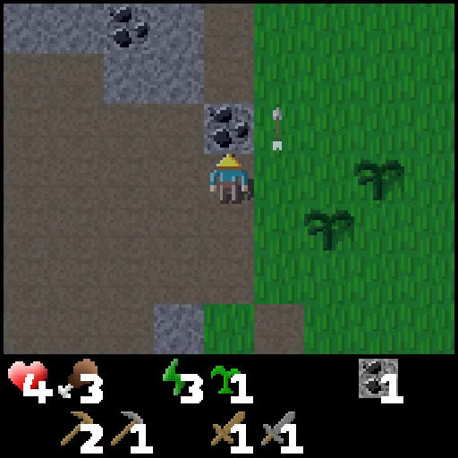
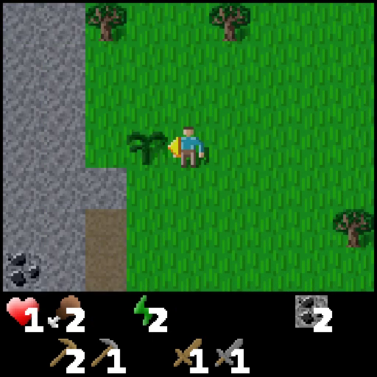
Cross-Trajectory Achievement Matching
Buffer
Collect Stone
Defeat Zombie
Collect Coal
Plant Sapling
Collect Stone
Make Stone Pickaxe
Collect Coal

Slide 6
Cross-Trajectory Achievement Matching
Buffer
Collect Stone
Defeat Zombie
Collect Coal
Plant Sapling
Collect Stone
0.05 | 0.29 | 0.19 | 0.38
0.23 | 0.10 | 0.33 | 0.15
0.42 | 0.58 | 0.25 | 0.06
Make Stone Pickaxe
Collect Coal
Cosine Distance

Slide 7
Cross-Trajectory Achievement Matching
Buffer
Collect Stone
Defeat Zombie
Collect Coal
Plant Sapling
Collect Stone
0.81 | 0.05 | 0.11 | 0.03
0.07 | 0.57 | 0.05 | 0.31
0.05 | 0.03 | 0.08 | 0.84
Make Stone Pickaxe
Collect Coal
Partial Optimal Transport

Slide 8
Cross-Trajectory Achievement Matching
Buffer
Collect Stone
Defeat Zombie
Collect Coal
Plant Sapling
Collect Stone
Make Stone Pickaxe
Collect Coal
Thresholding

Slide 9
Cross-Trajectory Achievement Matching
Buffer
Collect Stone
Defeat Zombie
Collect Coal
Plant Sapling
Collect Stone
Make Stone Pickaxe
Collect Coal

Slide 10
Cross-Trajectory Achievement Matching
Buffer
Collect Stone
Defeat Zombie
Collect Coal
Plant Sapling
Collect Stone
Make Stone Pickaxe
Positive
Anchor
Collect Coal
Negative

Slide 11
Cross-Trajectory Achievement Matching
Buffer
Collect Stone
Defeat Zombie
Collect Coal
Plant Sapling
Collect Stone
Make Stone Pickaxe
Positive
Anchor
Collect Coal
Negative

