Slide 1

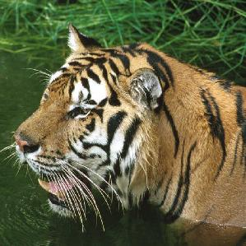
Top 5
quilt, comforter
6.64%
5.87%
tiger, Panthera tigris
3.92%
fly
2.79%
pillow
2.54%
crossword puzzle
Combinatorial Perturbation

