Slide 1
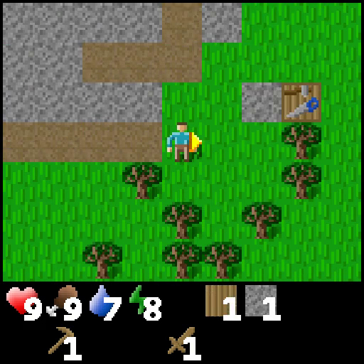
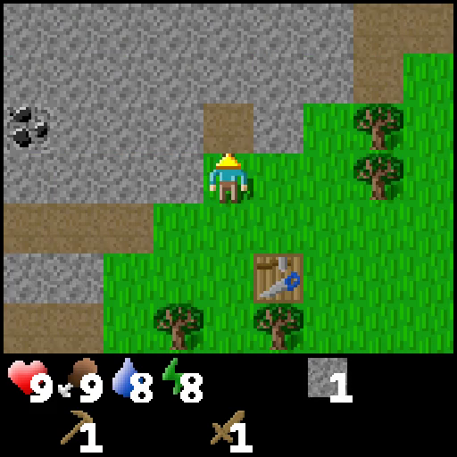
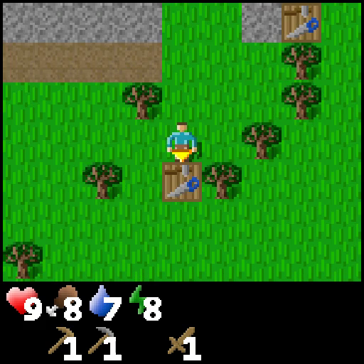
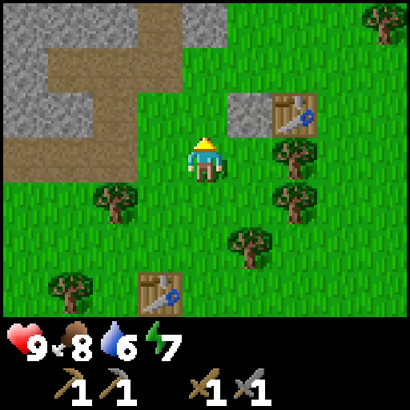
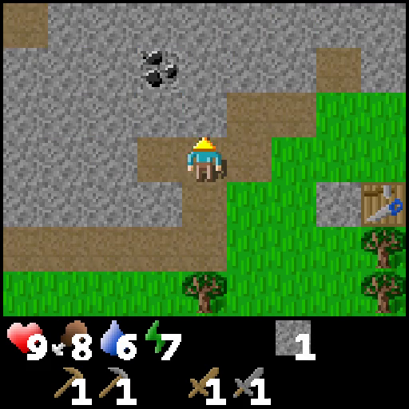
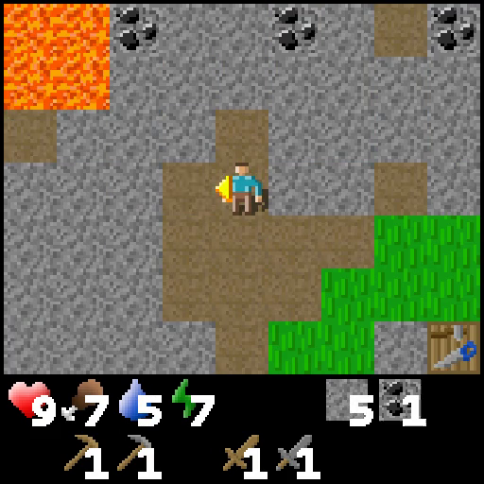
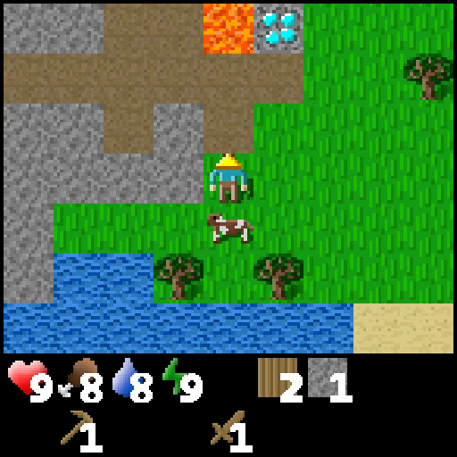
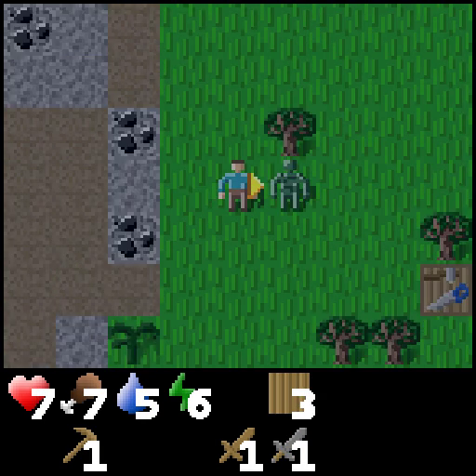
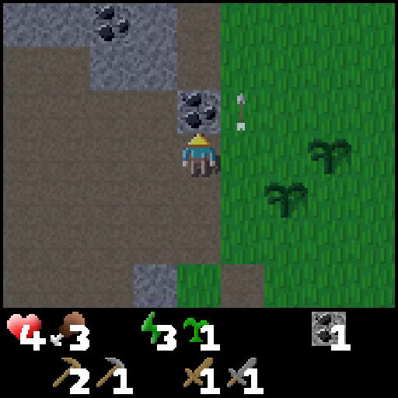
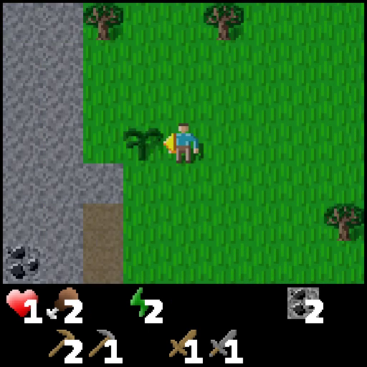
Intra-Trajectory Achievement Prediction
Collect Stone
Make Stone Pickaxe
Collect
Coal
Positive
Anchor
Current
(s, a)
Next Achievement
Random
(s, a)
Negative
Cross-Trajectory Achievement Matching
0.05 | 0.29 | 0.19 | 0.38
0.23 | 0.10 | 0.33 | 0.15
0.42 | 0.58 | 0.25 | 0.06
0.81 | 0.05 | 0.11 | 0.03
0.07 | 0.57 | 0.05 | 0.31
0.05 | 0.03 | 0.08 | 0.84
Positive
Anchor
Negative
Cosine Distance
Soft Matching
Hard Matching

Slide 2
Intra-Trajectory Achievement Prediction
Collect Stone
Make Stone Pickaxe
Collect
Coal
Positive
Anchor
Random
(s, a)
Negative
Current
(s, a)
Next Achievement
Cross-Trajectory Achievement Matching
0.05 | 0.29 | 0.19 | 0.38
0.23 | 0.10 | 0.33 | 0.15
0.42 | 0.58 | 0.25 | 0.06
0.81 | 0.05 | 0.11 | 0.03
0.07 | 0.57 | 0.05 | 0.31
0.05 | 0.03 | 0.08 | 0.84
Positive
Anchor
Negative
Cosine Distance
Soft Matching
Hard Matching

