Slide 1
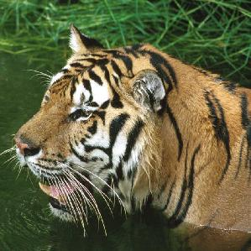
Top 5
tiger, Panthera tigris
81.28%
13.08%
tiger cat
0.08%
space shuttle
0.05%
jaguar, panther
0.04%
lynx, catamount
Original Image

Slide 2

Top 5
tiger, Panthera tigris
81.11%
13.18%
tiger cat
0.10%
space shuttle
0.07%
jaguar, panther
0.04%
lynx, catamount
Initial Noise

Slide 3
Top 5
tiger, Panthera tigris
81.11%
13.18%
tiger cat
0.10%
space shuttle
0.07%
jaguar, panther
0.04%
lynx, catamount
Interpolation

Slide 4

Top 5
tiger, Panthera tigris
77.73%
16.52%
tiger cat
0.13%
space shuttle
0.06%
jaguar, panther
0.03%
lynx, catamount
Combinatorial Perturbation

Slide 5
Top 5
tiger, Panthera tigris
77.73%
16.52%
tiger cat
0.13%
space shuttle
0.06%
jaguar, panther
0.03%
lynx, catamount
Interpolation

Slide 6

Top 5
tiger, Panthera tigris
65.56%
14.95%
tiger cat
0.33%
jaguar, panther
0.19%
space shuttle
0.17%
tabby, tabby cat
Combinatorial Perturbation

Slide 7
Top 5
tiger, Panthera tigris
65.56%
14.95%
tiger cat
0.33%
jaguar, panther
0.19%
space shuttle
0.17%
tabby, tabby cat
Interpolation

Slide 8

Top 5
tiger, Panthera tigris
7.55%
5.45%
jaguar, panther
4.90%
quilt, comforter
3.96%
cougar, puma
2.43%
tiger cat
Combinatorial Perturbation

Slide 9
Top 5
tiger, Panthera tigris
7.55%
5.45%
jaguar, panther
4.90%
quilt, comforter
3.96%
cougar, puma
2.43%
tiger cat
Interpolation

Slide 10

Top 5
quilt, comforter
6.64%
5.87%
tiger, Panthera tigris
3.92%
fly
2.79%
pillow
2.54%
crossword puzzle
Combinatorial Perturbation

