Slide 1
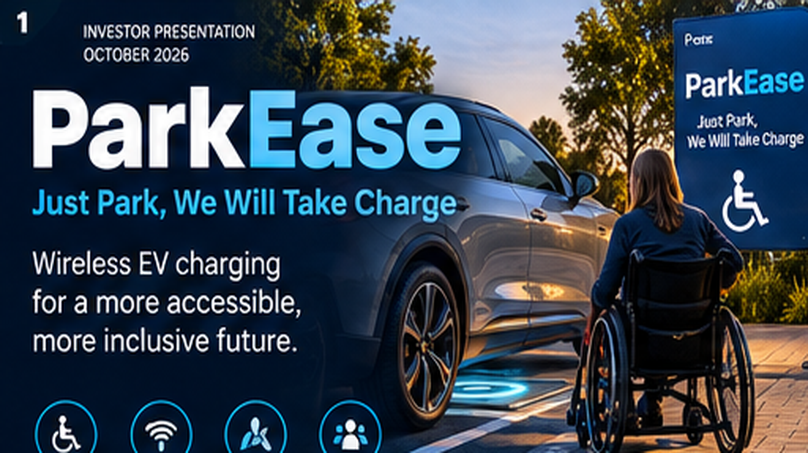
CONCEPT VISUALISATION • Proposed product; prototype, performance, market claims and certification require validation

Slide 2
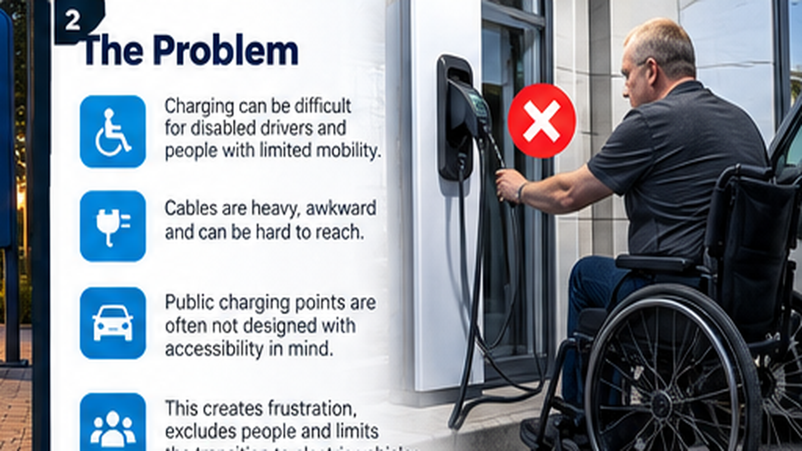
CONCEPT VISUALISATION • Proposed product; prototype, performance, market claims and certification require validation

Slide 3
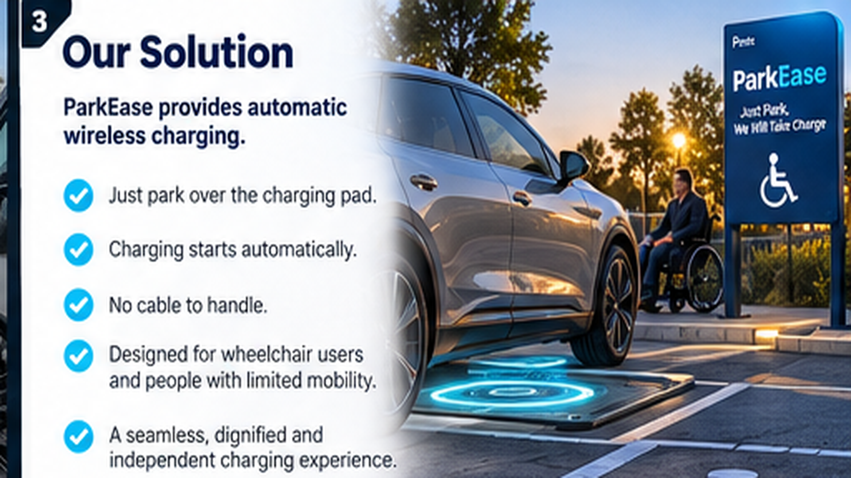
CONCEPT VISUALISATION • Proposed product; prototype, performance, market claims and certification require validation

Slide 4
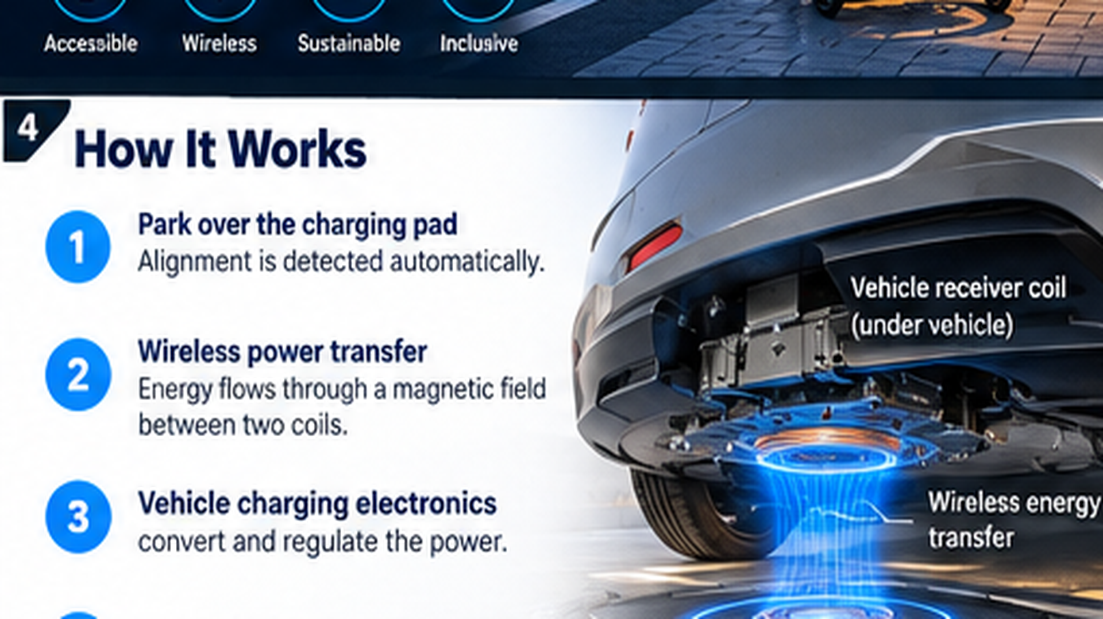
CONCEPT VISUALISATION • Proposed product; prototype, performance, market claims and certification require validation

Slide 5
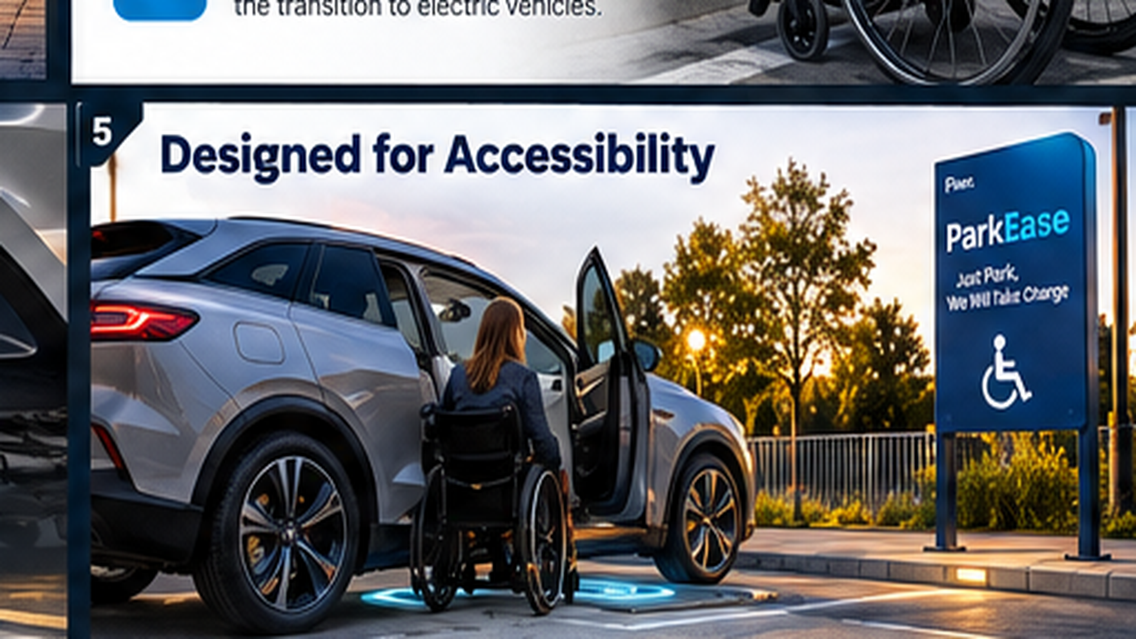
CONCEPT VISUALISATION • Proposed product; prototype, performance, market claims and certification require validation

Slide 6
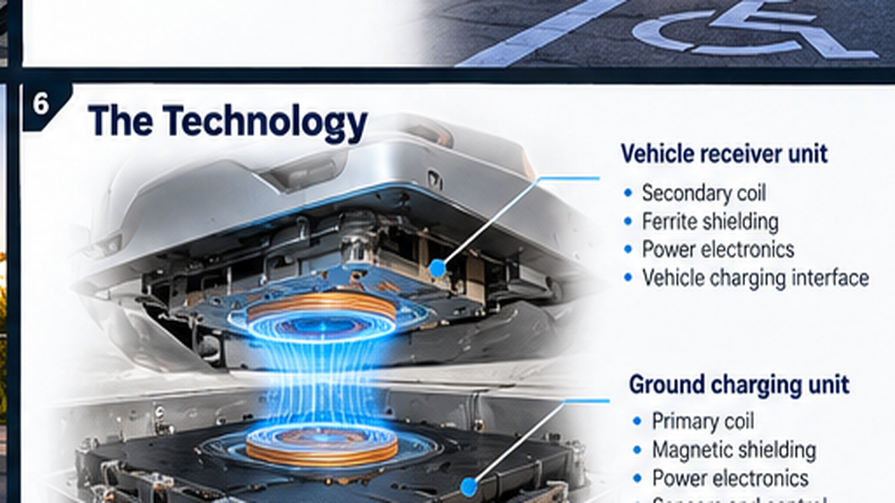
CONCEPT VISUALISATION • Proposed product; prototype, performance, market claims and certification require validation

Slide 7
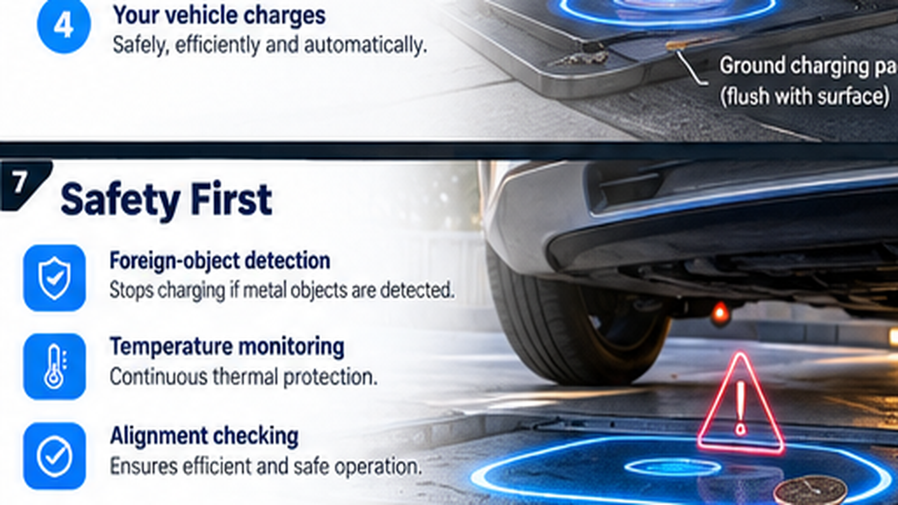
CONCEPT VISUALISATION • Proposed product; prototype, performance, market claims and certification require validation

Slide 8
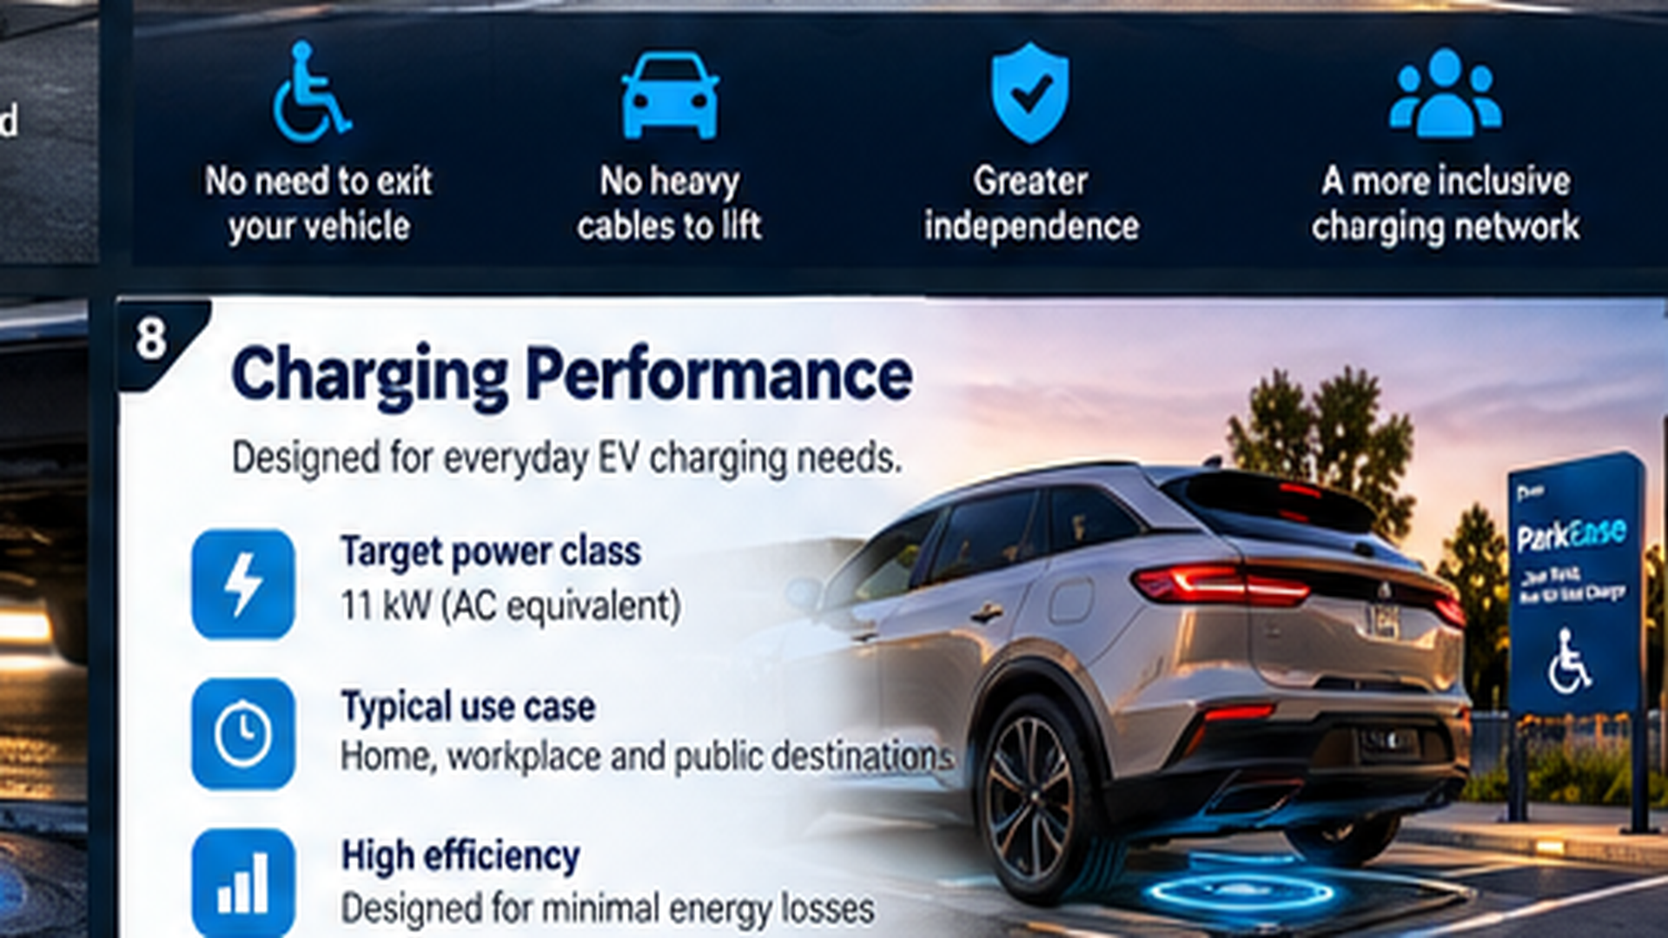
CONCEPT VISUALISATION • Proposed product; prototype, performance, market claims and certification require validation

Slide 9
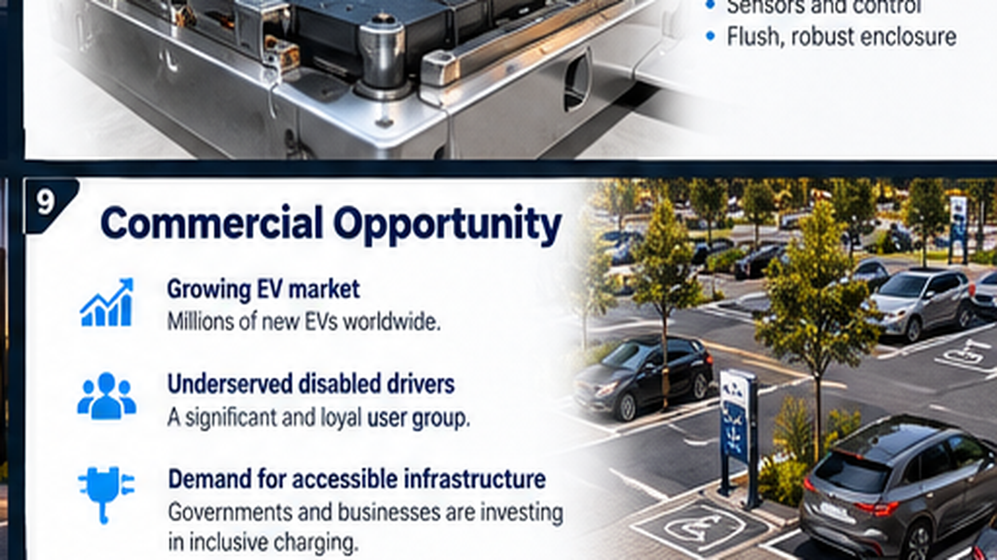
CONCEPT VISUALISATION • Proposed product; prototype, performance, market claims and certification require validation

Slide 10
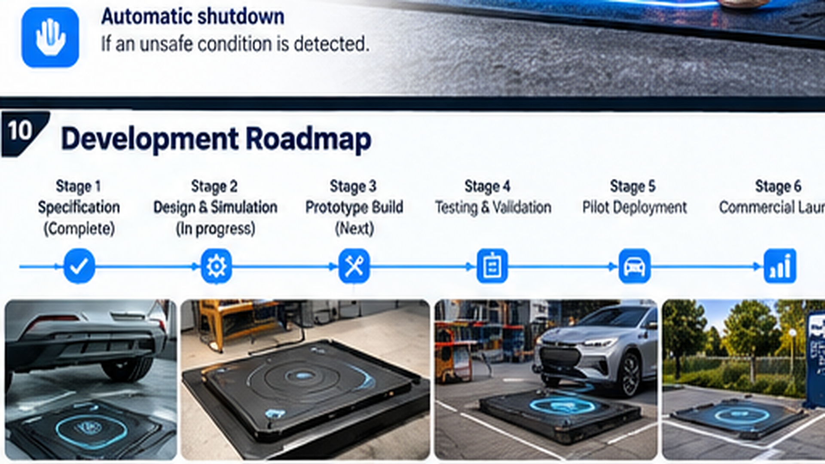
CONCEPT VISUALISATION • Proposed product; prototype, performance, market claims and certification require validation

Slide 11
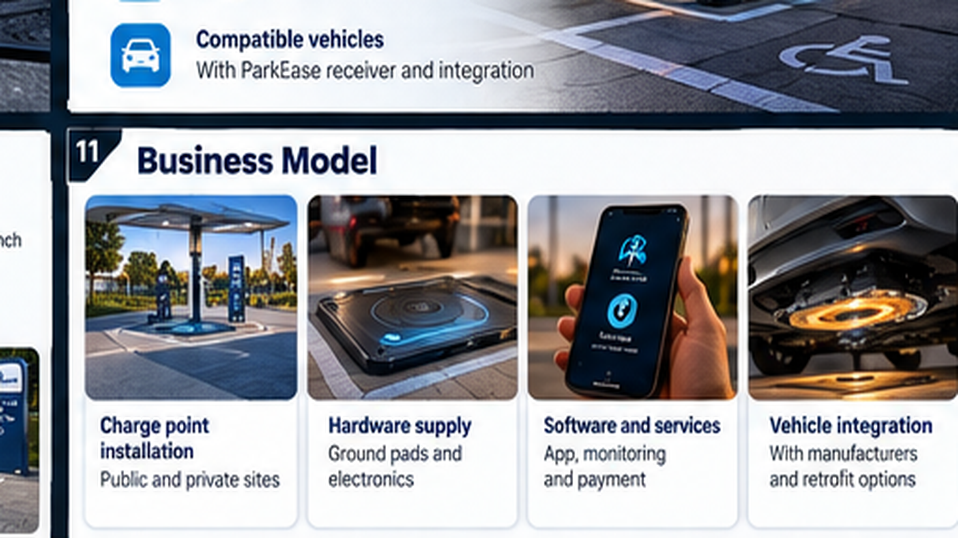
CONCEPT VISUALISATION • Proposed product; prototype, performance, market claims and certification require validation

Slide 12
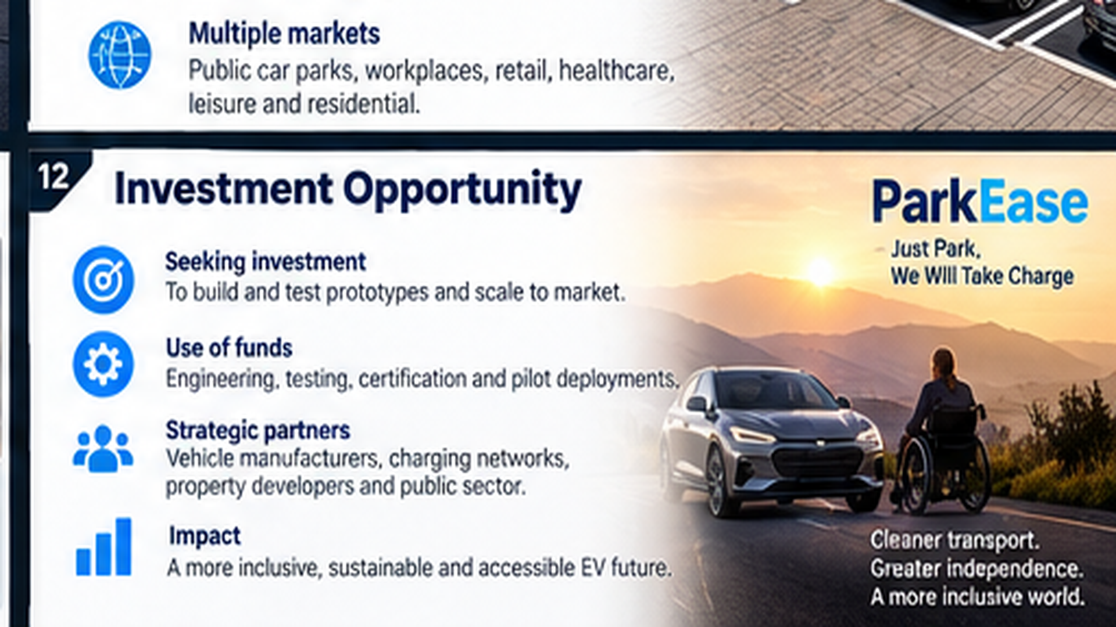
CONCEPT VISUALISATION • Proposed product; prototype, performance, market claims and certification require validation

Slide 13
PARKEASE / INVESTOR DUE DILIGENCE
Investment thesis: what is proven and what is not
A transparent early-stage opportunity, with technical milestones before commercial claims.
Established problem
Proposed solution
Still to validate
Cable handling and physical access can make EV charging difficult for some disabled drivers.
A ground coil and under-vehicle receiver could remove manual plug handling.
Transfer efficiency, cost, vehicle compatibility, safety compliance and user acceptance.
No certified product, proven charging performance, commercial contracts or quantified market share are claimed.

Slide 14
PARKEASE / INVESTOR DUE DILIGENCE
Funding milestones and decision gates
Investment should be tied to measurable engineering progress, not unverified forecasts.
01 FEASIBILITY
Electromagnetic simulation; receiver packaging; safety and regulatory gap analysis.
02 BENCH PROOF
Demonstrate controlled low-power transfer and quantify alignment and efficiency.
03 ENGINEERING PROTOTYPE
Integrate controls, thermal protection and foreign-object detection.
04 ACCESSIBILITY PILOT
Validate parking, authorisation, error recovery and charging with users.
Investor decision: agree budget and capital requirement only after engineering quotations and scope approval.

Slide 15
PARKEASE / INVESTOR DUE DILIGENCE
Key investor questions to resolve
Commercial assumptions requiring evidence before a priced funding round.
Unit economics
Installed pad cost, receiver cost, maintenance and efficiency losses
Compatibility
OEM integration, retrofit feasibility and interoperability
Route to market
Infrastructure partners, property owners and fleet operators
Defensibility
Patent landscape, freedom to operate and proprietary differentiation
Adoption
Accessibility trials, willingness to pay and buyer procurement cycles
ParkEase — Just Park, We Will Take Charge

