Slide 1
SDGKU / FULL-STACK & MOBILE
Capstone finish lines
One project across
three courses
118, 119 and 120
Six classes per course. Eighteen classes in total.
01
Notes:
Introduce this as the proposed capstone roadmap. Students retain their choice of product and implementation. The shared expectations concern demonstrable outcomes.

Slide 2
THE ROADMAP
Three courses, one growing product
118
119
120
Core idea works
MVP is complete
Product is ready
One useful workflow connects
the interface to real storage.
Someone else can complete
the essential user journey.
A tested release is accessible
and ready to demonstrate.
02
Notes:
The same capstone continues through all three courses. MVP means minimum viable product: the smallest complete version that delivers the intended user value.

Slide 3
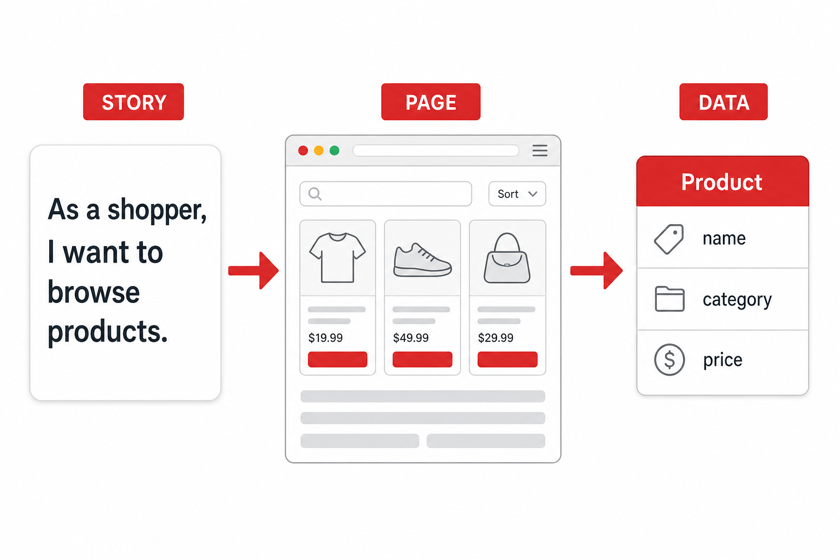
COURSE 118 / CLASSES 1–6
118: The core idea works
Finish line
One small workflow works
from screen to storage.
A user completes a useful action.
The app saves and retrieves real data.
Validation and feedback support the action.
03
Notes:
Evidence: run the app, perform the core action, and show the stored result. Planning and wireframes support the build, but working software is the course finish line. Example: create a booking and reopen it. Authentication is required when the product or program learning outcomes require it. Illustration: shared/images/118-story-to-page.png, generated for this curriculum.

Slide 4
COURSE 118 / SUGGESTED CHECKPOINTS
118: A path to the first working workflow
Classes 1–2
Choose the user journey and launch the project.
Class 3
Create and retrieve one meaningful record.
Class 4
Implement identity and access where needed.
Class 5
Connect the complete action and validate input.
Class 6
Demonstrate the workflow and revise the scope.
04
Notes:
Suggested end-of-class targets, adjustable to session length and student preparation. Data storage decisions happen early. An app without accounts should still explain its access model. Check deployment or device installation feasibility early.

Slide 5
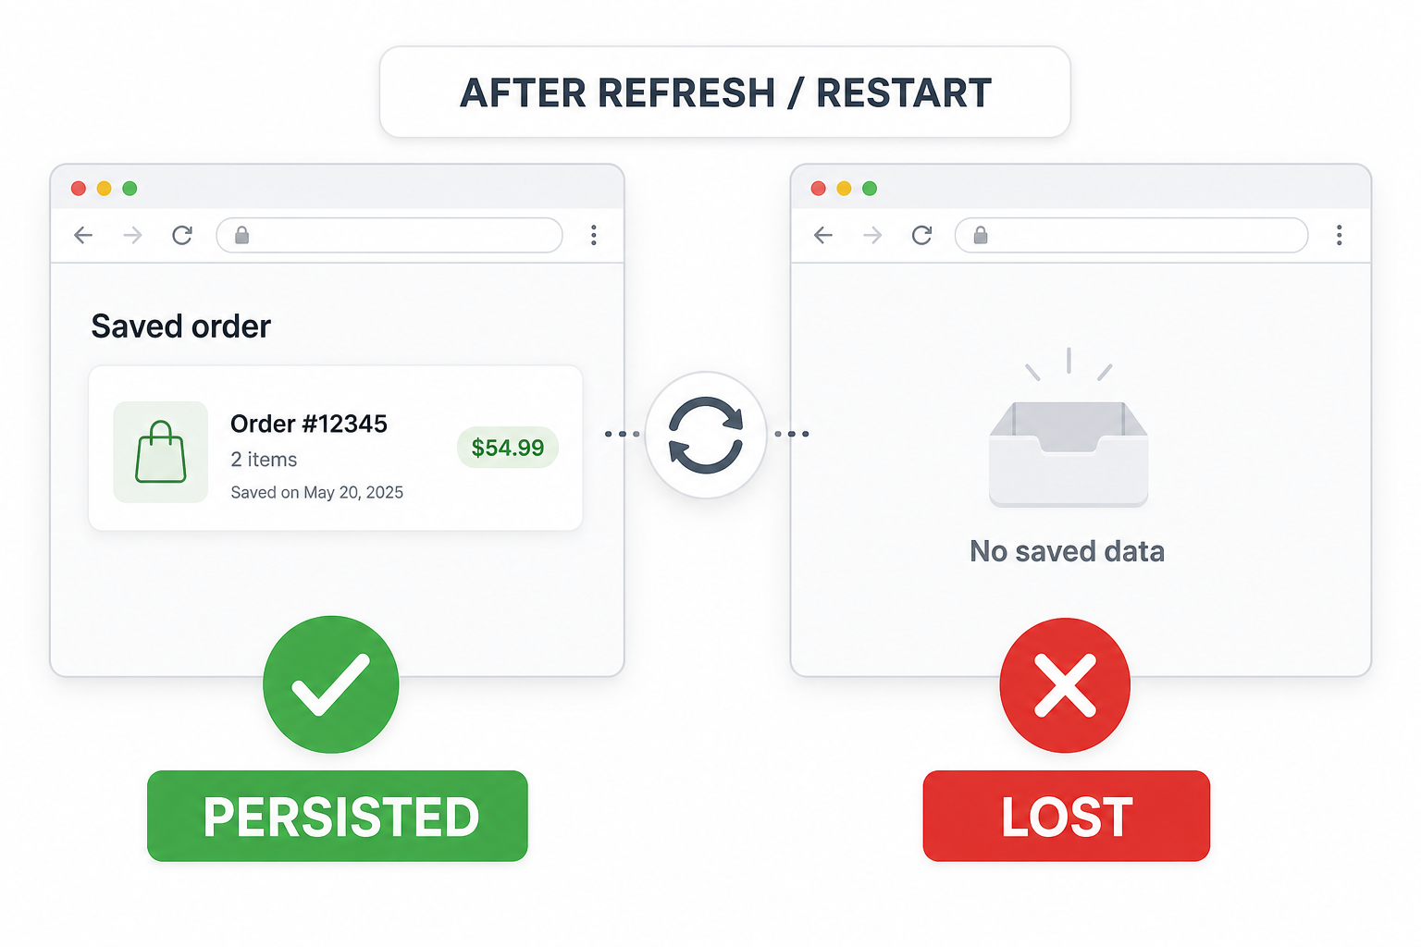
COURSE 119 / CLASSES 7–12
119: The MVP is complete
Finish line
Another person completes
the essential journey.
Essential features connect.
Empty and error states make sense.
Core tests repeat reliably.
User feedback produces an improvement.
05
Notes:
MVP means minimum viable product. Evidence: ask a peer to perform the main journey without coaching. Show normal behavior, an invalid action, and persistence after refresh or restart. Finish with a known-issues list and freeze the essential feature scope. Illustration: shared/images/119-refresh-test.png.

Slide 6
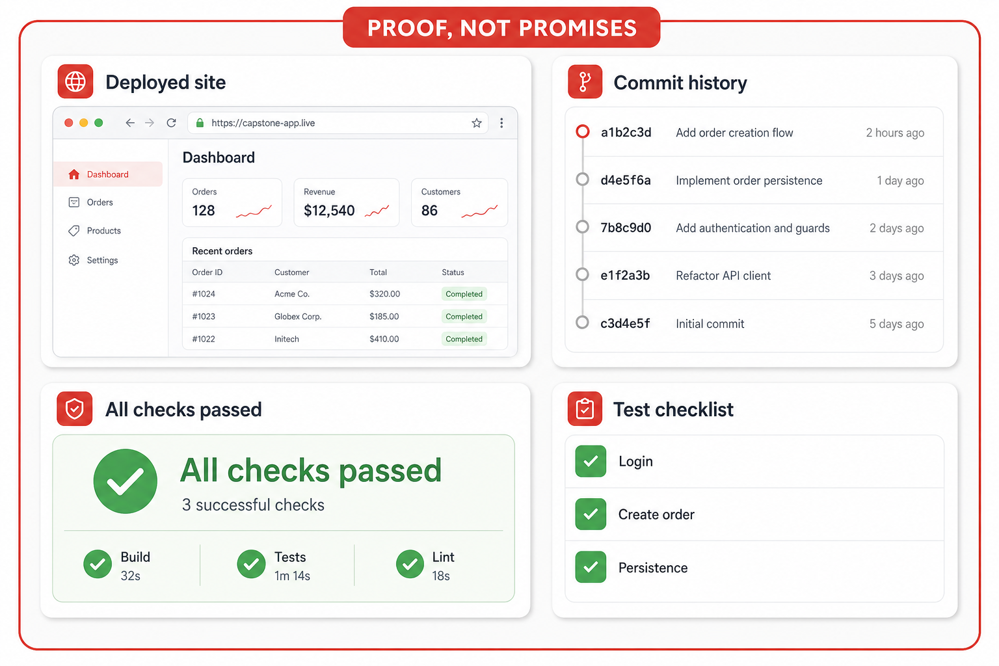
COURSE 120 / CLASSES 13–18
120: The product is ready to deliver
Finish line
A tested release that
others can access.
Fix serious issues and polish usability.
Repeat the build and core checks.
Provide a web link or mobile build.
Demonstrate results with evidence.
06
Notes:
Web delivery can be a deployed site. Mobile delivery can be an installable build or an approved testing distribution; public app-store publication is not automatically required. Supply access/setup instructions and known limitations. The final demo explains the user problem, workflow, technical decisions and evidence. Illustration: shared/images/120-demo-evidence.png.

Slide 7
EXAMPLES / WEB AND MOBILE
Different projects can meet the same standard
A web booking app
A mobile habit tracker
118 Create and reopen a booking.
119 Complete booking management,
with access rules and error handling.
120 Deliver a tested web release
with clear access instructions.
118 Save a habit and retain it after restart.
119 Complete tracking and history,
with useful empty and error states.
120 Deliver a tested installable build
with clear setup instructions.
07
Notes:
Illustrative examples, not required project types. Students may choose different stacks and storage solutions. Authentication is conditional on product needs and course requirements. Evaluate the same outcomes while allowing appropriate technical differences.

Slide 8
COURSE-END DEMONSTRATIONS
Evidence at each finish line
118
119
120
Show one action
Let someone use it
Deliver the product
Run the workflow.
Show the saved result.
Explain the next scope decision.
Observe the complete journey.
Show a failure case and a test.
Explain a feedback-driven change.
Share a working release.
Show repeatable checks.
Explain decisions and limitations.
08
Notes:
Use working demonstrations for behavior. Screenshots alone do not establish persistence or correctness. These are completion standards, not a proposed grading scheme. If students work in teams, each student should explain a meaningful contribution and the associated technical decisions.

Slide 9
PLANNING ACTIVITY
Your capstone finish lines
118
By the end of 118, a user can…
119
By the end of 119, a new user can complete…
120
By the end of 120, I can deliver and prove…
09
Notes:
Give students five minutes to complete these statements with observable behaviors. Then ask a partner to identify the evidence needed for each. Keep the initial scope small enough to finish. Revisit these statements at each course review.

