Slide 1
JOBCLICK
TEAM MEMBERS
ANANYA MOHANTY
DHANASHREE VANNAM
NEHA GAIKWAD
RONAKKUMAR SHINGALA
DRISHTI SHISHODIYA

Slide 2
OVERVIEW
We have designed and created a job search portal that job hunters today can use that will maximize their chances of finding a position of their choice, improve their existing skills and knowledge through online learning and certification and various other services like Resume evaluation.

Slide 3
STRATEGY PLANE
PRODUCT OBJECTIVE
USER NEEDS

Slide 4
PRODUCT OBJECTIVE
Our objective is to provide one stop platform for job seekers to find available jobs, connect with recruiters, gain latest skills through online learning and certifications and various other services like document evaluation

Slide 5
USER NEEDS
User friendly job search portal
Free evaluation of Resume, Cover letter
Access to latest interview questions
Online learning and certification

Slide 6
SCOPE PLANE
FUNCTIONAL SPECIFICATIONS
CONTENT REQUIREMENTS

Slide 7
FUNCTIONAL SPECIFICATIONS
User should be able to search for jobs
User should be able to look for Companies(About, Location, Interview Questions)
User should be able to search and reach to recruiters directly for each Company hiring for the positions they are interested
User can access Online Learning modules
User should be able to request for Job document evaluation
Users should be able to connect to social media sites

Slide 8
CONTENT REQUIREMENTS
Sign up: Details of each user should be maintained
Contents: Details about the Companies, job postings, online learning materials should be up to date
User Interactions: User can add Reviews, Interview questions, Salary
Feeds: Top and trending Companies

Slide 9

PERSONAS
Edward Dunham
Personal Background
Age 24, Single
Professional Background
Graduate Student
User Environment
oHeavy user of internet
oActive on Facebook, linkedin.
oUses laptop and smartphone
Challenges/Pain points
o Finds it difficult to get in contact with the right recruiters
o Confused on which course/certifications to go for that fulfills his goal
o Needs help in Resume evaluation

Slide 10

PERSONAS
Alexa Robert
Personal Background
Age 35, Married
Professional Background
Mid-level Software Engineer
User Environment
oActive on Facebook, job search sites, linkedin.
oUses laptop and smartphone
Challenges/Pain points
o She wants a career change and looking for prospective job openings
o Needs help in course selection and online learning platform she can use to gain new knowledge and skills at the comfort of her home and schedule

Slide 11
STRUCTURE PLANE
CONCEPTUAL MODEL
INFORMATION ARCHITECTURE

Slide 12
CONCEPTUAL MODEL
In this step, development ideas move from intangible data points to actual areas of application.
The website helps students and professionals to:
Find appropriate jobs
Checkout company requirements
Connect with recruiters
Get resume and cover letter guidelines, feedback and samples
Study online courses and attend webinars
The information architecture shows the flow of actions throughout the website.

Slide 13
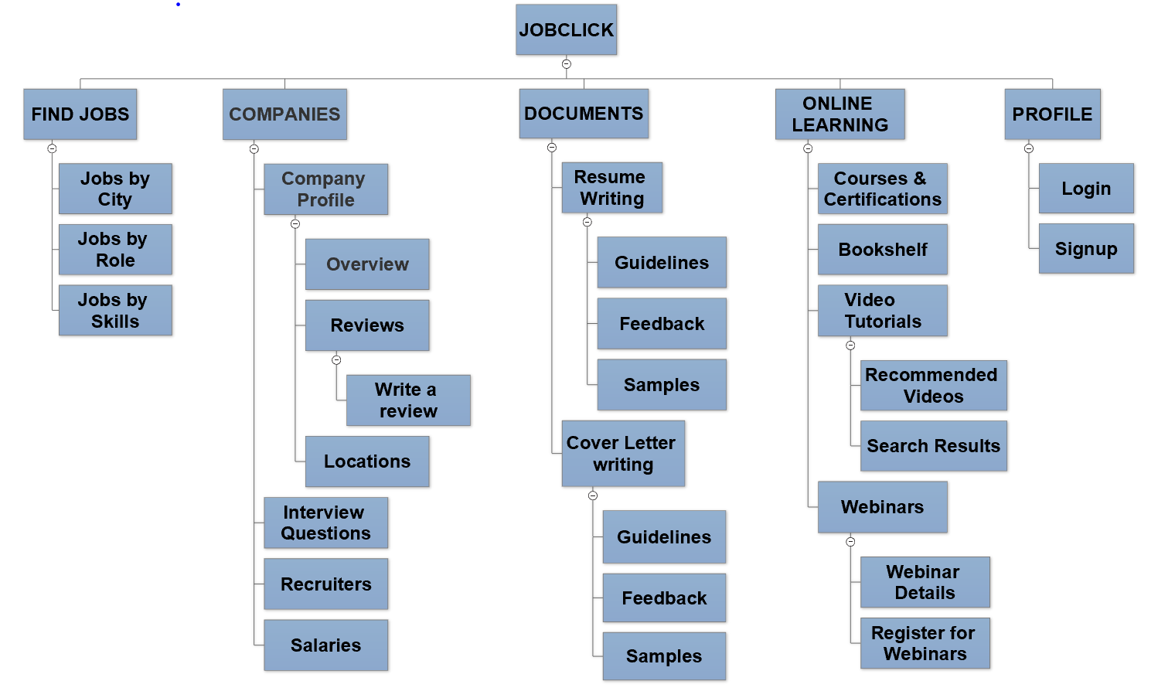
INFORMATION ARCHITECTURE

Slide 14
SKELETON PLANE
INTERFACE DESIGN
NAVIGATION DESIGN

Slide 15
SKELETON PLANE
Interface Design
Placement of correct interface elements
Check boxes, Drop downs, text boxes, Action Buttons as required
Navigation Design
Global Navigation
Supplementary Navigation

Slide 16
SURFACE PLANE
DESIGN
ELEMENTS

Slide 17
SURFACE PLANE
Design
Most important on the top of the page like navigation and statistics
Contrast color combination
Button highlights in every page
Maintains internal consistency
Some elements that are added during this step of the process include:
Color palettes
Typefaces
Icons
Tables
Buttons
Brand identity

Slide 18



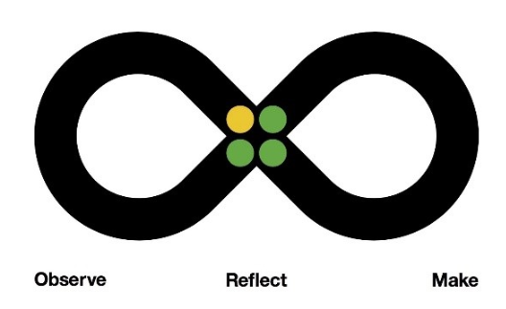



IBM DESIGN THINKING
Principles
The Loop
The Keys

Slide 19
Principles
Focus on user outcomes
2. Multi-disciplinary teams
3. Restless reinvention
These principles provide the foundation for delivering solutions that meet or exceed your users’ expectations.

Slide 20
The Loop
Design problems are problems with no predetermined solution. They are questions with no right answer.
In the midst of this uncertainty, design thinking provides us a model for action. We call this model the Loop: a continuous cycle of observing, reflecting, and making.
“Understand the present and envision the future in a continuous cycle of observing, reflecting, and making “

Slide 21
The Keys
Hills
2. Playbacks
3. Sponsor Users
The Keys are our three most important techniques for diverse teams to reflect together as we move from idea to outcome. They help us get aligned, stay aligned, and stay in touch with real-world needs—even when we’re deep in the work.

Slide 22
GOOGLE MATERIAL DESIGN
Google material design principles had been inspired by the real materials and were called to create the most intuitive and simple design for the applications and websites. Basically, this is a unified design system that works with all the available devices, and it doesn’t mean what kind of device we are talking about: tablet, smartphone or even desktop PC.
Google created a standard to promote a unified experience across platforms, consistent look and feel delighted users.
Principles
Material is the metaphor
Bold, graphic, intentional
Motion provides meaning

Slide 23
GOOGLE MATERIAL DESIGN
Some of the google material designs used in the JOBCLICK website include:
Shadows
Motion
Components
Styles
Icons

Slide 24
ELEMENTS
Carousel
Image slider
Scroll pane
Dropdown
Labels
Text boxes
Paragraph
Button
Icons
Images
Header
Footer

Slide 25
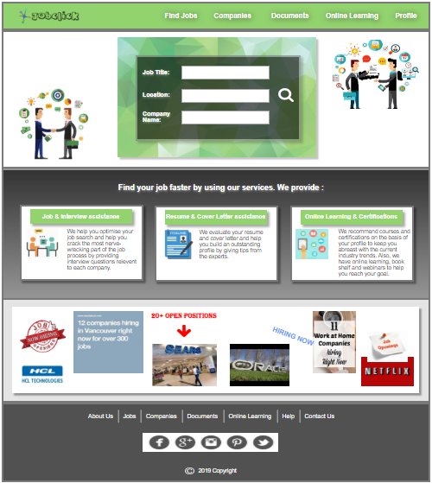
HIGH FIDELITY PROTOTYPE
High-fidelity prototype is simply layered visual detail on top of its predecessor.
Use library of UI elements.
The layers were preserved, so we only had to click on the elements and add interactions.

Slide 26
HUMAN COMPUTER INTERACTION
HCI is an academic discipline, which means studying people interacting with computer technology.
It is a design discipline, which means designing interventions for systems involving people and technology.
It is a multidisciplinary field of study focusing on the design of computer technology and, in particular, the interaction between humans (the users) and computers. While initially concerned with computers, HCI has since expanded to cover almost all forms of information technology design.
JOBCLICK is designed as per HCI “USE” words:
Useful – functional, does things.
Usable – easy to do things, does the right things, enjoyable, user experience.
Used – attractive, available. Acceptable to organization.

Slide 27
USER RESEARCH METHODS
User research is how you will know your product or service will work in the real world, with real people. It’s where you will uncover or validate the user needs which should form the basis of what you are designing.
User research focuses on understanding user behaviors, needs, and motivations through observation techniques, task analysis, and other feedback methodologies.
It is the process of understanding the impact of design on an audience.
The types of user research you can or should perform will depend on the type of site, system or app you are developing, your timeline, and your environment.
Modern day UX research methods answer a wide range of questions. To know when to use which user research method, each of 20 methods is mapped across 3 dimensions and over time within a typical product-development process.

Slide 28
USER INTERVIEWS
A user interview is a UX research method during which a researcher asks one user, questions about a topic of interest (e.g., use of a system, behaviors and habits) with the goal of learning about that topic. It is also used to discover the attitudes, beliefs, and experiences of users (and potential users) of a product.
Unlike focus groups, which involve multiple users at the same time, user interviews are one-on-one sessions. UX Interviews tend to be a quick and easy way to collect user data.
Interviews are typically conducted by one interviewer speaking to one user at a time for 30 minutes to an hour or can take place face-to-face, over the phone, or via video streaming.
User interviews follow a structured methodology whereby the interviewer prepares a number of topics to cover, makes a record of what is said in the interview, and systematically analyzes the conversation after the interview.

Slide 29
Sample Questionnaire
What do you think about this application look and feel?
2. Are you able to navigate to any particular section effortlessly like contact page?
3. Was there anything surprising or unexpected about this product?
4. If there are two such similar websites, which website will you prefer and why?
5. When did you last time purchased/used/subscribed for a product/service?
6. What might keep people from using this product?
7. What type of people you think will use this product/service?
8. Was there anything you expected to happen but didn’t happen?

Slide 30
USABILITY TESTING
The idea of usability testing is to know how the users do it; what is the user flow and what aspects need to be improved. Observe what the users do, if they succeed or not, and where they have difficulties with the user interface. Let the users do their thing, don’t help them, just observe.
During a usability test, we:
Learnt if participants were able to complete specified tasks successfully and,
Identified how long it took to complete specified tasks.
Found out how satisfied participants were with our Website.
Identified changes required to improve user performance and satisfaction.
And analyzed the performance to see if it meets our usability objectives.

Slide 31
INTERCEPT INTERVIEWS
Intercept research is a commonly used mode of marketing data collection. Intercept research, also known as Store Intercepts or Street Intercepts, is designed to conduct surveys with consumers on site, while they are interacting with the client’s business.
Intercept Form:
User Name :
Branch:
NUID:
1)How easy you find to use the application:
Bad
Moderate
Good
Excellent

Slide 32
INTERCEPT INTERVIEWS
2)How is the look and feel of the website Interface:
Bad
Moderate
Good
Excellent
3)How useful it can be for physically challenged people
Bad
Moderate
Good
Excellent
4)Specify Feature you liked most:
5)Give your Suggestions:

Slide 33
FOCUS GROUP METHODOLOGY
A focus group is qualitative research because it asks participants for open-ended responses conveying thoughts or feelings.
A focus group can offer insights consistent with those shared by the broader target market.
What is our target area of research?
Recent graduates looking for jobs
Experienced professionals looking for job change
Users willing to enhance their skills by online tutorials

Slide 34
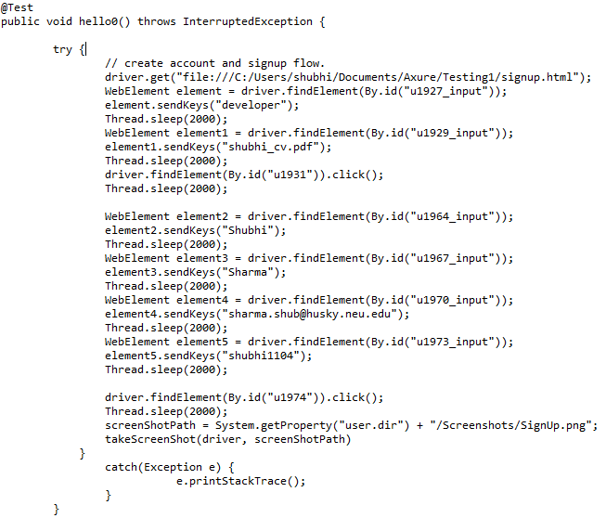
SELENIUM TESTING
Test case 1: Signup

Slide 35
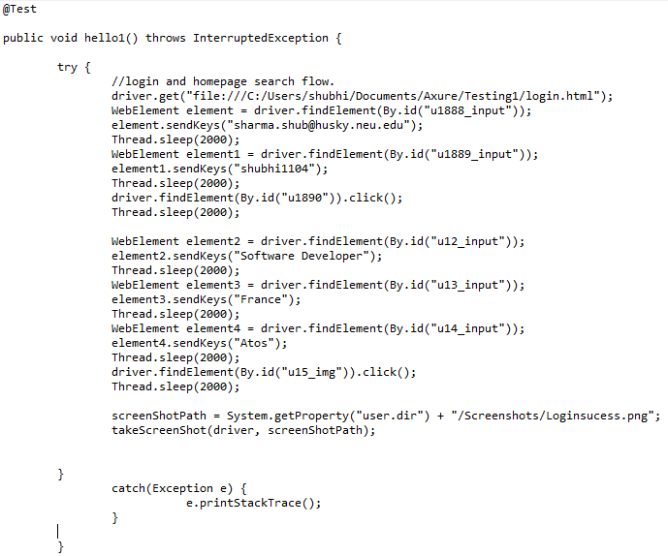
SELENIUM TESTING
Test case 2: Login

Slide 36
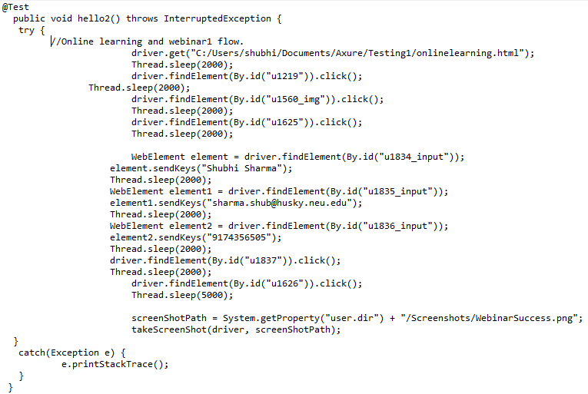
SELENIUM TESTING
Test case 3: Online learning

Slide 37
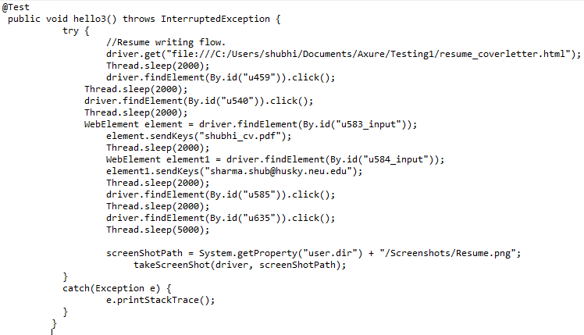
SELENIUM TESTING
Test case 4: Resume Writing

Slide 38
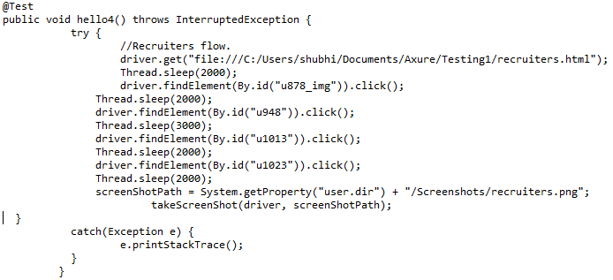
SELENIUM TESTING
Test case 5: Recruiters

Slide 39
MOONSHOTS
User can get a real life interview experience using virtual reality which can make the candidate more prepared and confident for future interviews.
User can attach a sample cover letter and then according to each separate job requirement a new updated cover letter can be generated by the website experts, automatically.
Users can be notified about the upcoming job fair details around the city.
According to the best learning tutorials taken by users, we can refer user’s profile to Fortune 500 companies with the referrals.
According to user’s application and jobs available in the location, we will try to conduct job fair for the ease of direct contact with the employer and recruitment teams.

Slide 40


