Slide 1
IBM University Engagement Project Submission
“Exploring the Power of Agentic AI with IBM Granite and LangFlow”

Slide 2

Project Tile – Course Content Simplification Agent
Domain of Project – Education
Student Name | Recent Passport Photo | Email ID | Mobile number [WhatsApp]
DRISHTI GUPTA |  | drishtigupta605@gmail.com | 9220860667

Slide 3
Problem Statement -
Problem Statement : Course Content Simplification Agent
The Challenge
Educational materials often vary in complexity and are not always accessible to learners with different levels of prior knowledge. Students may struggle to grasp key concepts due to jargon- heavy or overly advanced explanations in faculty notes and textbooks. The challenge is to develop an AI- powered agent that can intelligently analyze academic content and reframe explanations based on the learner's current proficiency—ranging from beginner to expert. This would support more inclusive
learning and personalized education delivery at scale.
The Objective
Build an AI-powered Course Content Simplification Agent that delivers reframed explanations tailored to learner proficiency for students at every level — beginner, intermediate, and expert. The solution should:
Proficiency-Based Reframing – Adjust explanation depth and language based on the learner's chosen level.
Jargon Detection & Definitions – Identify and briefly define technical terms within the content.
Multi-Format Input – Accept pasted text or uploaded PDF/TXT files for simplification.
Accuracy Safeguards – Flag ambiguous content and avoid fabricating facts not present in the source.
Structured Output – Core Idea summary (one-line takeaway), Explanation section (reframed content), Key Takeaways (bulleted highlights), Real-World Example (practical anchor)
Session Continuity – Remember recent content within a session to support follow-up questions.

Slide 4
Proposed Solution -
Proposed Solution: ExplainIt — AI-Powered Course Content Simplification Agent
The proposed solution is a single-agent Flask web application built using Python Flask, IBM watsonx.ai, IBM Granite models, and IBM BOB to reframe academic content by learner proficiency level. The system addresses comprehension gaps caused by jargon-heavy textbooks and lecture notes through a simple, focused architecture.
At its core, the solution uses a carefully engineered system prompt (AGENT_INSTRUCTIONS) sent to the IBM Granite model with every request, instructing it to adjust vocabulary, depth, and structure based on the learner's chosen level (Beginner / Intermediate / Expert).
The system performs four key functions:
Content Ingestion accepts pasted text or extracts text from uploaded PDF/TXT files (via PyMuPDF).
Proficiency-Based Reframing sends the content to Granite with level-specific instructions to produce a Core Idea, Explanation, Key Takeaways, and Real-World Example.
Conversational Handling detects casual greetings and responds normally instead of forcing the structured format.
Feedback & Session Memory logs 👍/👎 ratings and remembers recent content within a session for follow-up questions.
The solution includes a clean, responsive web interface with dark mode, drag-and-drop file upload, and a live chat-style output panel.
IBM BOB was used to scaffold the Flask backend and frontend, while watsonx.ai handles secure, scalable model access. Granite powers reasoning, reframing, and personalization.
Overall, this solution delivers an end-to-end, deployment-ready learning assistant that makes dense academic content accessible to every learner, regardless of their starting point.

Slide 5
Technology Used
IBM BOB - Coding assistant used to scaffold the Flask backend, frontend, and API integration
IBM Granite model - For natural language understanding, content reframing, and proficiency-level reasoning
IBM Cloud – Hosts watsonx.ai Studio, the project workspace, and API credentials. IBM Cloud enables a reliable, secure, and scalable environment for deploying ExplainIt.
System Prompt Engineering – AGENT_INSTRUCTIONS define tone, output structure, and per-level rules, making ExplainIt's responses consistent and accurate.
IBM Watsonx.ai - For secure Granite model access via API, project management, and inferencing
Render (Deployment) – Free-tier cloud hosting for the live, publicly accessible app

Slide 6
Key Components Used-
Content Input Panel – Text-paste box and drag-and-drop PDF/TXT upload where learners submit content and select a proficiency level.
Flask Backend + watsonx.ai API - Sends content and AGENT_INSTRUCTIONS to the Granite model and processes the response.
IBM Granite Model - ibm/granite-3-8b-instruct → Fast, efficient reasoning for real-time content reframing.
Structured Output Panel - Displays Core Idea, Explanation, Key Takeaways, and Real-World Example for each simplified response.
PyMuPDF - Extracts text from uploaded PDF files so they can be simplified directly.

Slide 7
Application Workflow-
Input — Learner pastes text or uploads a PDF/TXT file, and selects a proficiency level (Beginner / Intermediate / Expert).
Extraction — Flask backend extracts text from uploaded files using PyMuPDF (for PDFs).
Reasoning — Content and AGENT_INSTRUCTIONS are sent to the IBM Granite model via the watsonx.ai API.
Structured Response — Granite returns a Core Idea, Explanation, Key Takeaways, and Real-World Example, reframed for the chosen level.
Feedback & Follow-up — Learner rates the response (👍/👎) and can ask follow-up questions using session memory.

Slide 8
Architecture blueprint
Frontend Layer — HTML/CSS/JS single-page interface (dark mode, chat UI, proficiency selector, file upload)
Application Layer — Python Flask server: routes (/api/simplify, /api/upload, /api/feedback, /api/clear, /api/health), AGENT_INSTRUCTIONS, session memory
Processing Layer — PyMuPDF for PDF text extraction; feedback logger (JSONL)
AI Layer — IBM watsonx.ai API → IBM Granite model (ibm/granite-3-8b-instruct), invoked with content, level, and AGENT_INSTRUCTIONS
Deployment Layer — GitHub (version control) → Render (free-tier live hosting), with credentials managed as encrypted environment variables

Slide 9
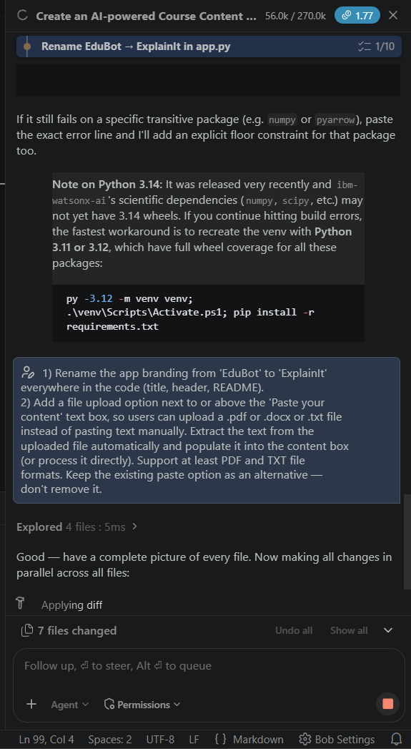
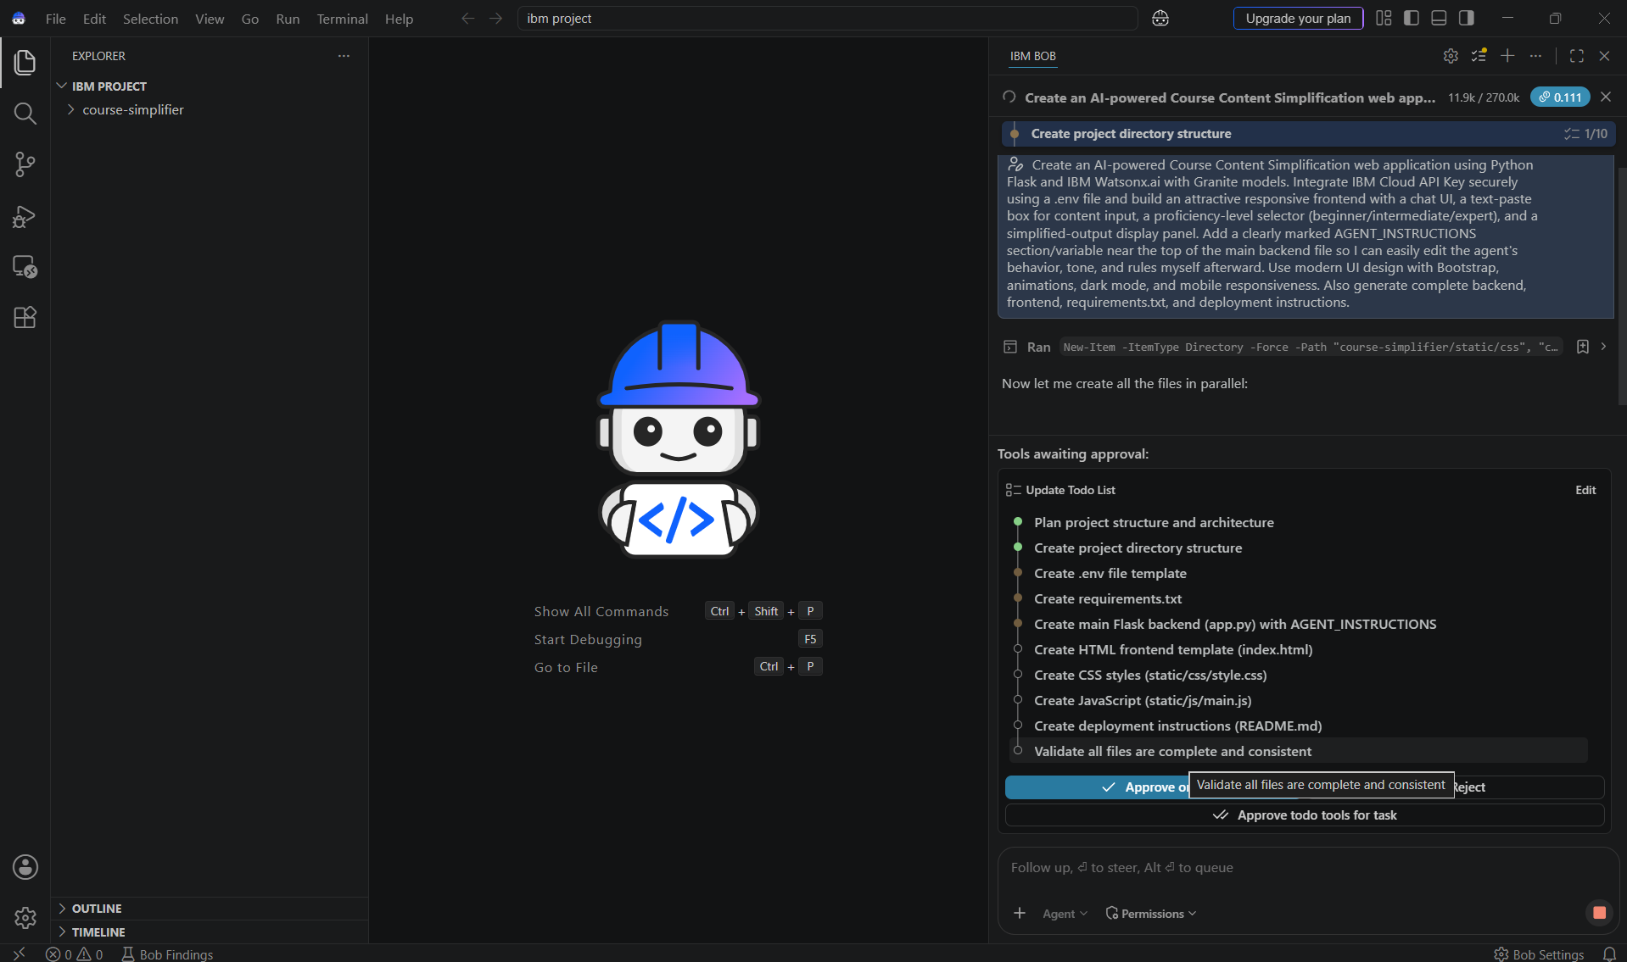
IBM BOB PROMPTS

Slide 10
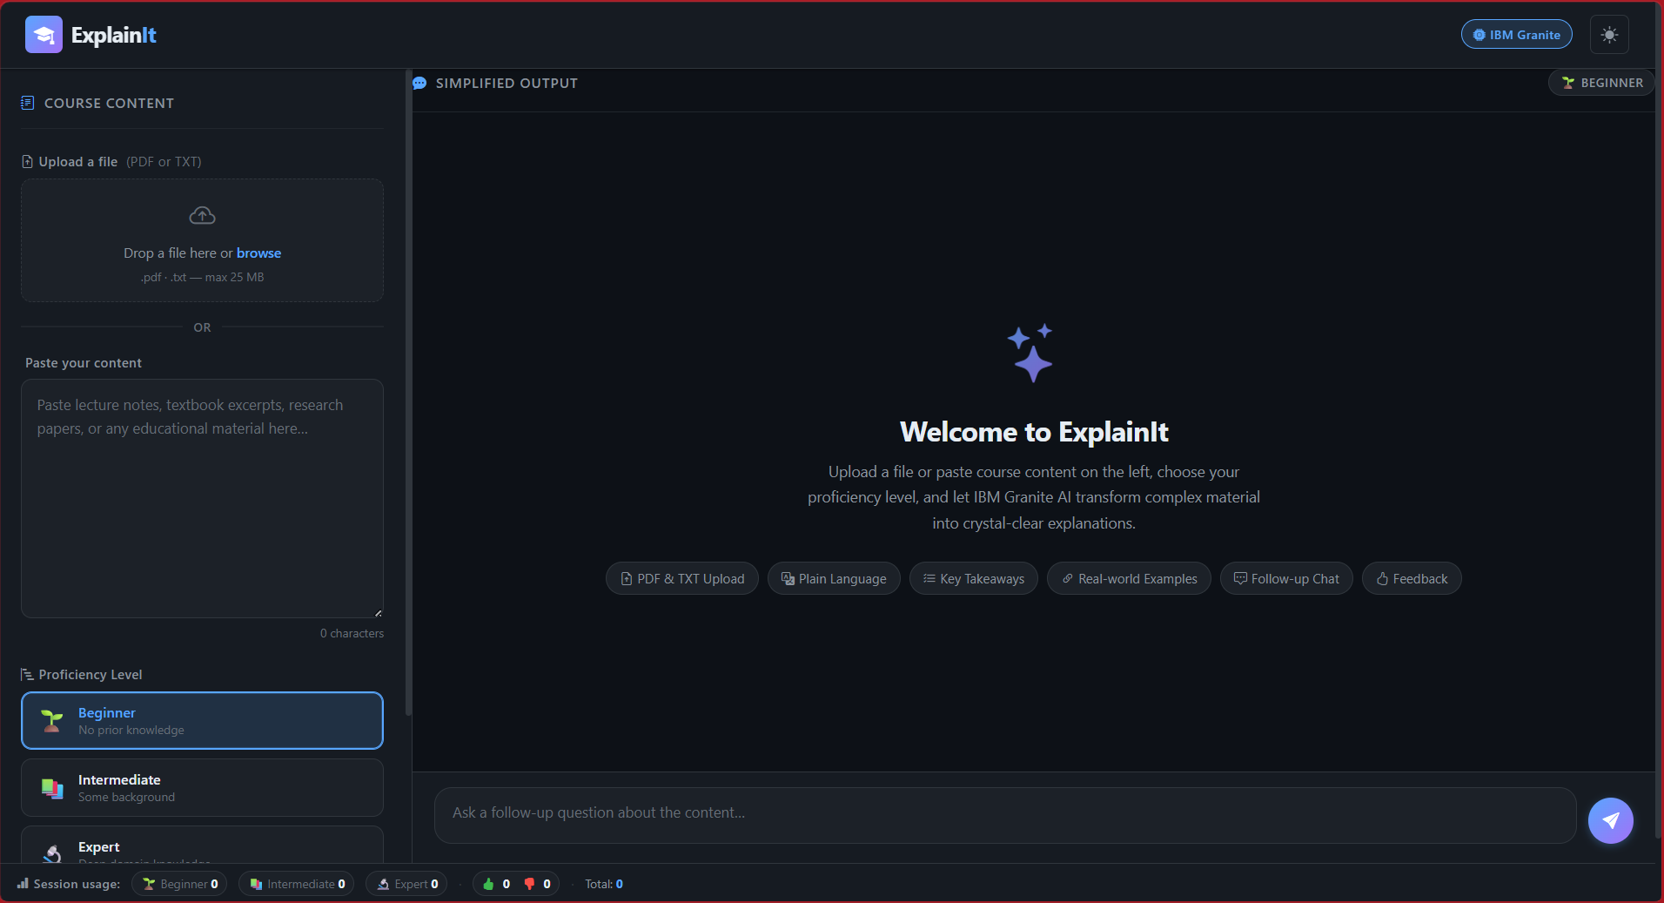
PROJECT SCREENSHOT

Slide 11
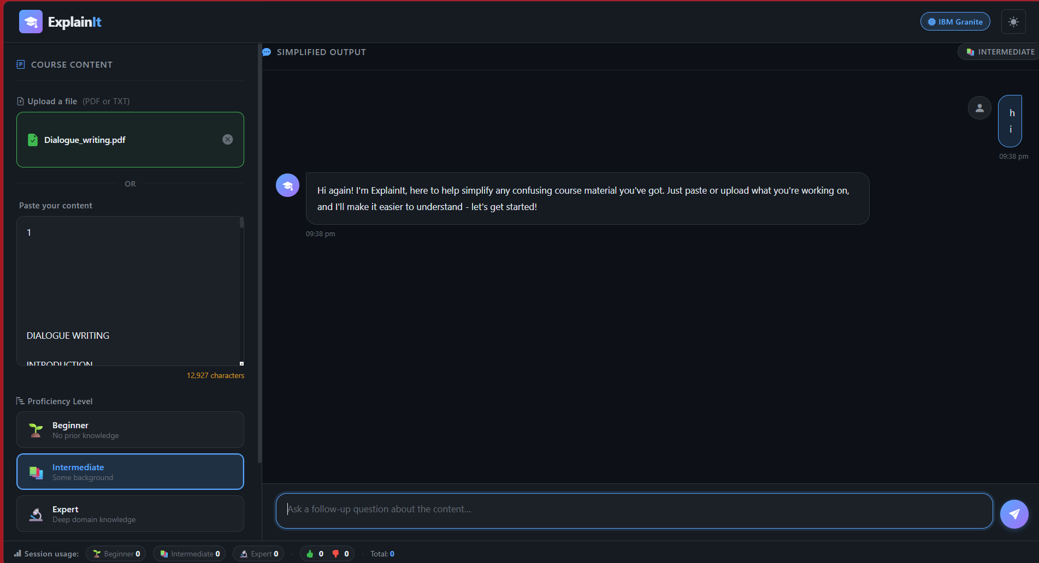

Slide 12
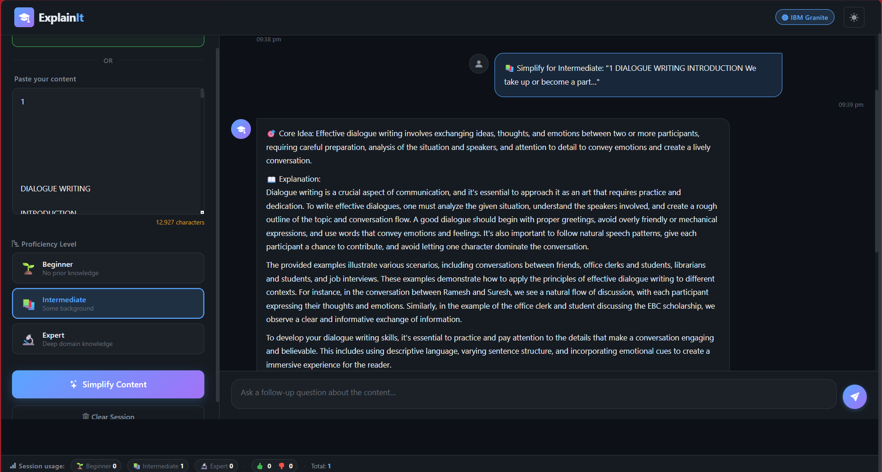

Slide 13

Role of Agentic AI in the solution
Role of Agentic AI in ExplainIt
Agentic AI enables ExplainIt to function as an intelligent reasoning system rather than a static text formatter. Using IBM watsonx.ai and IBM Granite models, it interprets the learner's proficiency level and autonomously decides how to restructure, simplify, and enrich the content.
The agent independently identifies jargon, decides what level of detail to include, and chooses when to invoke the structured Core Idea/Explanation/Key Takeaways format versus a plain conversational reply. This autonomous decision-making ensures relevant, level-appropriate output without manual configuration per request.
Agentic AI also brings context awareness, tracking recent content within a session to answer follow-up questions coherently. It supports real-time adaptation, adjusting explanation depth instantly when a learner switches proficiency levels.
Additionally, the agent applies built-in accuracy safeguards — flagging ambiguous content and avoiding fabricated facts — without explicit instruction each time.
Overall, Agentic AI makes the system proactive, adaptive, and learner-centered, acting like a personal tutor that meets every student at their own level of understanding.

Slide 14
Novelty and Uniqueness
ExplainIt stands out by combining Agentic AI, prompt engineering, and proficiency-based personalization into a single, lightweight, deployable system.
Proficiency-Aware Reasoning – The same content is reframed three distinct ways (Beginner/Intermediate/Expert) without separate models or pipelines.
Built-In Accuracy Safeguards – Explicitly instructed to avoid fabricating facts and to flag ambiguous source content.
Structured, Consistent Output – Every response follows a Core Idea → Explanation → Key Takeaways → Real-World Example format for scannable clarity.
Conversational Intelligence – Detects casual greetings vs. real content requests, avoiding an over-engineered response to "hi".
Multi-Format Input – Accepts pasted text or uploaded PDF/TXT files, extracted automatically via PyMuPDF.
Feedback-Driven Improvement – Logs 👍/👎 ratings per response, creating a foundation for future prompt tuning.
Deployment-Ready – Built on IBM watsonx.ai with IBM Granite models, live and publicly accessible on Render.
This makes the solution a genuinely useful study companion, not just a static text formatter.

Slide 15
Git Hub Link
https://github.com/drishtiguptaa/explainit-course-simplifier.git
Live Demo
·
ExplainIt — AI Course Simplifier
Note: hosted on Render's free tier — if inactive for a while, the first load may take ~50 seconds to spin up.
·
·

Slide 16
Future Scope
Multi-Language & RAG Grounding – Add translation support for regional languages (Hindi, Marathi, Tamil, Bengali) to serve non-English-medium learners, and integrate Retrieval-Augmented Generation against verified syllabus/textbook sources to further strengthen factual accuracy.
Adaptive Personalization & Accessibility – Use logged feedback (👍/👎) to refine prompts over time, extend session memory into persistent user history across visits, and add text-to-speech and dyslexia-friendly formatting for more inclusive learning.
·
·
·

Slide 17
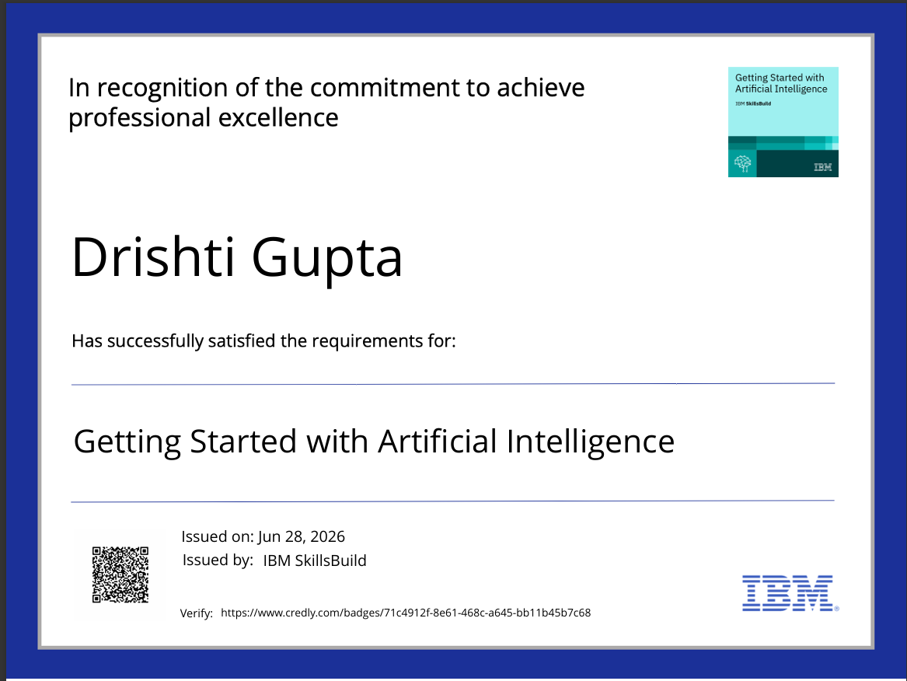
Certificates Earned:

Slide 18

Certificates Earned:

Slide 19
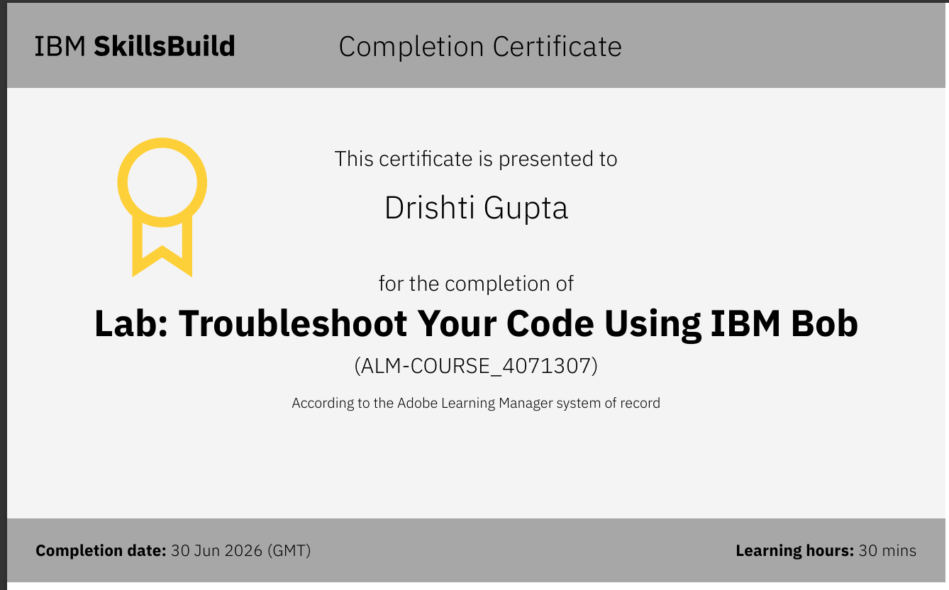
Certificates Earned:​

Slide 20
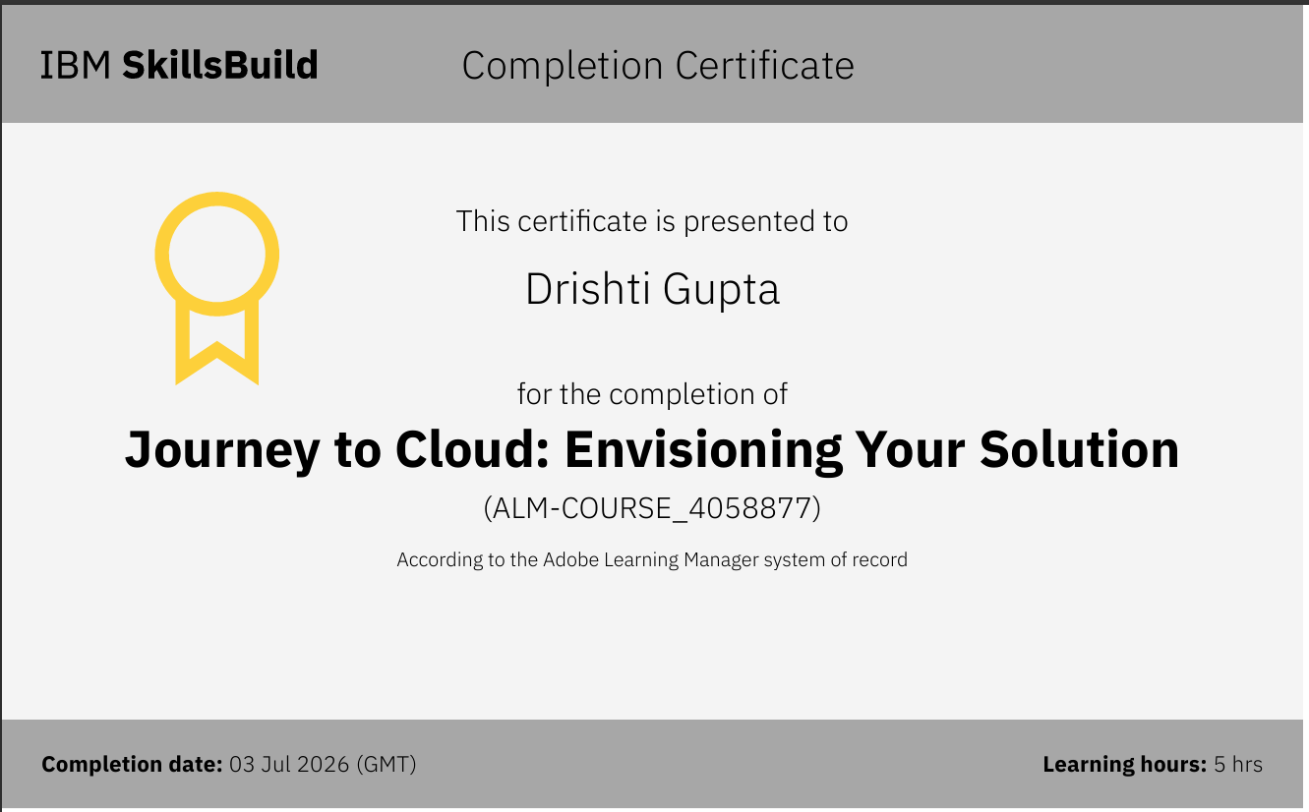
Certificates Earned:​

Slide 21


