Slide 1
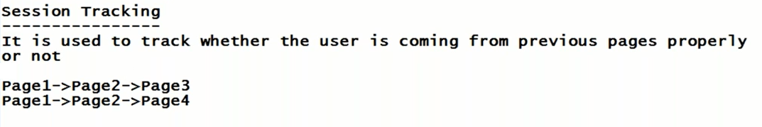
Example :
Gmail application
Login screen (page1)
Inbox(page2)
Assume Some copied URL of page2
It redirects to home page

Slide 2
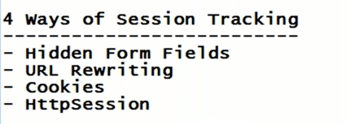

Slide 3
(Previous page)

Slide 4
In order to track the session if you are going for hidden form fields.
Hidden form fields means not visible to the user
Session tracking needs to be done with out knowing to the user
In page 1 we create one hidden filed which is not visible to user , then when we connect from page 1 to page 2.
in page 2 we read the value of hidden field
So in page 2 if you are able to read the value of hidden field indicates that you are coming from page 1.
If you are not coming from page1 if you open page 2 directly , then can you able to read the value of hidden filed ? NO
So we can say invalid session if some one access page 2 directly

Slide 5
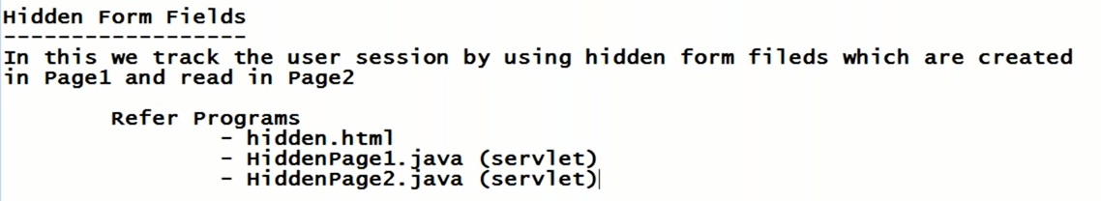

Slide 6
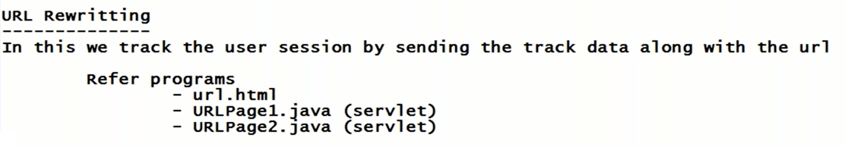

Slide 7
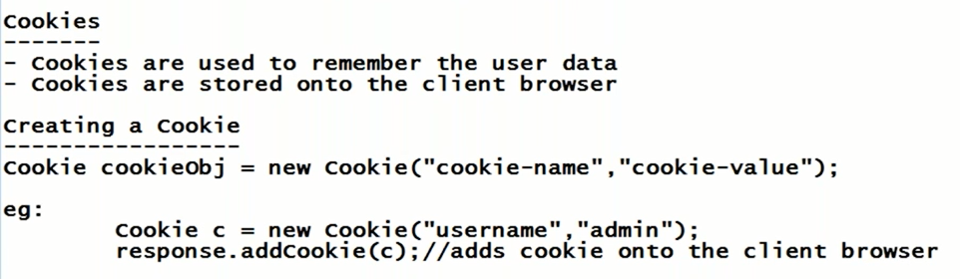

Slide 8
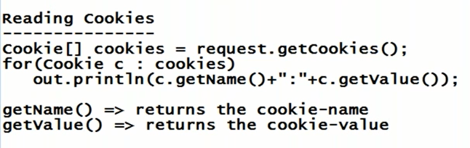
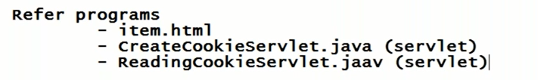

Slide 9
