Slide 1
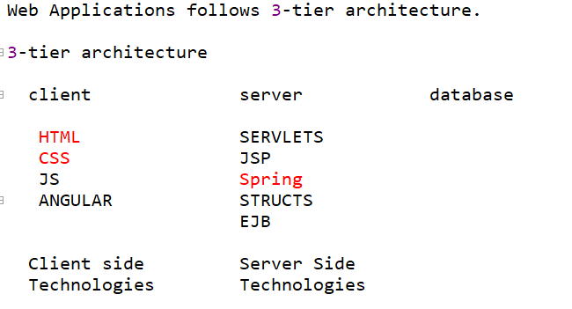

Slide 2
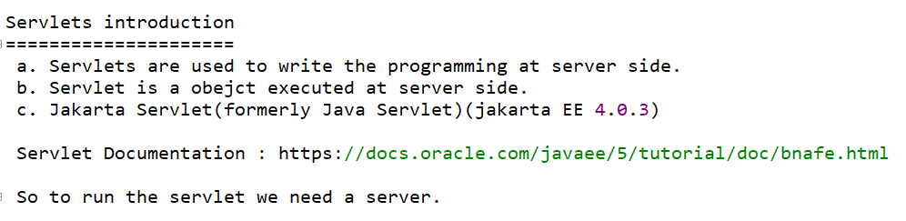

Slide 3
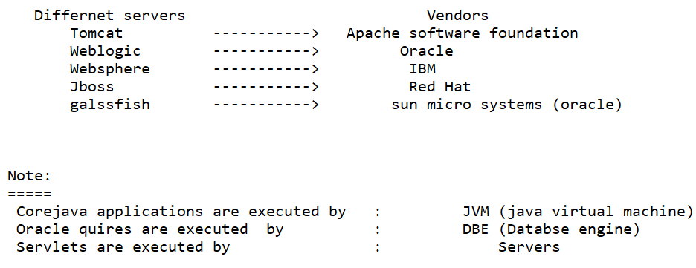

Slide 4
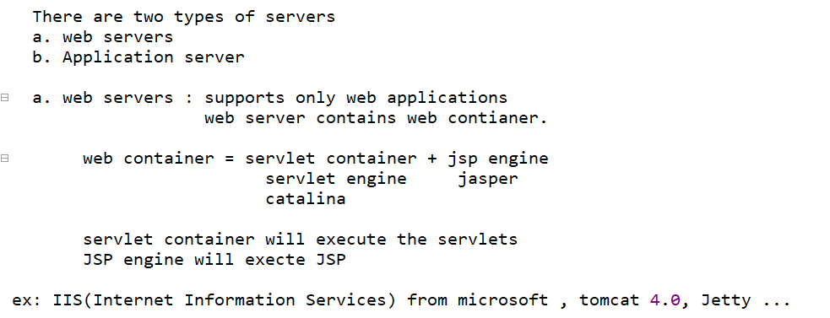

Slide 5
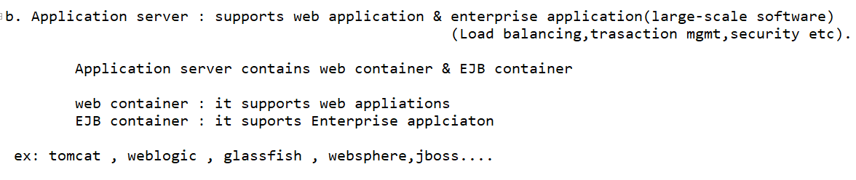

Slide 6
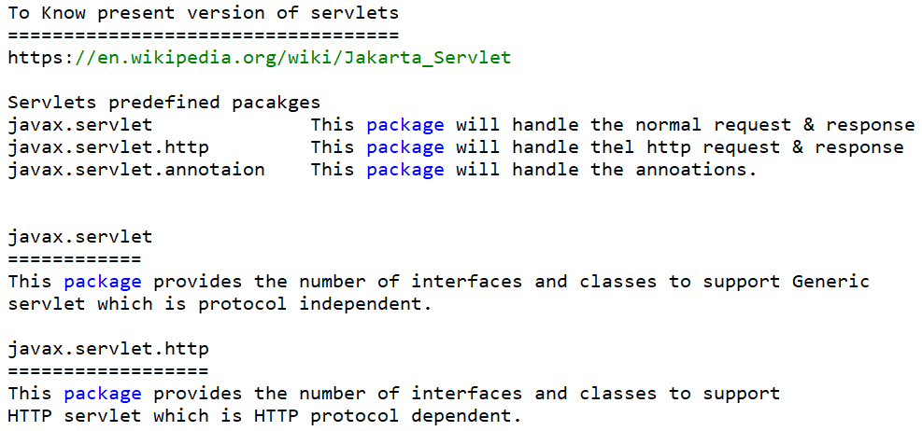

Slide 7
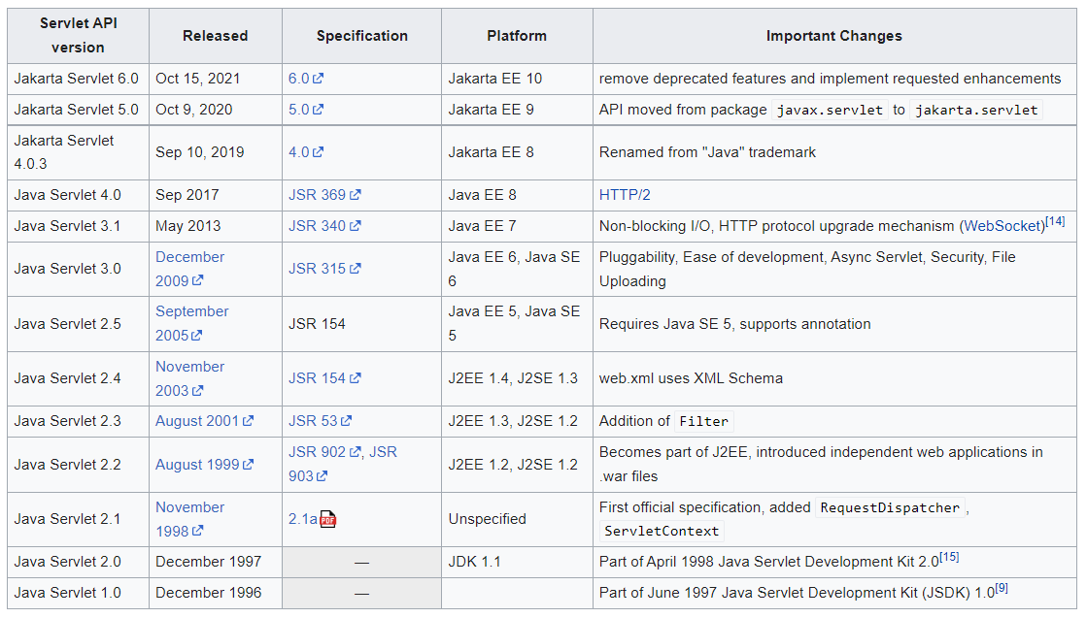

Slide 8
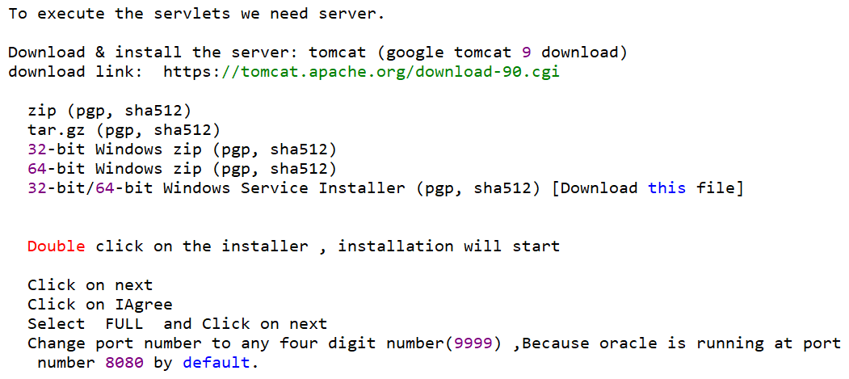

Slide 9
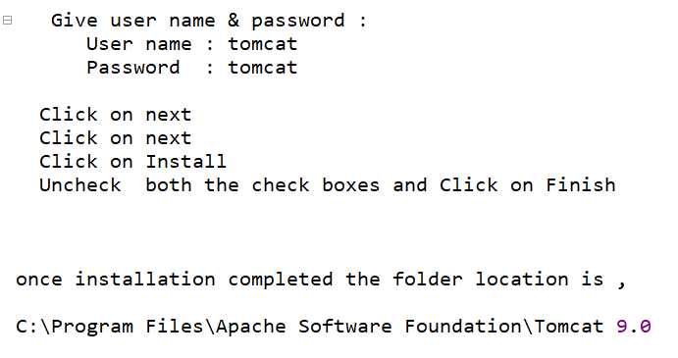

Slide 10
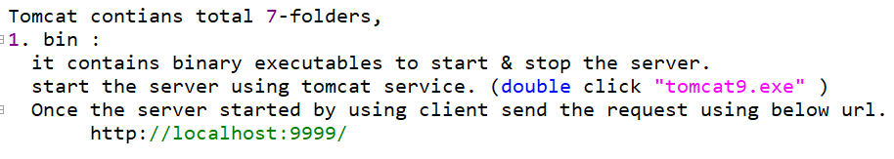

Slide 11
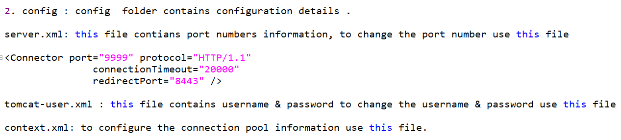

Slide 12
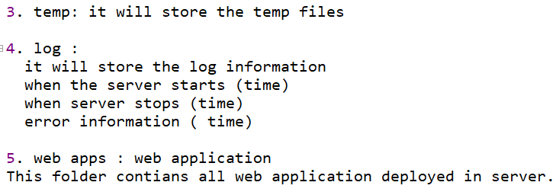

Slide 13
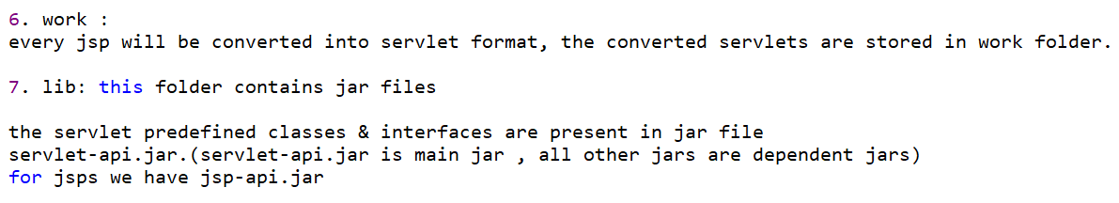

Slide 14
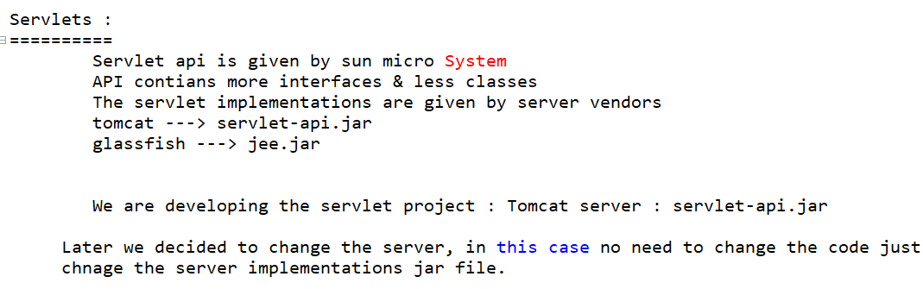

Slide 15
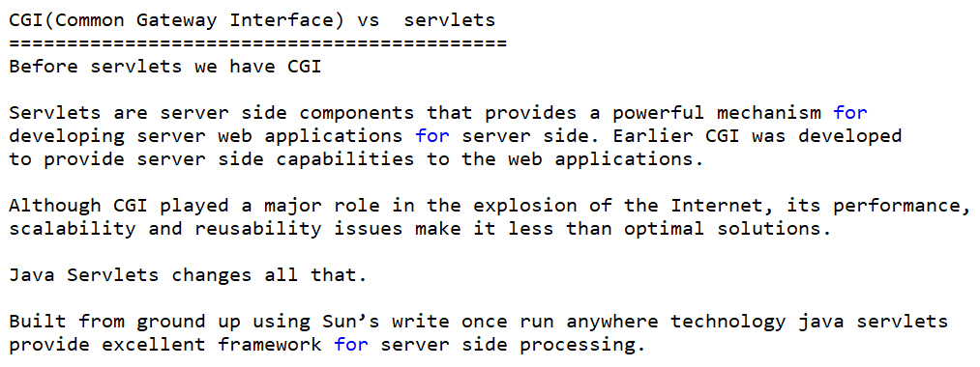

Slide 16
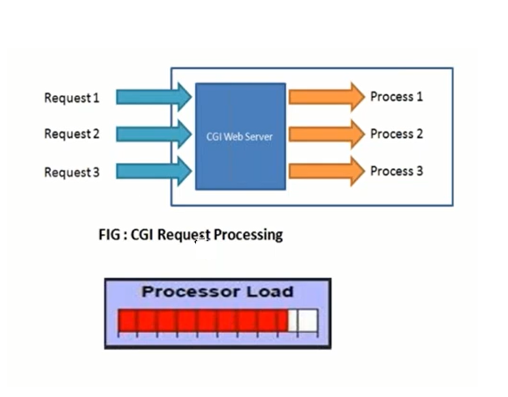

Slide 17
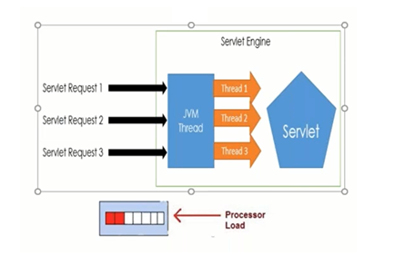

Slide 18
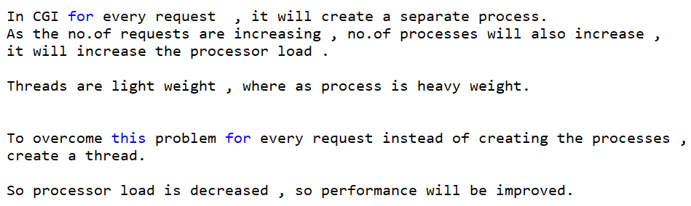

Slide 19
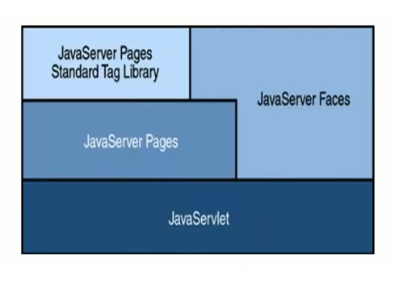

Slide 20
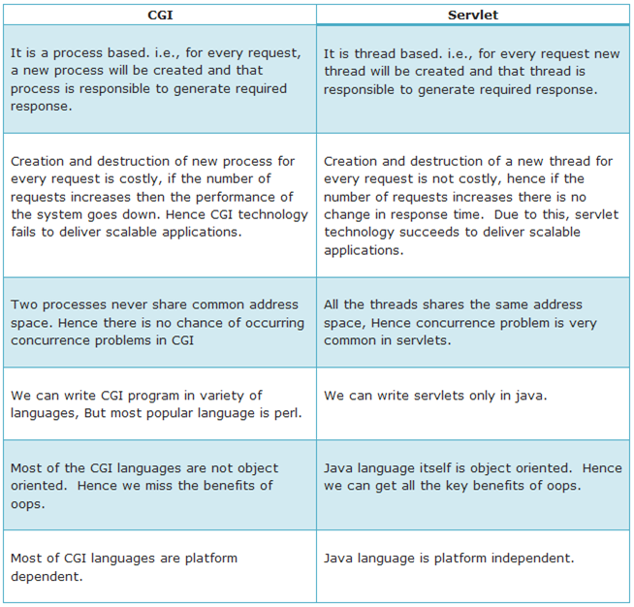

Slide 22
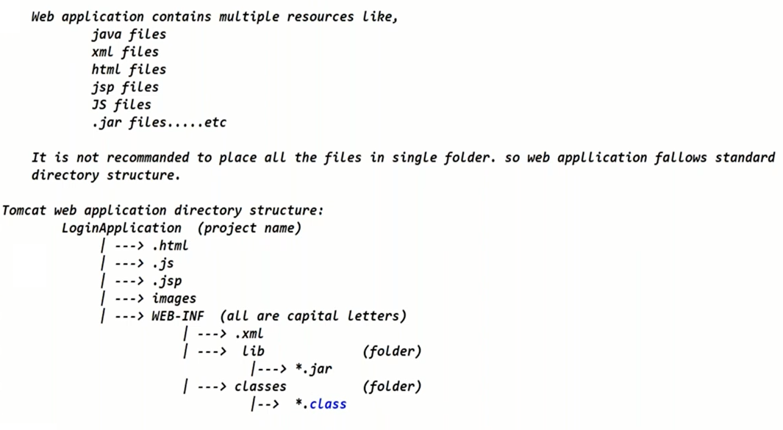
(under the project folder directly we can place .html , .js , .jsp files , generally we call this area as public area)
(Web.xml)

Slide 23
Above is standard directory structure , Eclipse IDE follows different directory structure.

Slide 24
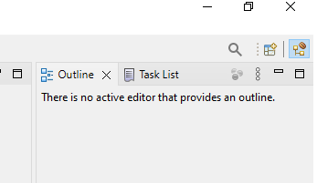
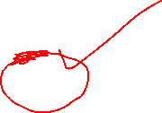
First create a new folder , and double click on Eclipse icon and select this newly created folder as workspace ,After opening Eclipse , click on the “+” symbol (open perspective) in the top right corner

Slide 25
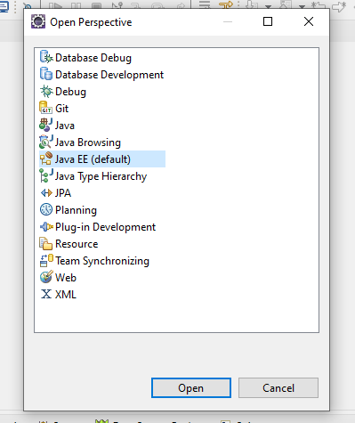



Slide 26
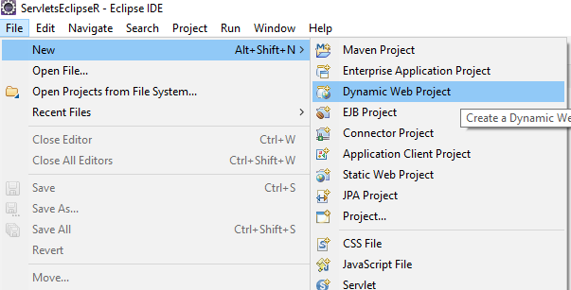





Slide 27
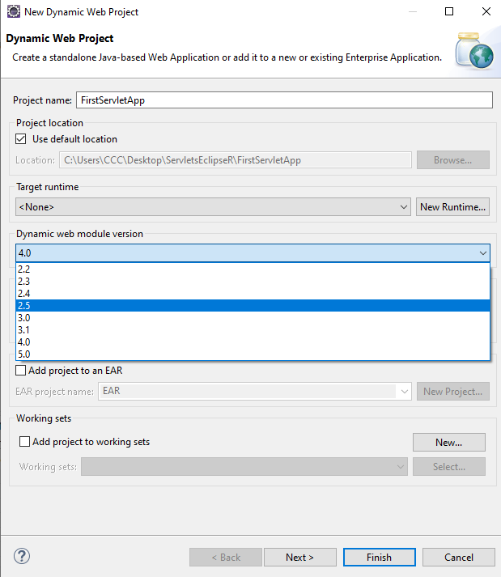




Slide 28
If you select 3.0 or above version , servlet 3.0 version supports annotations .
It supports annotations means it doesn’t take web.xml file.

Slide 29
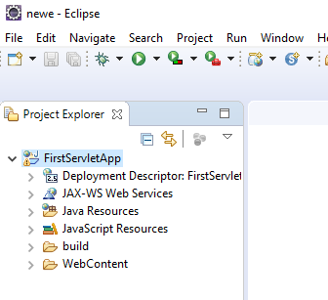

Slide 30
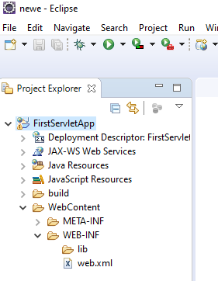

Slide 31
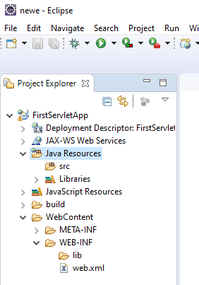

Slide 32
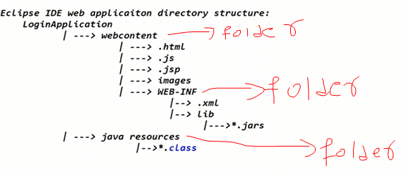

Slide 33
There are three ways to create a servlet,
a. implements Servlet interface
b. extends GenericServlet
c. extends HttpServlet

Slide 34
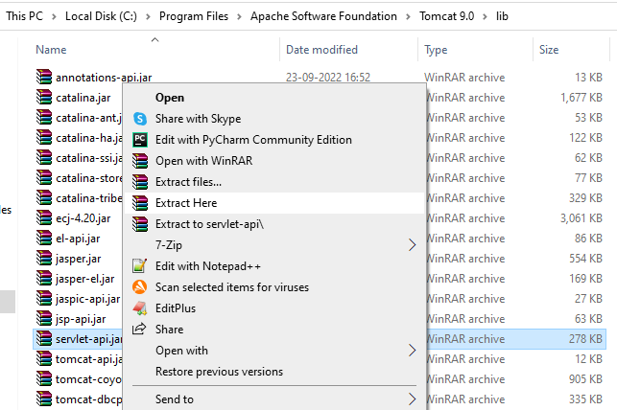

Slide 35
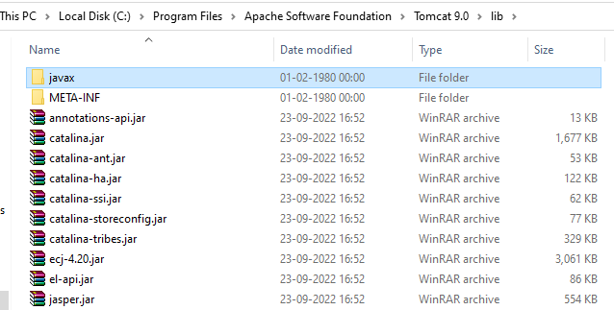

Slide 36
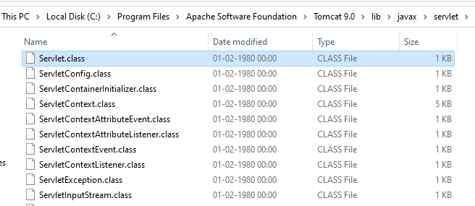

Slide 37
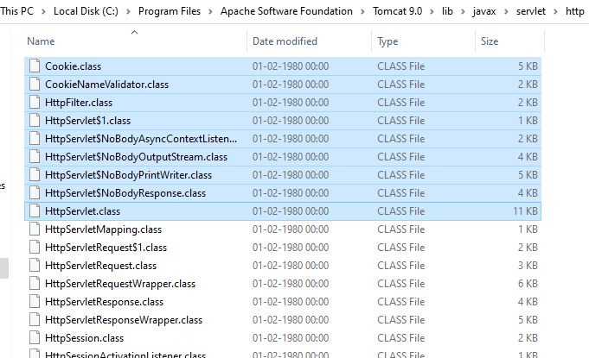

Slide 38
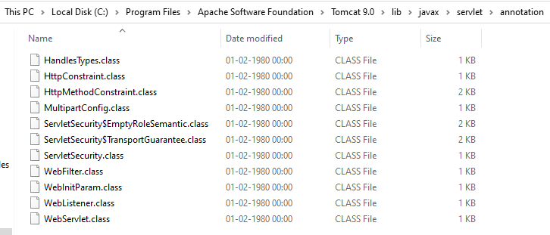

Slide 39
Open Servlet.class file using online java decompiler

Slide 40
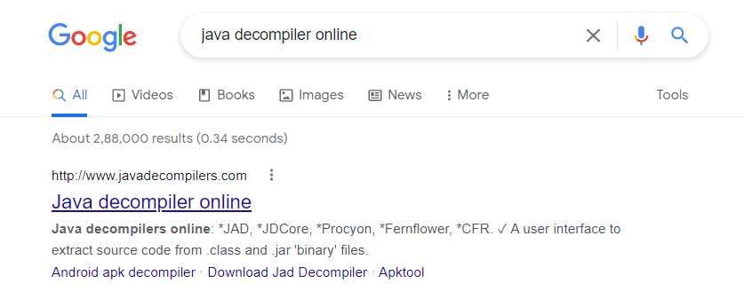

Slide 41
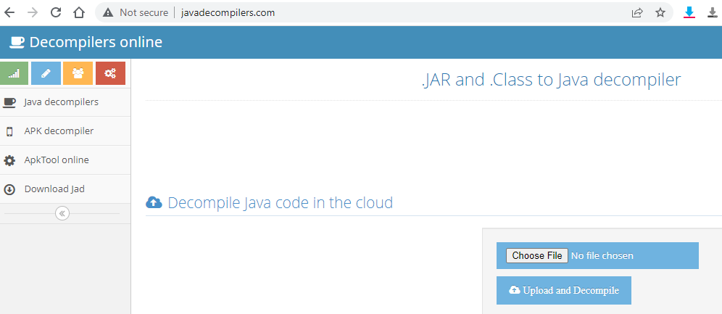

Slide 42
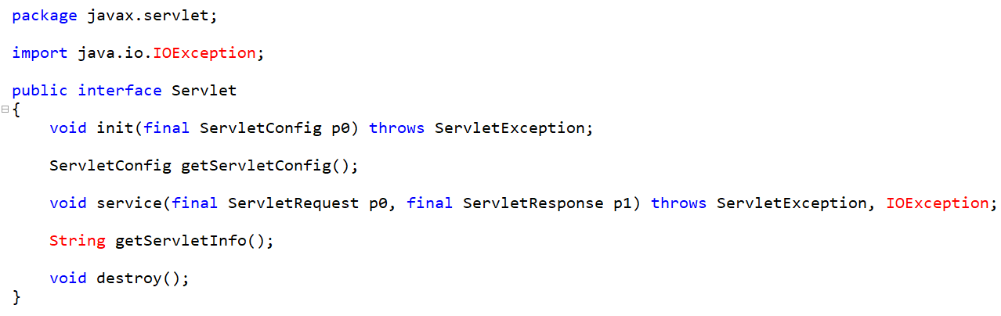

Slide 43
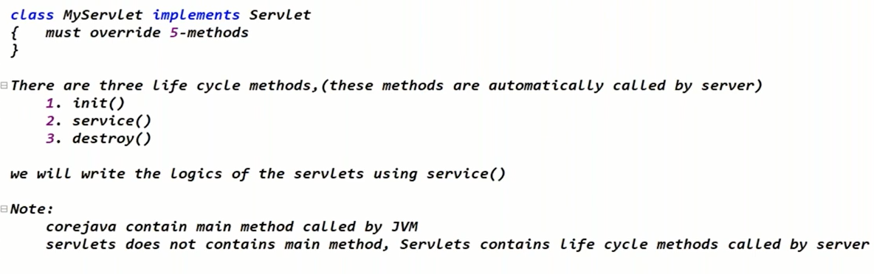

Slide 44
At server side we create first servlet , after creating first servlet , we have to give some URL pattern to the client .
In first application we are just creating a servlet at server side , for that servlet I am creating one URL using web.xml file , using the URL the client will access my servlet.
So first step is to create the servlet at server side.

Slide 45
Servlet 3.0 will have new concept like annotations , I said just now at the server side you can create the servlet , for the servlet we have to create one URL pattern .
How we will create the URL pattern ?
Previously we will create URL pattern using XML file (web.xml file)
For the single servlet to create URL pattern we have to write almost all 10 lines of code.
If no.of servlets are increased xml configurations are increased .
To reduce that XML configurations instead of the XML , we are using annotations concept.
Basically annotations will reduce the configurations of XML files .

Slide 46
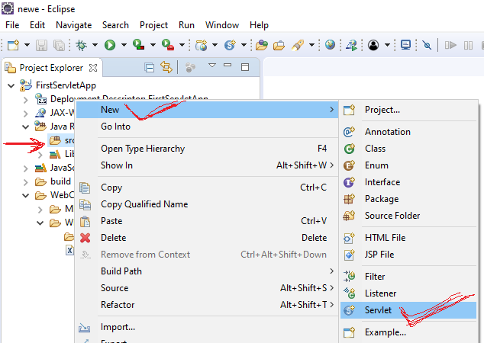

Slide 47
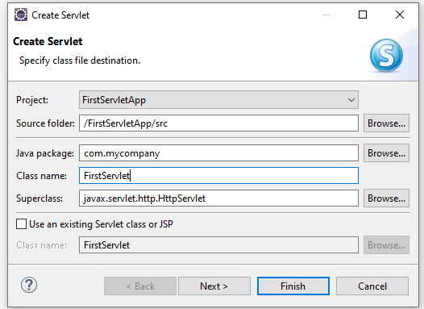




Slide 48
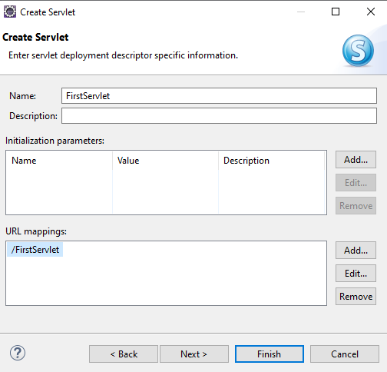

Eclipse IDE automatically generates web.xml file,
By default class name is taken as URL pattern .

Slide 49
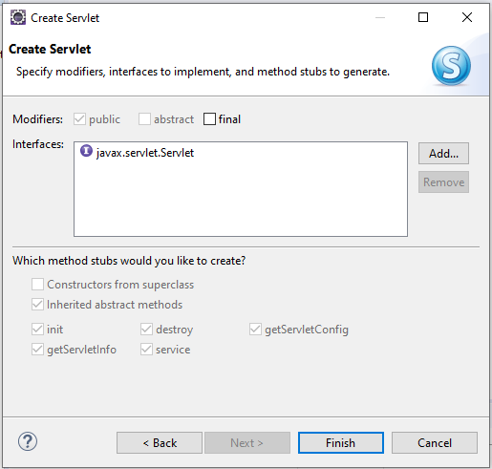


Slide 50
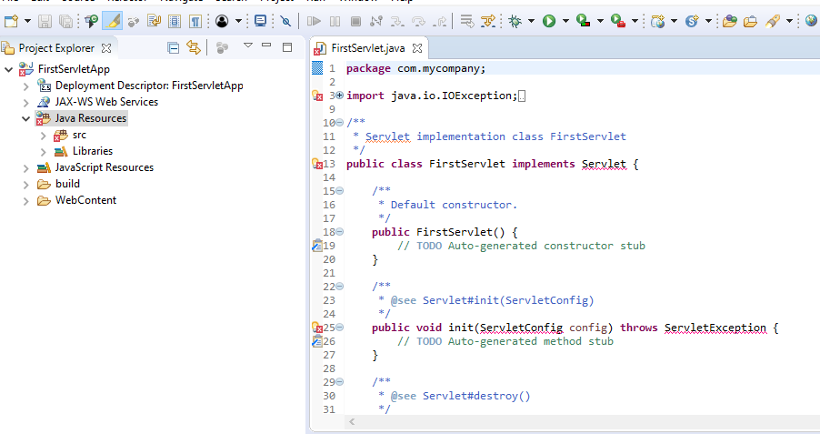

Slide 51
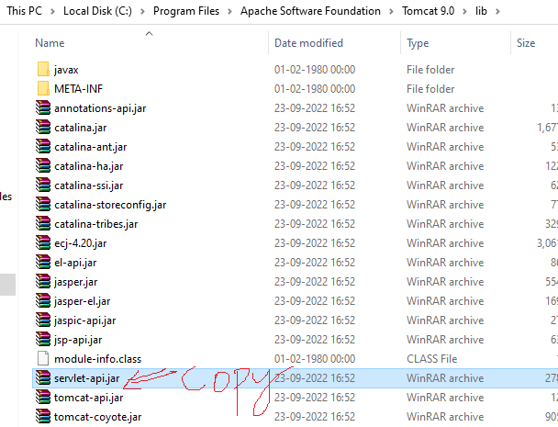

Slide 52
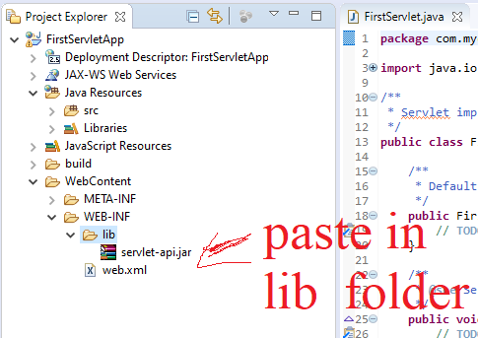

Slide 53
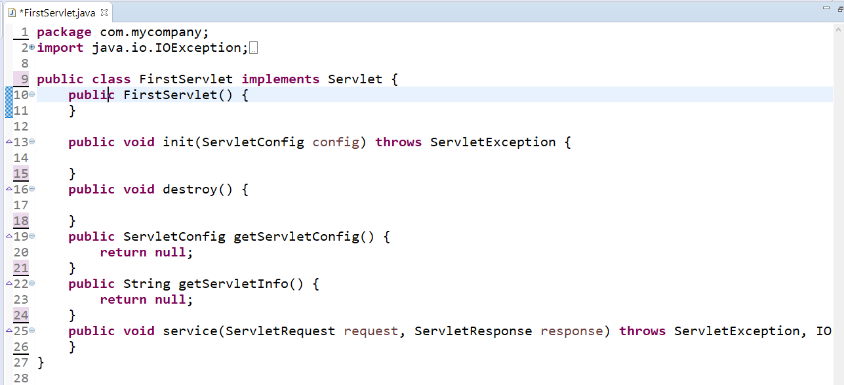

Slide 54
Request object contains the data which is coming from the client side , because from the client you are getting some username , password etc .
The details which are coming from the client side , those details are stored in request object.
What ever response you are trying to give to the browser , that response we are adding to response object.
Some general settings are there for every application . Before sending response from the servlet , we have to specify what type of response we are sending to the browser.

Slide 55


Slide 56
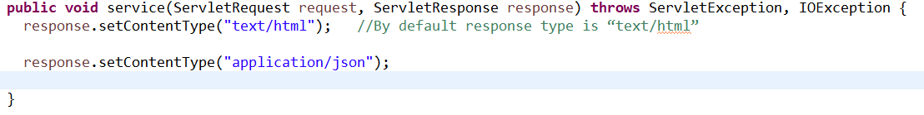

Slide 57
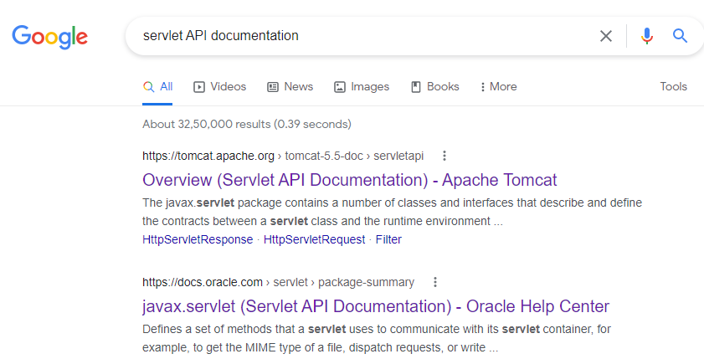


Slide 58
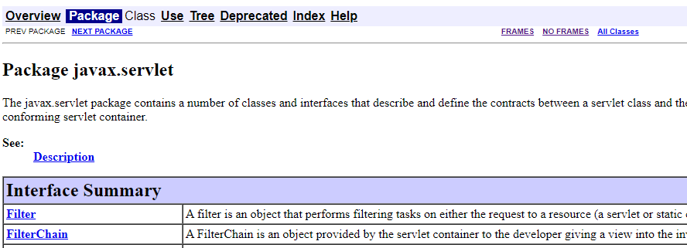


Slide 59



Slide 60



Slide 61



Slide 62


Slide 63

Initially response object is empty , we have to add some response into response object.
printWriter is a class in java.
java.io package

Slide 64
package com.mycompany;
import java.io.IOException;
import java.io.PrintWriter;
import javax.servlet.Servlet;
import javax.servlet.ServletConfig;
import javax.servlet.ServletException;
import javax.servlet.ServletRequest;
import javax.servlet.ServletResponse;
public class FirstServlet implements Servlet {
public FirstServlet() {
}
public void init(ServletConfig config) throws ServletException {
}
public void destroy() {
}
public ServletConfig getServletConfig() {
return null;
}
public String getServletInfo() {
return null;
}
public void service(ServletRequest request, ServletResponse response) throws ServletException, IOException {
response.setContentType("text/html"); //By default response type is “text/html”
//response.setContentType("application/json");
PrintWriter writer=response.getWriter();
writer.println("This is first Servlet Application....");
}
}
FirstServlet.java

Slide 65


Slide 66
<?xml version="1.0" encoding="UTF-8"?>
<web-app>
<servlet>
<servlet-name>FirstServlet</servlet-name>
<servlet-class>com.mycompany.FirstServlet</servlet- class>
</servlet>
<servlet-mapping>
<servlet-name>FirstServlet</servlet-name>
<url-pattern>/FirstServlet</url-pattern>
</servlet-mapping>
</web-app>
The logical name associated with url pattern is FirstServlet .
Logical name , this and that logical names are matched so com.tcs.FirsrServlet class will be executed.

Slide 67
Root tag of web.xml file is <web-app>
And it has two child tags
<servlet>
<servlet-mapping>

Slide 68
By default class name is taken as URL pattern , in browser window when you type the URL pattern , that URL pattern comes to server side , in the server side it will check in web.xml file . In web.xml file the url is matched , for that URL pattern the logical name is “FirstServlet” , with that logical name which class is configured , that class will be taken .

Slide 69


Slide 70


Slide 71


Slide 72


Slide 73


Slide 74



Slide 75


Slide 76


Slide 77


Slide 78


Slide 79


Slide 80


Slide 81


Slide 82


Slide 83

Approach -2 for creating a Servlet

Slide 84


Slide 85


Slide 86


Slide 87


Slide 88


Slide 89


Slide 90


Slide 91


Slide 92


Slide 93


Slide 94



Slide 95


Slide 96


Slide 97


Slide 98


Slide 99


