Slide 1
Project Presentation of CO-OP Project at Industry (Module-2) (22CS421)
On
API security and Traffic Management
Drishti Middha, Mannat
2210991549, 2210990556
Supervised By
Dr. Lalit Sharma
Department of Computer Science and Engineering,
Chitkara University, Punjab

Slide 2
Introduction
In the modern digital ecosystem, web applications and APIs process massive volumes of requests, making effective traffic management essential for maintaining performance and reliability. Uncontrolled or malicious API requests can overload backend systems, causing increased latency, degraded performance, and even server failures. Traditional rate-limiting methods often lack precision in distributed or high-concurrency environments and may suffer from race conditions, making them less suitable for modern scalable architectures.
To address these challenges, this project proposes a Redis-based Sliding Window Rate Limiter that uses Redis Sorted Sets for accurate request tracking and Lua scripting for atomic execution of rate-limiting logic. By combining in-memory storage with the sliding window algorithm, the system ensures fair and precise request control, prevents race conditions, and maintains low-latency performance. Designed for scalability and easy backend integration, the solution provides a reliable mechanism for protecting APIs and improving overall system stability in high-traffic environments.
2

Slide 3
Project Overview
This project presents the design and implementation of a Redis-Based Sliding Window Rate Limiter using Lua Scripting — an efficient and scalable mechanism for precise API request control in distributed backend systems.
The system uses Redis Sorted Sets for timestamp-based request tracking and Lua scripting to ensure atomic execution of all operations, eliminating race conditions under heavy concurrent traffic.
The solution achieves high performance, low latency, and scalability, making it suitable for modern distributed architectures. It integrates seamlessly as Node.js/Express middleware to protect any REST API.
3

Slide 4
Problem Background
In today's digital ecosystem, backend APIs handle massive request volumes. Uncontrolled traffic leads to:
Performance degradation and increased latency under load
Server overload and complete system failures
Security vulnerabilities from malicious traffic floods
Traditional rate-limiting techniques are inefficient because:
They suffer from race conditions in concurrent, distributed environments
Fixed Window algorithms allow burst traffic at window boundaries — double the allowed rate
They lack scalability and do not share state across multiple server instances
They fail under high-concurrency due to non-atomic operations
4

Slide 5
Objectives and Scope
The objective of this project is to:
Design and implement an efficient Redis-based sliding window rate limiter
Use Lua scripting for atomic, race-condition-free Redis operations
Prevent API abuse and protect backend systems from overload
Maintain low latency and ensure fairness among all clients
Build clean Express.js middleware with configurable limit and window
Scope:
In Scope: Redis Sorted Set tracking, Sliding Window algorithm, Lua atomic execution, Express middleware, per-IP and per-feature limits, HTTP 429 enforcement
Out of Scope: Token/Leaky Bucket, Auth system, Monitoring dashboard, Cloud deployment, API Gateway integration
5

Slide 6
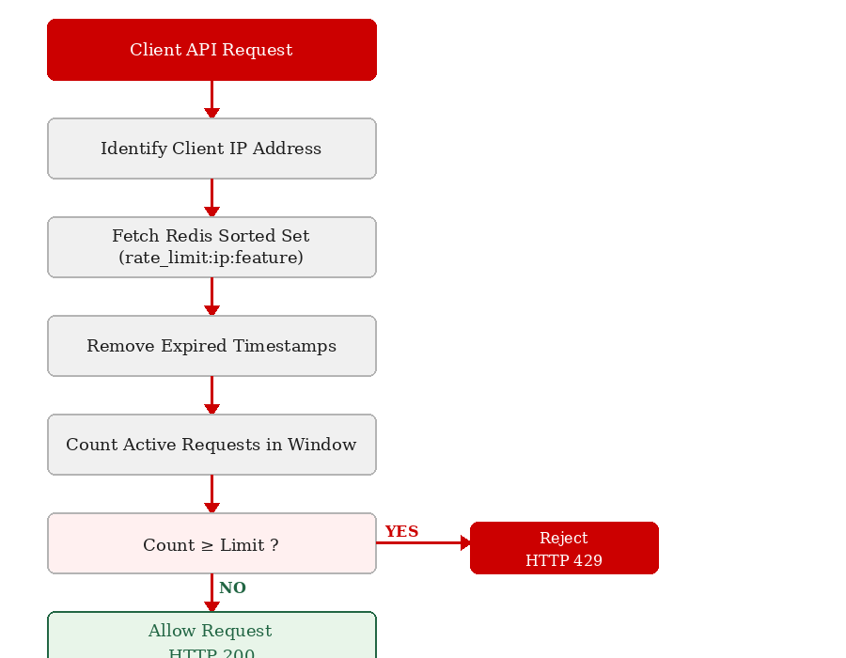
Methodology — Proposed Solution
The system processes each incoming API request through these steps:
Step 1: Identify the client IP address
Step 2: Fetch Redis Sorted Set (rate_limit:ip:feature)
Step 3: Remove expired timestamps outside the window
Step 4: Count active requests in current window
Step 5: Compare count against configured limit
Step 6: Allow (HTTP 200) or Reject (HTTP 429)
Step 7: Store new timestamp in Redis if allowed
6

Slide 7
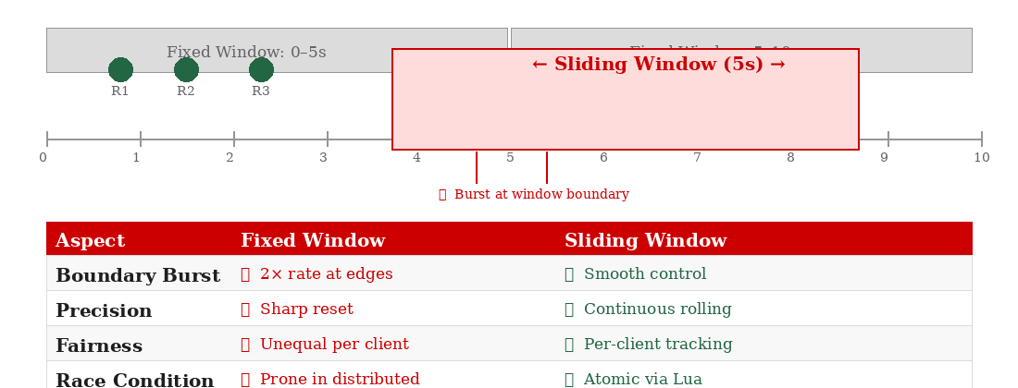
Sliding Window Algorithm
The Sliding Window algorithm dynamically tracks requests within a moving time interval, avoiding the boundary burst problem of Fixed Window approaches.
Advantages over Fixed Window:
Higher precision — tracks every request timestamp, no sharp resets
Fair distribution — each client tracked independently
Prevents burst traffic — no 2x rate exploit at window boundaries
Atomic safety — Lua script executes all Redis steps in one transaction
7

Slide 8
Tools and Technologies
Redis — in-memory datastore used for extremely low latency, high throughput, and Sorted Set support for timestamp-based request tracking.
Lua Scripting — enables atomic execution of Redis commands, eliminates race conditions, and provides better performance than multiple round trips.
Node.js — used for backend integration due to its non-blocking I/O model and high concurrency support.
Express.js — framework used to create REST APIs, integrate middleware, and test rate-limiting functionality per route.
ioredis — Redis client for Node.js; ioredis-mock used for unit testing without a live Redis instance.
nanoid — compact unique ID library used to generate member values for the Redis Sorted Set.
8

Slide 9
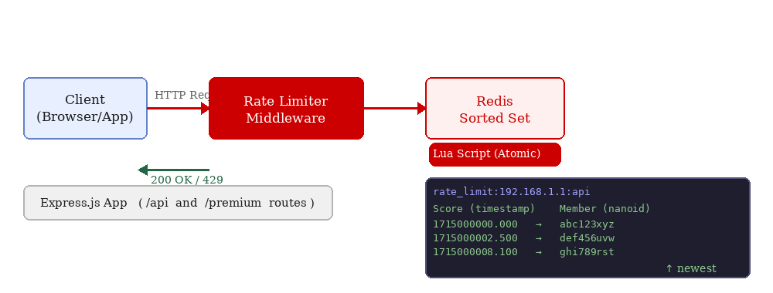
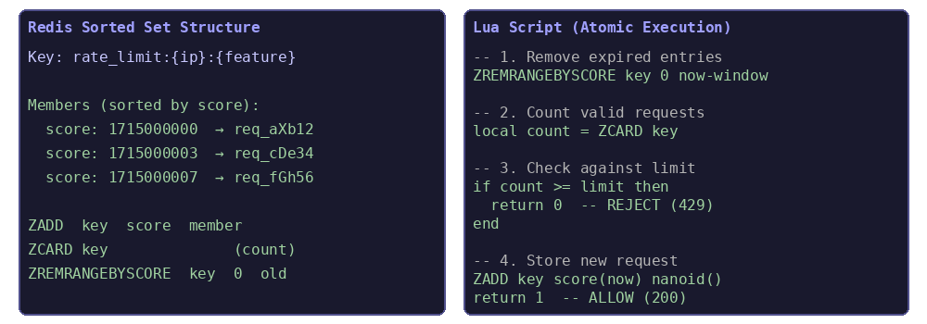
Implementation
Middleware Integration:
app.use(rateLimit({ redis: redis, feature: "api", limit: 5, window: 10000 }))
app.use("/premium", rateLimit({ limit: 10, window: 5000 }))
Rate Limiter Core: generates nanoid member, builds Redis key (rate_limit:ip:feature), calls Lua executor, returns allow/reject.
System architecture and Lua script structure:
9

Slide 10
Working Snapshots
Snapshot 1 — Initial State:
The Atomic Rate Limiter frontend is loaded. Two endpoints are shown: Standard API (5 req / 10s) and Premium API (10 req / 5s). The Real-time Log panel shows 'No requests yet. Fire away!'
Snapshot 2 — Rate Limit Enforced:
After sending multiple GET requests to the Standard API, the real-time log captures:
HTTP 200 — Standard API request successful! (Rem: 2)
HTTP 200 — Standard API request successful! (Rem: 1)
HTTP 200 — Standard API request successful! (Rem: 0)
HTTP 429 — Rate Limit Exceeded (Rem: 0)
The sliding window correctly enforced the 5 req/10s limit — powered by Redis + Express.
10

Slide 11
Major Findings / Outcomes / Results
Performance Improvements:
Significant reduction in API abuse incidents under test load
Stable server performance — no overload observed during stress testing
Sub-millisecond rate-limit decisions maintained consistently
Accuracy of Rate Limiting:
Precise request counting with no boundary burst issues unlike Fixed Window
Fair enforcement across all clients tracked independently
HTTP 429 returned on exact limit breach, HTTP 200 otherwise
Concurrency Handling:
Lua atomic execution eliminated all race conditions
Consistent behavior maintained under concurrent requests
Scalability: Suitable for distributed microservices, cloud-native applications, and high-traffic backend systems.
11

Slide 12
Conclusion and Future Scope
This project successfully demonstrates the design and implementation of a Redis-Based Sliding Window Rate Limiter using Lua Scripting. By combining Redis Sorted Sets, the Sliding Window Algorithm, and atomic Lua execution, the system ensures reliable rate limiting, fair user access, low latency, high scalability, and prevention of backend overload.
The solution is well-suited for modern distributed backend architectures and integrates cleanly as Express.js middleware into any Node.js REST API.
Future Scope:
Dynamic per-user and custom plan rate limits
Real-time monitoring dashboard for traffic insights
Machine learning-based anomaly detection for API traffic
Open-source npm package release
12

Slide 13
References
Redis Documentation — https://redis.io/docs
Lua Scripting in Redis — https://redis.io/docs/manual/programmability/eval-intro/
Node.js Documentation — https://nodejs.org/docs
Express.js Documentation — https://expressjs.com/
ioredis GitHub Repository — https://github.com/redis/ioredis
NanoID Documentation — https://github.com/ai/nanoid
Cloudflare: What is Rate Limiting? — https://www.cloudflare.com/learning/bots/what-is-rate-limiting/
Kong Blog: Rate Limiting Algorithms — https://konghq.com/blog/how-to-design-a-scalable-rate-limiting-algorithm
13

Slide 14
Thank You
14

