Slide 1
Perform Career Analysis of a Renowned Football Player
Exploratory Data Analysis

Slide 2
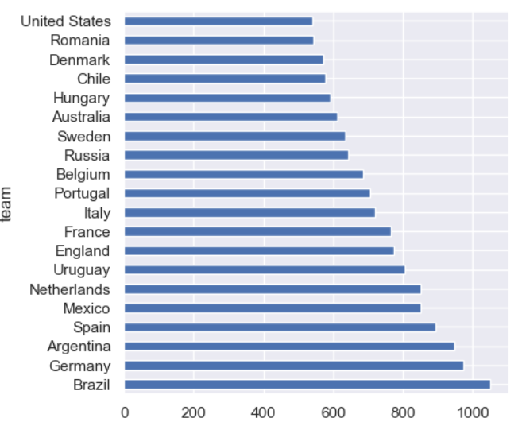
Most Played Team
Brazil is most played team with 1051 number.

Slide 3
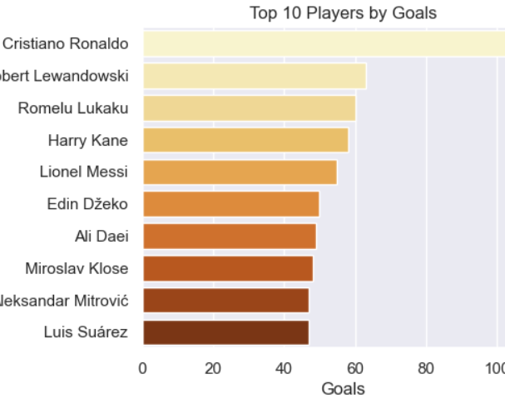
Top Players by Goals
Cristiano Ronaldo leads as the top goal scorer in football history.

Slide 4
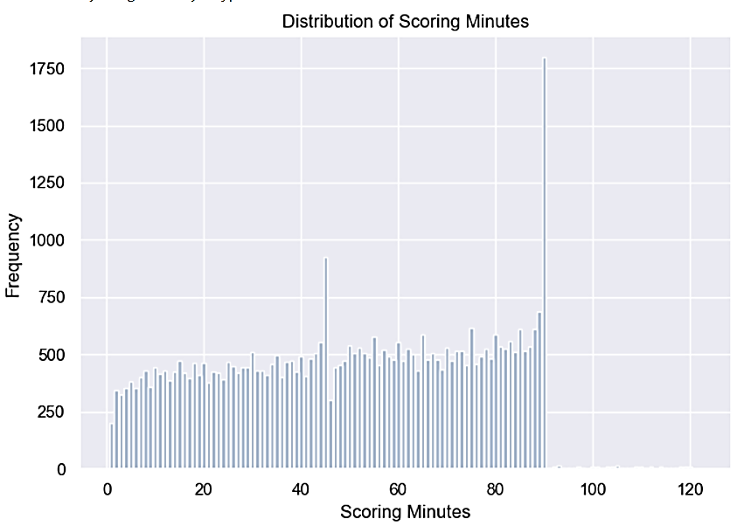
Most Common Scoring Minute
The most common scoring minute in football matches is the 90th minute. This finding suggests that late-game goals are more frequent, possibly due to the added pressure and urgency as the match nears its end.

Slide 5
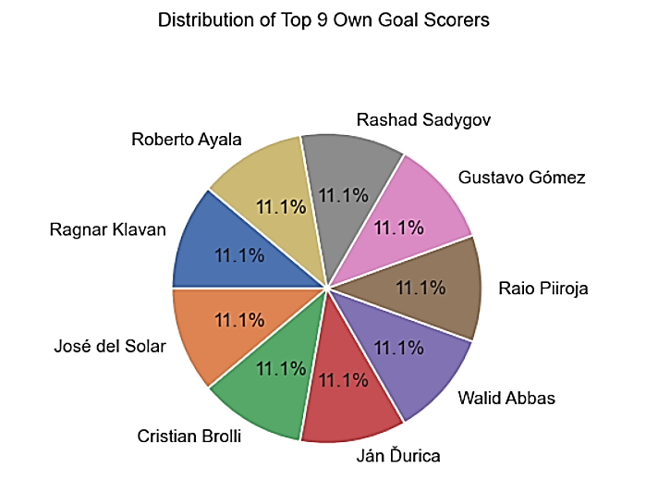
Top Goal Scorer Distribution
The top 9 teams with the highest occurrences of their own goals, where players accidentally scored in their own net. Among these teams, each has a few players who have scored their own goals 3 times each.

Slide 6
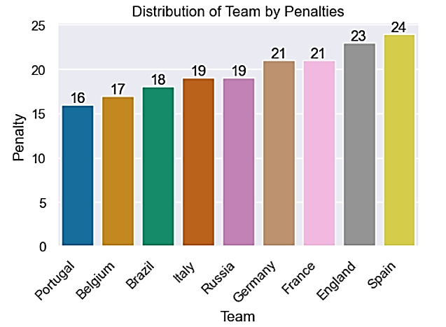
Distribution of Team by Penalties
Top 09 teams that have encountered the highest number of penalties in football matches.

Slide 7
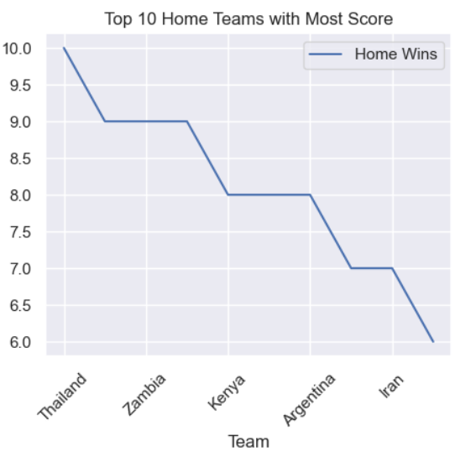
Top 10 Home Teams with Most Score
Argentina 1 155
Argentina 2 154
Mexico 1 151
South Korea 2 148
Brazil 2 144
Japan 1 144
England 2 143
Germany 1 141
Saudi Arabia 1 140
Switzerland 1 139

Slide 8
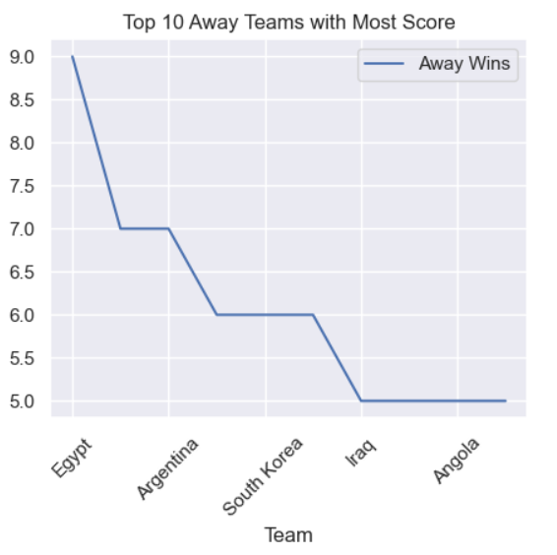
Top 10 Away Teams with Most Score
Uruguay 1 177
Sweden 1 172
Paraguay 0 171
Uruguay 0 171
Paraguay 1 168
Finland 0 168
Finland 1 165
Argentina 1 162
Northern Ireland 0 162
Chile 0 160

Slide 9
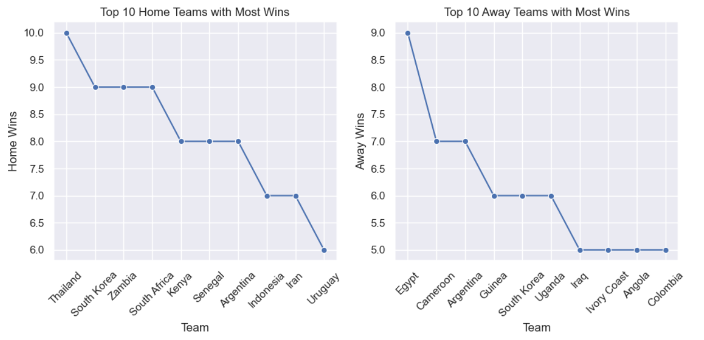
Top 10 Away and Home Teams Excel in Football Victories
The top 10 away teams with the highest number of victories and the top 10 home teams with the most wins. These insights shed light on teams performance in different environments. By comparing these statistics, we gain a well-rounded understanding of teams’ capabilities both on and off their home ground.

Slide 10
Conclusion
In this article, I presented a variety of insights gained from performing an EDA on a football dataset. The insights highlight key trends and patterns in the data, including:
The most common scoring minute in football matches is the 90th minute, suggesting that late-game goals are more frequent.
Argentina has won the most matches in football history, while Cristiano Ronaldo is the top goal scorer.
The top 9 teams with the highest occurrences of penalties are Spain, England, France, Germany, Russia, Italy, Brazil, Belgium, Portugal.
The top 10 home teams with the most wins are Thailand, South Korea, Zambia, South Africa, Kenya, Senegal, Argentina, Indonesia, Iran and Uruguay.
The top 10 home teams with the most wins are Egypt, Cameroon, Argentina, Guinea, South Korea, Uganda, Iraq, Ivory Coast, Angola and Colombia.
The pie chart illustrates the leading host cities and countries in football, emphasizing the global appeal of the sport and its regional popularity.

