Slide 1
BASICS OF COMPUTER HARWARE:
AN EDUCATIONAL OVERVIEW

Slide 2

KEY COMPONENTS
CPU(CENTRAL PROCESSING UNIT)
RAM(RANDOM ACESS MEMORY)
STORAGE(HDD/SSD)

Slide 3
WHAT IS COMPUTER HARDWARE?
PHYSICAL,TANGIBLE PARTS OF COMPUTER SYSTEM.
WORKS IN COMBINATION WITH SOFTWARE TO RUN APPLICATIONS.
CATEGORIZED INTO: INPUT,PROCESSING,STORAGE AND OUTPUT.

Slide 4
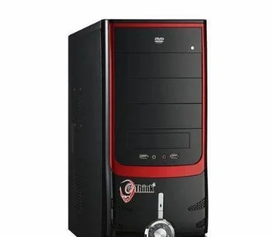
CENTRAL PROCESSING UNIT:
BRAIN OF COMPUTER
EXECUTES PROGRAM INSTRUCTIONS AND PERFORMS CALCULATIONS.
CONTAINS THE CONTROL UNIT(CU) AND ARITHEMATIC LOGIC UNIT(ALU).
MEASURED IN GIGAHERTZ(GHz).

Slide 5
RAM V/S ROM
RAM(RANDOM ACESS MEMORY)-VOLATILE,TEMPORARY STORAGE FOR ACTIVE TASKS.
ROM(READ ONLY MEMORY)-NON-VOLATILE,PERMANENT MEMORY HOLDING STARTUP INSTRUCTIONS(BIOS)

Slide 6
RAM VS ROM
RAM | ROM
TEMPORILY HOLDS DATA. | PERMANENTLY HOLDS DATA.
VOLATILE | NON VOLATILE
ALLOWS BOTH READING AND WRITING | ALLOWS READING ONLY.
FASTER | SLOWER

Slide 7
STORAGE SYSTEMS
HDD(HARD DISK DRIVES):MAGNETIC STORAGE,LARGER CAPACITY AT LOWER COST.
SSD(SOLID STORAGE DRIVE):FLASH MEMORY,SIGNIFICANTLY FASTER,
EXTERNAL STORAGE:USB DRIVES,MEMORY CARDS,EXTERNAL SSDs.

Slide 8
INPUT AND OUTPUT DEVICES
INPUT DEVICES:KEYBOARD,MOUSE,SCANNER,MICROPHONE
OUTPUT DEVICES: MONITOR,PRINTER,SPEAKERS

Slide 9
SYSTEM ARCHITECTURE
MOTHERBOARD:MAIN PRINTED CIRCUIT BOARD CONNECTING CPU,RAM AND EXPENSION CARDS.
POWER SUPPLY UNIT:CONVERTS WALL AC POWER INTO USABLE DC POWER.

Slide 10
SUMMARY
ALL HARDWARE COMPONENTS MUST WORK TOGETHER FOR SMOOTH OPERATION.
SYSTEM SPEED DEPENDS ON A BALANCE OF CPU,MEMORY AND FAST STORAGE.

Slide 11
THANK YOU

