Slide 1



7 sources, 3 methods, 1 landing zone
Flight-ops files
CSV · flights, airports
Snowflake · SKYHOP.BRONZE
file drop → PUT
@LANDING stage → COPY → 4 raw tables
API_RAW: 1 JSON document per request
Every column text, + source file + load time
One container image, one command per Airflow task: files · postgres · apis · verify
Exit code 1 if a source fails → retry, alert
Reservation DB
PostgreSQL · bookings, passengers
incremental, watermark
5 public APIs
Open-Meteo · ECB · GOV.UK · Nager · OurAirports
REST, validated → MERGE
Member 1 · Data & ingestion · Dashboard
Evidence: ingestion/skyhop_ingest · tests/member1
Notes:
~60 s. Two internal logical sources (files + database) plus five public APIs, no key, no cost. Why PostgreSQL extract by watermark and not CDC: decisions are daily, a batch watermark is enough and simpler to operate. APIs land as raw JSON (VARIANT) so a new field never breaks the load. Every answer is validated before loading: a 200 with the wrong body is an error.
[Sources] ingestion/skyhop_ingest/apis.py, bronze.py, postgres_extract.py.

Slide 2
Bronze: raw, traceable, replay-safe
13,749
27
0
raw rows in 8 files
seed 42, 2 daily batches
API documents
12 weather · 12 airports · 3 calendars/FX
rows rejected
bronze never filters
Replay risk | Mechanism | Result
Same file re-sent | PUT OVERWRITE=FALSE | SKIPPED
Task retried | COPY without FORCE (64-day load history) | 0 files processed
API pulled twice | MERGE on (source, request_key) | updated, not duplicated
Crash mid-extract | watermark moves after COPY only | batch re-sent, harmless
Column renamed (batch 2) | read CSV by header name | booked_at_v2 kept
Member 1 · Data & ingestion · Dashboard
Evidence: verify command · 02_bronze_checks.sql · test_bronze.py
Notes:
~60 s. 'verify' compares bronze rows per file with the counts computed from the source files: 8 files, 13,749 rows; it exits 1 if a file is missing, doubled or unexpected. That is the gate before Member 2's dbt run. Show the screenshot of the verify output and LIST @LANDING.
[Sources] docs/member1/bronze_expected_counts.json, snowflake/bronze/02_bronze_checks.sql.

Slide 3

What bronze revealed for Member 2
fare_gbp | £393.31 · 380.07 GBP · 237,06 · negatives · €60.79 (30 rows) · pence ×100
timestamps | +01:00 offsets · epoch · dd/mm/yyyy · 1970 / 2099 defaults
delay, seats | ' 5 ' · 138 units · negative · ×1000
airports | AP003X orphans · origin = destination
categories | BUSINESS · businesss · ' premium ' · platinums
e-mails (PII) | upper case · no @ · leading spaces
ids | 9,496 booking rows for 9,100 ids: duplicates + day-2 updates
Handover contract
column profile per table
suggested rule per mess
JSON paths in API_RAW
gold columns my dashboard needs
Member 1 · Data & ingestion · Dashboard
Evidence: bronze_profile.md · HANDOVER_TO_M2.md
Notes:
~45 s. The profile is generated from the files, not written by hand, and cross-checked with the generator's issues_report. Hand-over line: 'Member 2 turns each of these rows into a cleaning rule.'
[Sources] docs/member1/bronze_profile.md, docs/member1/HANDOVER_TO_M2.md.

Slide 4
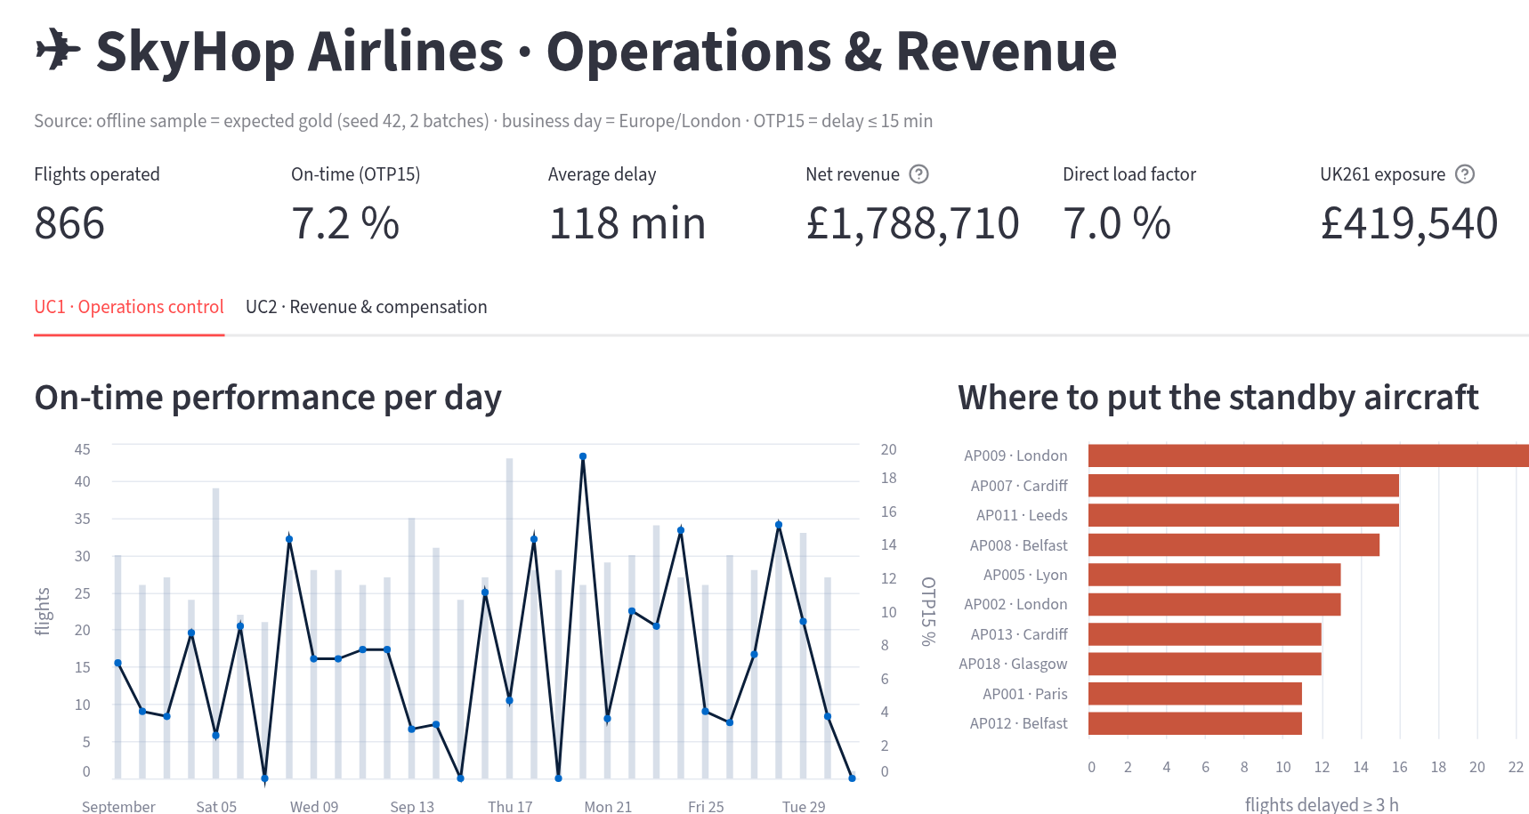
Dashboard: one view per decision
UC1 Ops control
OTP15 per day; airports with most ≥ 3 h delays → standby aircraft
UC2 Revenue
net revenue vs UK261 exposure; weakest flights by load factor
Verified
tiles = expected totals (866 · 61/853 · £1,788,710 · £419,540), automated test
Reads gold only, role SKYHOP_ANALYST, no personal data · runs in Streamlit in Snowflake or locally
Member 1 · Data & ingestion · Dashboard
Evidence: dashboard/app.py · test_dashboard.py
Notes:
~60 s. Screenshot is the offline run on the expected gold (seed 42). On demo day, show the same app on Member 2's gold: same numbers = acceptance test passed. Limitation to say: simulated delays are uniform 0–240 min, so 7.2 % OTP is not realistic; the pipeline is what we validate.
[Sources] dashboard/app.py; screenshot of the running app.

Slide 5
Incidents I own at the source
Replay / double delivery
re-run batch 1 → PUT SKIPPED, COPY 0 files, verify unchanged
B
Tested offline · live demo
Public API down
Frankfurter unreachable → 3 retries, FAILED, 4 sources still loaded, exit 1 → Airflow alert
C
Tested offline
Corrupted daily feed
I inject a broken day as batch 3; verify flags it, M2's checks stop gold
A
Live rehearsal with M2
Limitation: SQL and live API calls run on our Snowflake account and laptop; tests here use fixtures and a fake connection.
Member 1 · Data & ingestion · Dashboard
Evidence: INCIDENT_REHEARSAL_M1.md · test_apis.py · test_bronze.py
Notes:
~45 s, then hand over to Member 2. Keep each live demo under 90 s; screenshots in docs/evidence/member1 are the backup if Wi-Fi fails.
[Sources] docs/member1/INCIDENT_REHEARSAL_M1.md.

