Slide 1
Building a Simple Social Network Database with Neo4j
Drithi Davuluri
B21AI055

Slide 2
Introduction
Problem Statement:
Creating a simple social network using Neo4j. The network should allow users to connect and post messages. Each user has a name, email, and age. Users can follow other users, and they can post messages on their own or other users' timelines.
Breakdown of tasks:
Installation of Neo4j
Data Insertion
Relationship Definition
Node Properties
Retrieval Queries

Slide 3
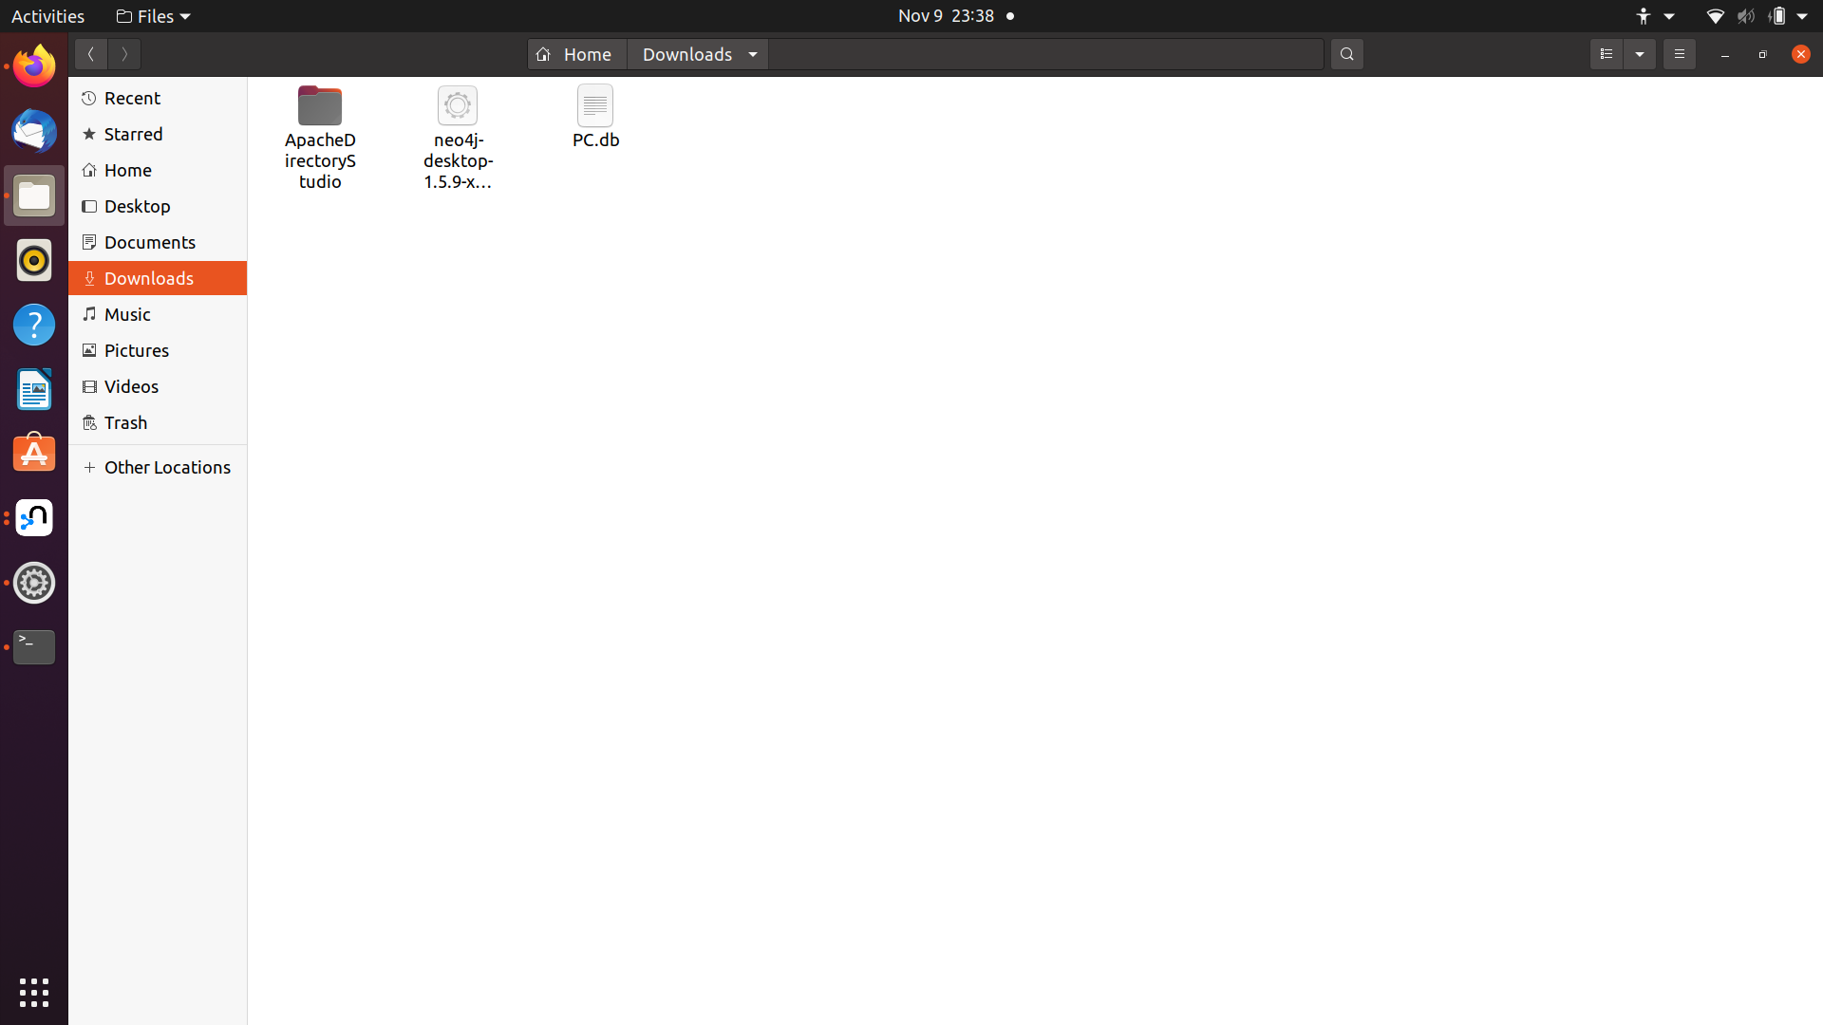
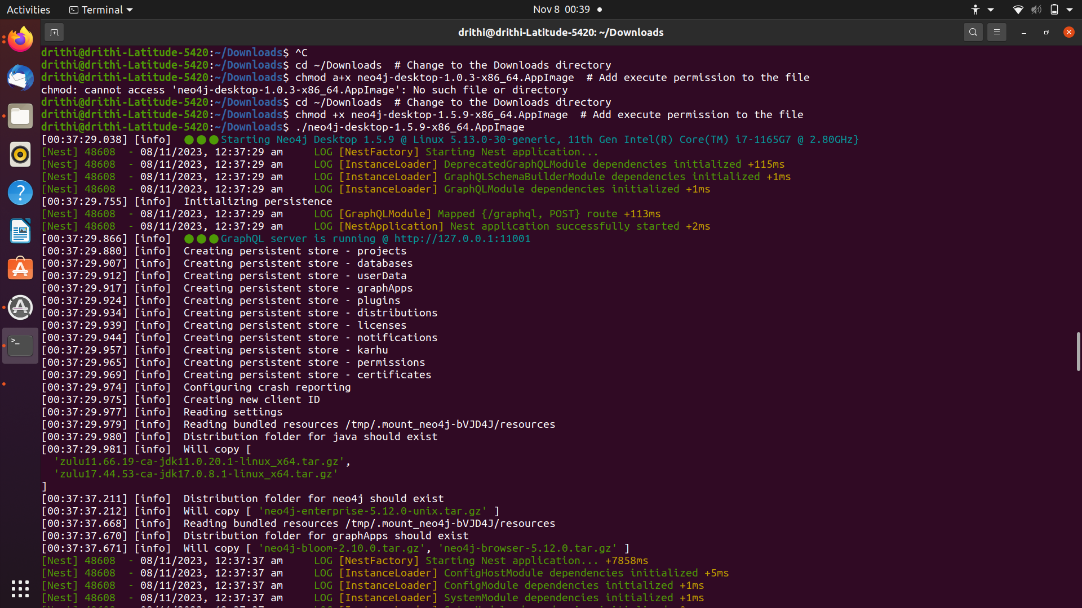
Task 1 - Installation of Neo4j
Installed Neo4j desktop on ubuntu then ran the following command curl -fsSL https://debian.neo4j.com/neotechnology.gpg.key |sudo gpg --dearmor -o /usr/share/keyrings/neo4j.gpg echo "deb [signed-by=/usr/share/keyrings/neo4j.gpg] https://debian.neo4j.com stable 4.1" | sudo tee -a /etc/apt/sources.list.d/neo4j.list sudo apt update sudo apt install neo4j sudo systemctl start neo4j.service
After this installation started with new project.

Slide 4
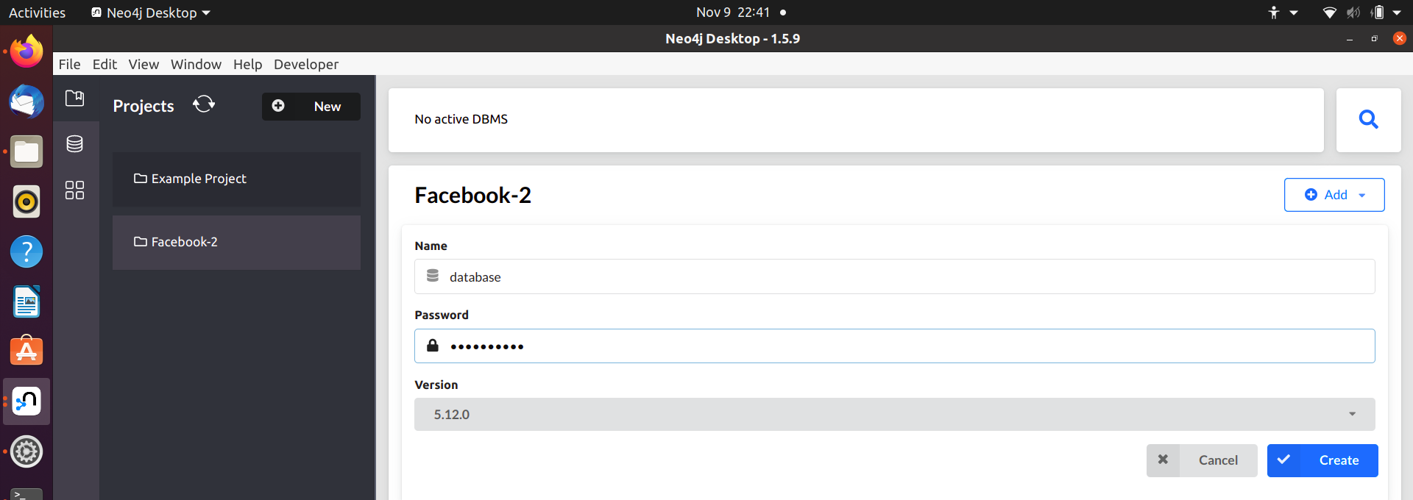
New Project
Added a New project named Facebook-2 and added a new database with name and password-

Slide 5
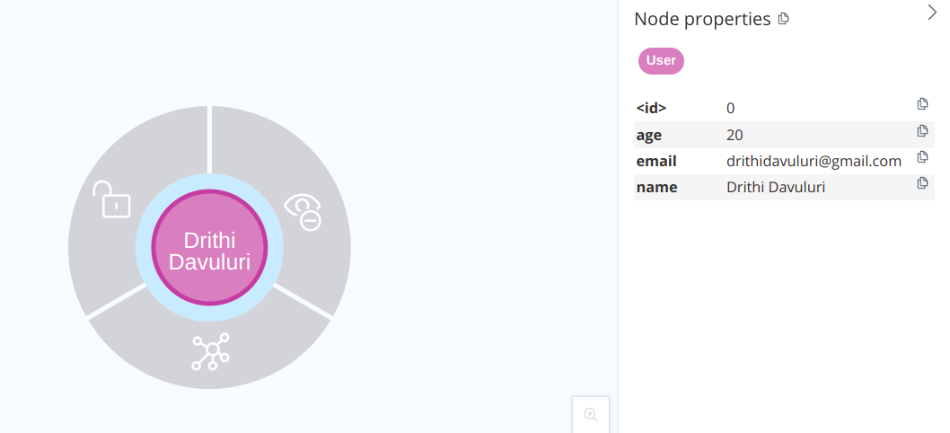
Task 2 - Data Insertion
Created four users using the following- CREATE (drithi:User {name: 'Drithi Davuluri', email: 'drithidavuluri@gmail.com', age: 20}) CREATE (anugya:User {name: 'Anugya Vats', email: 'anugyavats@gmail.com', age: 21}) CREATE (nishtha:User {name: 'Nishtha Karki', email: 'nishthakarki@gmail.com', age: 21}) CREATE (tamanna:User {name: 'Tamanna Maheshwari', email: 'tamanna.com', age: 20})
Each node looked like this-

Slide 6
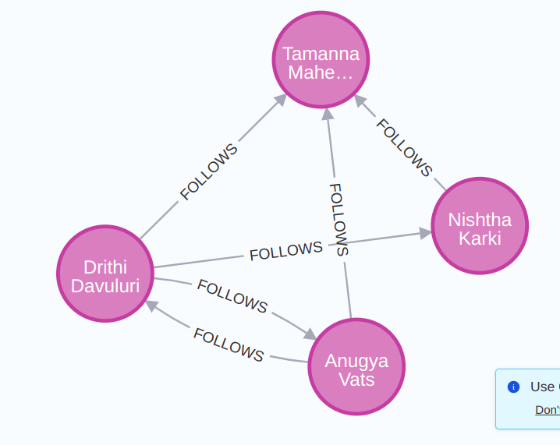
Task 3 - Relationship Definition
Created the relation of follows using the following- MATCH (drithi:User {email: 'drithidavuluri@gmail.com'}) MATCH (anugya:User {email: 'anugyavats@gmail.com'}) MATCH (nishtha:User {email: 'nishthakarki@gmail.com'}) MATCH (tamanna:User {email: 'tamanna.com'}) CREATE (drithi)-[:FOLLOWS]->(anugya), (drithi)-[:FOLLOWS]->(nishtha), (drithi)-[:FOLLOWS]->(tamanna), (anugya)-[:FOLLOWS]->(drithi), (anugya)-[:FOLLOWS]->(tamanna), (nishtha)-[:FOLLOWS]->(tamanna) RETURN drithi, anugya, nishtha, tamanna

Slide 7
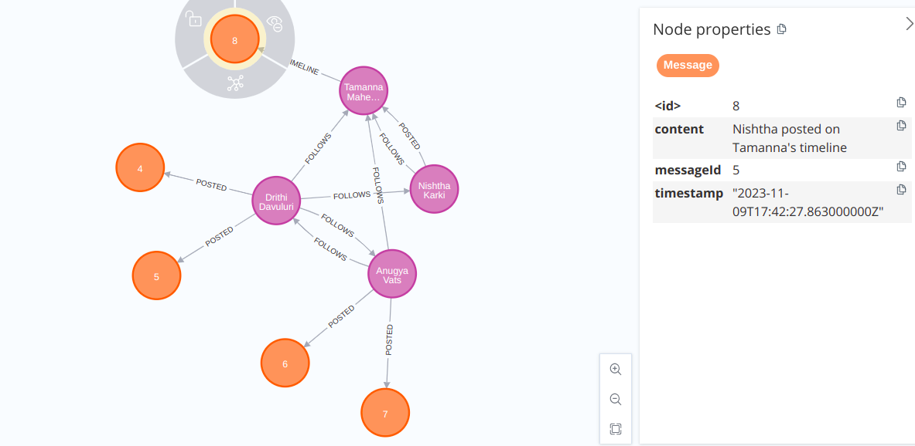
Posted Relationship
New posts were created by users on their own timeline or can also post on others timeline. Time stamp was also included. This was done as below- MATCH (drithi:User {email: 'drithidavuluri@gmail.com'}) MATCH (anugya:User {email: 'anugyavats@gmail.com'}) MATCH (nishtha:User {email: 'nishthakarki@gmail.com'}) MATCH (tamanna:User {email: 'tamanna.com'}) CREATE (drithi)-[:POSTED]->(m1:Message {messageId: '1', content: 'Hi! I am Drithi', timestamp: datetime()}) CREATE (drithi)-[:POSTED]->(m2:Message {messageId: '2', content: 'Another post by Drithi', timestamp: datetime()}) CREATE (anugya)-[:POSTED]->(m3:Message {messageId: '3', content: 'Hi! I am Anugya', timestamp: datetime()}) CREATE (anugya)-[:POSTED]->(m4:Message {messageId: '4', content: 'Another post by Anugya', timestamp: datetime()}) CREATE (nishtha)-[:POSTED]->(tamanna)-[:TIMELINE]->(m5: Message {messageId: '5', content: 'Nishtha posted on Tamanna\'s timeline', timestamp: datetime()}) RETURN drithi, anugya, nishtha, tamanna, m1, m2, m3, m4, m5;

Slide 8
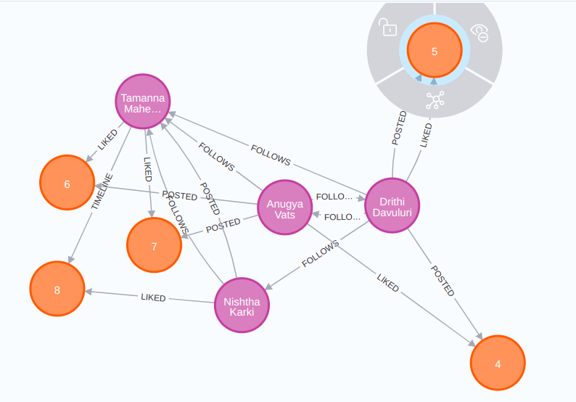
Likes Relationship
Relationship between messages and users are made to represent likes on a particular message- MATCH (drithi:User {email: 'drithidavuluri@gmail.com'}) MATCH (anugya:User {email: 'anugyavats@gmail.com'}) MATCH (nishtha:User {email: 'nishthakarki@gmail.com'}) MATCH (tamanna:User {email: 'tamanna.com'}) MATCH (m1:Message {messageId: '1'}) MATCH (m2:Message {messageId: '2'}) MATCH (m3:Message {messageId: '3'}) MATCH (m4:Message {messageId: '4'}) MATCH (m5:Message {messageId: '5'}) CREATE (drithi)-[:LIKED]->(m2) CREATE (anugya)-[:LIKED]->(m1) CREATE (nishtha)-[:LIKED]->(m5) CREATE (tamanna)-[:LIKED]->(m4) CREATE (tamanna)-[:LIKED]->(m3); RETURN drithi, anugya, nishtha, tamanna, m1, m2, m3, m4, m5;

Slide 9
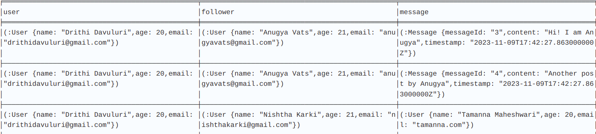
Task 5 - Retrieval Queries
For finding all the messages posted by users followers following query is used- MATCH (user:User {email: 'drithidavuluri@gmail.com'})-[:FOLLOWS]->(follower)-[:POSTED]->(message) RETURN user, follower, message;
Then the messages are displayed-

Slide 10
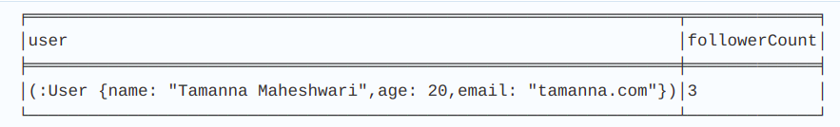
Retrieval Queries
For finding user who has most followers following query is used- MATCH (user:User)<-[:FOLLOWS]-(follower) WITH user, COUNT(follower) AS followerCount ORDER BY followerCount DESC LIMIT 1 RETURN user, followerCount;

Slide 11
Thank you

