Slide 1
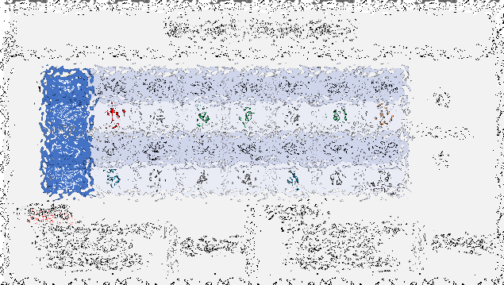
Bitcoin Changes – Soft Fork History and Theory
TabConf 2024
Oct 25, 2024 Paul Sztorc

Slide 2
Past TabConf Talks
Augur/Gnosis (MM 2014/2015)
Polymarket (>$1.5B last month)
Solana (Meta-DAO), $75 M
Dec 2013 - Truthcoin
July 2015 – The Win-win Blocksize solution,
Fork Futures via the Exchange
TabConf 2018
Prediction Markets / Futarchy
"This is something that could entirely reshape human civilization," Proph3t said. "This could solve politics."
DLCs
May 2016 -Sidechain Privatization Jan 2017 - Blind Merged Mining
TabConf 2019 “Sidechain leeching”
“MEV” ($m/day)
Producer-Builder separation
SF Bikeshedding
Eigenlayer ($100M a16z)
Planetary scale ($X00 B/yr)
zCash-privacy
Eternal competitiveness
…
Nov 2015 -
Drivechain
Lightning CoinJoin Ark Core
TabConf 2021 - Drivechain
2023 - Debate with Peter
Dec 2016 “Better Fork Terminology” “Against the Hard fork” “Forks and Splits” (later)
MIT Talk 2023 Softforks
CUSF 2024
Today’s Talk
Bip9 Bip8 UASF Stasis / A:ing

Slide 3
Agenda
Intro | 5 minutes
Soft Fork Basics & History | 10 minutes
Soft Forks & Protocol Governance | 10 minutes
Soft Forks Over Time | 5 minutes
CUSF | 5 minutes
Q&A | 10 minutes

Slide 4
One Slide About Me
Author BIPs 300/301 “Drivechain” – drivechain.info
Bitcoin Researcher and Blogger – truthcoin.info
Founder LayerTwo Labs – LayerTwoLabs.com
“making every transaction a Bitcoin txn”
SigNet Testnet , + faucet + explorer
CUSF Bip300/301 Activator for Core .. ( + OP_CAT also )
Zk-snark L2 (“Zcash sidechain”)
EVM-L2 (“EthSide”)
BitNames – Namecoin L2
BitAssets – Counterparty/Ordinals/Erc20 L2
Thunder – set of largeblock sidechains
New GUI for Bitcoin Core
Fmr Statistican in the Yale Econ Department (2012-2015)
My Opinion
Lightning
ARK
CoinJoin
DLCs
Bitcoin Core
Waste of Time (no offense)

Slide 5
Soft Forks Basics/History
Part 1 of 4

Slide 6
Soft Forks – The Basics
Soft vs Hard
“Tighten Rules” vs “Loosen Rules”
Optional Discretionary Upgrade vs Immediate Mandatory Upgrade
Notable Soft Forks
Aug 2010 – Disable a bunch of opcodes
Sep 2010 – Limit blocksize to 1 MB
Apr 2012 – Add P2SH
Dec 2015 – Add CLTV
Aug 2017 – Add SegWit
Infamous Attempted Hard Forks
2015 – Raise the Blocksize Limit (BitcoinXT / Bitcoin Classic / etc)
2017 – SegWit2x
2017 – BCH (which became its own community)

Slide 7
Some History – Not Widely Known
Gavin Called Them “Soft Changes” (June 2012)
“Changes” is a better term – “Fork” is a bad term.
How the “Soft Fork” Term created (Nov 2012)
And why it’s actually good.
The Logic Behind It All

Slide 8
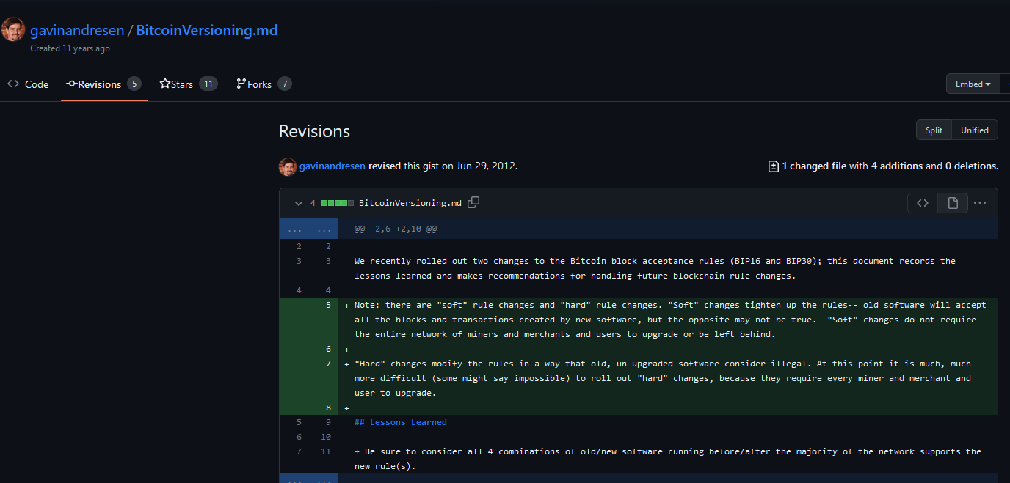
Gavin Called them “Soft Changes”

Slide 9
Gavin Called them “Soft Changes”
Forbidden, on grounds of impracticality

Slide 10
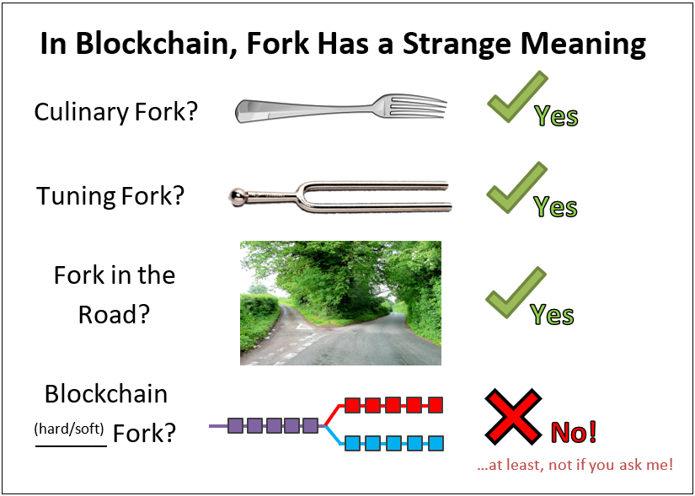

Slide 11
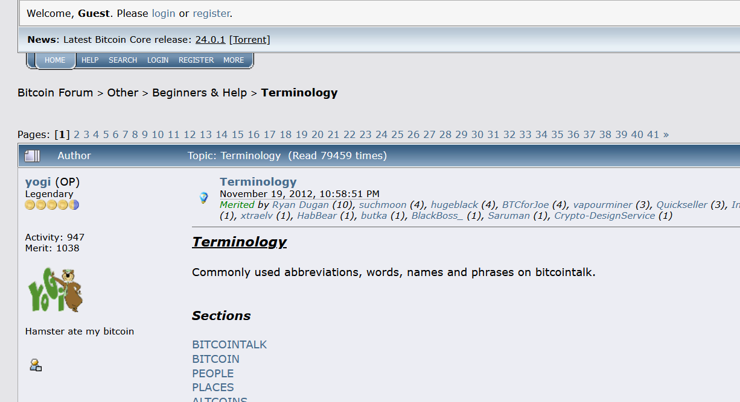
Nov 2012 Definitions
Nov 2012 – Definitions

Slide 12
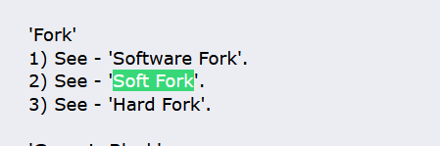
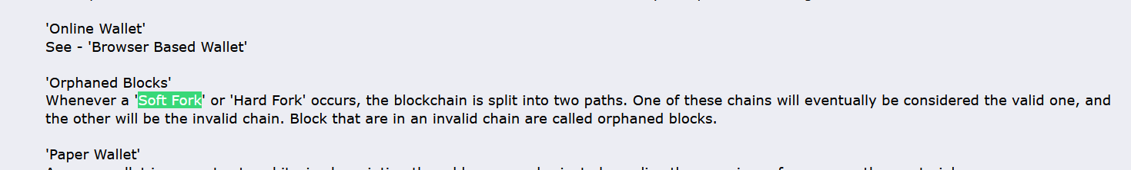
Nov 2012 – Definitions

Slide 13
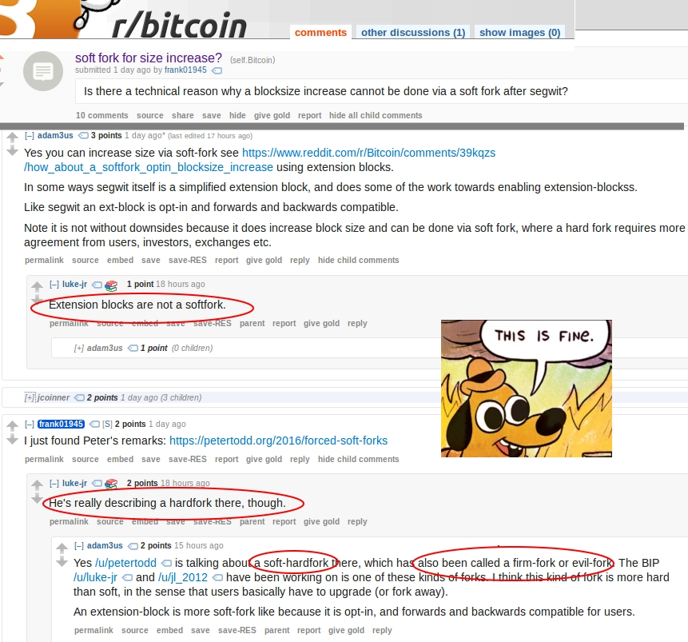
Even Adam Back and Luke Dashjr Disagree

Slide 14
Nov 2012 – Definitions

Slide 15
The Logic (historic)
A soft fork “will resolve itself”.
It will either collapse in the “use the new feature” direction, or...
... it will collapse in the “new feature is broken” direction.
If >50% hashrate upgrades to support a feature, then the fork will always resolve in the direction that supports the feature.
Rebel-blocks are always orphaned (it is as if they arrived too late).
Thus, a feature goes from being 0% safe, to 100% safe, on a defined date.
With hashrate-signaling, everyone can learn the exact date that the feature activates.
Very useful!
…paired with “blank” anyone-can-spend OP NOP

Slide 16
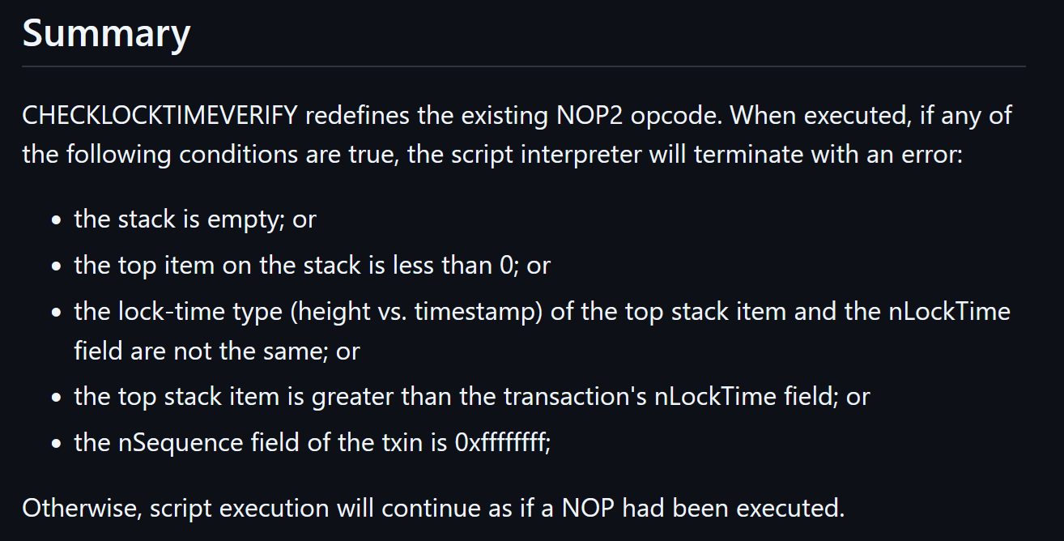
A concise soft fork
Default behavior = allow the txn

Slide 17
Soft Forks and Protocol Governance
Part 2 of 4

Slide 18
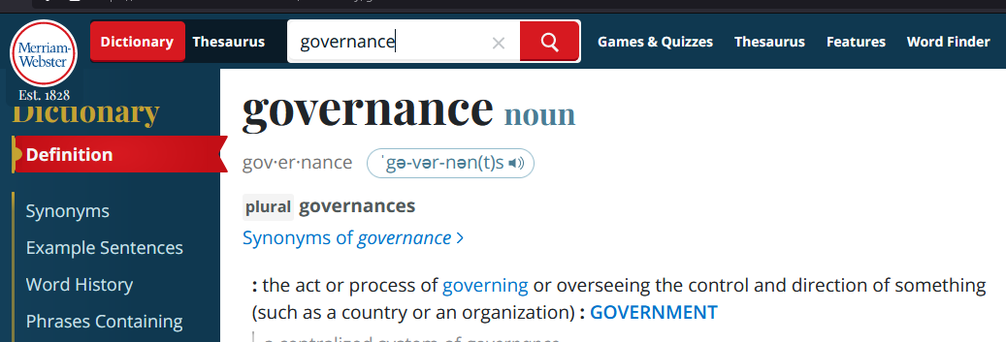
Governance – Definition

Slide 19
Governance – Definition
Rejects P2P

Slide 20
Governance – Definition
Rejects P2P
Too vague!! (There is no success criterion, no objective function.)

Slide 21
Governance = Finding today’s node software
Governance = where does the node software come from? What process?
In that sense, it is more like an industrial process, or recipe. (Eg, how do we build a bridge? How do we build the node software?)
Which code is fullnode-code?
How do we tell Bitcoin Nodes from non-nodes?
If there is a dispute, then who is correct (and who is wrong)? Why?
In other words, Governance is:
The problem of meta-consensus ; consensus about consensus. (A full node does consensus, but only after you find the node software and run it!)
Or, call it “pre-consensus”. How do find the consensus software.
If you didn’t have a node, how would you get one?
I will call this: “Node Constructor-Theory”
Governance
Problem: What is today’s node software ? → I know how to find it!

Slide 22
NodeFinding Strategies – The Big 3
Go to Bitcoin.org and Run The Latest Version
Luke Dashjr Position
Mike Hearn position as well!
Satoshi’s position, (?) repudiated when he removed OP VER.
Find the oldest node-like thing, run that, then plug your ears!
Never revisit this process. The relative costs and benefits – the node software does consensus pretty well, meta-consensus is much harder to do. Be mistrustful of this.
Mircea Popescu’s “Bitcoin Foundation” – 0.5.4 (2014)
The “original” is the full node. Everything later is a *distortion*. Everything afterwards is ...wargames for a bait-and-switch.
Soft Fork “Pluralism”
Soft fork means that different pieces of software can coexist
Anything in the “Line of Coexistance” is fair game!
“Latest Core”
“Static” Protocol
“Linear Coexistence” (Consent-Based)

Slide 23
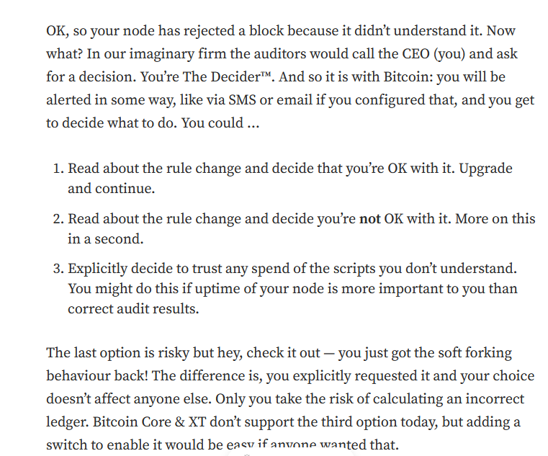
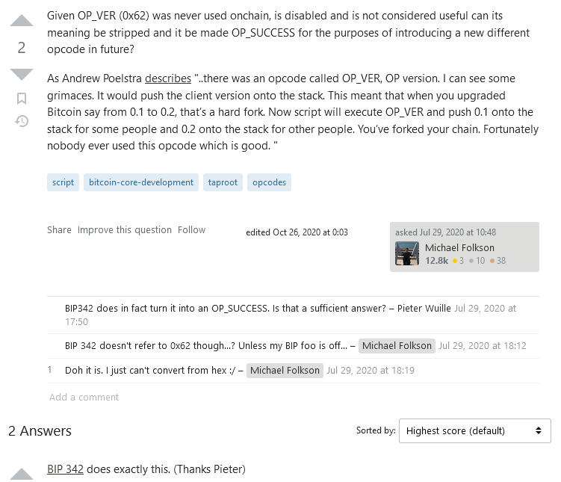
Mike Hearn
Satoshi – OP VER
https://medium.com/@octskyward/on-consensus-and-forks-c6a050c792e7
https://bitcoin.stackexchange.com/questions/97258/given-op-ver-was-never-used-is-disabled-and-not-considered-useful-can-its-meani

Slide 24
NodeFinding Strategies – The Big 3
Go to Bitcoin.org and Run The Latest Version
Luke Dashjr Position
Mike Hearn position as well!
Satoshi’s position, (?) repudiated when he removed OP VER.
Find the oldest node-like thing, run that, then plug your ears!
Never revisit this process. The relative costs and benefits – the node software does consensus pretty well, meta-consensus is much harder to do. Be mistrustful of this.
Mircea Popescu’s “Bitcoin Foundation” – 0.5.4 (2014)
The “original” is the full node. Everything later is a *distortion*. Everything afterwards is ...wargames for a bait-and-switch.
Soft Fork “Pluralism”
Soft fork means that different pieces of software can coexist
Anything in the “Line of Coexistance” is fair game!
“Latest Core”
“Static” Protocol
“Linear Coexistence” (Consent-Based)

Slide 25
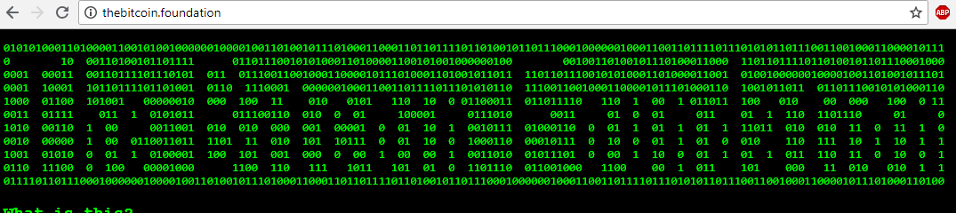
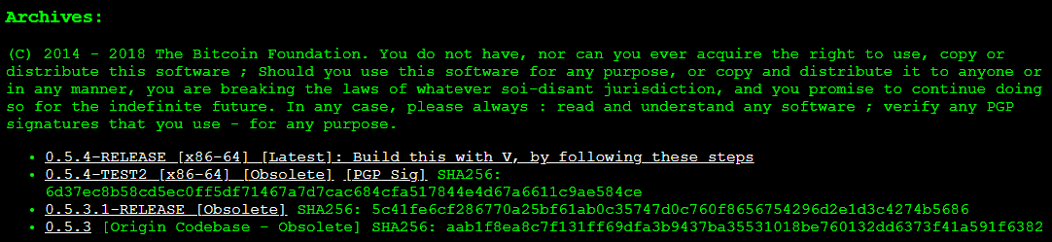
The “Static Protocol” Position
Bitcoin Foundation

Slide 26
NodeFinding Strategies – The Big 3
Go to Bitcoin.org and Run The Latest Version
Luke Dashjr Position
Mike Hearn position as well!
Satoshi’s position, (?) repudiated when he removed OP VER.
Find the oldest node-like thing, run that, then plug your ears!
Never revisit this process. The relative costs and benefits – the node software does consensus pretty well, meta-consensus is much harder to do. Be mistrustful of this.
Mircea Popescu’s “Bitcoin Foundation” – 0.5.4 (2014)
The “original” is the full node. Everything later is a *distortion*. Everything afterwards is ...wargames for a bait-and-switch.
Soft Fork “Pluralism”
Soft fork means that different pieces of software can coexist
Anything in the “Line of Coexistance” is fair game!
“Latest Core”
“Static” Protocol
“Linear Coexistence” (Consent-Based)

Slide 27
Upgrading via Soft Fork
“line” of protocols that are all compatible with each other
Bitcoin 0.5.0
Compatibility
Bitcoin 0.6.0
Bitcoin 0.7.0

Slide 28
NodeFinding Strategies – The Big 3
Go to Bitcoin.org and Run The Latest Version
Luke Dashjr Position
Mike Hearn position as well!
Satoshi’s position, (?) repudiated when he removed OP VER.
Find the oldest node-like thing, run that, then plug your ears!
Never revisit this process. The relative costs and benefits – the node software does consensus pretty well, meta-consensus is much harder to do. Be mistrustful of this.
Mircea Popescu’s “Bitcoin Foundation” – 0.5.4 (2014)
The “original” is the full node. Everything later is a *distortion*. Everything afterwards is ...wargames for a bait-and-switch.
Soft Fork “Pluralism”
Soft fork means that different pieces of software can coexist
Anything in the “Line of Coexistance” is fair game!
“Latest Core”
“Static” Protocol
“Linear Coexistence” (Consent-Based)

Slide 29
Governance Strategies... And their Problems
 | Problem of Expertise / Charisma Attack | Outsourced Thinking / Fallibilism | Problem of Innovation / “Dissent”
“Latest Core”
“Static” Protocol
“Linear Coexistence” (Consent-Based)

Slide 30
Governance Strategies... And their Problems
 | Problem of Expertise / Charisma Attack | Outsourced Thinking / Fallibilism | Problem of Innovation / “Dissent”
“Latest Core” |  | Outsource Your Thinking to Bitcoin.org
“Static” Protocol |  | Stays the Same
“Linear Coexistence” (Consent-Based)

Slide 31
Governance Strategies... And their Problems
 | Problem of Expertise / Charisma Attack | Outsourced Thinking / Fallibilism | Problem of Innovation / “Dissent”
“Latest Core” |  | Outsource Your Thinking to Bitcoin.org
“Static” Protocol |  | Stays the Same
“Linear Coexistence” (Consent-Based) |  | Allows Error-Correction

Slide 32
Expertise... is Mandatory!
Luke-Jr Position:
Must run latest version. Running old versions of the software is illegitimate!
Must ensure the version on Bitcoin.org is good, by participating in technical community.
Problems
Learning takes effort.
Impossible for everyone to be an expert!
Laypeople are important! But this view says: no laypeople allowed!
No accumulation of recognizability. Instead, continual effort needed.

Slide 33
Governance Strategies... And their Problems
 | Problem of Expertise / Charisma Attack | Outsourced Thinking / Fallibilism | Problem of Innovation / “Dissent”
“Latest Core” | No Laypeople Allowed | Outsource Your Thinking to Bitcoin.org
“Static” Protocol | Accumulates Trust | Stays the Same
“Linear Coexistence” (Consent-Based) | Requires dispute-resolution | Allows Error-Correction

Slide 34
Two Incompatible SFs at once = HF
NOP 8 = Q
NOP 8
NOP 8 = T (!= Q)
Begins with a formally-defined “ignorable state”,
And ends with a formally defined “new state” that achieves consensus socially.

Slide 35
Upgrading via Soft Fork
“line” of protocols that are all compatible with each other
Bitcoin 0.5.0
Compatibility
Bitcoin 0.6.0
Bitcoin 0.7.0
Must be in order!

Slide 36

Bitcoiners Often Disagree
Carnivores vs Vegans
But also...
Bip9 vs Bip8
Lot=true vs false
Ordinals
US Regulation
Op Cat
...just about everything!

Slide 37
Governance Strategies... And their Problems
 | Problem of Expertise / Charisma Attack | Outsourced Thinking / Fallibilism | Problem of Innovation / “Dissent”
“Latest Core” | No Laypeople Allowed | Outsource Your Thinking to Bitcoin.org
“Static” Protocol | Accumulates Trust | Stays the Same
“Linear Coexistence” (Consent-Based) | Requires dispute-resolution | Allows Error-Correction

Slide 38
Governance Strategies... And their Problems
 | Problem of Expertise / Charisma Attack | Outsourced Thinking / Fallibilism | Problem of Innovation / “Dissent”
“Latest Core” | No Laypeople Allowed | Outsource Your Thinking to Bitcoin.org | Allows Innovation
“Static” Protocol | Accumulates Trust | Stays the Same | No Innovation Allowed
“Linear Coexistence” (Consent-Based) | Requires dispute-resolution | “Ratchet” –Resists Future Errors | Allows Most Innovation

Slide 39
Governance Strategies... And their Problems
 | Problem of Expertise / Charisma Attack | Outsourced Thinking / Fallibilism | Problem of Innovation / “Dissent”
“Latest Core” | No Laypeople Allowed | Outsource Your Thinking to Bitcoin.org | Allows Innovation
“Static” Protocol | Accumulates Trust | Stays the Same | No Innovation Allowed
“Linear Coexistence” (Consent-Based) | Requires dispute-resolution | “Ratchet” –Resists Future Errors | Allows Most Innovation
Sidechains/ Layers/CUSF | Accumulates Trust | Actively Promotes Error-Correction | Allows Even Hardfork Style Innovation

Slide 40
Soft Forks Over Time
Part 3 of 4

Slide 41
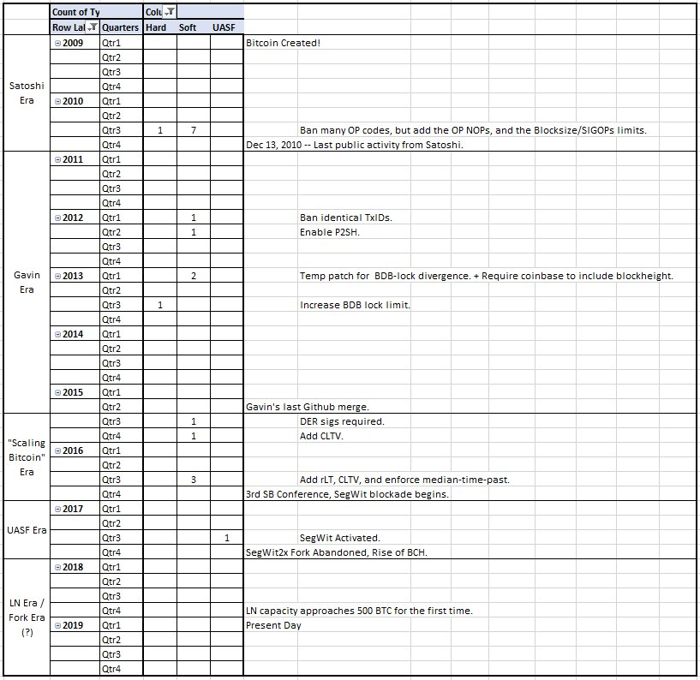
Soft Forks Over Time
(according to BitMex)

Slide 42
Bitcoin’s Ossification
original source code & edit history are mostly lost
Year | 2009 | 2010 | 2011 | 2012 | 2013 | 2014 | 2015 | 2016
# of Soft Forks | 0* | 7 | 0 | 2 | 2 | 0 | 2 | 3
16
Year | 2017 | 2018 | 2019 | 2020 | 2021 | 2022 | 2023 | 2024
# of Soft Forks | 1 | 0 | 0 | 0 | 1 | 0 | 0 | 0 (Presumably)
2
SegWit
Announced Dec 2015
Coded Oct 2016
Activated Aug 2017
Taproot
Announced Jan 2018
Coded Oct 2020
Activated Nov 2021
20 Months
46 Months

Slide 43
Problems
First – is it a problem ?
Some people don’t want Bitcoin to “change”…
…but soft forks aren’t a mandatory change. (The old software works.)
Soft forks benefits:
Grant new options to users.
Improves the software; improve the money.
Multisig + Lightning (SegWit) were created via soft fork.
Security, (op vault), privacy, scalability require new soft forks.
Soft forks costs…
Soft fork is basically free: SFs are optional, reversible, and inevitable.
Optional = The old protocol survives, so the upgrade is consensual.
Reversible = A soft fork claiming OP NOP 6 , for example, could be later deactivated by a 2nd soft fork, that just bans OP NOP 6.
Inevitable = If 51% hashrate mines a new version, then the soft fork activates – end of story.
Users who “resist” the soft fork, will break the heaviest-valid-chain rule and will hard fork.
Any soft fork that increases miner profitability, can and will activate, eventually.
Cynical take: some prefer software NOT to improve, since they are middlemen.

Slide 44
CUSF Core Untouched Soft Fork “Ordinal-ization” of Soft Forks “Sidechain-ziation” of Soft Forks
Part 4 of 4

Slide 45
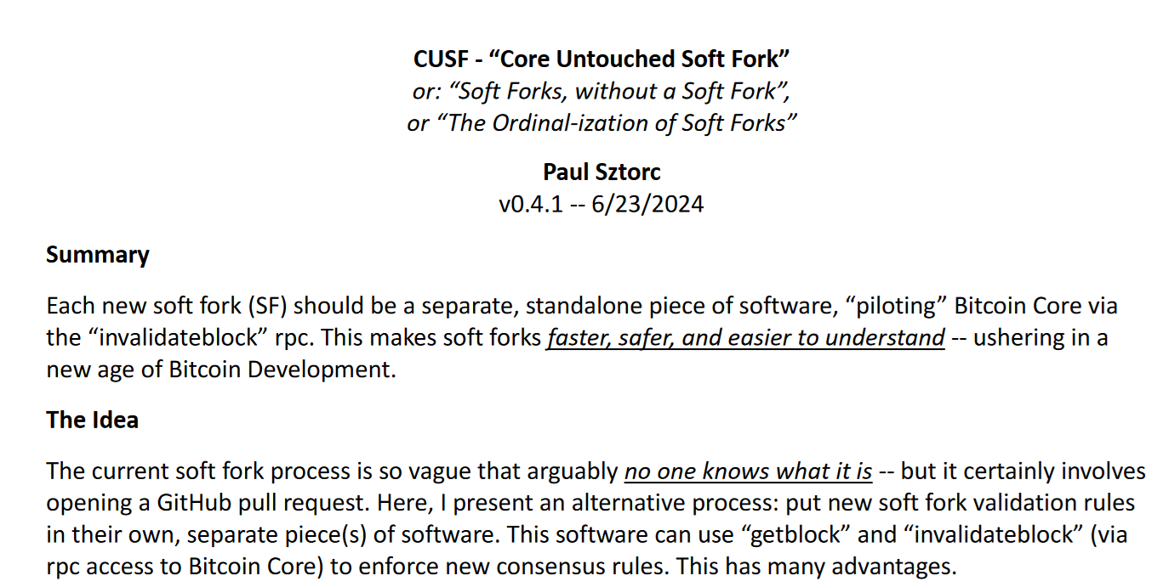
Paper at: https://bip300cusf.com
Soft fork via a 2nd piece of software –
Takes blocks from Bitcoin Core, and gives them a “second pass”.
Calls `invalidateblock` in Bitcoin Core if new rulebreaking.

Slide 46
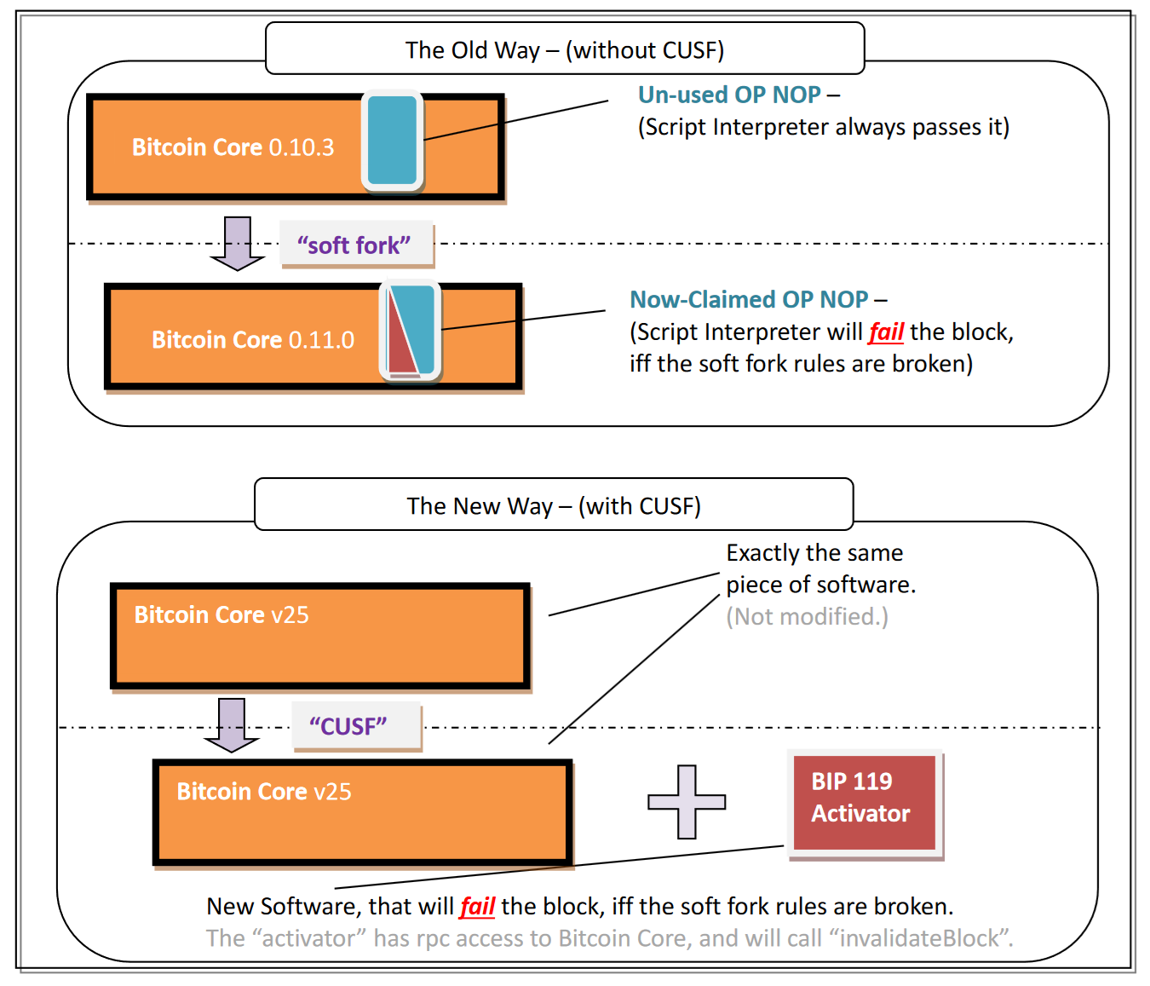
Same effect
But two software daemons
Two RPC servers
“Inefficient” for computer – 2x as much work
But “separable” at the human level – socially scalable.
Simple change, many advantages

Slide 47
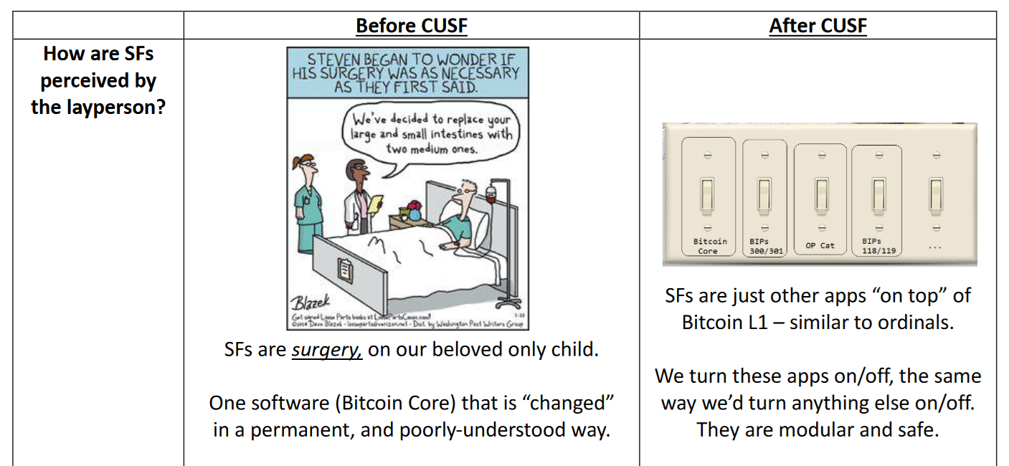

Slide 48
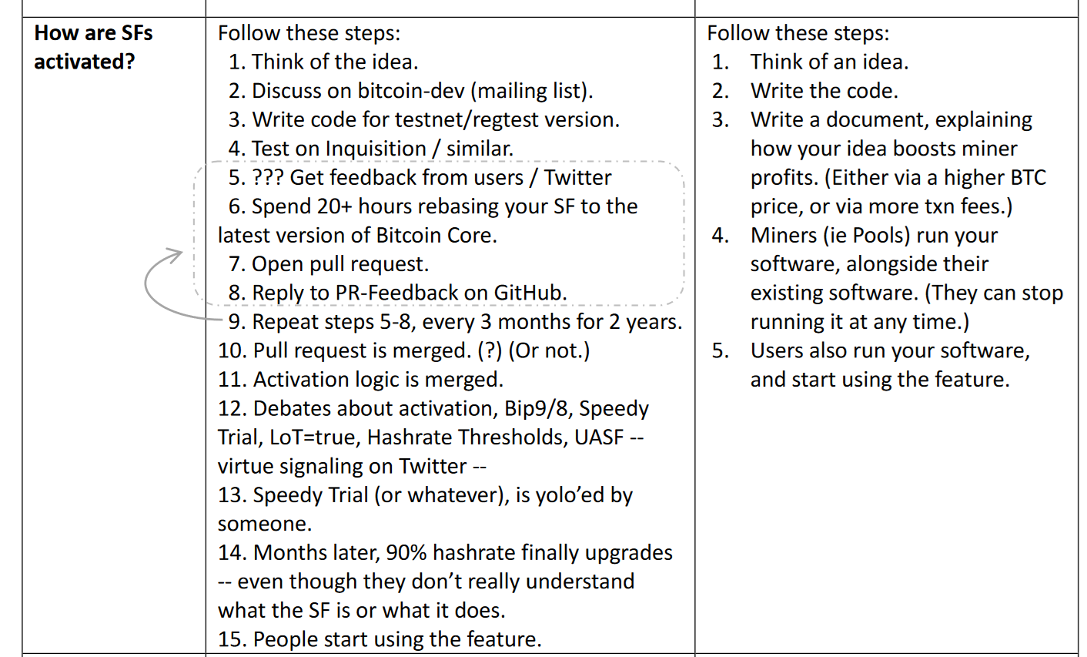

Slide 49
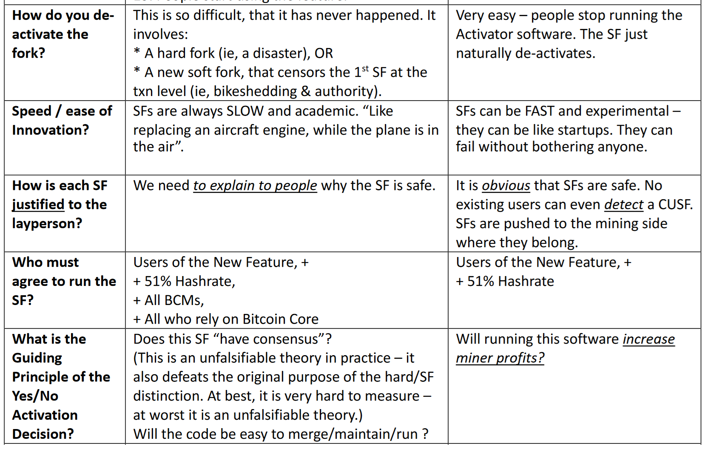

Slide 50
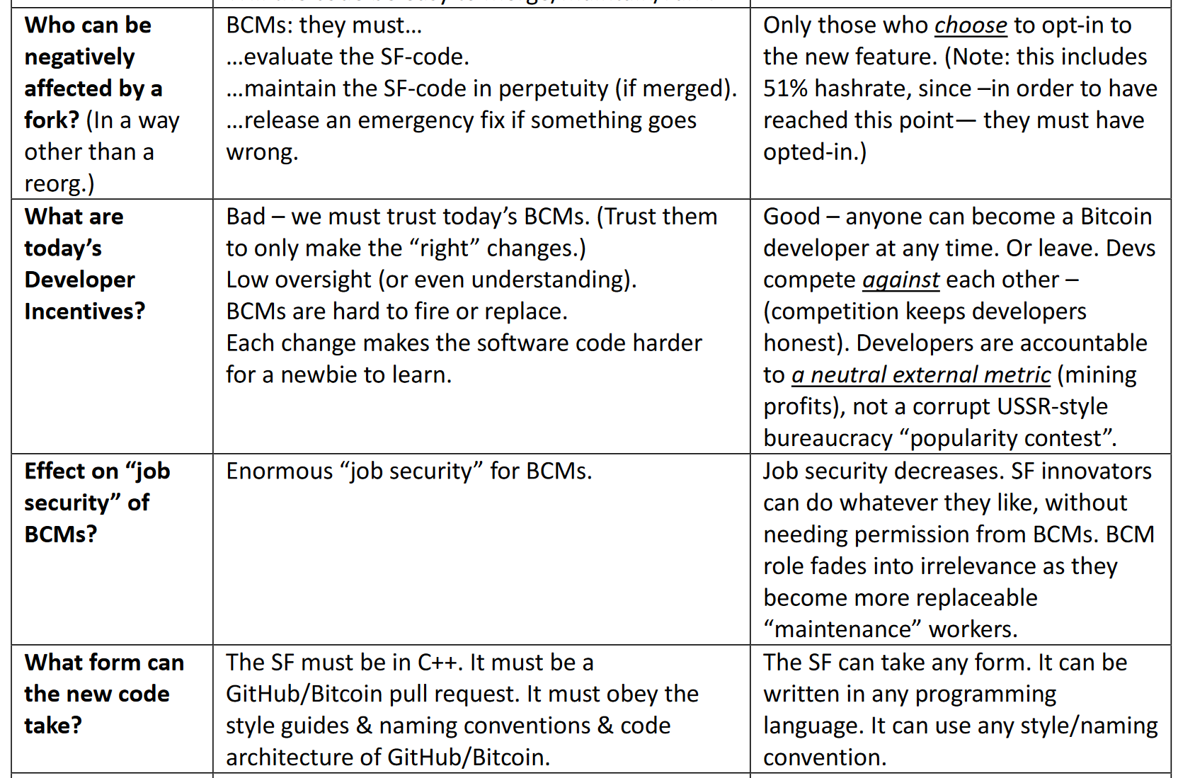

Slide 51
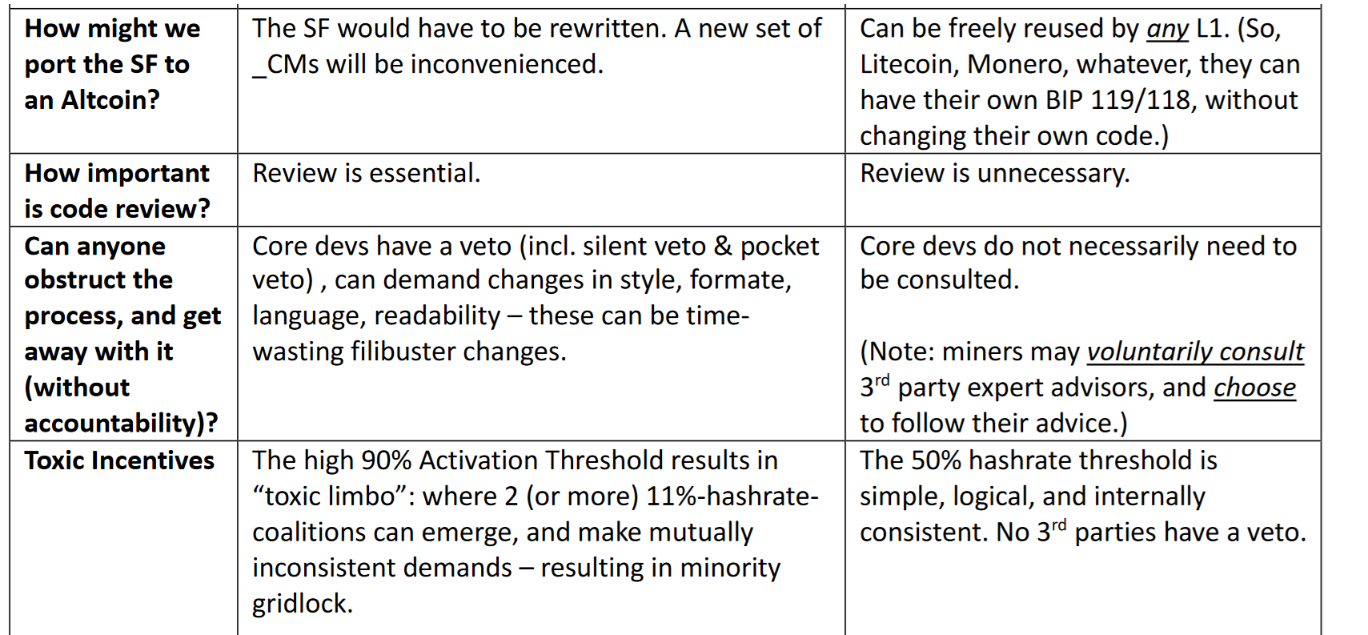

Slide 52
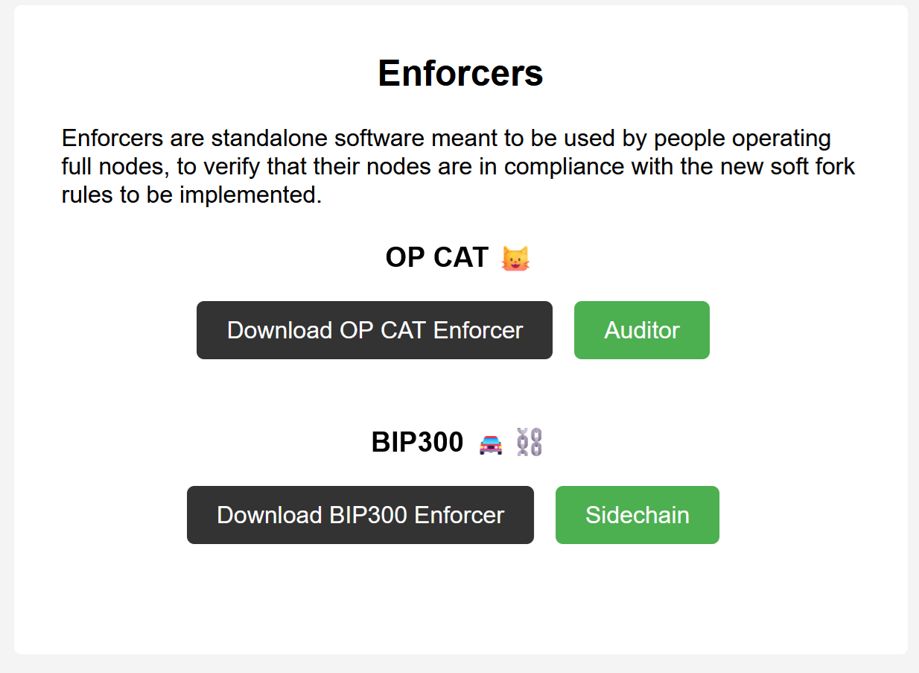
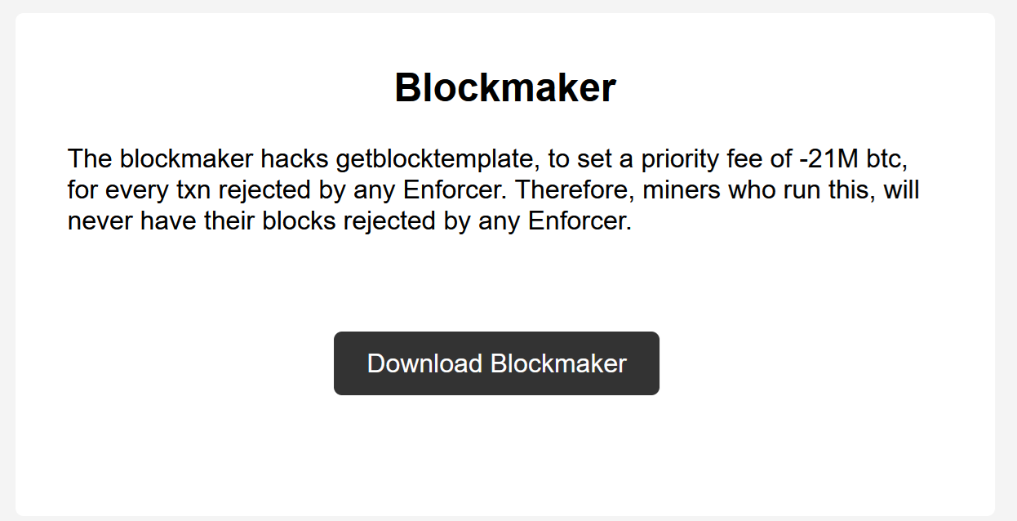
Download Today – OP CAT & BIP300
bip300cusf.com/download
(This is one easy way of solving all of our soft fork problems.)

Slide 53
The End
Paul Sztorc
layertwolabs.com ;
truthcoin.info
bitcoinhivemind.com
drivechain.info
Twitter: @truthcoin ; Telegram: @psztorc
Please Ask Your Questions Now

Slide 54
New Soft Forks ??
Is there even still a process?
SegWit Trauma / PTSD
Unsolved mysteries of the Blocksize war
Why did people get hashrate support for a hard fork, when hashrate is irrelevant to a hard fork? I don’t know.
Miners signed a meaningless piece of paper backing the wrong side, but they never actually did anything. Yet still they feel guilty and unwilling to do further soft forks.
Ratio of Experts / Laypeople is plummeting. More Ls, harder to E.
Sour Grapes

Slide 55
New Soft Forks ??
Is there even still a process?
SegWit Trauma / PTSD
Unsolved mysteries of the Blocksize war
Why did people get hashrate support for a hard fork, when hashrate is irrelevant to a hard fork? I don’t know.
Miners signed a meaningless piece of paper backing the wrong side, but they never actually did anything. Yet still they feel guilty and unwilling to do further soft forks.
Ratio of Experts / Laypeople is plummeting. More Ls, harder to E.
Sour Grapes
The real reason....

Slide 56
The Real Reason...

Slide 57
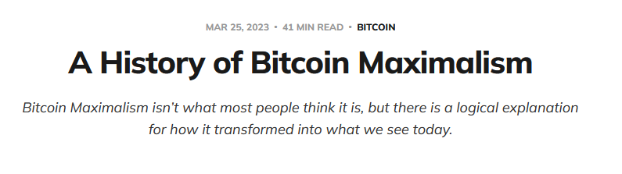
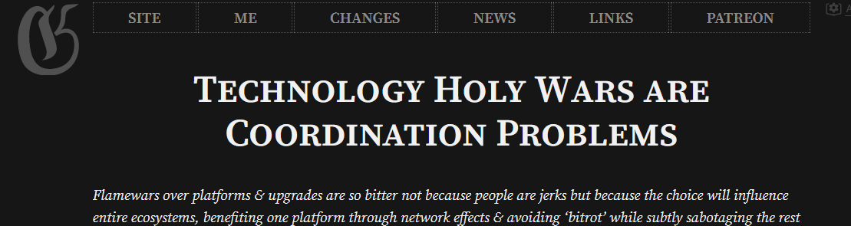
Jameson Lopp’s Article
Gwern’s Article

