Slide 1
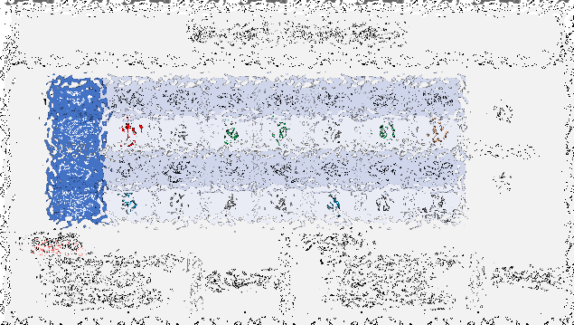
Soft Forks, Governance, Culture
MIT Bitcoin Expo
April 22, 2023 Paul Sztorc

Slide 2
Agenda
Soft Forks
The Basics
Four Comments
Governance
A useful definition, in a P2P context
The Big Three
The Governance Table
Culture
Soft Forks Over Time
Conventional Wisdom, vs Fundamental Analysis
A Simple explanation that ties it all together

Slide 3
Soft Forks
Part 1 of 3

Slide 4
Soft Forks – The Basics
Soft vs Hard
“Tighten Rules” vs “Loosen Rules”
Optional Upgrade vs Immediate Mandatory Upgrade
Notable Soft Forks
Aug 2010 – Disable a bunch of opcodes
Sep 2010 – Limit blocksize to 1 MB
Apr 2012 – Add P2SH
Dec 2015 – Add CLTV
Aug 2017 – Add SegWit
Infamous Attempted Hard Forks
2015 – Raise the Blocksize Limit (BitcoinXT / Bitcoin Classic / etc)

Slide 5
Soft Forks – Some Useful History
Gavin Called Them “Soft Changes” (June 2012)
“Changes” is a better term – “Fork” is a bad term.
How the “Soft Fork” Term created (Nov 2012)
And why it’s actually good.
The Logic Behind It All

Slide 6
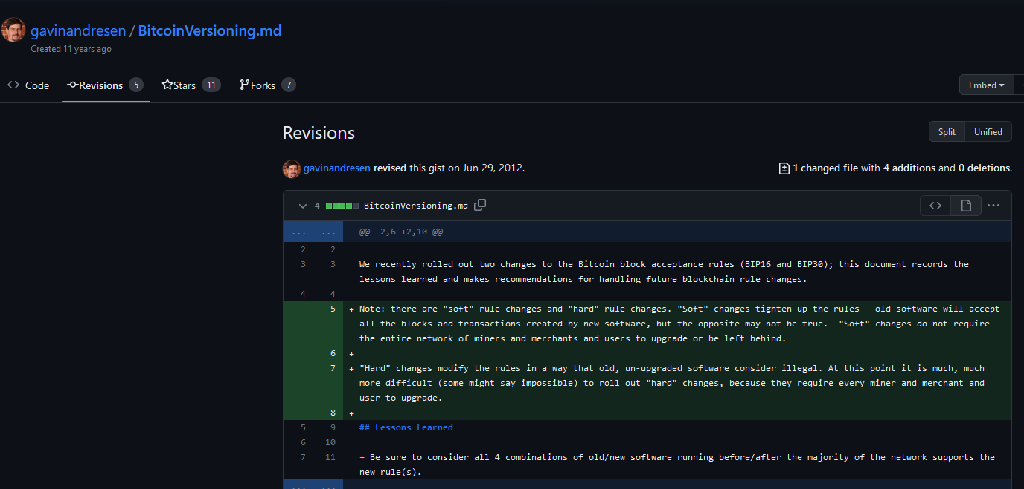
Gavin Called them “Soft Changes”

Slide 7
Gavin Called them “Soft Changes”
Forbidden, on grounds of impracticality

Slide 8
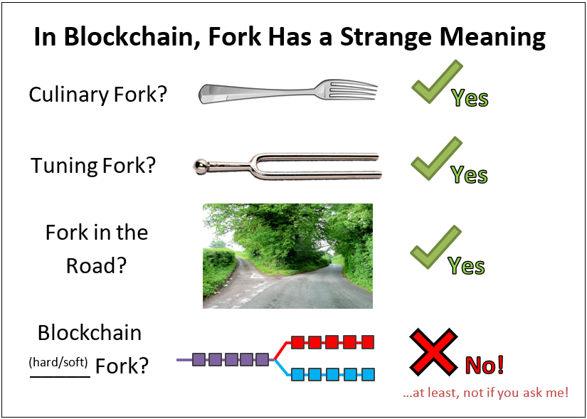

Slide 9
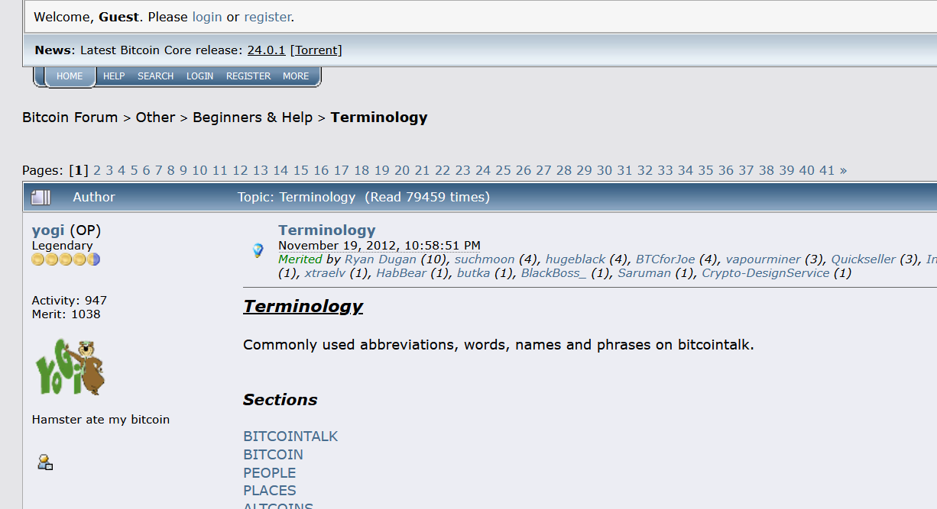
Nov 2012 Definitions
Nov 2012 – Definitions

Slide 10
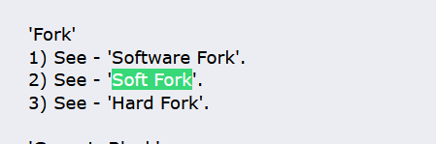
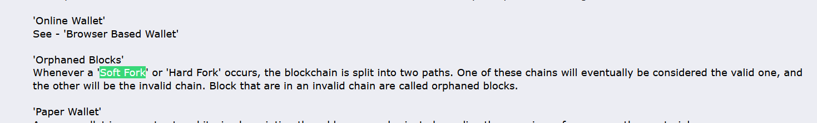
Nov 2012 – Definitions

Slide 11
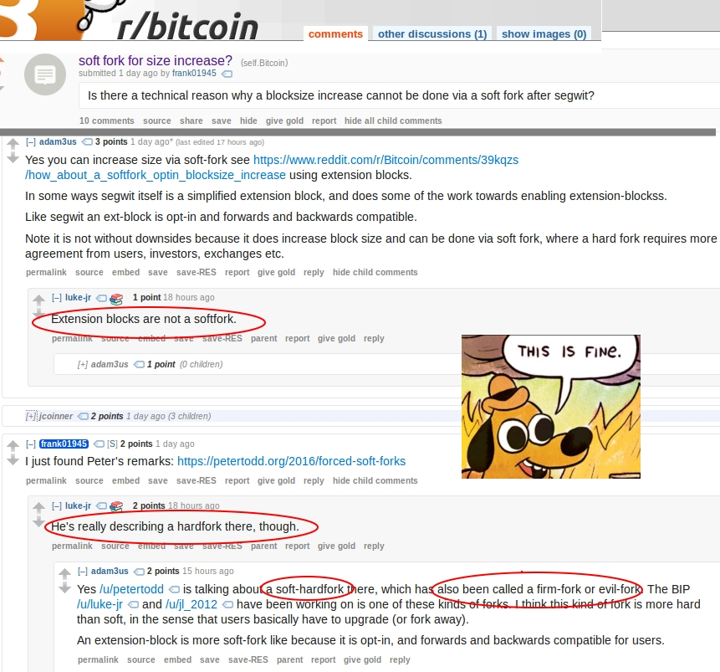
Even Adam Back and Luke Dashjr Disagree

Slide 12
Nov 2012 – Definitions

Slide 13
The Logic
A soft fork “will resolve itself”.
It will either collapse in the “use the new feature” direction, or...
... it will collapse in the “new feature is broken” direction.
If >50% hashrate upgrades to support a feature, then the fork will always resolve in the direction that supports the feature.
Rebel-blocks are always orphaned (it is as if they arrived too late).
Thus, a feature goes from being 0% safe, to 100% safe, on a defined date.
With hashrate-signaling, everyone can learn the exact date that the feature activates.
Very useful!

Slide 14
Governance
Part 2 of 3

Slide 15
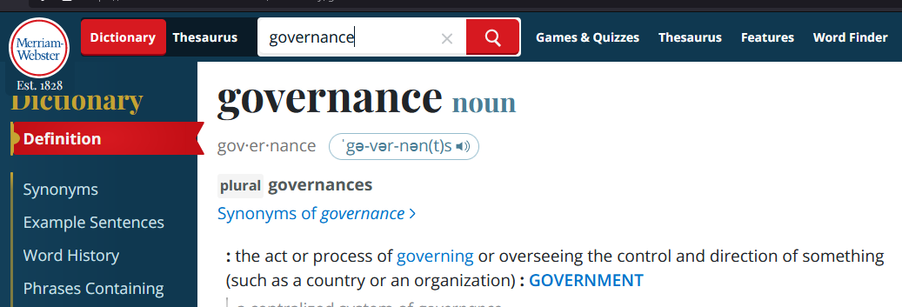
Governance – Definition

Slide 16
Governance – Definition
Rejects P2P

Slide 17
Governance – Definition
Rejects P2P
Too vague!! (There is no success criterion, no objective function.)

Slide 18
Governance = Finding today’s node software
Governance = where does the node software come from? What process?
In that sense, it is more like an industrial process, or recipe. (Eg, how do we build a bridge? How do we build the node software?)
Which code is fullnode-code?
How do we tell BItcoin Nodes from non-nodes?
If there is a dispute, then who is correct (and who is wrong)? Why?
In other words, Governance is:
The problem of meta-consensus ; consensus about consensus. (A full node does consensus, but only after you find the node software and run it!)
Or, call it “pre-consensus”. How do find the consensus software.
If you didn’t have a node, how would you get one?
I will call this: “Node Constructor-Theory”
Governance
Problem: What is today’s node software ? → I know how to find it!

Slide 19
NodeFinding Strategies – The Big 3
Go to Bitcoin.org and Run The Latest Version
Luke Dashjr Position
Mike Hearn position as well!
Satoshi’s position, (?) repudiated when he removed OP VER.
Find the oldest node-like thing, run that, then plug your ears!
Never revisit this process. The relative costs and benefits – the node software does consensus pretty well, meta-consensus is much harder to do. Be mistrustful of this.
Mircea Popescu’s “Bitcoin Foundation” – 0.5.4 (2014)
The “original” is the full node. Everything later is a *distortion*. Everything afterwards is ...wargames for a bait-and-switch.
Soft Fork “Pluralism”
Soft fork means that different pieces of software can coexist
Anything in the “Line of Coexistance” is fair game!
“Latest Core”
“Static” Protocol
“Linear Coexistence” (Consent-Based)

Slide 20
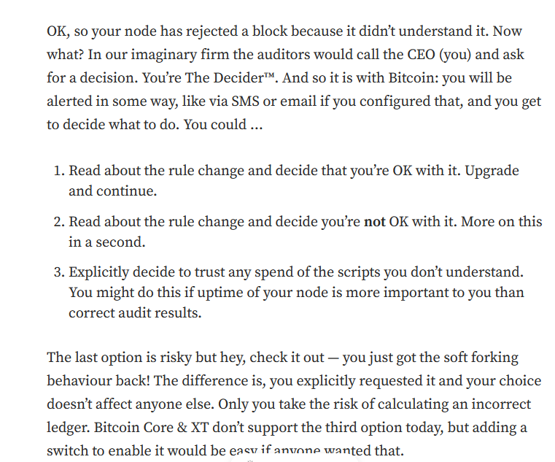
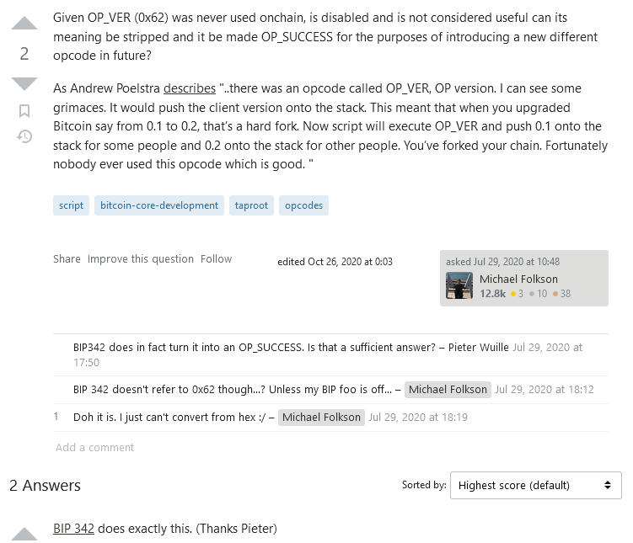
Mike Hearn
Satoshi – OP VER
https://medium.com/@octskyward/on-consensus-and-forks-c6a050c792e7
https://bitcoin.stackexchange.com/questions/97258/given-op-ver-was-never-used-is-disabled-and-not-considered-useful-can-its-meani

Slide 21
NodeFinding Strategies – The Big 3
Go to Bitcoin.org and Run The Latest Version
Luke Dashjr Position
Mike Hearn position as well!
Satoshi’s position, (?) repudiated when he removed OP VER.
Find the oldest node-like thing, run that, then plug your ears!
Never revisit this process. The relative costs and benefits – the node software does consensus pretty well, meta-consensus is much harder to do. Be mistrustful of this.
Mircea Popescu’s “Bitcoin Foundation” – 0.5.4 (2014)
The “original” is the full node. Everything later is a *distortion*. Everything afterwards is ...wargames for a bait-and-switch.
Soft Fork “Pluralism”
Soft fork means that different pieces of software can coexist
Anything in the “Line of Coexistance” is fair game!
“Latest Core”
“Static” Protocol
“Linear Coexistence” (Consent-Based)

Slide 22
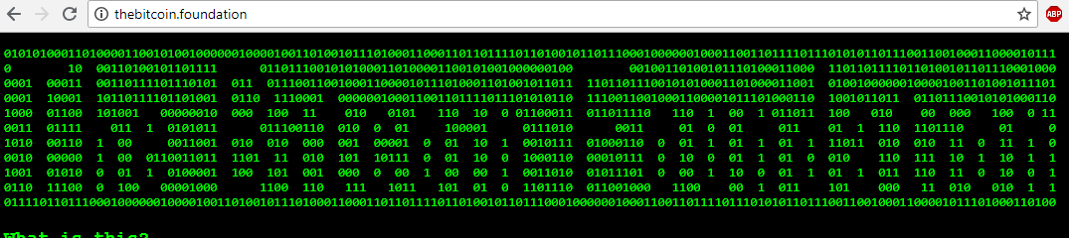
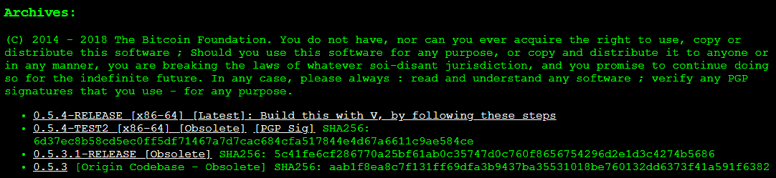
The “Static Protocol” Position
Bitcoin Foundation

Slide 23
NodeFinding Strategies – The Big 3
Go to Bitcoin.org and Run The Latest Version
Luke Dashjr Position
Mike Hearn position as well!
Satoshi’s position, (?) repudiated when he removed OP VER.
Find the oldest node-like thing, run that, then plug your ears!
Never revisit this process. The relative costs and benefits – the node software does consensus pretty well, meta-consensus is much harder to do. Be mistrustful of this.
Mircea Popescu’s “Bitcoin Foundation” – 0.5.4 (2014)
The “original” is the full node. Everything later is a *distortion*. Everything afterwards is ...wargames for a bait-and-switch.
Soft Fork “Pluralism”
Soft fork means that different pieces of software can coexist
Anything in the “Line of Coexistance” is fair game!
“Latest Core”
“Static” Protocol
“Linear Coexistence” (Consent-Based)

Slide 24
Upgrading via Soft Fork
“line” of protocols that are all compatible with each other
Bitcoin 0.5.0
Compatibility
Bitcoin 0.6.0
Bitcoin 0.7.0

Slide 25
Governance Strategies... And their Problems
 | Problem of Expertise | The Euthyphro Dilemma / Fallibilism | Problem of Innovation / “Dissent” | Social Attack / Charisma (Constant Vigilance Needed)
“Latest Core”
“Static” Protocol
“Linear Coexistence” (Consent-Based)

Slide 26
The Euthyphro Dilemma
Bitcoin.org can tell us that some software is “Bitcoin”
God tell us something is good...
God’s opinion is the only opinion Divine Command Theory
God is a professor / advisor who knows more about morality than us
We could have learned morality without His help. He merely sped us up.
We can’t learn morality without God’s instructions... But...
...God can change his mind.
...we can later learn that we misunderstood God.

Slide 27
The Euthyphro Dilemma
Bitcoin.org can tell us that some software is “Bitcoin”
God tell us something is good...
God’s opinion is the only opinion Divine Command Theory
God is a professor / advisor who knows more about morality than us
Fallibilism
We could have learned morality without His help. He merely sped us up.
We can’t learn morality without God’s instructions... But...
...God can change his mind.
...we can later learn that we misunderstood God.

Slide 28
Governance Strategies... And their Problems
 | Problem of Expertise / Charisma Attack | The Euthyphro Dilemma / Fallibilism | Problem of Innovation / “Dissent”
“Latest Core” |  | Outsource Your Thinking to Bitcoin.org
“Static” Protocol |  | Stays the Same
“Linear Coexistence” (Consent-Based)

Slide 29
Governance Strategies... And their Problems
 | Problem of Expertise / Charisma Attack | The Euthyphro Dilemma / Fallibilism | Problem of Innovation / “Dissent”
“Latest Core” |  | Outsource Your Thinking to Bitcoin.org
“Static” Protocol |  | Stays the Same
“Linear Coexistence” (Consent-Based) |  | Allows Error-Correction

Slide 30
Expertise... is Mandatory!
Luke-Jr Position:
Must run latest version. Running old versions of the software is illegitimate!
Must ensure the version on Bitcoin.org is good, by participating in technical community.
Problems
Learning takes effort.
Impossible for everyone to be an expert!
Laypeople are important! But this view says: no laypeople allowed!
No accumulation of recognizability. Instead, continual effort needed.

Slide 31
Governance Strategies... And their Problems
 | Problem of Expertise / Charisma Attack | The Euthyphro Dilemma / Fallibilism | Problem of Innovation / “Dissent”
“Latest Core” | No Laypeople Allowed | Outsource Your Thinking to Bitcoin.org
“Static” Protocol | Accumulates Trust | Stays the Same
“Linear Coexistence” (Consent-Based) | Requires dispute-resolution | Allows Error-Correction

Slide 32
Two Incompatible SFs at once = HF
NOP 8 = Q
NOP 8
NOP 8 = T (!= Q)
Begins with a formally-defined “ignorable state”,
And ends with a formally defined “new state” that achieves consensus socially.

Slide 33
Upgrading via Soft Fork
“line” of protocols that are all compatible with each other
Bitcoin 0.5.0
Compatibility
Bitcoin 0.6.0
Bitcoin 0.7.0
Must be in order!

Slide 34

Bitcoiners Often Disagree
Carnivores vs Vegans
But also...
Bip9 vs Bip8
Lot=true vs false
Ordinals
US Regulation
...just about everything!

Slide 35
Governance Strategies... And their Problems
 | Problem of Expertise / Charisma Attack | The Euthyphro Dilemma / Fallibilism | Problem of Innovation / “Dissent”
“Latest Core” | No Laypeople Allowed | Outsource Your Thinking to Bitcoin.org
“Static” Protocol | Accumulates Trust | Stays the Same
“Linear Coexistence” (Consent-Based) | Requires dispute-resolution | Allows Error-Correction

Slide 36
Governance Strategies... And their Problems
 | Problem of Expertise / Charisma Attack | The Euthyphro Dilemma / Fallibilism | Problem of Innovation / “Dissent”
“Latest Core” | No Laypeople Allowed | Outsource Your Thinking to Bitcoin.org | Allows Innovation
“Static” Protocol | Accumulates Trust | Stays the Same | No Innovation Allowed
“Linear Coexistence” (Consent-Based) | Requires dispute-resolution | “Ratchet” –Resists Future Errors | Allows Most Innovation

Slide 37
Governance Strategies... And their Problems
 | Problem of Expertise / Charisma Attack | The Euthyphro Dilemma / Fallibilism | Problem of Innovation / “Dissent”
“Latest Core” | No Laypeople Allowed | Outsource Your Thinking to Bitcoin.org | Allows Innovation
“Static” Protocol | Accumulates Trust | Stays the Same | No Innovation Allowed
“Linear Coexistence” (Consent-Based) | Requires dispute-resolution | “Ratchet” –Resists Future Errors | Allows Most Innovation
The Sidechain Vision | Accumulates Trust | Actively Promotes Error-Correction | Allows Even Hardfork Style Innovation

Slide 38
Culture
Part 3 of 3

Slide 39
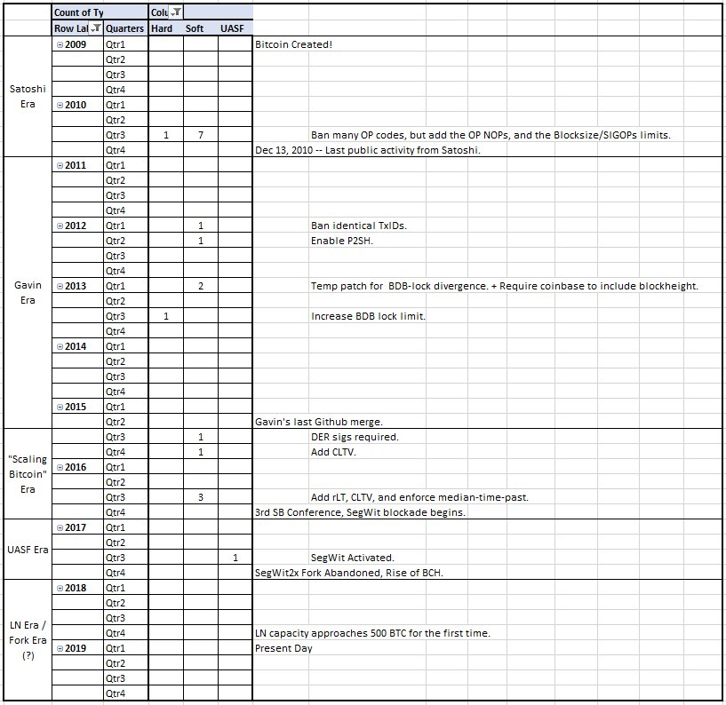
Soft Forks Over Time
(according to BitMex)

Slide 40
Bitcoin’s Ossification
Year | 2010 | 2011 | 2012 | 2013 | 2014 | 2015 | 2016
# of Soft Forks | 7 | 0 | 2 | 2 | 0 | 2 | 3
Taproot
Announced Jan 2018
Coded Oct 2020
Activated Nov 2021
16
Year | 2017 | 2018 | 2019 | 2020 | 2021 | 2022 | 2023
# of Soft Forks | 1 | 0 | 0 | 0 | 1 | 0 | 0 (Presumably)
2
SegWit
Announced Dec 2015
Coded Oct 2016
Activated Aug 2017
Taproot
Announced Jan 2018
Coded Oct 2020
Activated Nov 2021
20 Months
46 Months

Slide 41
New Soft Forks ??
Is there even still a process?
Segwit Trauma / PTSD
Unsolved mysteries of the Blocksize war
Why did people get hashrate support for a hard fork, when hashrate is irrelevant to a hard fork? I don’t know.
Miners signed a meaningless piece of paper backing the wrong side, but they never actually did anything. Yet still they feel guilty and unwilling to do further soft forks.
Ratio of Experts / Laypeople is plummeting. More Ls, harder to E.
Sour Grapes

Slide 42
New Soft Forks ??
Is there even still a process?
Segwit Trauma / PTSD
Unsolved mysteries of the Blocksize war
Why did people get hashrate support for a hard fork, when hashrate is irrelevant to a hard fork? I don’t know.
Miners signed a meaningless piece of paper backing the wrong side, but they never actually did anything. Yet still they feel guilty and unwilling to do further soft forks.
Ratio of Experts / Laypeople is plummeting. More Ls, harder to E.
Sour Grapes
The real reason....

Slide 43
The Real Reason...

Slide 44
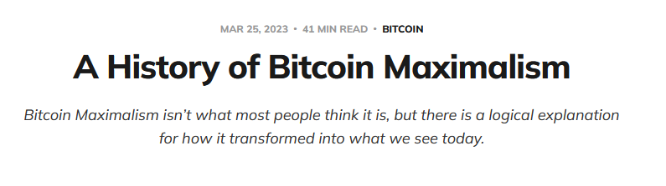
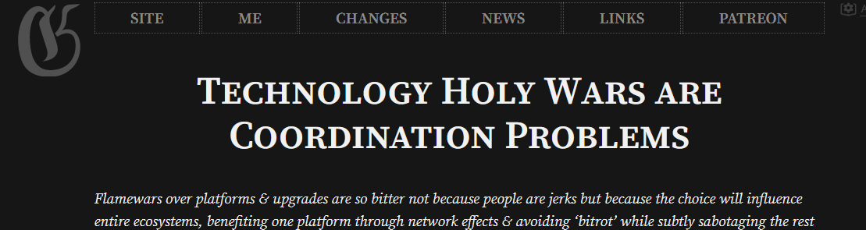
Jameson Lopp’s Article
Gwern’s Article

Slide 45
The End
About Me
Paul Sztorc, Founder and CEO, LayerTwo Labs – “Making every transaction on Earth, a Bitcoin Txn”
Sites: layertwolabs.com ; truthcoin.info ; bitcoinhivemind.com ; drivechain.info
Many essays, “Nothing is Cheaper Than Proof of Work”, “Measuring Decentralization”
Author of BIPs 300 and 301.
Twitter: @truthcoin ; Telegram: @psztorc
Questions?

