Slide 1
CUSF
Scale Bitcoin to 8 billion people
No changes to Bitcoin Core
Collect Billions in Txn Fees
OP NEXT Nov 9, 2024 Boston MA Paul Sztorc

Slide 2
Agenda
Background, Context – 15 mins
CUSF (the solution) – 5 mins
Q & A – 10 mins

Slide 3
My History
Scaling I, II, III (Sept 2015) → This conference (?)
“Truthcoin” (Dec 2013) → BitcoinHivemind.com → [other ppl] PolyMarket
“Measuring Decentralization” (Sept 2015) → “Drivechain” (Nov 2015) → BIP-300
“Sidechain Privatization” (Jun 2016) → Blind Merged Mining (Jan 2017) → BIP-301 → proposer-builder separation
“Win-Win Blocksize Solution” (July 2015) → “Fork Futures”
BitAssets (Jun 2018) → [other ppl] Ordinals , Coordinate , ERC20
“Better Fork Terminology” (Dec 2016) → MIT talk (2023) → CUSF (2024)

Slide 4
Fee Comparison
This diagram is to scale.
$640 billion (Earth’s 6.4 trillion txn
X $0.10 , 2022)
$128 million (fee revenue 2022)
$767 million (fee revenue 2023 – the ordinals year)
$3.0 billion (All-Altcoin Fee Revenue 2022)
12345678901234567890123456789012345678901234567890123456789012345678901

Slide 5



Non-Mined L2s vs Mined L2s
Non-Mined L2s
Mined L2s
$640 billion
L1
12345678901234567890123456789012345678901234567890123456789012345678901

Slide 6
The Coming L2 War
Instability
Conflict between L1 and L2
Incentives for Mining Centralization
Vertical integration – eg “Foundry Lighting – AntPool LSP”
Original L2 security model obsolete
L2 Revenue
L1 Revenue

Slide 7
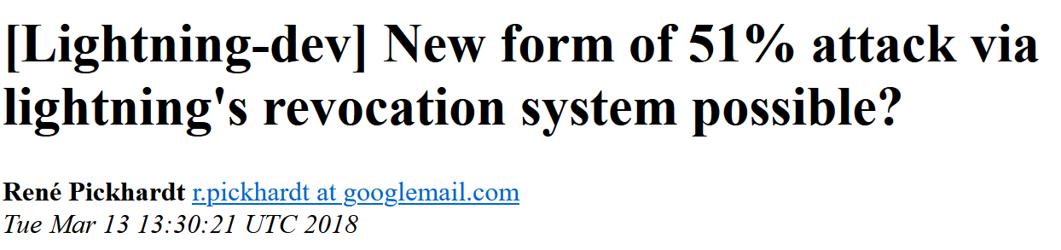
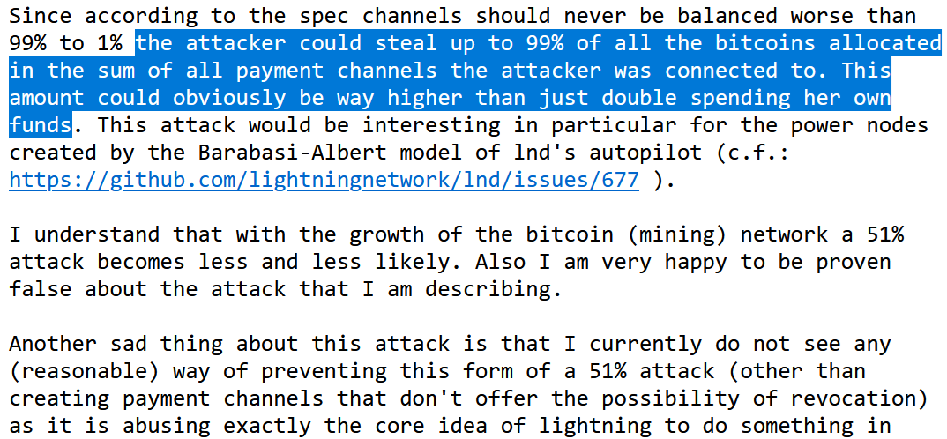
Every L2 is vulnerable to 51% attack by miners
onboard, offboard, and “justice” txns on L1 can all be censored

Slide 8
Centralization Advantage
Lightning “LSP” backed by large hashrate
Other LSPs cannot compete
Eventually: all LSPs are backed by large pools
L2 Revenue (Now MEV)
L1 Revenue

Slide 9
Non-Mined L2s vs Mined L2s
Non-Mined L2s
Mined L2s
$640 billion
L1
12345678901234567890123456789012345678901234567890123456789012345678901

Slide 10
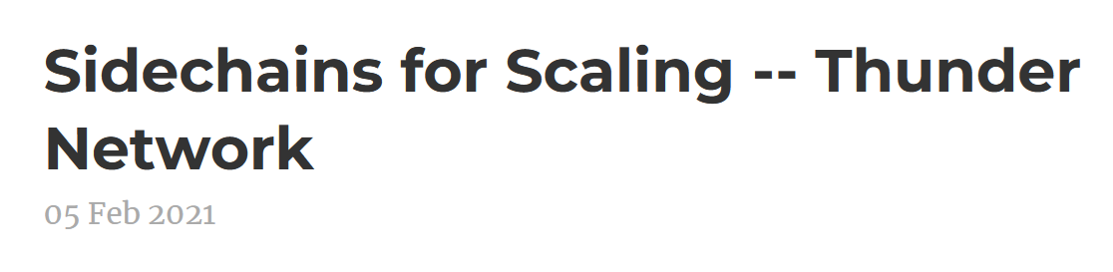
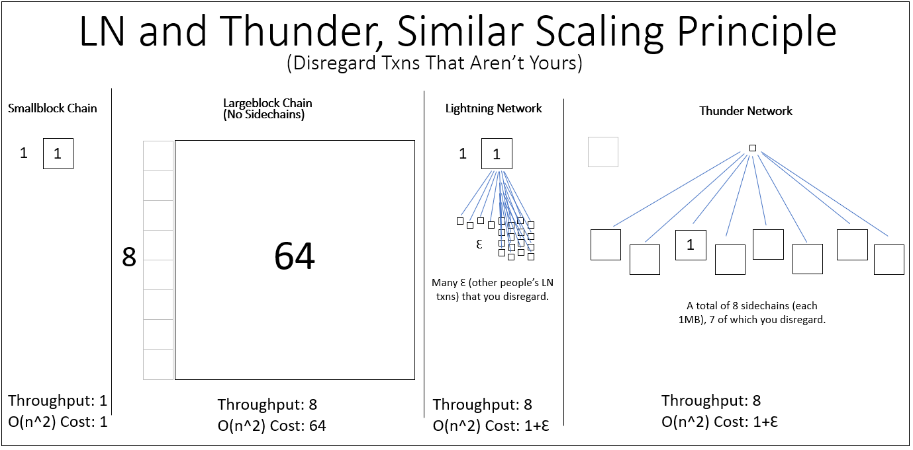
My Proposal 13-13

Slide 11

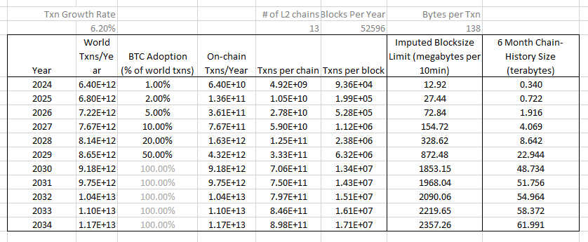

Slide 12
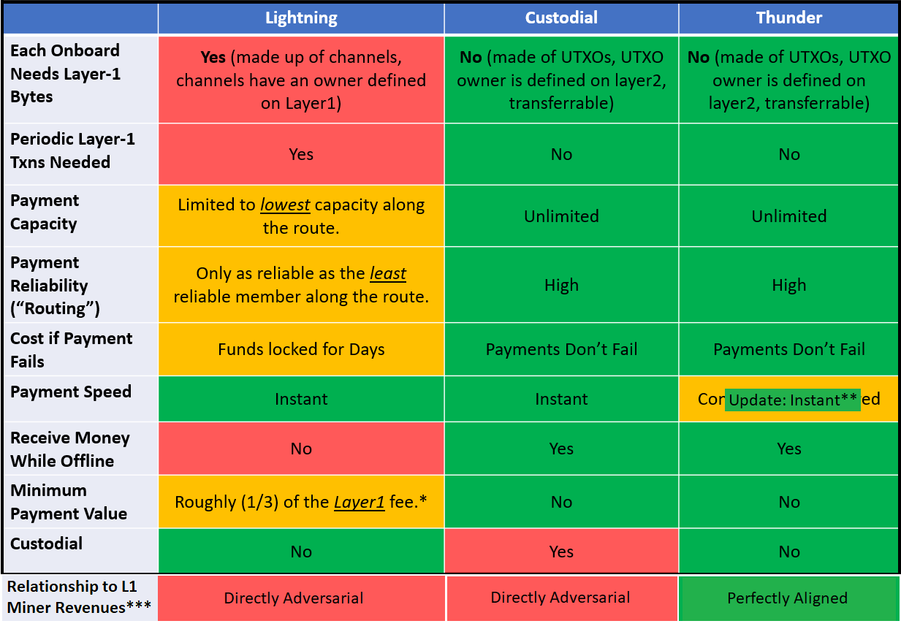
Advantages

Slide 13
Advantages

Slide 14
Advantages
+ Fast Cashouts from Pools to Hashers
+ Does not require changes to Bitcoin Core (but does require CUSF)

Slide 15
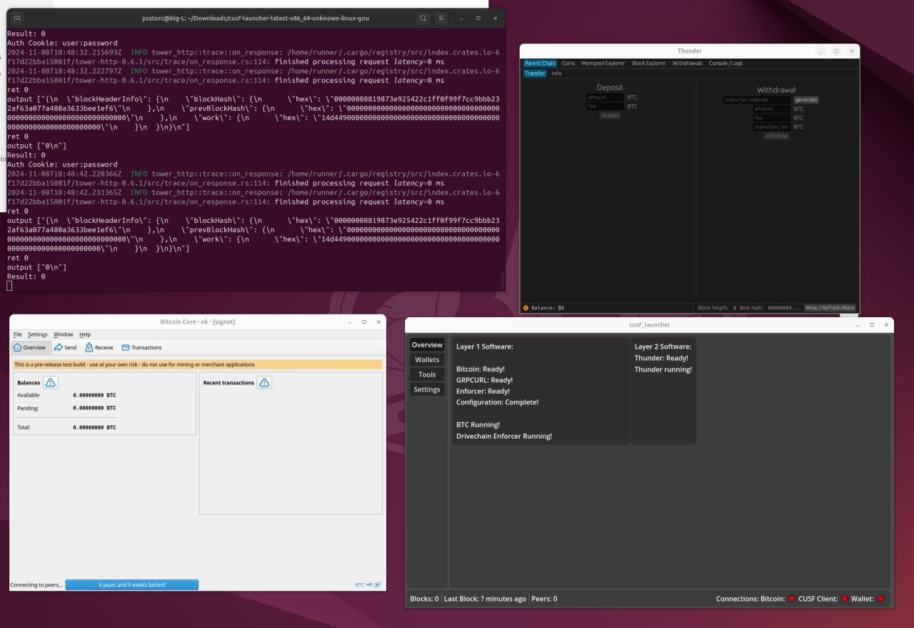

Slide 16
CUSF Core Untouched Soft Fork “Ordinal-ization” of Soft Forks (The Solution to everyone’s problems)
Part 2 of 3

Slide 17
Bitcoin’s Ossification
original source code & edit history are mostly lost
Year | 2009 | 2010 | 2011 | 2012 | 2013 | 2014 | 2015 | 2016
# of Soft Forks | 0* | 7 | 0 | 2 | 2 | 0 | 2 | 3
16
Year | 2017 | 2018 | 2019 | 2020 | 2021 | 2022 | 2023 | 2024
# of Soft Forks | 1 | 0 | 0 | 0 | 1 | 0 | 0 | 0 (Presumably)
2
SegWit
Announced Dec 2015
Coded Oct 2016
Activated Aug 2017
Taproot
Announced Jan 2018
Coded Oct 2020
Activated Nov 2021
20 Months
46 Months

Slide 18
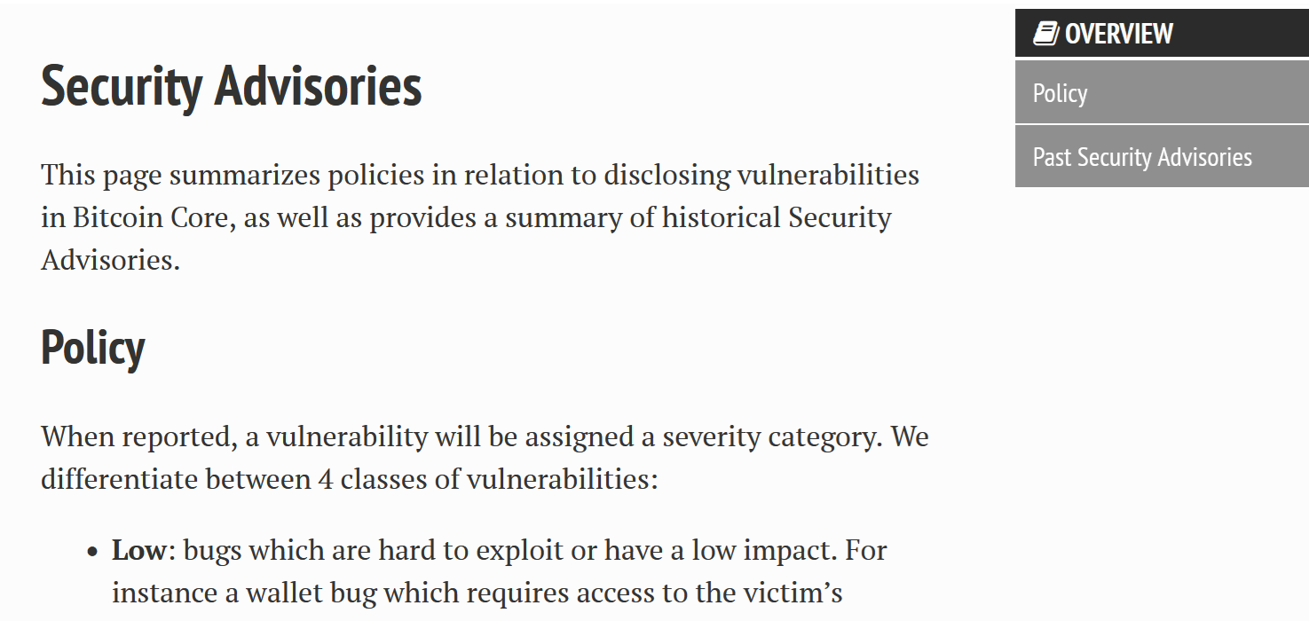
Roadblock 2: You can’t leave.

Slide 19
Two Roadblocks
Bitcoin Core doesn’t work anymore – (for soft forks).
You can’t leave Bitcoin Core.
Solution: Keep Core unchanged – add a 2nd “activator” software.
- Takes blocks from Bitcoin Core, and gives them a “second pass”.
- Calls `invalidateblock` in Bitcoin Core if new rulebreaking.
Benefits:
Faster
Safer
Easier to Understand

Slide 20
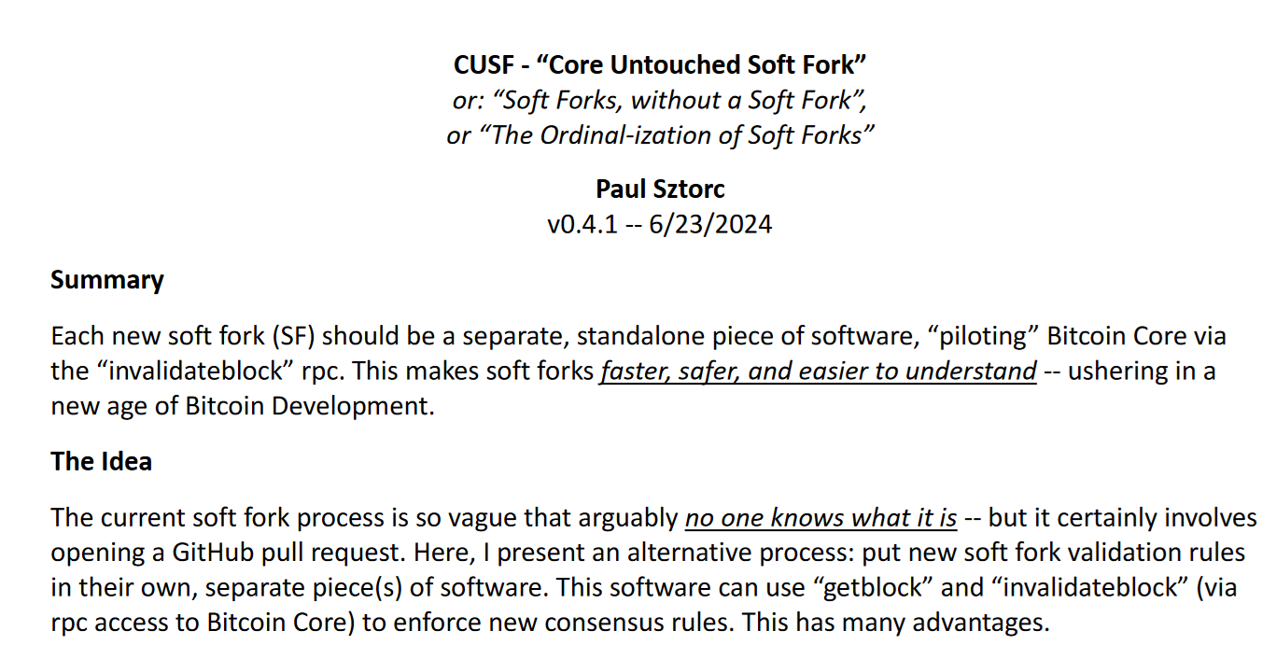
Paper at: https://bip300cusf.com

Slide 21
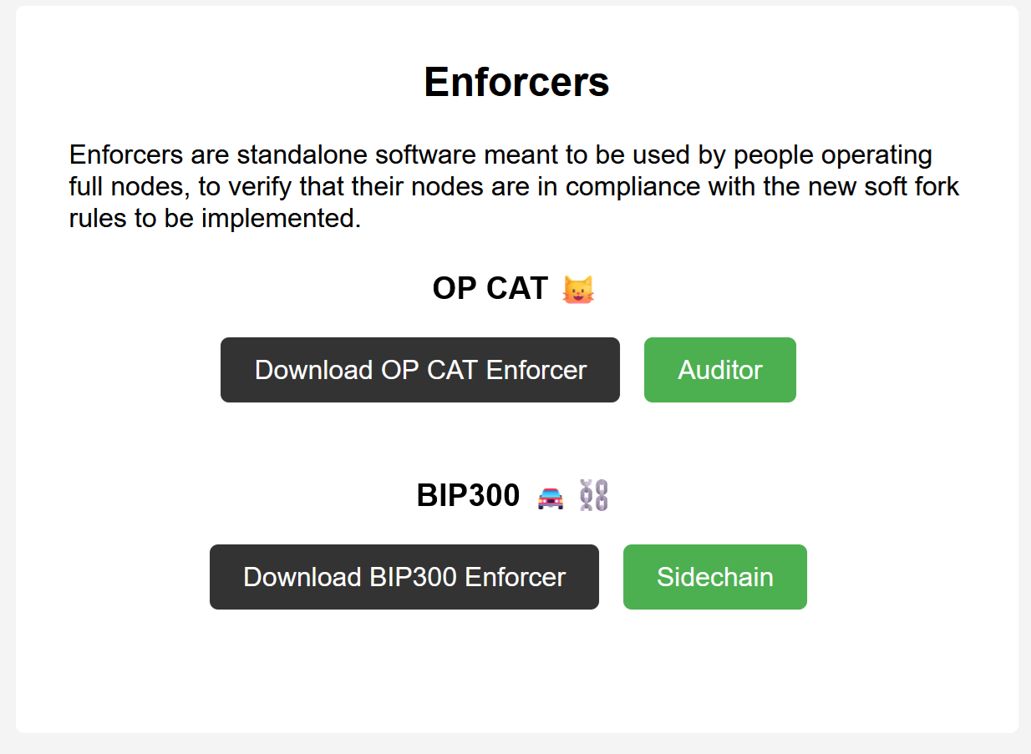
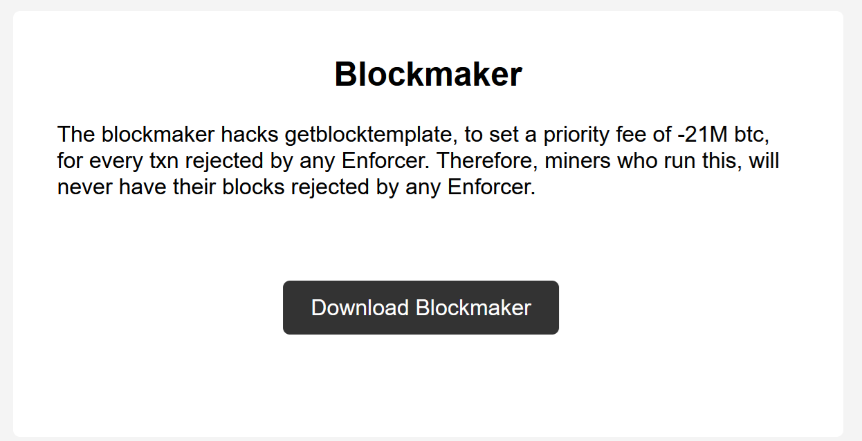
Download Today – OP CAT & BIP300
bip300cusf.com/download
(This is one easy way of solving all of our soft fork problems.)

Slide 22
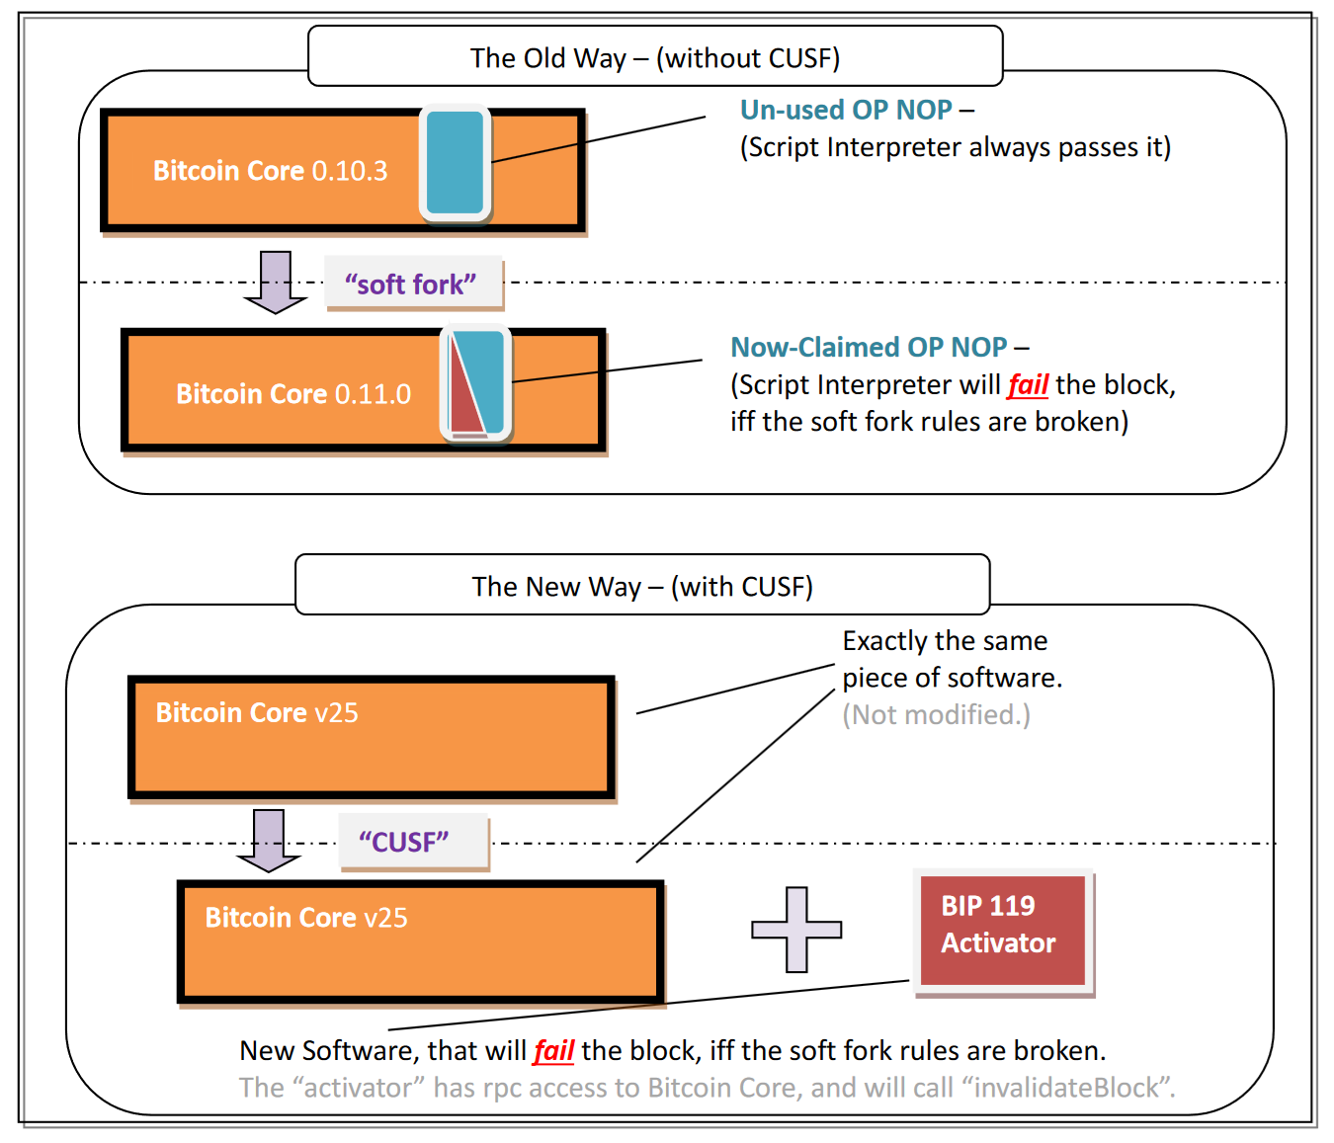
Same effect
But two software daemons
Two RPC servers
“Inefficient” for computer – 2x as much work
But “separable” at the human level – socially scalable.
Simple change, many advantages

Slide 23
My Proposal Is…
Miners run the Bip300 CUSF activator, (Bitcoin Core continues to do nothing).
Once 51% hashrate runs the CUSF addon, Bip300 activates.
Miners activate the Mined-L2s, (13-13) and collect $$ from them.
Problem solved! (Bitcoin gets scalability & privacy & extensibility & security budget & ossification)

Slide 24
The Alternative Plan
Take the same people, who for years were overoptimistic about the viability of Lightning…
…give them money, & wait more years, for them to finish ARK….
…something that is way worse, for the user, for no reason (more interactivity requirements, a liquidity rental cost, more complexity)…
…something which may not work at all (which is very likely, given the track record of LN, CoinPool, channel factories)…
…such that, even if it did work, miners would get none of the money , leading to conflict , eventual vertical integration, and MEV off-the-charts (as miners pursue their self-interest, of fee-collection)…
…leading to a total collapse of the original security model anyway (which is of course not designed to withstand Miners-as-sole counterparty), making all the tech effort pointless…
…with the added risk that, if it takes too long to implement, then the whole Bitcoin project might be replaced , and fail and go to zero.

Slide 25
The Alternative Plan
Take the same people, who for years were overoptimistic about the viability of Lightning…
…give them money, & wait more years, for them to finish ARK….
…something that is way worse, for the user, for no reason (more interactivity requirements, a liquidity rental cost, more complexity)…
…something which may not work at all (which is very likely, given the track record of LN, CoinPool, channel factories)…
…such that, even if it did work, miners would get none of the money , leading to conflict , eventual vertical integration, and MEV off-the-charts (as miners pursue their self-interest, of fee-collection)…
…leading to a total collapse of the original security model anyway (which is of course not designed to withstand Miners-as-sole counterparty), making all the tech effort pointless…
…with the added risk that, if it takes too long to implement, then the whole Bitcoin project might be replaced , and fail and go to zero.

Slide 26
More About CUSF

Slide 27
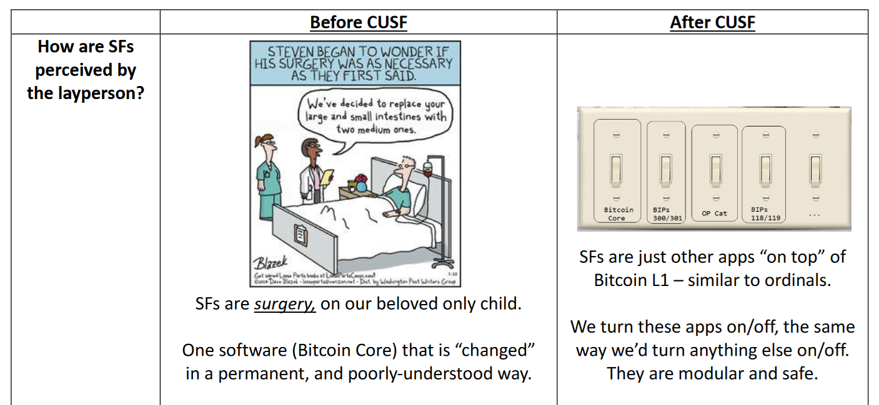

Slide 28
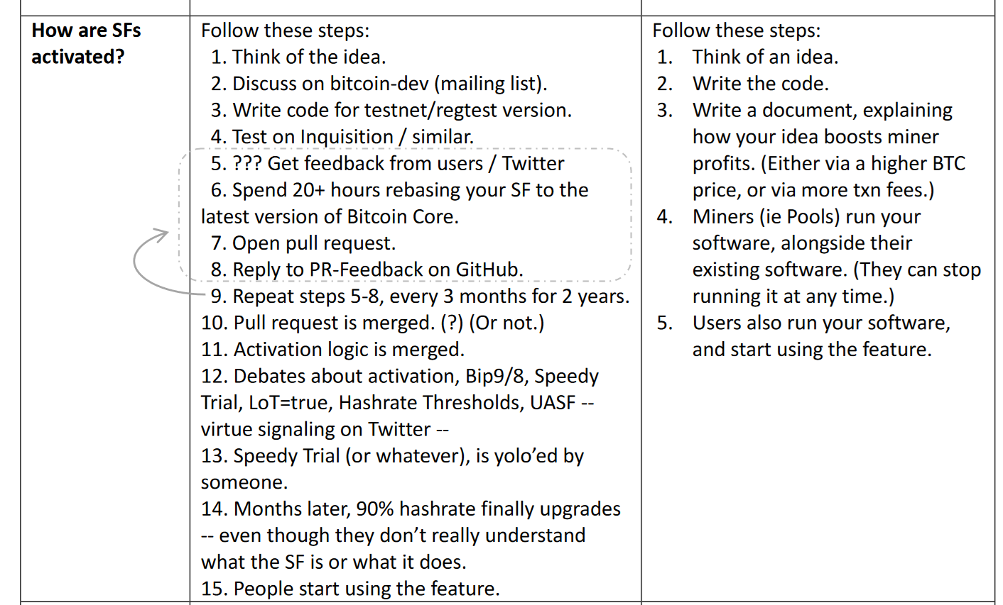

Slide 29
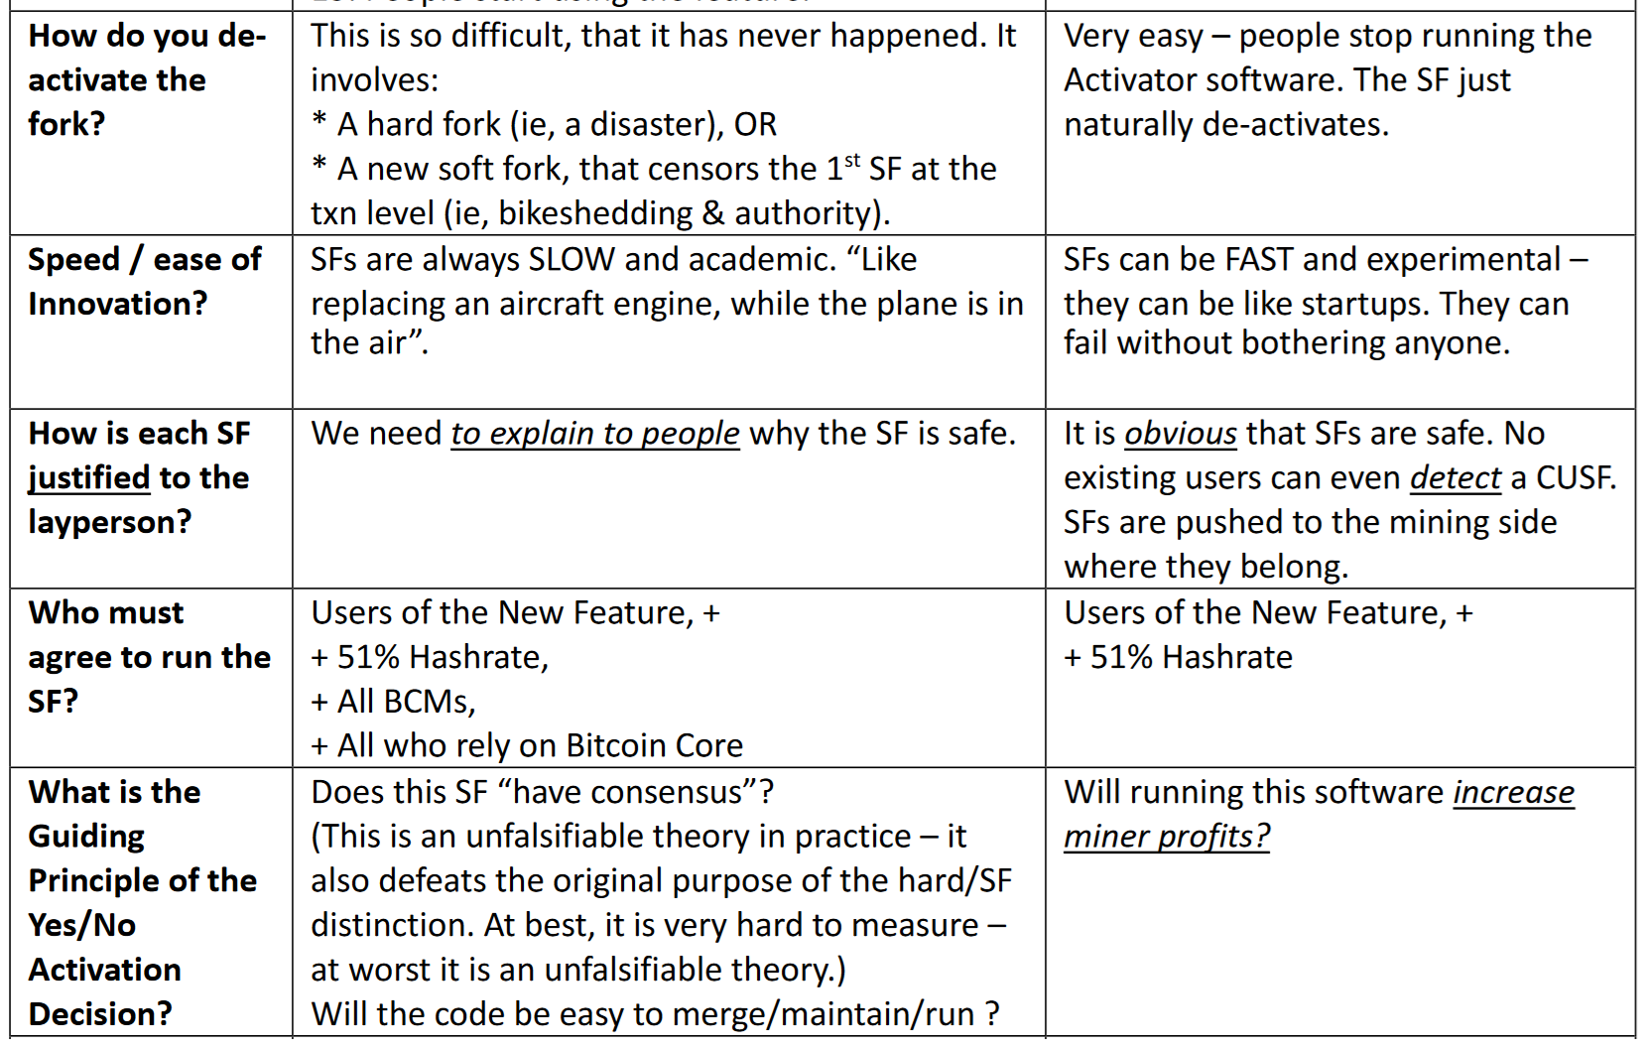

Slide 30
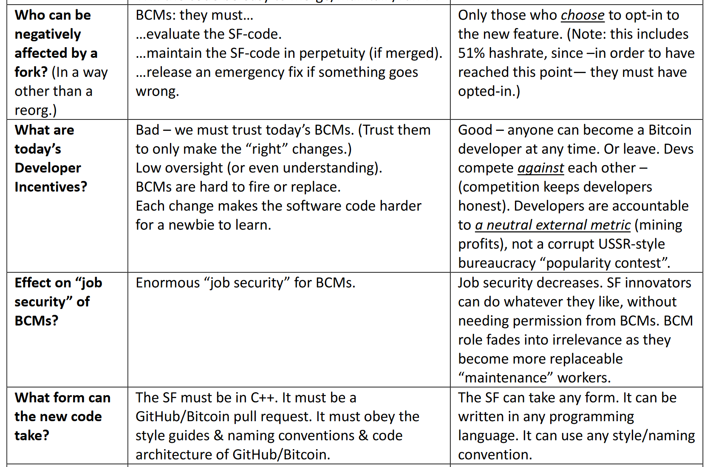

Slide 31
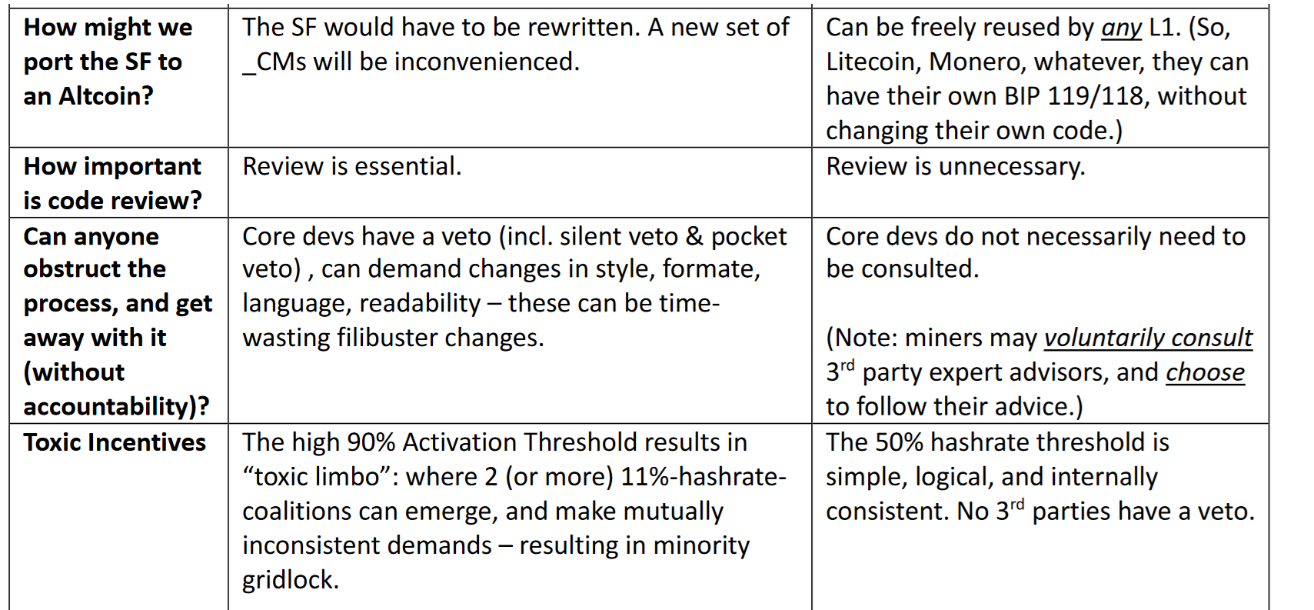

Slide 32
Yet More Slides

Slide 33
Conflicts of Interest
People’s reputation, business model riding on various projects, so -- consciously or not, they will be biased in their assessment.
 | Miners | Investors | Developers | Users
Miners |  | Liquidity-vs-Illiquidity Hype-vs-Substance Volatility-vs-Stability | Non-mined L2s (LN, ARK, BitVM, Liquid) / “middlemen schemes” (taking fees from miners). vs Merged Mining | High Total Fees vs Low $/txn feerate
Investors |  | - | Developer “Pet Project” Lock-In, Monopolist Guilds, vs Improving Coin Competitiveness | Number Go Up vs Day to Day Usage
Developers |  |  | - | Complex Impressive Whitepapers, Backends vs Great UX, Nice Features, Frontends
Users

Slide 34
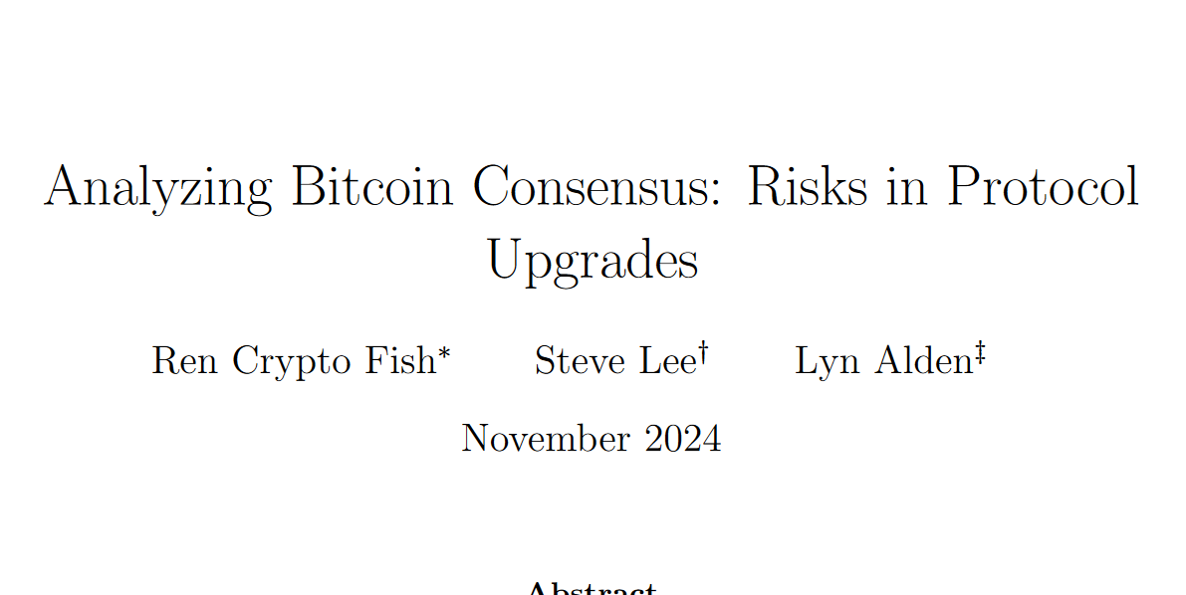
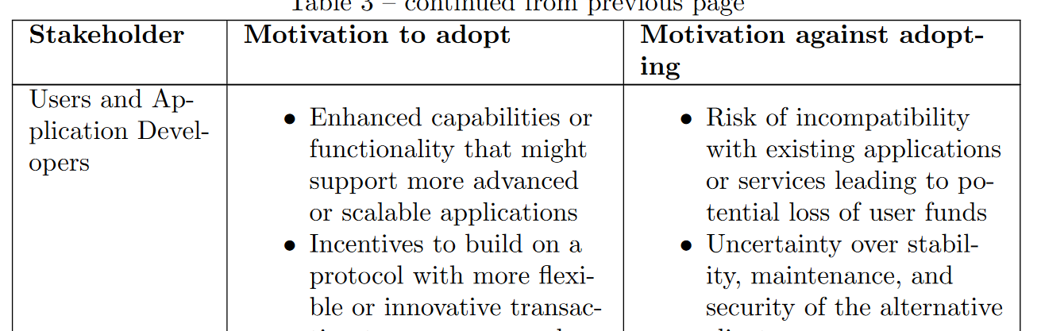
“Motivation to Adopt” a Soft Fork

Slide 35
“Motivation to Adopt” a Soft Fork
Full Throttle Innovation + Adoption
Complacency & Laziness
Bitcoin Survives
→ 15 M$/coin
X00 B $/year fees
Bitcoin Dies
(something else becomes global money) Btc price & fees → 0

Slide 36
Problem
Adoption
Blockchain tech is improving fast.
99% of new projects are scams – but this has blinded people to the true pace of progress.
In 3-5 years, it will be possible for anyone to launch a new coin that is [1] globally scalable, [2] fully private, [3] capable of replacing fiat payment systems, all on [4] layperson hardware/internet.
After that, only network effects will matter. Whichever coin innovates most on adoption will then win.
Soon (probably by 2035), only one currency will remain. BTC will either go to $200T, or $0.
Innovation & adoption will either make, or break, BTC.
Innovation
Innovation created Bitcoin – so, it could create something better, any day now!
Innovation is unpredictable – no one predicted the invention of Bitcoin ...the next great idea will also be a surprise.
... is hard to assess. For every genius inventor, there are 500 frauds and cranks.
... is always a risk. Every improvement is a change – it could therefore, instead be a mistake, an attack vector, or sabotage.
... is always a dissent from a prevailing orthodoxy. Most cypherpunks / Austrians hated Bitcoin at first – all good new ideas will be hated by Bitcoiners at first.
... always reorders status in a community. Better scaling would put Lightning out of business, better privacy would put CoinJoin out of business, improved self-custody would put BitGo out of business. Better UX puts educators out of business, etc. These are natural enemies of innovation. Innovation never has consensus.

Slide 37
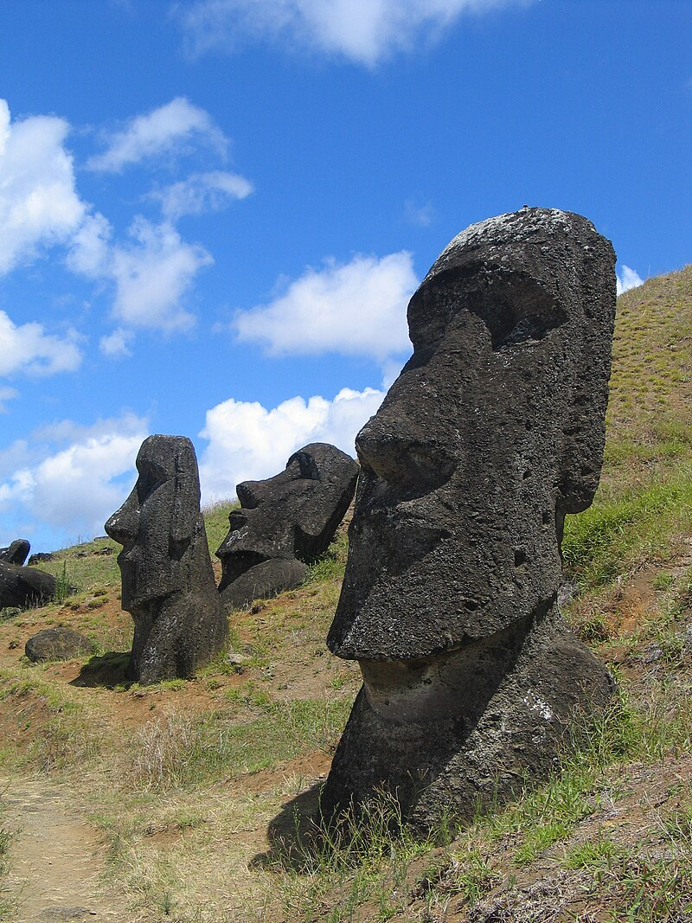

The Hubris of Complacency
“[Easter Islanders] may have arrived on the island as early as the fifth century CE. They developed a complex Stone Age civilization, which suddenly collapsed over a millennium later. By some accounts there was starvation, war and perhaps cannibalism. The population fell to a small fraction of what it had been, and their culture was lost. The prevailing theory is that the Easter Islanders brought disaster upon themselves, in part by chopping down the forest which had originally covered most of the island. They eliminated the most useful species of tree altogether. … Of the hundreds of statues on the island, built over the course of several centuries, fewer than half are at their intended destinations. The rest, including the largest, are in various stages of completion, with as many as 10% already in transit on specially built roads. Again there are conflicting explanations, but, according to the prevailing theory, it is because there was a large increase in the rate of statue-building just before it stopped for ever. In other words, as disaster loomed, the islanders diverted ever more effort not into addressing the problem – for they did not know how to do that – but into making ever more and bigger (but very rarely better) monuments to their ancestors. And what were those roads made of? Trees.” -David Deutsch, The Beginning of Infinity
“Wrong Solution” Feedback Loop More Problems → More Statues

Slide 38
Things Which Are Inevitable
Planetary Scale Tech Stack – one cryptocurrency will be able to process trillion txns/year. This has already happened – theory in 2021 and is happening now in practice.
Coins Adopt This Tech Stack – Desperate for market share / selling points, Altcoins will install this tech stack.
Pro-Adoption Coin Takes Over – One coin will prioritize adoption, and it will slowly gain network effect. Will hit various “critical mass” points and achieve super-exponential growth.
That coin will process all the world’s txns – x trillion, $0.10 /txn, their miners will collect X00 B per year, growing 6% per year.
Probably, all other coins will die off at that point.

Slide 39
Mistaken Beliefs About Soft Forks
Wrong | Truth
Soft forks are a change, and every change is a risk | Soft forks are NOT a change (the old protocol survives), Soft forks can always be undone later, with a 2nd soft fork
We need to limit what people can do with Bitcoin, to protect it, as we protected the Blocksize limit. | Adoption and innovation will make or break BTC. If adoption is too slow, BTC will go to zero. To protect Bitcoin, we need to limit hard forks. Not soft forks.
Miners should not get involved in technical matters. | Miners have the most $ at stake, and have the most illiquid position. Miners stand to gain/lose the most from Bitcoin’s success. Miners are like the parent , of a child – devs are like the child’s friends or teachers – possibly good, possibly sinister.
Miners screwed up | Miner’s neglect has already caused enormous damage to Bitcoin, which unfortunately continues to this day.
 | Miners stand to gain billions or even trillions of dollars if Bitcoin is a success.

Slide 40
Soft Forks Basics/History
Part 1 of 4

Slide 41
Soft Forks – The Basics
Soft vs Hard
“Tighten Rules” vs “Loosen Rules”
Optional Discretionary Upgrade vs Immediate Mandatory Upgrade
Notable Soft Forks
Aug 2010 – Disable a bunch of opcodes
Sep 2010 – Limit blocksize to 1 MB
Apr 2012 – Add P2SH
Dec 2015 – Add CLTV
Aug 2017 – Add SegWit
Infamous Attempted Hard Forks
2015 – Raise the Blocksize Limit (BitcoinXT / Bitcoin Classic / etc)
2017 – SegWit2x
2017 – BCH (which became its own community)

Slide 42
Some History – Not Widely Known
Gavin Called Them “Soft Changes” (June 2012)
“Changes” is a better term – “Fork” is a bad term.
How the “Soft Fork” Term created (Nov 2012)
And why it’s actually good.
The Logic Behind It All

Slide 43
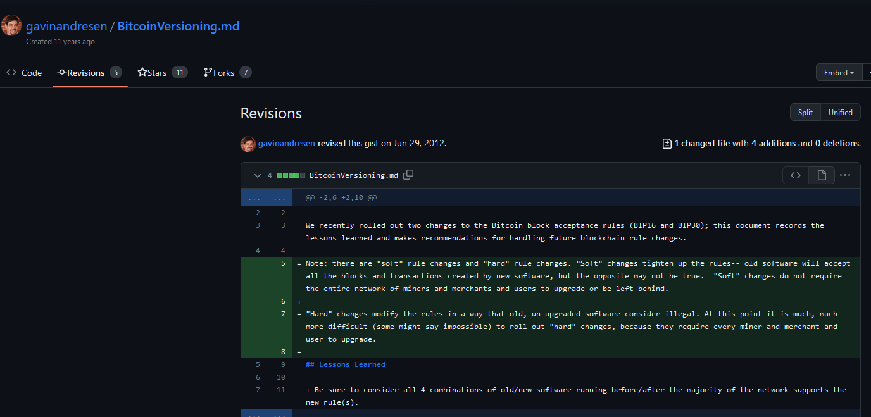
Gavin Called them “Soft Changes”

Slide 44
Gavin Called them “Soft Changes”
Forbidden, on grounds of impracticality

Slide 45
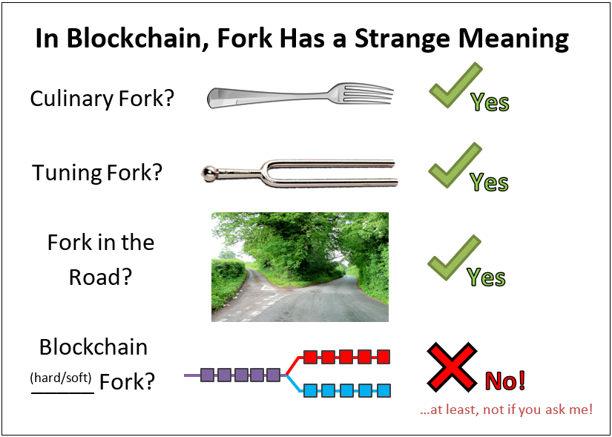

Slide 46
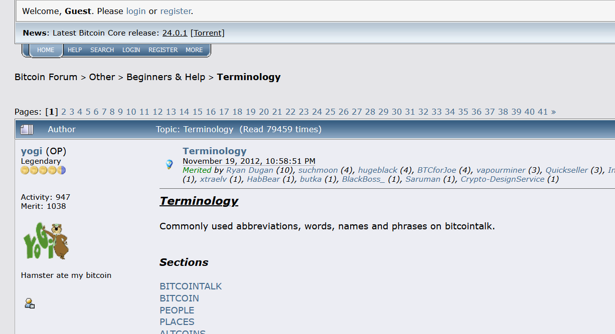
Nov 2012 Definitions
Nov 2012 – Definitions

Slide 47
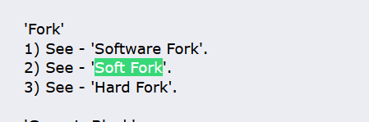
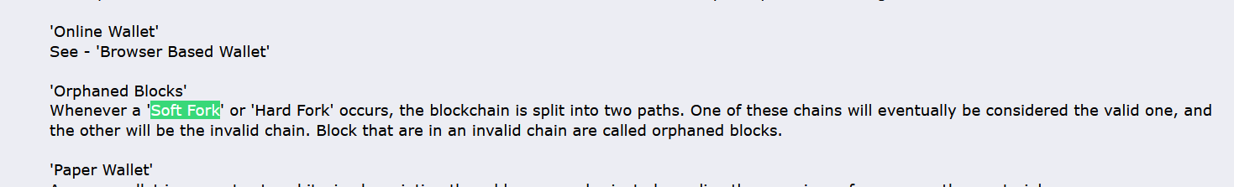
Nov 2012 – Definitions

Slide 48
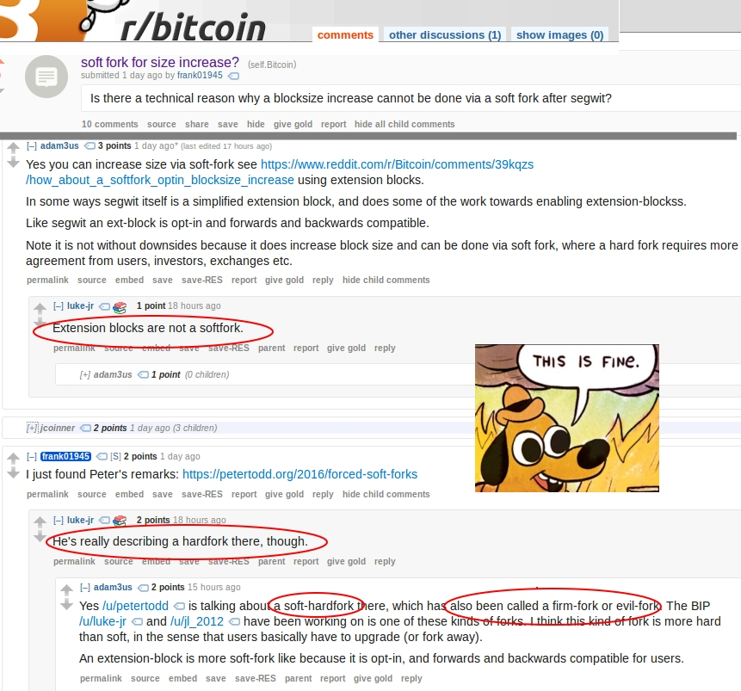
Even Adam Back and Luke Dashjr Disagree

Slide 49
Nov 2012 – Definitions

Slide 50
The Logic (historic)
A soft fork “will resolve itself”.
It will either collapse in the “use the new feature” direction, or...
... it will collapse in the “new feature is broken” direction.
If >50% hashrate upgrades to support a feature, then the fork will always resolve in the direction that supports the feature.
Rebel-blocks are always orphaned (it is as if they arrived too late).
Thus, a feature goes from being 0% safe, to 100% safe, on a defined date.
With hashrate-signaling, everyone can learn the exact date that the feature activates.
Very useful!
…paired with “blank” anyone-can-spend OP NOP

Slide 51
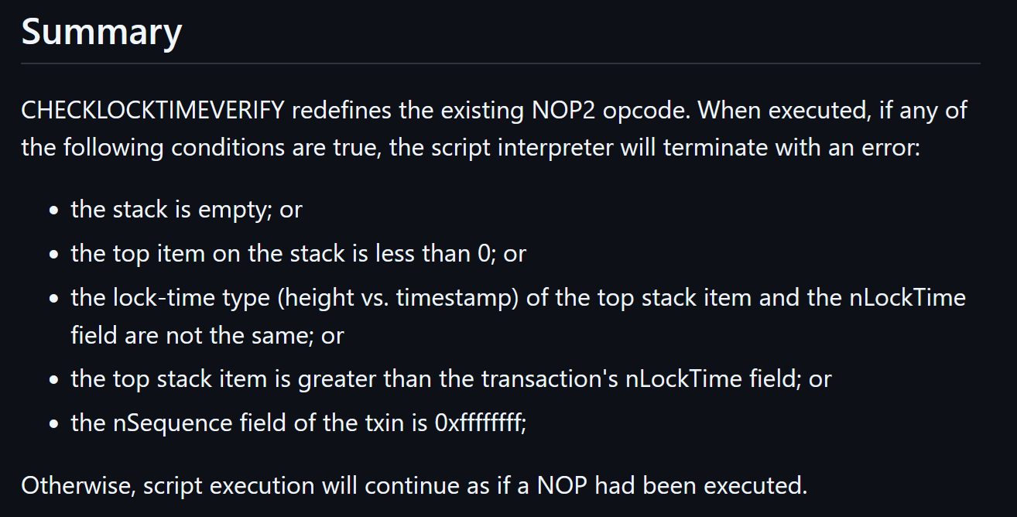
A concise soft fork
Default behavior = allow the txn

Slide 52
Soft Forks and Protocol Governance
Part 2 of 4

Slide 53
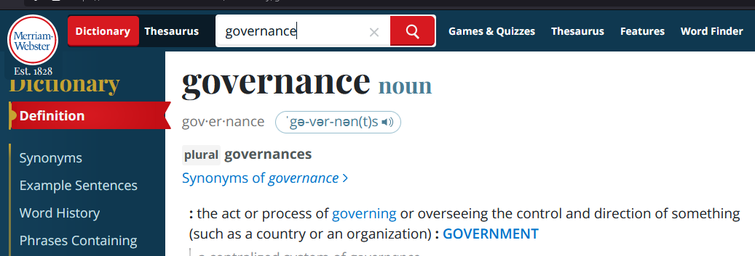
Governance – Definition

Slide 54
Governance – Definition
Rejects P2P

Slide 55
Governance – Definition
Rejects P2P
Too vague!! (There is no success criterion, no objective function.)

Slide 56
Governance = Finding today’s node software
Governance = where does the node software come from? What process?
In that sense, it is more like an industrial process, or recipe. (Eg, how do we build a bridge? How do we build the node software?)
Which code is fullnode-code?
How do we tell Bitcoin Nodes from non-nodes?
If there is a dispute, then who is correct (and who is wrong)? Why?
In other words, Governance is:
The problem of meta-consensus ; consensus about consensus. (A full node does consensus, but only after you find the node software and run it!)
Or, call it “pre-consensus”. How do find the consensus software.
If you didn’t have a node, how would you get one?
I will call this: “Node Constructor-Theory”
Governance
Problem: What is today’s node software ? → I know how to find it!

Slide 57
NodeFinding Strategies – The Big 3
Go to Bitcoin.org and Run The Latest Version
Luke Dashjr Position
Mike Hearn position as well!
Satoshi’s position, (?) repudiated when he removed OP VER.
Find the oldest node-like thing, run that, then plug your ears!
Never revisit this process. The relative costs and benefits – the node software does consensus pretty well, meta-consensus is much harder to do. Be mistrustful of this.
Mircea Popescu’s “Bitcoin Foundation” – 0.5.4 (2014)
The “original” is the full node. Everything later is a *distortion*. Everything afterwards is ...wargames for a bait-and-switch.
Soft Fork “Pluralism”
Soft fork means that different pieces of software can coexist
Anything in the “Line of Coexistance” is fair game!
“Latest Core”
“Static” Protocol
“Linear Coexistence” (Consent-Based)

Slide 58
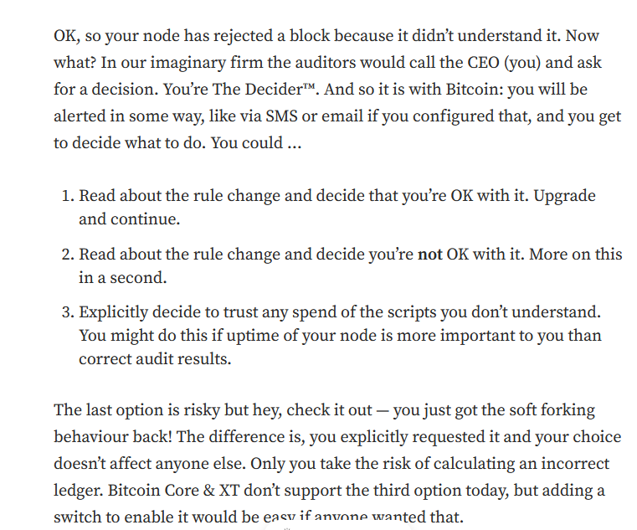
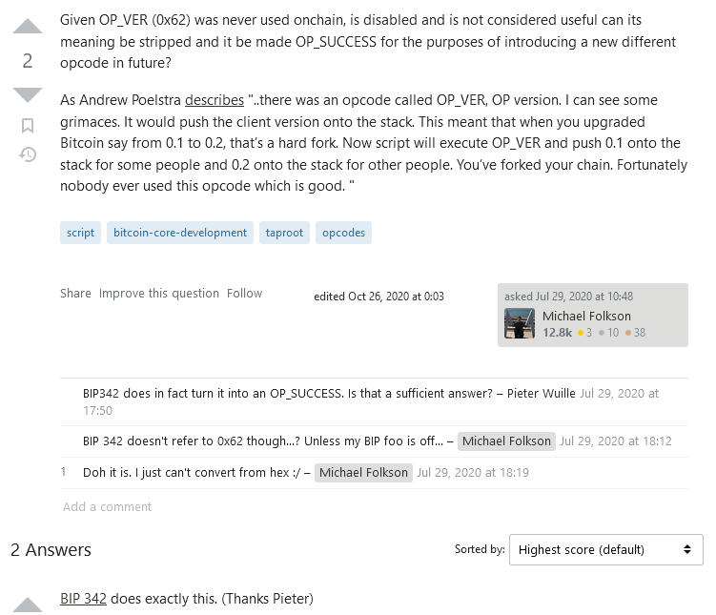
Mike Hearn
Satoshi – OP VER
https://medium.com/@octskyward/on-consensus-and-forks-c6a050c792e7
https://bitcoin.stackexchange.com/questions/97258/given-op-ver-was-never-used-is-disabled-and-not-considered-useful-can-its-meani

Slide 59
NodeFinding Strategies – The Big 3
Go to Bitcoin.org and Run The Latest Version
Luke Dashjr Position
Mike Hearn position as well!
Satoshi’s position, (?) repudiated when he removed OP VER.
Find the oldest node-like thing, run that, then plug your ears!
Never revisit this process. The relative costs and benefits – the node software does consensus pretty well, meta-consensus is much harder to do. Be mistrustful of this.
Mircea Popescu’s “Bitcoin Foundation” – 0.5.4 (2014)
The “original” is the full node. Everything later is a *distortion*. Everything afterwards is ...wargames for a bait-and-switch.
Soft Fork “Pluralism”
Soft fork means that different pieces of software can coexist
Anything in the “Line of Coexistance” is fair game!
“Latest Core”
“Static” Protocol
“Linear Coexistence” (Consent-Based)

Slide 60
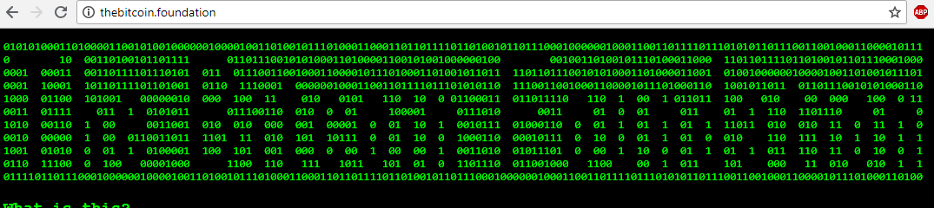
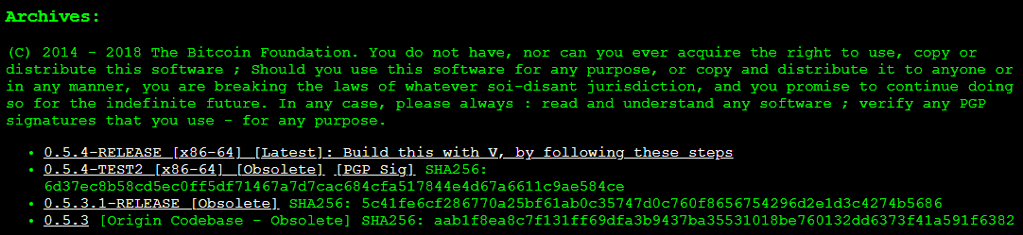
The “Static Protocol” Position
Bitcoin Foundation

Slide 61
NodeFinding Strategies – The Big 3
Go to Bitcoin.org and Run The Latest Version
Luke Dashjr Position
Mike Hearn position as well!
Satoshi’s position, (?) repudiated when he removed OP VER.
Find the oldest node-like thing, run that, then plug your ears!
Never revisit this process. The relative costs and benefits – the node software does consensus pretty well, meta-consensus is much harder to do. Be mistrustful of this.
Mircea Popescu’s “Bitcoin Foundation” – 0.5.4 (2014)
The “original” is the full node. Everything later is a *distortion*. Everything afterwards is ...wargames for a bait-and-switch.
Soft Fork “Pluralism”
Soft fork means that different pieces of software can coexist
Anything in the “Line of Coexistance” is fair game!
“Latest Core”
“Static” Protocol
“Linear Coexistence” (Consent-Based)

Slide 62
Upgrading via Soft Fork
“line” of protocols that are all compatible with each other
Bitcoin 0.5.0
Compatibility
Bitcoin 0.6.0
Bitcoin 0.7.0

Slide 63
NodeFinding Strategies – The Big 3
Go to Bitcoin.org and Run The Latest Version
Luke Dashjr Position
Mike Hearn position as well!
Satoshi’s position, (?) repudiated when he removed OP VER.
Find the oldest node-like thing, run that, then plug your ears!
Never revisit this process. The relative costs and benefits – the node software does consensus pretty well, meta-consensus is much harder to do. Be mistrustful of this.
Mircea Popescu’s “Bitcoin Foundation” – 0.5.4 (2014)
The “original” is the full node. Everything later is a *distortion*. Everything afterwards is ...wargames for a bait-and-switch.
Soft Fork “Pluralism”
Soft fork means that different pieces of software can coexist
Anything in the “Line of Coexistance” is fair game!
“Latest Core”
“Static” Protocol
“Linear Coexistence” (Consent-Based)

Slide 64
Governance Strategies... And their Problems
 | Problem of Expertise / Charisma Attack | Outsourced Thinking / Fallibilism | Problem of Innovation / “Dissent”
“Latest Core”
“Static” Protocol
“Linear Coexistence” (Consent-Based)

Slide 65
Governance Strategies... And their Problems
 | Problem of Expertise / Charisma Attack | Outsourced Thinking / Fallibilism | Problem of Innovation / “Dissent”
“Latest Core” |  | Outsource Your Thinking to Bitcoin.org
“Static” Protocol |  | Stays the Same
“Linear Coexistence” (Consent-Based)

Slide 66
Governance Strategies... And their Problems
 | Problem of Expertise / Charisma Attack | Outsourced Thinking / Fallibilism | Problem of Innovation / “Dissent”
“Latest Core” |  | Outsource Your Thinking to Bitcoin.org
“Static” Protocol |  | Stays the Same
“Linear Coexistence” (Consent-Based) |  | Allows Error-Correction

Slide 67
Expertise... is Mandatory!
Luke-Jr Position:
Must run latest version. Running old versions of the software is illegitimate!
Must ensure the version on Bitcoin.org is good, by participating in technical community.
Problems
Learning takes effort.
Impossible for everyone to be an expert!
Laypeople are important! But this view says: no laypeople allowed!
No accumulation of recognizability. Instead, continual effort needed.

Slide 68
Governance Strategies... And their Problems
 | Problem of Expertise / Charisma Attack | Outsourced Thinking / Fallibilism | Problem of Innovation / “Dissent”
“Latest Core” | No Laypeople Allowed | Outsource Your Thinking to Bitcoin.org
“Static” Protocol | Accumulates Trust | Stays the Same
“Linear Coexistence” (Consent-Based) | Requires dispute-resolution | Allows Error-Correction

Slide 69
Two Incompatible SFs at once = HF
NOP 8 = Q
NOP 8
NOP 8 = T (!= Q)
Begins with a formally-defined “ignorable state”,
And ends with a formally defined “new state” that achieves consensus socially.

Slide 70
Upgrading via Soft Fork
“line” of protocols that are all compatible with each other
Bitcoin 0.5.0
Compatibility
Bitcoin 0.6.0
Bitcoin 0.7.0
Must be in order!

Slide 71

Bitcoiners Often Disagree
Carnivores vs Vegans
But also...
Bip9 vs Bip8
Lot=true vs false
Ordinals
US Regulation
Op Cat
...just about everything!

Slide 72
Governance Strategies... And their Problems
 | Problem of Expertise / Charisma Attack | Outsourced Thinking / Fallibilism | Problem of Innovation / “Dissent”
“Latest Core” | No Laypeople Allowed | Outsource Your Thinking to Bitcoin.org
“Static” Protocol | Accumulates Trust | Stays the Same
“Linear Coexistence” (Consent-Based) | Requires dispute-resolution | Allows Error-Correction

Slide 73
Governance Strategies... And their Problems
 | Problem of Expertise / Charisma Attack | Outsourced Thinking / Fallibilism | Problem of Innovation / “Dissent”
“Latest Core” | No Laypeople Allowed | Outsource Your Thinking to Bitcoin.org | Allows Innovation
“Static” Protocol | Accumulates Trust | Stays the Same | No Innovation Allowed
“Linear Coexistence” (Consent-Based) | Requires dispute-resolution | “Ratchet” –Resists Future Errors | Allows Most Innovation

Slide 74
Governance Strategies... And their Problems
 | Problem of Expertise / Charisma Attack | Outsourced Thinking / Fallibilism | Problem of Innovation / “Dissent”
“Latest Core” | No Laypeople Allowed | Outsource Your Thinking to Bitcoin.org | Allows Innovation
“Static” Protocol | Accumulates Trust | Stays the Same | No Innovation Allowed
“Linear Coexistence” (Consent-Based) | Requires dispute-resolution | “Ratchet” –Resists Future Errors | Allows Most Innovation
Sidechains/ Layers/CUSF | Accumulates Trust | Actively Promotes Error-Correction | Allows Even Hardfork Style Innovation

Slide 75
Soft Forks Over Time
Part 3 of 4

Slide 76
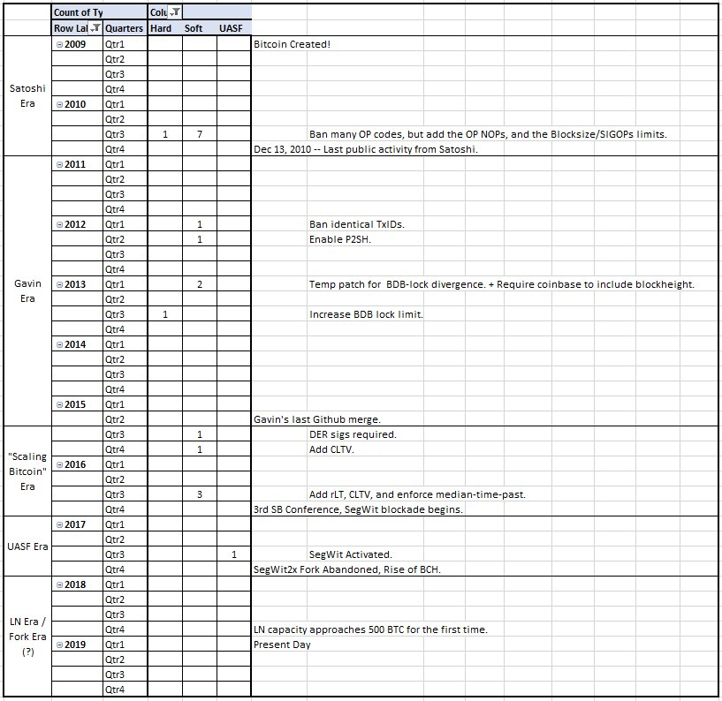
Soft Forks Over Time
(according to BitMex)

Slide 77
Bitcoin’s Ossification
original source code & edit history are mostly lost
Year | 2009 | 2010 | 2011 | 2012 | 2013 | 2014 | 2015 | 2016
# of Soft Forks | 0* | 7 | 0 | 2 | 2 | 0 | 2 | 3
16
Year | 2017 | 2018 | 2019 | 2020 | 2021 | 2022 | 2023 | 2024
# of Soft Forks | 1 | 0 | 0 | 0 | 1 | 0 | 0 | 0 (Presumably)
2
SegWit
Announced Dec 2015
Coded Oct 2016
Activated Aug 2017
Taproot
Announced Jan 2018
Coded Oct 2020
Activated Nov 2021
20 Months
46 Months

Slide 78
Problems
First – is it a problem ?
Some people don’t want Bitcoin to “change”…
…but soft forks aren’t a mandatory change. (The old software works.)
Soft forks benefits:
Grant new options to users.
Improves the software; improve the money.
Multisig + Lightning (SegWit) were created via soft fork.
Security, (op vault), privacy, scalability require new soft forks.
Soft forks costs…
Soft fork is basically free: SFs are optional, reversible, and inevitable.
Optional = The old protocol survives, so the upgrade is consensual.
Reversible = A soft fork claiming OP NOP 6 , for example, could be later deactivated by a 2nd soft fork, that just bans OP NOP 6.
Inevitable = If 51% hashrate mines a new version, then the soft fork activates – end of story.
Users who “resist” the soft fork, will break the heaviest-valid-chain rule and will hard fork.
Any soft fork that increases miner profitability, can and will activate, eventually.
Cynical take: some prefer software NOT to improve, since they are middlemen.

Slide 79
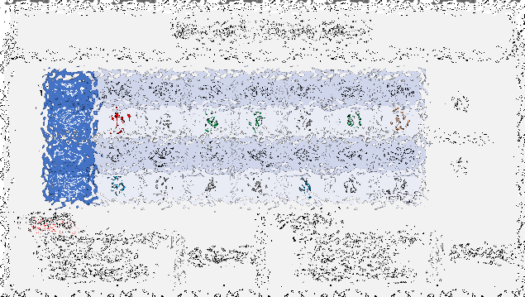
The End
Paul Sztorc
layertwolabs.com ;
truthcoin.info
bitcoinhivemind.com
drivechain.info
Twitter: @truthcoin ; Telegram: @psztorc
Please Ask Your Questions Now

Slide 80
New Soft Forks ??
Is there even still a process?
SegWit Trauma / PTSD
Unsolved mysteries of the Blocksize war
Why did people get hashrate support for a hard fork, when hashrate is irrelevant to a hard fork? I don’t know.
Miners signed a meaningless piece of paper backing the wrong side, but they never actually did anything. Yet still they feel guilty and unwilling to do further soft forks.
Ratio of Experts / Laypeople is plummeting. More Ls, harder to E.
Sour Grapes

Slide 81
New Soft Forks ??
Is there even still a process?
SegWit Trauma / PTSD
Unsolved mysteries of the Blocksize war
Why did people get hashrate support for a hard fork, when hashrate is irrelevant to a hard fork? I don’t know.
Miners signed a meaningless piece of paper backing the wrong side, but they never actually did anything. Yet still they feel guilty and unwilling to do further soft forks.
Ratio of Experts / Laypeople is plummeting. More Ls, harder to E.
Sour Grapes
The real reason....

Slide 82
The Real Reason...

Slide 83
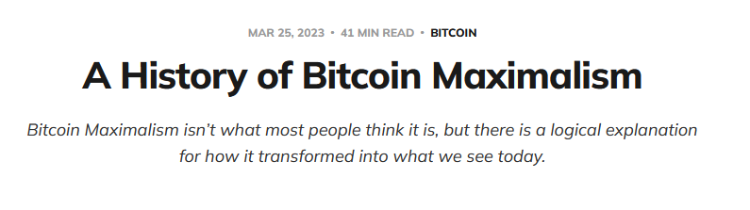
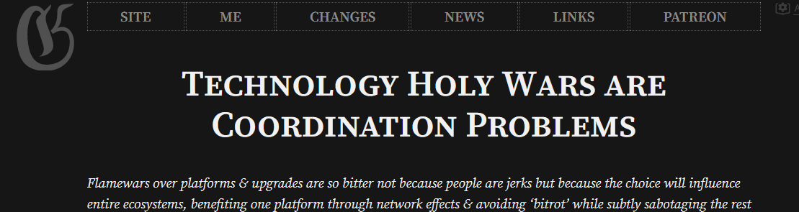
Jameson Lopp’s Article
Gwern’s Article

