Slide 1
Database Design Final Group Project
General Scenario
Car Service Store
Group 2
Boddapati Venkata Sudheer Kumar
Dave Sanket Dharmendrabhai
Gohil Hiren Yogeshbhai
Patel Deepam Mahesh
Rohit Dhirenkumar

Slide 2
Scenario
The Car Services is a database created to simplify and automate the management of different car services provided by an automotive service centre. The database is made to store and manage information about customers, vehicles, service requests, and service histories. This enables effective tracking and management of car services.

Slide 3
Table of contents
01
Unnormalized form
02
ER Diagram
Queries
Procedures
03
04
With final 3NF form
that will be useful for the system.
that will be useful for the system.

Slide 4
1. Unnormalized form
`app_id`, `customer_id, `app_time` `app_employee` `app_status
`car_id’, `color` `model`, fuel_type, `mileage` `powerc` `car_number
`customer_id` `customer_name`customer_mobile` `customer_password` ,`customer_address` `customer_username`
`username` `password’,`owner_id` `owner_name` `address` `contact_no` `owner_username, `owner_password`, `recovery_email` ,`recovery_phone`
`payment_id`,payment_date`, `payment_bill`, `payment_description`, `recovery_email`, `recovery_phone`
`service_id` ,`customer_id`, `service_name`, `service_type` `service_fees`

Slide 5
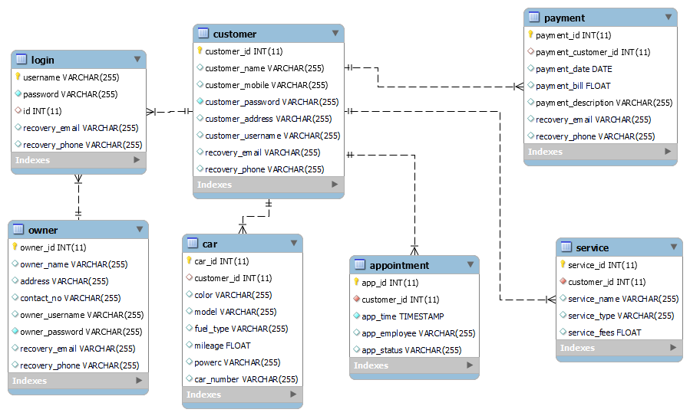
2. ER Diagram

Slide 6
3.Queries
Query 1
select * from appointment where app_status='scheduled’;
select * from appointment where app_status='completed’;
select * from appointment where app_status='cancelled’;
Query 2
select avg(powerc) from car;
select car_id,color,model,powerc,mileage from car where powerc>(select avg(powerc) from car) ;
Query 3
SELECT c.customer_id, c.customer_name, ca.color, ca.model, ca.fuel_type, ca.mileage, ca.powerc, ca.car_number FROM customer c JOIN car ca ON c.customer_id = ca.customer_id;

Slide 7
4.Procedures
Procedure 1
DELIMITER //
CREATE PROCEDURE login_user (IN p_username VARCHAR(50), IN p_password VARCHAR(50))
BEGIN
DECLARE v_password VARCHAR(50);
SELECT password INTO v_password FROM login WHERE username = p_username;IF v_password = p_password
THEN
SELECT "Login Successful" as result;
ELSE
SELECT "Please check the username or the password" as result;
END IF;
END //
DELIMITER ;
E.g. CALL login_user('DavidLee', 'password123');

Slide 8
4.Procedures
Procedure 2
DELIMITER //
CREATE PROCEDURE create_car(IN p_car_id INT, IN p_customer_id INT, IN p_color VARCHAR(20), IN p_model VARCHAR(50), IN p_fuel_type VARCHAR(20), IN p_mileage INT, IN p_power INT, IN p_car_number VARCHAR(20))
BEGIN
INSERT INTO car (car_id,customer_id, color, model, fuel_type, mileage, powerc, car_number) VALUES (p_car_id,p_customer_id, p_color, p_model, p_fuel_type, p_mileage, p_power, p_car_number);
END//
DELIMITER ;
CALL create_car('21', '17','yellow','m3','petrol’,’1500','15','4569');

Slide 9
4.Procedures
Procedure 3
DELIMITER //
CREATE PROCEDURE `get_cars_by_customer` (IN customer_name_in VARCHAR(255))
BEGIN
DECLARE v_customer_id INT;SELECT customer_id INTO v_customer_id FROM customer
WHERE customer_name = customer_name_in;
SELECT * FROM car WHERE customer_id = v_customer_id;
END//
DELIMITER ;
call get_cars_by_customer('David lee');

Slide 10
Thank You

