Slide 1

Wine_Data
Data Historians – Meet the team
KrthkN
Kihoon
Darel
jessica
March 9 2019

Slide 2
Approach & Data Sets
Problem Definition: Find what is the finest wine at an accessible price and location.
Sources Considered: Kaggle, Weather Data & Census Data
Data Sources acquired and used: Kaggle, Wine Mag Data & Google API
Analysis Considered:
Wine Price v. Income Data
Wine Score v. Weather Data
Weather data Harvest Timing Census Data Income Affluence Google Maps Wine Score 130k rows Region Zip Code
Price Country Province Napa Valley Quality Standard Deviation

Slide 3
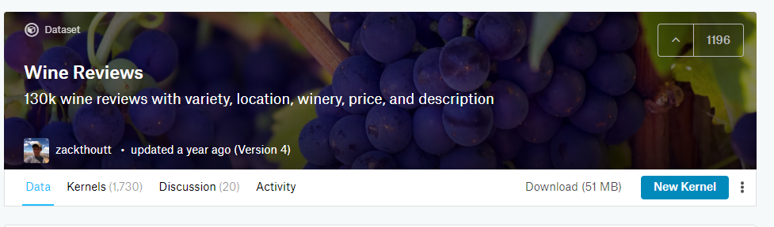
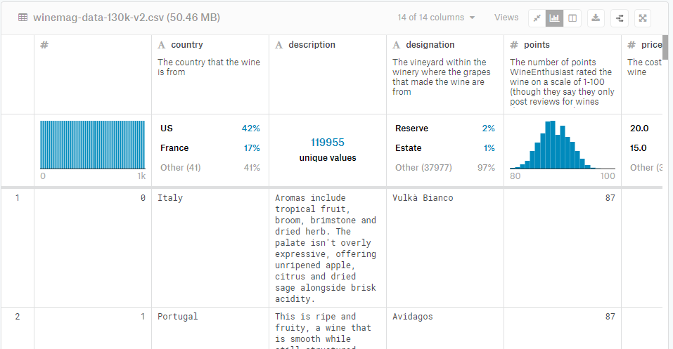

Tool Set Used
Kaggle
Excel
Jupyter
Python
Google API
Gmaps
Tool Sets Considered:
Census Data – To tie regional wine price to income level
Weather Data – to tie weather data during harvest time to wine price for futures forecasting

Slide 4
Analysis Process
countryThe country that the wine is from
description
designationThe vineyard within the winery where the grapes that made the wine are from
pointsThe number of points WineEnthusiast rated the wine on a scale of 1-100 (though they say they only post reviews for wines that score >=80)
priceThe cost for a bottle of the wine
provinceThe province or state that the wine is from
region_1The wine growing area in a province or state (ie Napa)
region_2Sometimes there are more specific regions specified within a wine growing area (ie Rutherford inside the Napa Valley), but this value can sometimes be blank
taster_name
taster_twitter_handle
titleThe title of the wine review, which often contains the vintage if you're interested in extracting that feature
varietyThe type of grapes used to make the wine (ie Pinot Noir)
wineryThe winery that made the wine
Fields of data available
Duplicate Wines
Incomplete Rows
Pulling zip code from Google API
Meaningful questions
Comparing Value by Price Ratio

Slide 5
Project Demo
Vision: A data base that seeks to help users navigate to the best wines to try by proximity to location, highest reviews and right price.
Objectives
Remove incomplete rows that would sku ratios
Link together the Google address data
Group data by location and winery for analysis
Pandas DataFrames and MatPlotlib

Slide 6
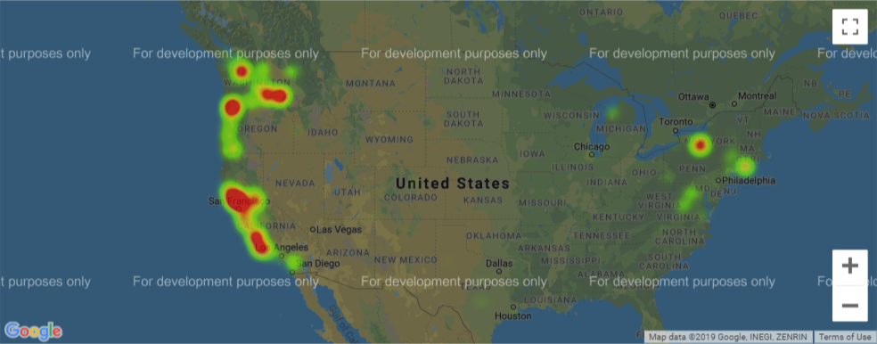
Heat Map of US Wineries - coastal wineries most common
Source: Pulled 2/23/29 - https://www.kaggle.com/zynicide/wine-reviews
Source: Scraped June 17, 2017 - https://www.winemag.com/?s=&drink_type=wine
Source: Google API –Long/Lat to retrieve zip codes

Slide 7
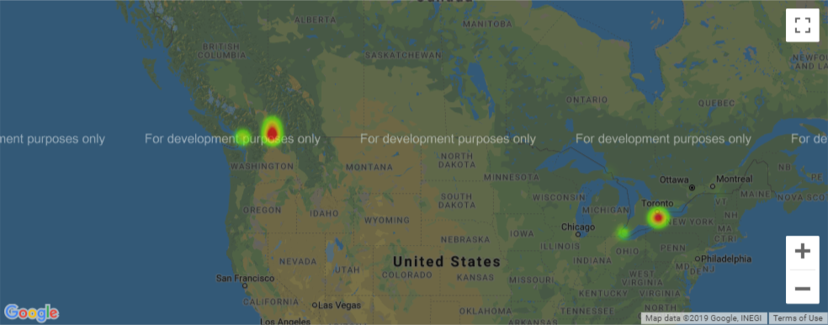
Heat Map of Canadian Wineries: Toronto and West Coast
Source: Pulled 2/23/29 - https://www.kaggle.com/zynicide/wine-reviews
Source: Scraped June 17, 2017 - https://www.winemag.com/?s=&drink_type=wine
Source: Google API –Long/Lat to retrieve zip codes

Slide 8
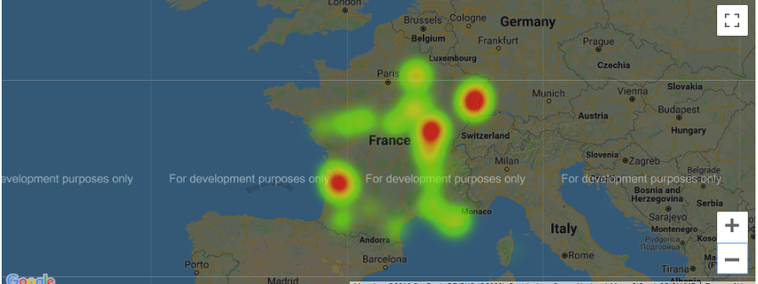
Heat Map of French Wineries: entire region temperate
Source: Pulled 2/23/29 - https://www.kaggle.com/zynicide/wine-reviews
Source: Scraped June 17, 2017 - https://www.winemag.com/?s=&drink_type=wine
Source: Google API –Long/Lat to retrieve zip codes

Slide 9
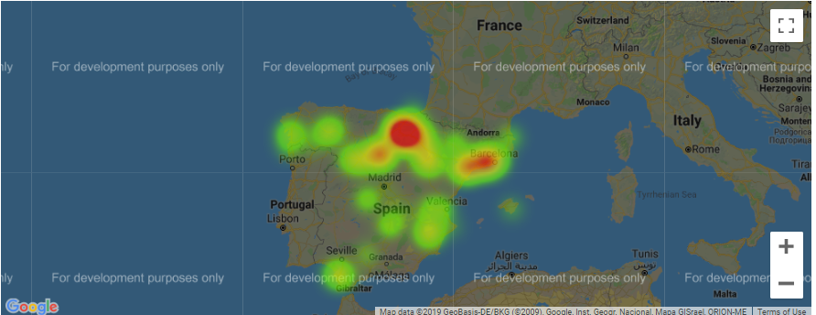
Heat Map of Spanish Wineries: nearest to France
Source: Pulled 2/23/29 - https://www.kaggle.com/zynicide/wine-reviews
Source: Scraped June 17, 2017 - https://www.winemag.com/?s=&drink_type=wine
Source: Google API –Long/Lat to retrieve zip codes

Slide 10
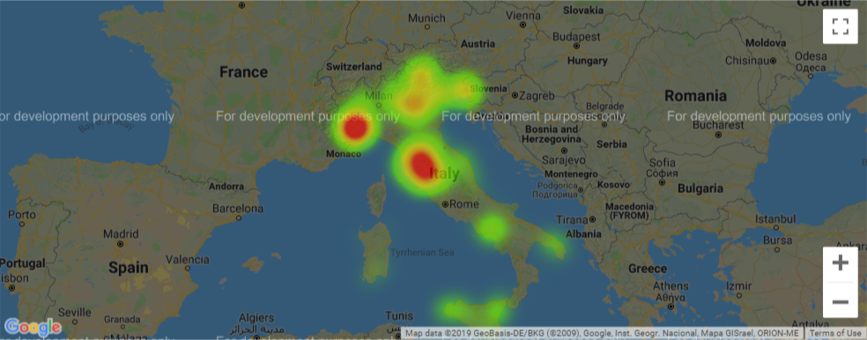
Heat Map of Italian Wineries: temperate nearest to France
Source: Pulled 2/23/29 - https://www.kaggle.com/zynicide/wine-reviews
Source: Scraped June 17, 2017 - https://www.winemag.com/?s=&drink_type=wine
Source: Google API –Long/Lat to retrieve zip codes

Slide 11
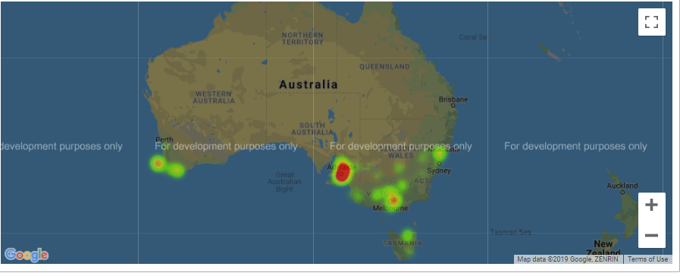
Heat Map of Australian Wineries: Southern coasts
Source: Pulled 2/23/29 - https://www.kaggle.com/zynicide/wine-reviews
Source: Scraped June 17, 2017 - https://www.winemag.com/?s=&drink_type=wine
Source: Google API –Long/Lat to retrieve zip codes

Slide 12
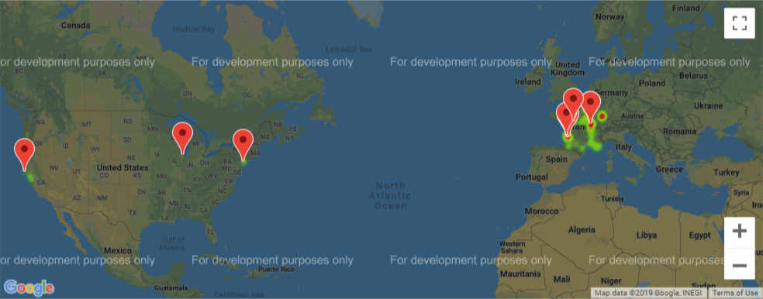
Top Global Wineries
Source: Pulled 2/23/29 - https://www.kaggle.com/zynicide/wine-reviews
Source: Scraped June 17, 2017 - https://www.winemag.com/?s=&drink_type=wine
Source: Google API –Long/Lat to retrieve zip codes

Slide 13
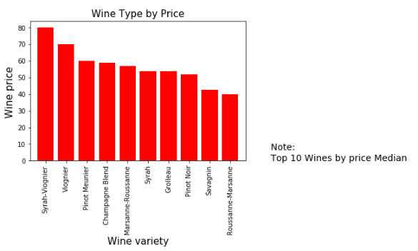
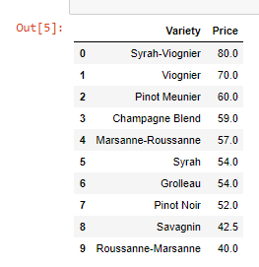
Arranging Top wines by Price (France):
Syrah – Viognier is the most expensive French wine variety and Roussanne-Marsanne is the least
Source: Pulled 2/23/29 - https://www.kaggle.com/zynicide/wine-reviews
Source: Scraped June 17, 2017 - https://www.winemag.com/?s=&drink_type=wine
Source: Google API –Long/Lat to retrieve zip codes

Slide 14
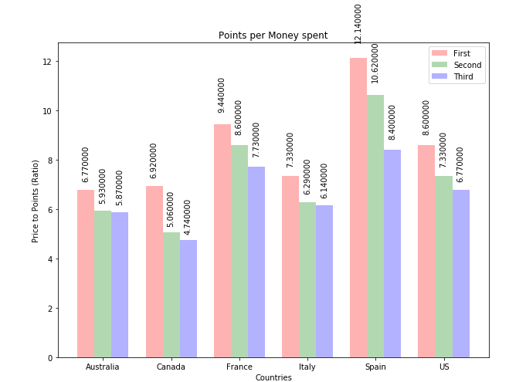
Value by Country
Points per Price measures the best wines per dollar spent
Spain leads with the top 2 ranked wine per dollar (12.1 and 10.6)
France takes the next spot with 9.4 and ties the US top wine with 8.6
Italy ties the 2nd best US wine at 7.3
Australia and Canada top wines have presence with their top wines on par with US and Italy 2nd and 3rd ranks
Source: Pulled 2/23/29 - https://www.kaggle.com/zynicide/wine-reviews
Source: Scraped June 17, 2017 - https://www.winemag.com/?s=&drink_type=wine
Source: Google API –Long/Lat to retrieve zip codes

Slide 15
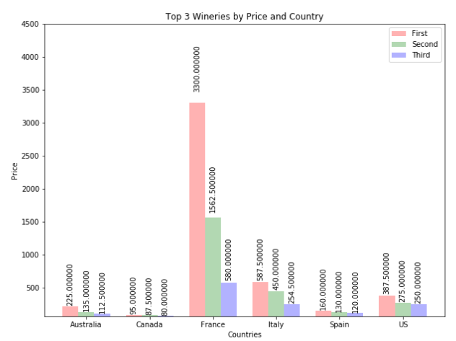
Top 3 Wineries by Price and Country
Australia: 225, 135, 112
Canada: 95, 87.5, 80
France: 3300, 1562.5, 580
Italy: 587, 450, 254.5
Spain: 160, 130, 120
US: 387, 275, 250
Rank:
France – most expensive
Italy
US
Australia
Spain
Canada
Source: Pulled 2/23/29 - https://www.kaggle.com/zynicide/wine-reviews
Source: Scraped June 17, 2017 - https://www.winemag.com/?s=&drink_type=wine
Source: Google API –Long/Lat to retrieve zip codes

Slide 16
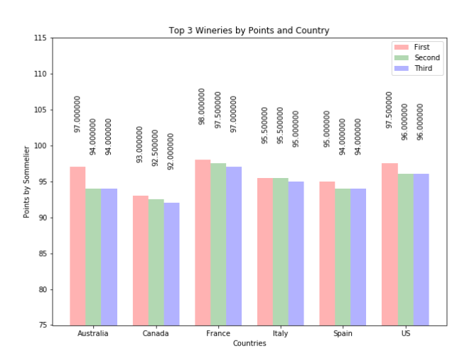
Top 3 Wineries by Points and Country
Australia: 97, 94, 94
Canada: 93, 92.5, 92
France: 98, 97.5, 97
Italy: 95.5, 95, 95
Spain: 95, 94, 94
US: 97, 96, 95
Top Wineries:
France 98
France 97.5
France/Australia/US 97
France is consistently top rated
Source: Pulled 2/23/29 - https://www.kaggle.com/zynicide/wine-reviews
Source: Scraped June 17, 2017 - https://www.winemag.com/?s=&drink_type=wine
Source: Google API –Long/Lat to retrieve zip codes

Slide 17
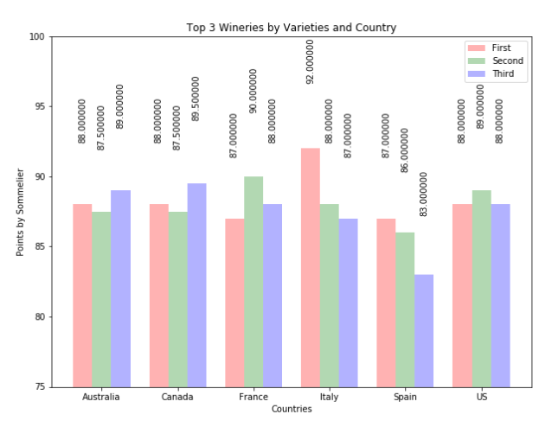
Top Ranked wine Varieties
Australia: 88, 87.5, 89
Canada: 88, 87.5, 89
France: 87, 90, 88
Italy: 92, 88, 87
Spain: 87, 86, 83
US: 88, 89, 83
Top Varieties are mostly consistent across the top 3 in scores.
Individual wineries cultivate specialties, not specific countries

Slide 18
Roadmap
Things we considered but had to table
A user interface to pop in zip code and give a list of closest wineries
A price forecaster to guess the price of wine futures
An aggregator for wine reviews by somallier
Segment wines by standard deviation for Price v. Wine Score
Source: Pulled 2/23/29 - https://www.kaggle.com/zynicide/wine-reviews
Source: Scraped June 17, 2017 - https://www.winemag.com/?s=&drink_type=wine
Source: Google API –Long/Lat to retrieve zip codes

Slide 19
Future Recommendations:
Refine the zip code locator to recommend best wineries by location
Create a system for examining the tasters for bias in scoring
Fine tune the rank v. pricing to consider other variables like prestige of the Winery and proximity to location to make recommendations
Include users preference and make recommendations that align with the tasters preference in scoring

Slide 20


Slide 21
Approach:
Identified critical rows for completeness
Conceptually designed questions
Got way too complicated so re-examined questions
Useful go forward questions and made a plan to parse out the data
Tools Used: Excel, Jupyter, Python, GOOGLE API
Weather data Harvest Timing Census Data Income Affluence Google Maps Wine Score 130k rows Region Zip Code
Price Country Province Napa Valley Quality Standard Deviation
Source: Pulled 2/23/29 - https://www.kaggle.com/zynicide/wine-reviews
Source: Scraped June 17, 2017 - https://www.winemag.com/?s=&drink_type=wine
Source: Google API –Long/Lat to retrieve zip codes

Slide 22
Data Exploration/Cleanup

