Slide 1

COMMENT SPAM FILTERING ON YOUTUBE
Awal Muhammad UMAR

Slide 2
Description of Dataset
The dataset was collect by real, public and non encoded data extracted from Youtube through its API.
The data is gathered from videos regarded as top 10 most watched Youtube videos in the first quarters of 2015, containing the Youtube ID for each comment, Date of comment, Authors, the content and the label
DataSets | Ham(Legitimate) | Spam | Total
Psy | 175 | 175 | 350
KatyPerry | 175 | 175 | 350
LMFAO | 202 | 235 | 438
Eminem | 203 | 245 | 448
Shakira | 196 | 174 | 370

Slide 3
Problem Formulation
Remove all other column except the CONTENT and CLASS, where the CONTENT contain the comment on each user and the CLASS comprises of preclassification if the statement is a ham(legitimate) or a spam comment.
Removal of missing value and duplicates row.
Bag of words model was used by tokenizing the word, removal of stop words and stemming, where the features space was generated from the processed text and the target as the class ( ham or spam).
The dataset is split into 80% training and 20% testing set.

Slide 4
Methodologies
Supervised learning Techniques was used to classify the type of message, these methods are best for machine learning and data mining.
 | Classification Method
SVM_Linear | Linear - Support Vector Machine
SVM_Polynomial | Polynomial- Support Vector Machine
SVM_Gaussian | Gaussian –Support Vector Machine
KNNeighbor | K-Nearest Neighbor
CART | Decision Tree
LogisticRegresiom | Logistics Regression
RandomForest | Random Forest
GaussianNB | Gaussian- Naïve Bayes
MultinomialNB | MultiNomial Naïve Bayes
BernouliNB | Bernouli Naïve Bayes

Slide 5
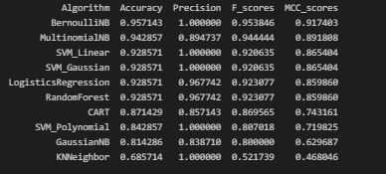
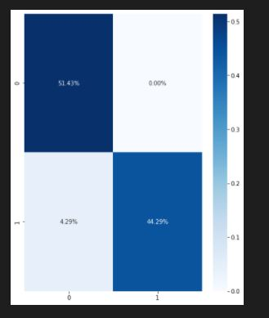
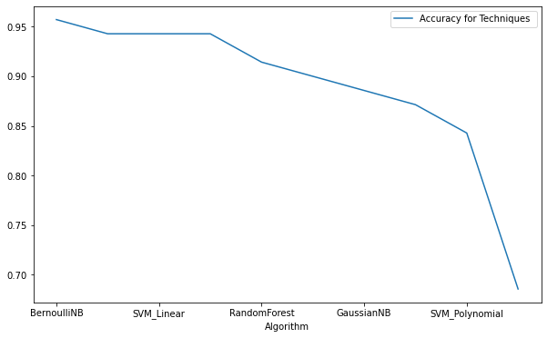
Experiment
The Metric used to compare the performance of each classification method are the Precision, Accuracy, F-score
Mathew Correlation Coefficient.
For Psy dataset

Slide 6
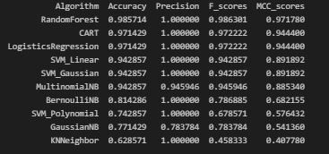
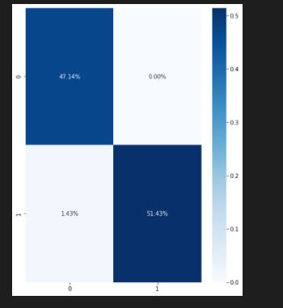
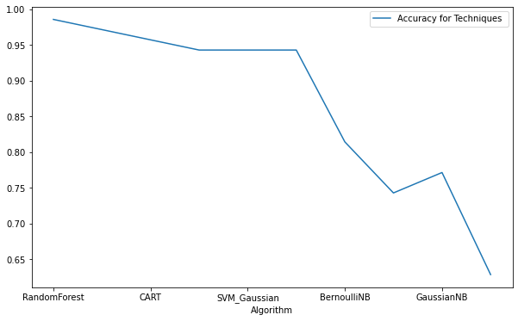
Keryperry Dataset

Slide 7
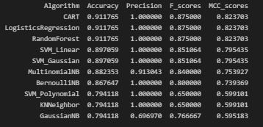
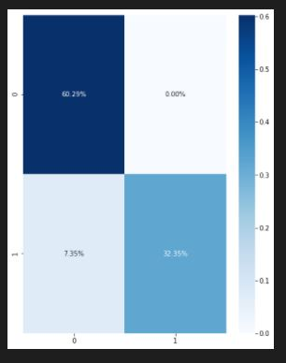
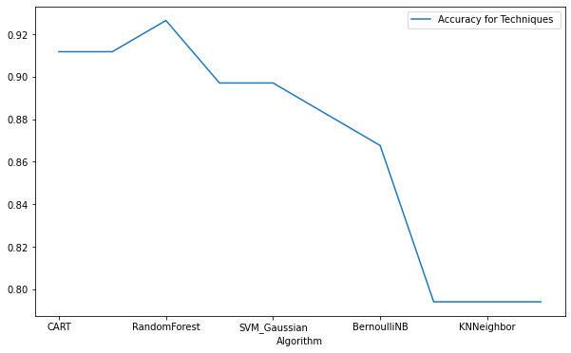
Lmfao dataset

Slide 8
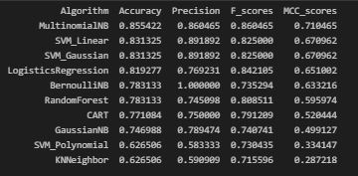
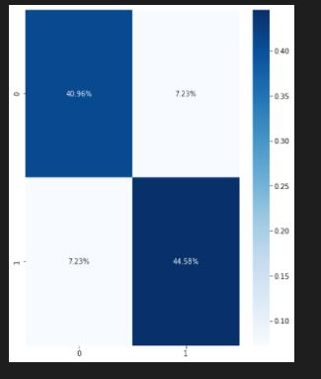
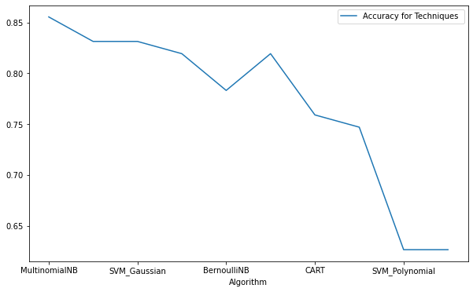
Eminem dataset

Slide 9
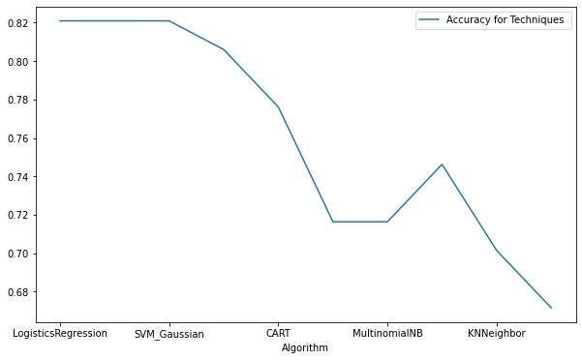
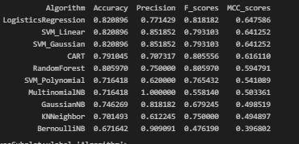
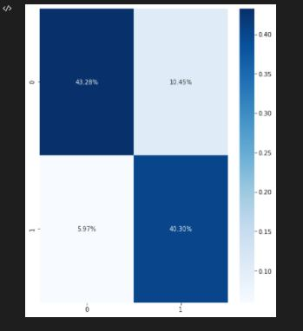
Shakira dataset

Slide 10
Conclusion
The techniques above-mentioned has a reasonable percentage of spam and ham rate.
The best technique for classifying spam comment are the Bernoulli NB, MultiNomialNB, CART, Logistics Regression, Random Forest, SVM-Linear, SVM- Gaussian.
It can be seen that the KNNeighbor continuously has a worse performance rate at the bottom.

Slide 11
References
T. Almeida, J. Almeida, and A. Yamakami, “Spam filtering: How the dimensionality reduction affects the accuracy of naive bayes classifiers,” Journal of Internet Services and Applications, JISA’11, vol. 1, no. 3, pp. 183–200, 2011.
T.C. Alberto, J. V. Lochter, T. A. Almeida ´Department of Computer Science, Federal University of Sao Carlos, “TubeSpam: Comment Spam Filtering on YouTube” , DOI: 10.1109/ICMLA.2015.37, December 2015.
M. Bassiouni, M. Ali & E. A. El-Dahshan , “Ham and Spam E-Mails Classification Using Machine Learning Techniques”, Journal of Applied Security Research, 13:3, 315-331,DOI:10.1080/19361610,2018.

