Slide 1

Algorithms Final Project
Drake AuClaire

Slide 2

Mountain Paths
Goals:
2D Elevation Maps
Greedy Algorithm
Dijkstra Algorithm
Contour Map of Mountain
Multiple Paths and Maps
Notes:
A contour map is a map illustrated with contour lines, for example a topographic map, which thus shows valleys and hills, and the steepness or gentleness of slopes. The contour interval of a contour map is the difference in elevation between successive contour lines.

Slide 3

What’s Interesting / Larger Context?
GPS Navigation
These algorithms are used in robotics and transportation systems
Greedy vs. Dijkstra
https://www.mapbox.com/blog/topology-data-implications - GIS

Slide 4

Technologies / Tools
PyCharm IDE
First Bridges
Matplotlib

Slide 5
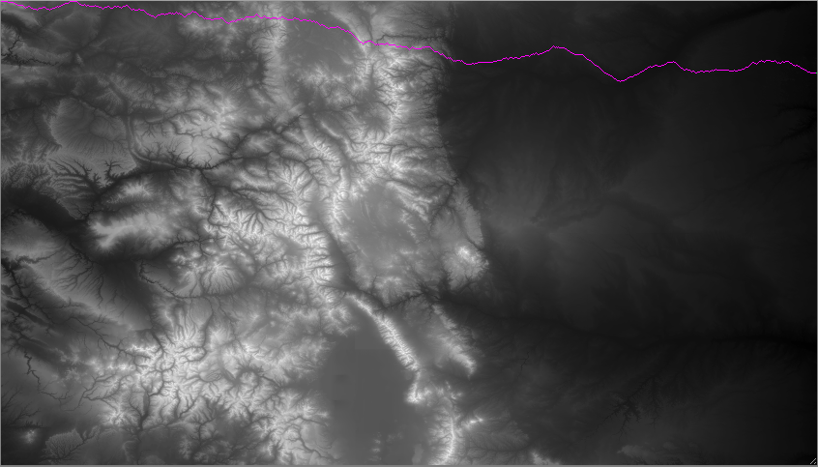
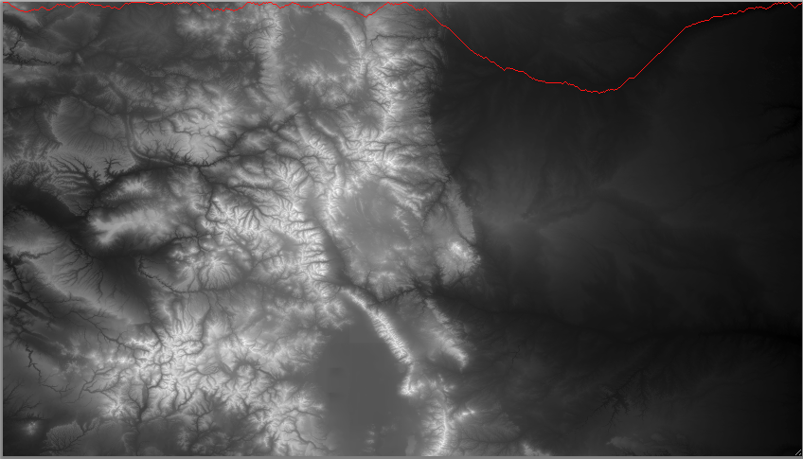
START
END
Greedy Algorithm – BRIDGES
START
END
Dijkstra Algorithm – BRIDGES

Slide 6
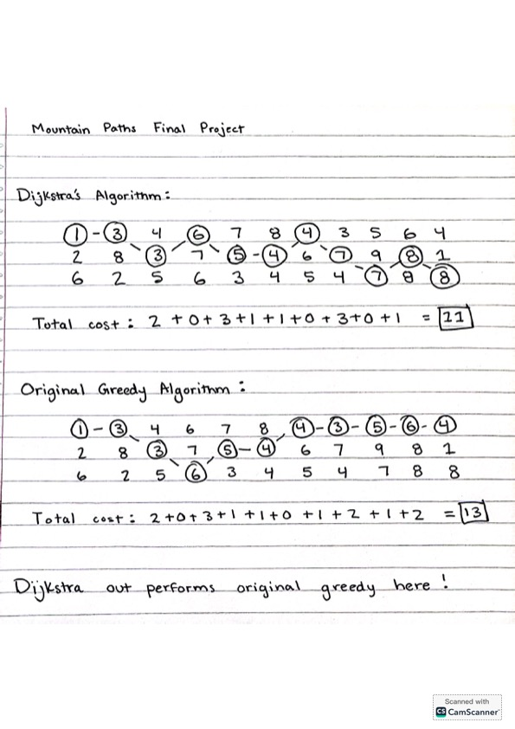

Simple Example

Slide 7
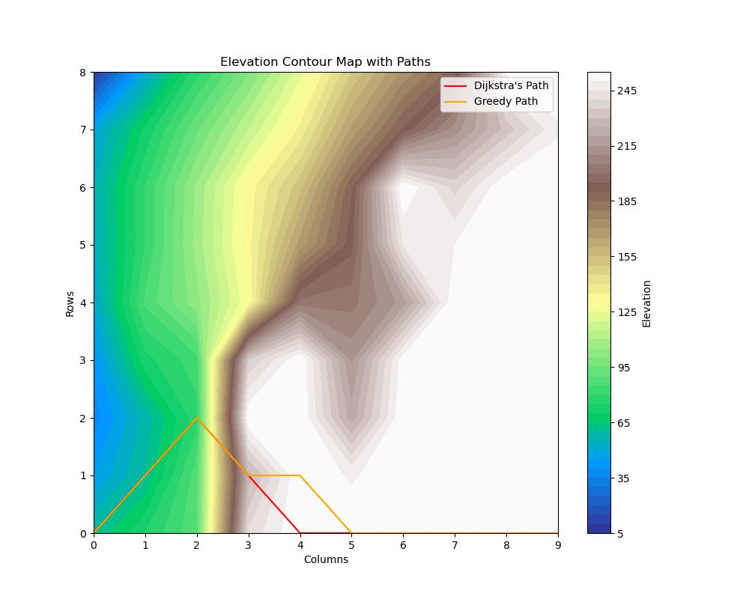
Small Dataset Map – 0
START
END

Slide 8
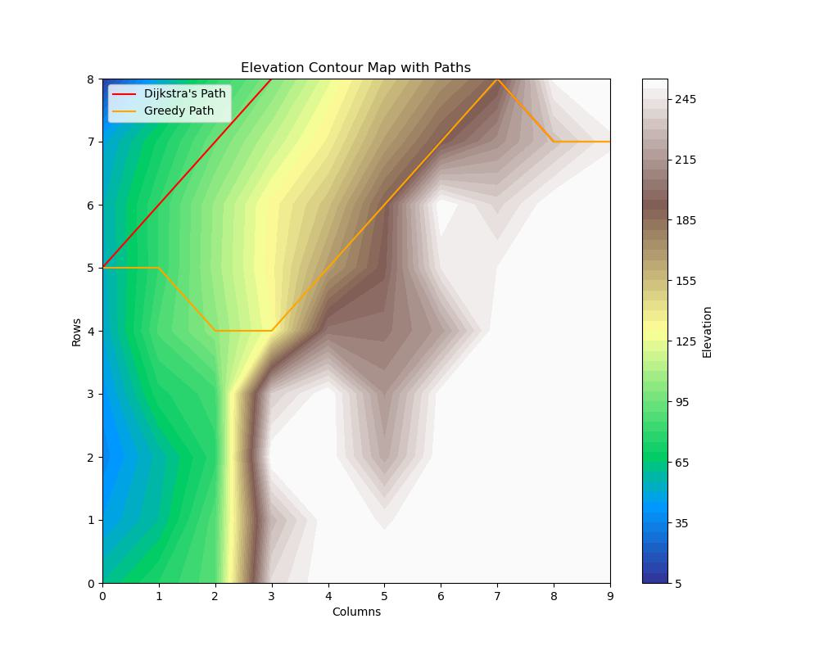
Small Dataset Map – 5
END
END
START

Slide 9
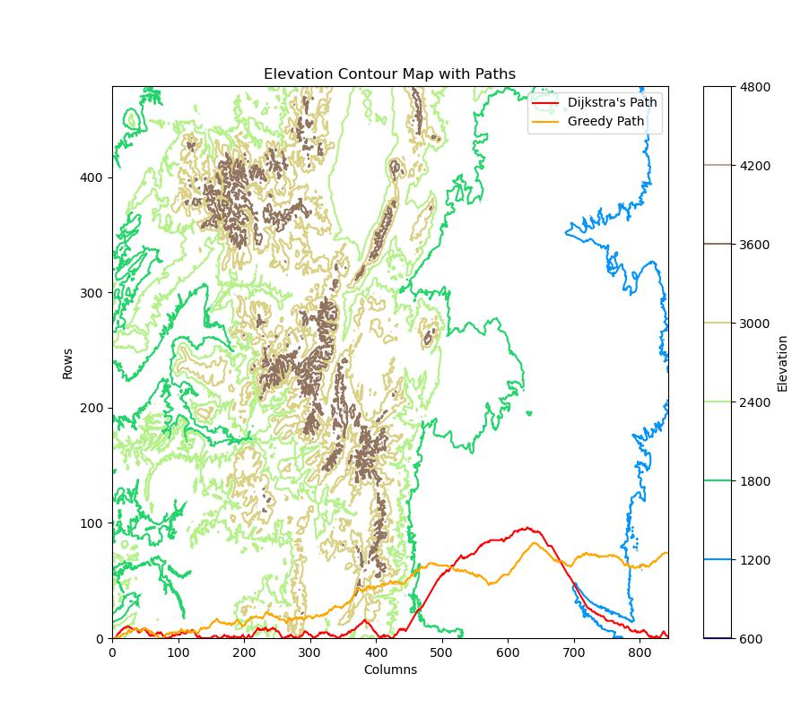
Large Contour Map – 0
END
START
END

Slide 10
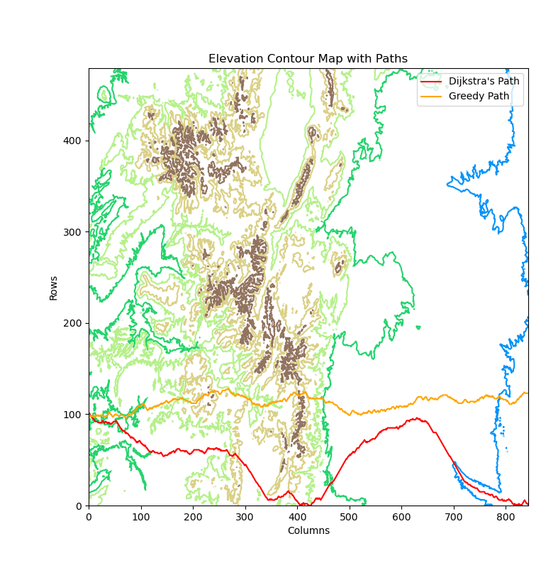
Large Contour Map – 100
END
START
END

Slide 11
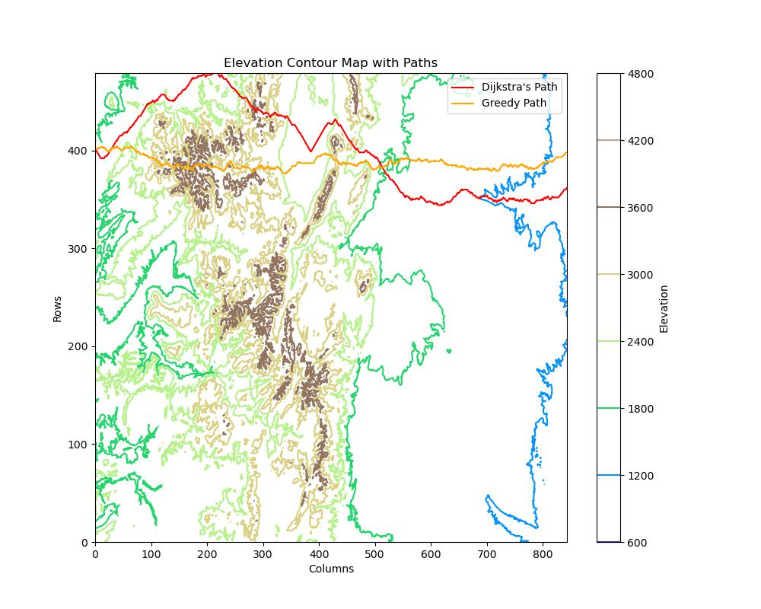
Large Contour Map - 400
START
END
END

Slide 12
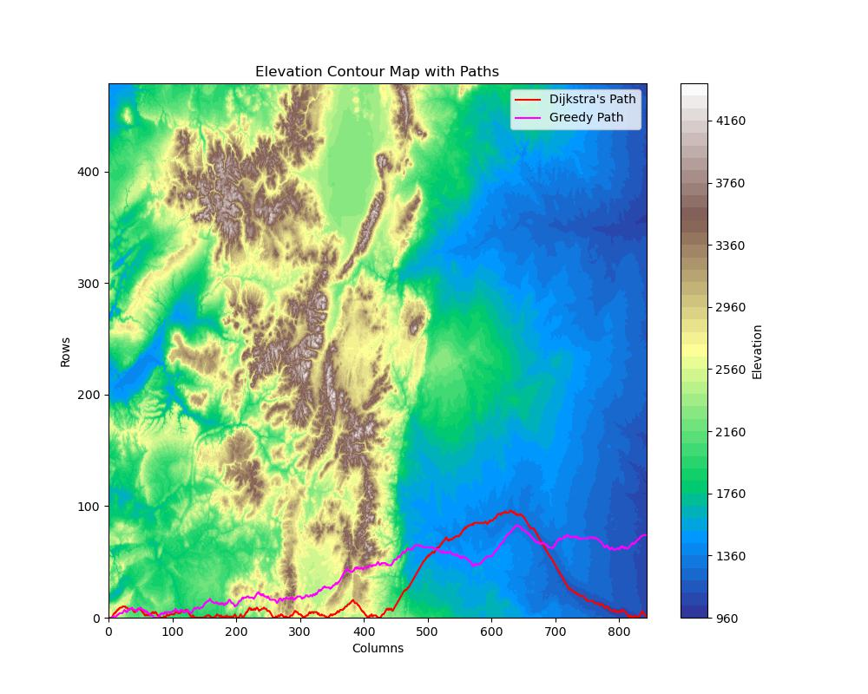
Large Filled Contour Map – 0

Slide 13
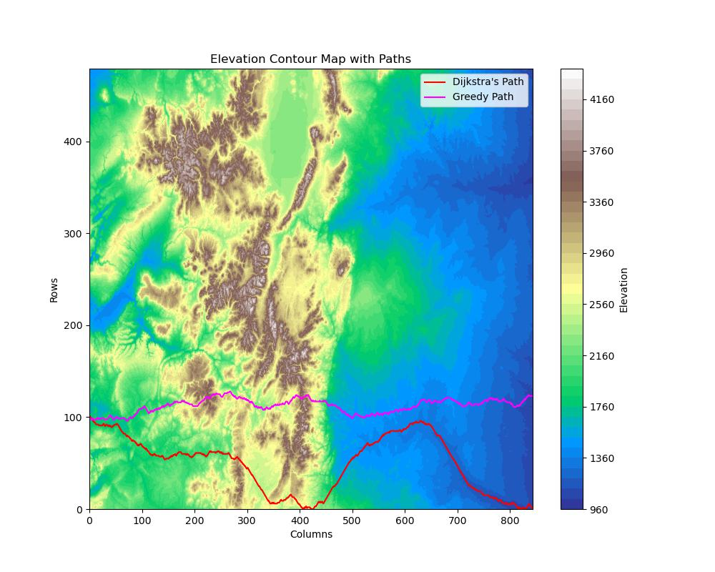
Large Filled Contour Map – 100

Slide 14
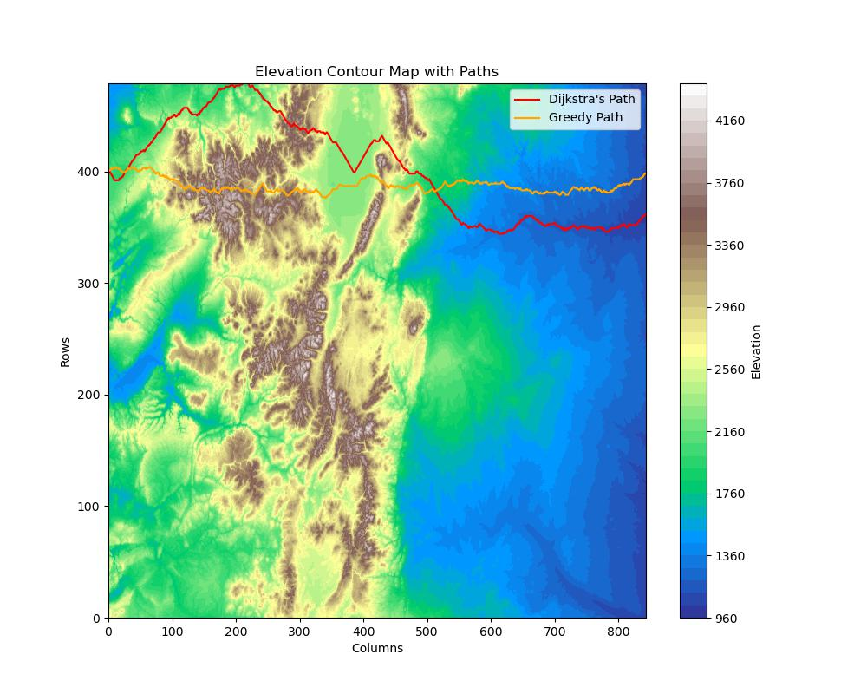
Large Filled Contour Map – 400

Slide 15
Comparing Dijkstra/Greedy
Dijkstra:
Finds Solution
Finds best path of least resistance – much better than Greedy
Path reconstruction
Adaptability
Greedy:
Finds Solution
Runs slightly faster than Dijkstra
Not always optimal
Simplicity

Slide 16
Any Questions??

