Slide 1


24 June 2020
Atelier Python | Python workshop
Pandas, tracer et l’analyse des données | Pandas, plotting and data analysis
Présenté par : Jarno van der Kolk
Helpers : Purvasha Patnaik, Masoumeh Soflaei, and Will Kochtitzky
it.uOttawa.ca
Notes:
PAGE COUVERTURE (option 2)
REMARQUE : À lire avant d’utiliser le gabarit
Les éléments suivants du gabarit ne peuvent pas être modifiés :
• En-tête institutionnel grenat (Université d’Ottawa | University of Ottawa)
• Pied de page institutionnel comprenant la bande grise et grenat ainsi que le logo
Les éléments suivants du gabarit peuvent être modifiés :
• L’adresse Web uOttawa.ca dans le pied de page peut être personnalisée afin de répondre aux besoins de l’utilisateur et le nom du document peut être inséré à la droite de l’URL si nécessaire. Vous pouvez simplement taper l’adresse Web désirée dans la boîte appropriée
• L’image ou la couleur de fond peut être remplacée par celle de votre choix
COVER PAGE (option 2)
NOTE: Read before using template
The following elements of the template must remain untouched and cannot be modified:
• Corporate (Université d'Ottawa | University of Ottawa) garnet header
• Corporate uOttawa footer including the grey/garnet stripe and logo
The following elements of the template may be customized:
• You may include the uOttawa.ca URL of your choice in the footer, and insert the name of the document to the right of the URL, if needed.
• The URL can be customized to a specific URL by following these simple steps: On the PowerPoint View tab, in the Master Views group, select Slide Master. Select the third slide on the left side panel, and type in the desired URL on the slide.
• The background image or colour may be replaced by the one of your choice

Slide 2
Getting Started
Download the slides: jarno.ca/python.pdf
Go to syzygy.ca
  Click on LAUNCH in top-right corner
  Choose UOTTAWA
  Click on the red house with “Log in” in small print
  Use your uoAccess credentials to log in
If you don’t have uoAccess credentials, talk to us over Teams

Slide 3
Program
9:00 | Intro
9:30 | Reading data
10:30 | Break
10:45 | Plotting
12:00 | Lunch break
13:00 | Data manipulation
14:30 | Break
14:45 | Basic scripting with if-then and for loops
16:00 | END

Slide 4

Say Hello!
We will use the chat function in Teams for interactivity
Say hello and introduce yourself!
  Why are you here?

Slide 5

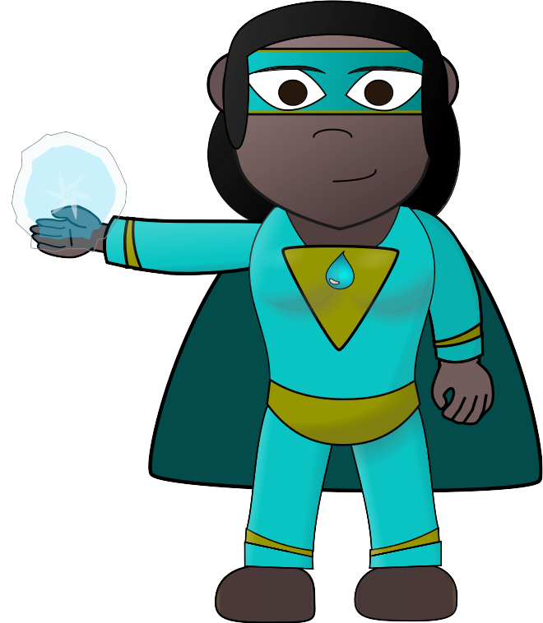
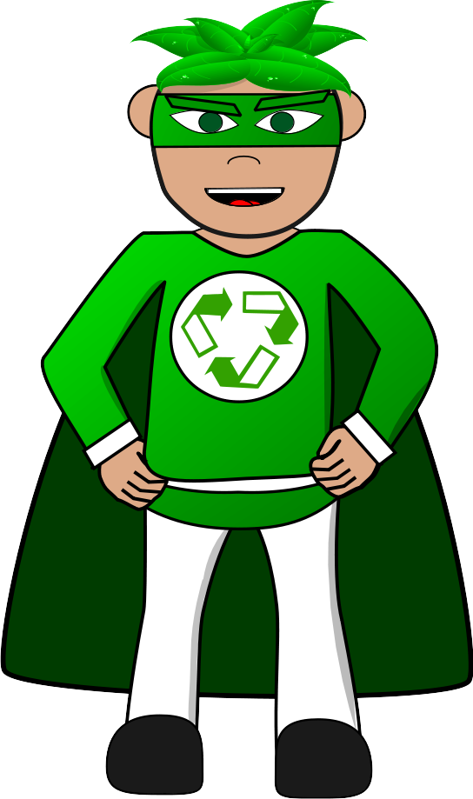
Helpers
We have three helpers with us today!
  Will Kochtitzky
  Purvasha Patnaik
  Fabrizio Donzelli
They will help if you get in trouble!
*All pictures shown are for illustration purpose only.
Actual appearance may differ from images shown.

Slide 6
Data Science
What do you think Data Science is?
Type your answers in the chat!
Data science is an exciting discipline that allows you to turn raw data into understanding, insight, and knowledge.

Slide 7
Normal Science
Hypothesis
Experiment
Data
Conclusion

Slide 8
Data Science
Visualize
Transform
Model
Data
Tidy
Conclusion

Slide 9
Data Science
Program
Visualize
Import
Tidy
Model
Conclusion
Transform

Slide 10
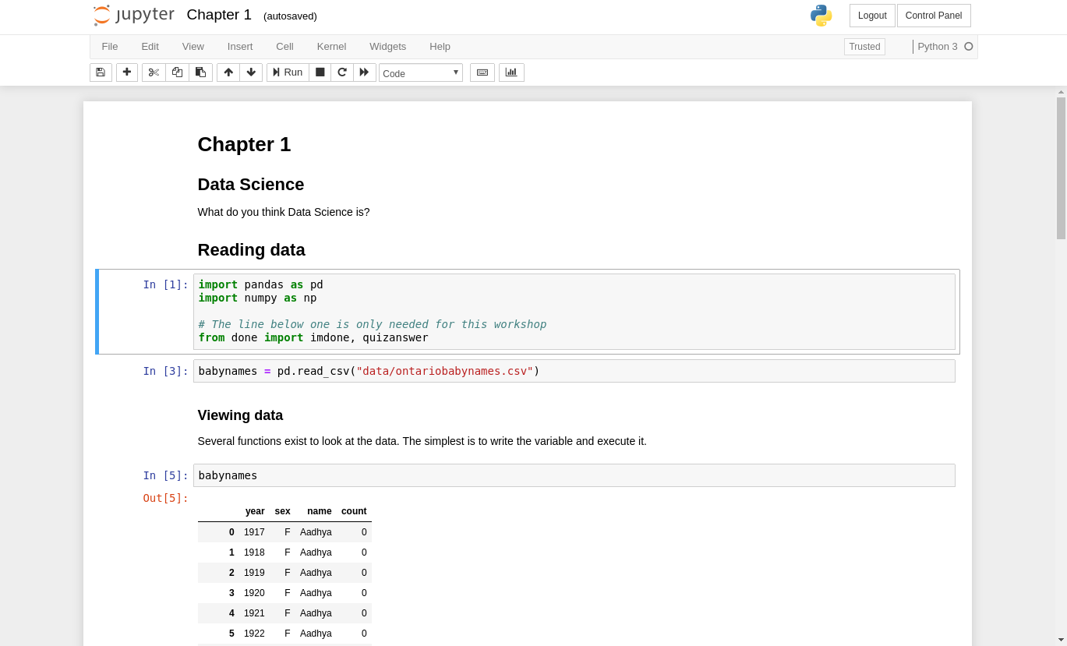
Reproducible Science
Programs are reproducible
Using Jupyter Notebook
Mix between program and report
Takes data and reproduces conclusions

Slide 11
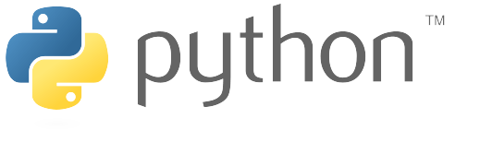
Python
High-level
General-purpose
Interpreted
Huge ecosystem

Slide 12
Python – The Language
Values: -1 1.3 "Ottawa"
Object: n = -1 x = 1.3 city_name = "Ottawa"
Functions: print(n) len(city_name)
Special values:
  Lists: [1,2,3,4] ["Hello", "world"]
  Dictionaries: {"num": 12, "name": "something"}

Slide 13
Warm Up
Which of these are numbers?
1 "1" "one" one

Slide 14
Warm Up
Which one of these will work? (assume one=1)
log(1) log("1") log("one") log(one)

Slide 15
Speed test
Numerical integration of f(x,y) = x² + x y + y² from -10 to 10 with steps of 0.001.
Python
C
Integral of f(x,y) = x^2 + xy + y^2 is 66.67333333332641
real 1m44.903s
user 1m44.866s
sys 0m0.004s
Factor of 96 difference!!
Integral of f(x,y) = x^2 + xy + y^2 is 66.673333
real 0m1.097s
user 0m1.097s
sys 0m0.000s

Slide 16
Well, that sucks... but!
The power of Python is in its ecosystem.
Thousands of packages are available. Many written in C but usable from Python.
Python is the glue to connect them all

Slide 17
Python Packages
Python Package Index (PyPI)
  https://pypi.org
233,536 projects
Package installation depends on how Python was installed, most common is conda or pip.
Our environment already has the most common packages installed
Using packages with import
import math
print("sin(3) = ", math.sin(3))

Slide 18
Jupyter Notebooks
Open your browser and go to
  https://uottawa.syzygy.ca
  Open Chapter 1.ipynb

Slide 19
Further Assistance
For help with
  Compute Canada
  Programming
  Servers
  Any research-related computing needs
Contact Jarno van der Kolk through TopDesk
  https://topdesk.uottawa.ca
Or by e-mail, jvanderk@uottawa.ca

