Slide 1
Evidence-Based Decision Making
in Healthcare
Course Overview
Dr. Jay K. Varma
https://drjayvarma.com
Notes:
1

Slide 2
Evidence-Based Decision Making
Derives from movement in clinical medicine called “evidence-based medicine”
Clinicians historically diagnosed and treated patients based on:
What they’d learned in school
What they’d been taught by their mentors
What their personal experience was
What they had read most recently
Dr Jay K Varma | https://drjayvarma.com

Slide 3
Evidence-Based Decision Making
In the 1960s, increasing use in healthcare of:
Randomized clinical trials
Statistics and epidemiology
In 1991, popular use of “evidence-based medicine”
Defined as “the conscientious, explicit, judicious use of current best evidence in making decisions about the care of individual patients”
Dr Jay K Varma | https://drjayvarma.com

Slide 4
Evidence-Based Decision Making
Became over-riding approach in scientific journals and clinical practice: “Is this [way to diagnose, way to treat, way to prevent] evidence-based?”
Eventually migrated into fields both adjacent and far from medicine
Evidence-based public health
Evidence-based policy
Dr Jay K Varma | https://drjayvarma.com

Slide 5
Decision Making in Healthcare
Requires setting priorities on how best to use limited resources
High consequence decisions
Life or death
Large economic costs
Dr Jay K Varma | https://drjayvarma.com

Slide 6
Considerations in Health Decisions
Number of people affected
Types of people affected, e.g., pregnant
Severity, urgency, and consequences of problem
Recognized priority by public, experts, and/or government
Dr Jay K Varma | https://drjayvarma.com

Slide 7
Decision Making in Healthcare
Structured: similar process for all major decisions
Comprehensive: considers all relevant factors
Transparent: write down all the relevant factors that went into the decision with description of the judgements that were made
Decisions should be re-evaluated as evidence, priorities, regulations, budget, and public demand changes
Dr Jay K Varma | https://drjayvarma.com

Slide 8
Evidence is the Start of Decision-Making
Evidence is the start of decision-making, but not the end of it
Some questions have never been rigorously studied
Some questions have evidence that conflicts
Some policies are not evidence-based due to other factors
People disagree about how to allocate resources
Dr Jay K Varma | https://drjayvarma.com

Slide 9
Evidence-Based or Evidence-Informed?
While evidence-based is the accepted term, evidence-informed is more accurate, because multiple other factors go into policy decisions
Feasibility
Acceptability
Affordability
Ethics, values, justice
Dr Jay K Varma | https://drjayvarma.com

Slide 10
GRADE Approach
One approach to making decision in healthcare
Designed primarily for developing guidelines for clinicians (e.g., “should I prescribe X medicine to treat Y disease?”)
But approach is broadly applicable to all issues of health policy and practice
Dr Jay K Varma | https://drjayvarma.com

Slide 11
GRADE Approach
Structured, comprehensive, and transparent
Framing questions
Choosing outcomes of interest
Aggregating, assessing, and grading evidence
Considering factors beyond the scientific evidence
Making final recommendation to clinicians, policy-makers, public
Dr Jay K Varma | https://drjayvarma.com

Slide 12
GRADE Approach
Technical team*
Synthesizes evidence for all inputs into decision
Decision or policy team
Makes judgments about the relative importance of each factor
Records judgements for future review or revision
Makes decision by weighing factors objectively and subjectively
Dr Jay K Varma | https://drjayvarma.com

Slide 13
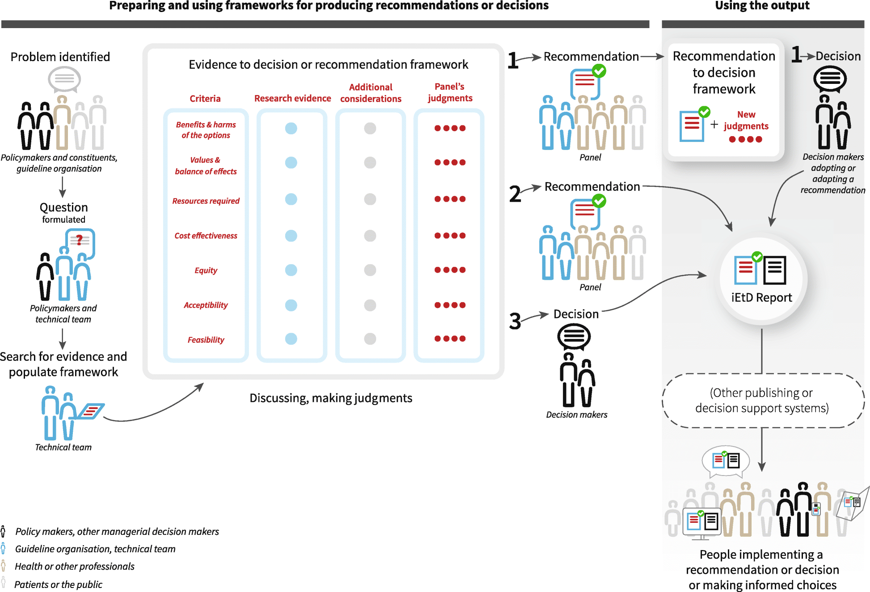
https://health-policy-systems.biomedcentral.com/articles/10.1186/s12961-018-0320-2/figures/1
Dr Jay K Varma | https://drjayvarma.com

Slide 14
What We Will Do in This Class
Learn about how to generate and evaluate scientific evidence, particularly bias
Learn the GRADE approach
Read articles and book that describe approach
Practice GRADE approach
Group project in which you develop a policy question, evaluate the evidence and other factors, then make a recommendation
Dr Jay K Varma | https://drjayvarma.com

Slide 15
What We Will Do in This Class
Practice “bare bones” version of GRADE for every-day use
Consider issues relevant to patient care (book assignment “Testing Treatments”)
Communicating decisions, particularly during situations that are urgent and involve uncertainty
Dr Jay K Varma | https://drjayvarma.com

Slide 16
Iterative Process
We will bounce around (especially today!) between where we are going and how to get there
Want to give you an overview of process before teaching you details about each step in process
Dr Jay K Varma | https://drjayvarma.com

Slide 17
Challenge and Opportunity
Different levels of knowledge about epidemiology, health research, and clinical practice
Several lectures on study design and bias
Different values and preferences
Lots of discussion and respectful debate
Dr Jay K Varma | https://drjayvarma.com

Slide 18
Class Objectives
Develop a focused, clinically-relevant question that can be answered by medical evidence review
Conduct a systematic review of the literature
Evaluate different aspects of studies that reduce or increase the quality of evidence
Dr Jay K Varma | https://drjayvarma.com

Slide 19
Class Objectives
Include objective or subjective assessments of harms, benefits, equity, and alignment with values in decision-making
Present recommendations in a transparent, reproducible way to decision-makers
Dr Jay K Varma | https://drjayvarma.com

