Slide 1
Evidence-Based Decision Making
in Healthcare
Framing Policy Questions and Outcomes
Dr. Jay K. Varma
https://drjayvarma.com
Dr Jay K Varma | https://drjayvarma.com
Notes:
1

Slide 2
Framing the Question in Healthcare
To make the right decision, first ask: What is the question?
Healthcare is different than other fields
Decisions have major consequences, e.g, life or death
Tests and treatments have harms
Costs to individuals, facilities, and payors can be substantial
People perceive and value health issues differently
Widespread agreement across all stakeholders that all decisions should, at a minimum, be grounded in evidence
To ground your decision in evidence, ask the right question, then review all available evidence that helps answer that question
Dr Jay K Varma | https://drjayvarma.com

Slide 3
PICO
Population: the population to whom recommendation applies
Intervention: the medication, vaccine, test, or action you will perform on the population
Comparison: the alternative interventions, including doing nothing
Outcome: beneficial outcomes (e.g., survival) and harmful outcomes
Dr Jay K Varma | https://drjayvarma.com
Notes:
Problem - option - comparison - outcome

Slide 4
PICO – Additional Considerations
Time: can specify when you define the “outcome”
Setting: can specify when you describe the “population”
Perspective: patient, clinician, health system, payor, government
For health policy teams, can also change to:
P – problem
O – policy option
C – comparison policy option
O - outcomes
Dr Jay K Varma | https://drjayvarma.com

Slide 5

An Example
It’s raining outside in New York City
What’s the best way of staying dry if I have to go outside?
Dr Jay K Varma | https://drjayvarma.com
Notes:
Problem - option - comparison - outcome

Slide 6
Population
Who? Where? What conditions?
Do you go broad or narrow?
How strictly do you define the groups?
Outcomes vary by many factors, eg, age, sex, race, ethnicity, income
Defining those factors may also be challenging
If divide men vs. women, do you classify by sex-at-birth or self-identified gender?
For big policy questions, general guidance is:
Broader rather than narrower definition
Specify important sub-groups you might alter recommendation for
Dr Jay K Varma | https://drjayvarma.com

Slide 7
Population: Our Example
Adults
Living in New York City
Who have to go outside
It’s raining
Does it matter what age you are?
Does it matter if you’re walking vs. subway vs. taxi?
How long are you walking for?
How much is it raining?
Is there wind?
Dr Jay K Varma | https://drjayvarma.com

Slide 8
Intervention and Comparison
Can be a single intervention or multiple different interventions
You will be reviewing studies to answer this question, so needs to be an intervention that, ideally, has been studied
Applies to healthcare or to public health
I used this approach when evaluating policies on whether kids should wear masks in schools during COVID-19
Need to specify what you are comparing against, even if it’s nothing
Dr Jay K Varma | https://drjayvarma.com

Slide 9
Intervention: Our Example
Using an umbrella
Using a raincoat
Trying to walk under scaffolding and over-hangs
compared with
No umbrella, raincoat, or attempt to dodge rain under cover
What type of umbrella? At all times?
What type of raincoat? At all times?
Dr Jay K Varma | https://drjayvarma.com

Slide 10
Outcomes
Focus first on the most important outcomes for the intervention
But need to review evidence to assess range of outcomes
Beneficial: cure, fewer symptoms, quality of life, survival
Harmful: kidney failure, skin rash
Resources: costs
Whose perspective matters?
Most patients are focused on being cured
Some patients are focused on not suffering any harm
Health systems fear harms and costs more than they value beneficial outcomes (agree?)
Dr Jay K Varma | https://drjayvarma.com

Slide 11
Outcomes
GRADE presents a table to rank outcomes as:
Critical
Important
Limited importance
Ranking is most important if you are developing a formal clinical guideline and want to make sure you have comprehensively assessed all possible benefits and harms
Do you also consider surrogate markers?
For example, a drug lowers blood glucose (a surrogate marker for better diabetes control) but not does increase life expectancy
Dr Jay K Varma | https://drjayvarma.com

Slide 12
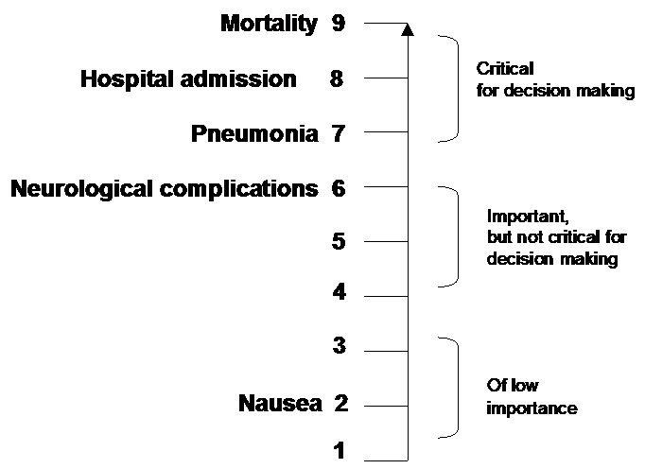
Outcomes from treatment of avian influenza H5N1 (“bird flu”) with oseltamivir (“Tamiflu”)
Dr Jay K Varma | https://drjayvarma.com

Slide 13
Outcome: Our Example
Get wet
But where? Head, legs, feet, all over?
How wet?
Costs of umbrella, including replacement when wind destroys it
Costs of raincoat, including ones of different quality
Do different people define wet differently?
Dr Jay K Varma | https://drjayvarma.com

Slide 14
Framing the Question
GRADE guidance has specific format, but you can choose whatever format best captures “PICO” for your evidence review and decision
Should [intervention] vs. [comparison] be used for [health problem]?
Should [intervention] vs. [comparison] be used in [population]?
Should [intervention] vs. [comparison] be used to diagnose [health condition] in [health problem and/or population]?
Dr Jay K Varma | https://drjayvarma.com

Slide 15
Framing the Question: Our Example
Should umbrellas vs. raincoats be used to stay dry by adults who have to walk in the rain in New York City?
In adults who have to walk in the rain in New York City and wish to stay dry, should adults use umbrellas, raincoats, or nothing?
Dr Jay K Varma | https://drjayvarma.com

Slide 16
Perspective Matters
The team considering the decision needs to be able to represent different perspectives
Diversity matters – professional, viewpoint, cultural, racial/ethnic
Are you a patient, clinician, or policy maker?
Do you trust medicine or distrust medicine?
Do you value quality or quantity of life?
Without that diversity, you may not consider and measure the right population, intervention, comparison, and outcomes
Dr Jay K Varma | https://drjayvarma.com

